Slide 1
MILESTONE M0 · ACCESS AND RECONNAISSANCE
Frontogenesis in the
LLC4320 California Current
Prove we can read the data, and settle every open empirical question before any physics is written.
M0 complete — all acceptance criteria PASS, two planning claims overturned
J. Xavier Prochaska · tile 330, face 10 · 2026-09-27/29

Slide 2
Contents
Six tasks, three findings worth their own slide
1
Environment
A dedicated py3.13 env; dbof from a worktree
2
First contact with the data
osn_tiles.py; one hour from both OSN stores
3
Five empirical questions
Land fill, surface W, spacing, rotation, advection scheme
⚑
What M0 overturned
Two planning claims contradicted by measurement
⚑
Numerical diffusion, quantified
The leading rival explanation for any slope < 1
⚑
Hourly displacement
Confirms the semi-Lagrangian choice
4
tile330_grid.zarr and two hours
The static grid store and a two-hour raw product
5
QA plot
Stencil rims, ribbon test, tile-edge crop test
6
This deck
M0 acceptance summary

Slide 3
TASK 1
Environment
A dedicated env, and one pin in the brief that was wrong
ENV `frontogenesis`
!
THE BRIEF'S `xgcm<0.10` PIN WAS WRONG
Python 3.13.15 · xarray 2026.7.0 · dask 2026.8.0
zarr 3.4.0 · xgcm 0.10.1 · scikit-fmm 2025.6.23
s3fs 2026.9.0 · torch 2.13.0 (untouched)
`set_xgcm_grid` passes `padding='fill'`, which exists only in xgcm >= 0.10 — and dbof's own pyproject requires it. The reason given for the pin was true of xgcm but backwards for dbof.
dbof installed --no-deps from a git worktree; fronts checkout undisturbed.
Upgraded to 0.10.1; brief corrected 2026-09-28.
Python 3.14 was checked and rejected.
conda-forge has scikit-fmm for 3.14, but PyPI has no wheel, xgcm 0.9 depends on the unmaintained `future`, and `fronts` drags timm 0.3.2, PyQt6, pyvista and healpy. Not worth debugging for this project.

Slide 4
TASK 2
First contact with the data
One hour, both OSN stores, anonymously
45 s
24.9 MB
0.6884
1022976
grid + two stores
grid tile in memory
ocean fraction
OSN iteration at t0
WRITTEN
TRAPS CONFIRMED
• `py/osn_tiles.py` — tile_spec, load_grid, build_xgcm, load_hour, load_wind_hour.
• Every pull checks the store's own decoded clock against the requested timestamp and raises on mismatch.
• Box lon −127.99..−113.01, lat 26.66..38.27 (planning said 38.20).
• Comodo attrs survive `process_llc4320_grid` on real OSN data — the §2.1 trap does not fire here (index coords keep their attrs).
• Both OSN stores are keyed by the same iteration; the timestamp round trip is exact.
• `drF = 1.0`, `Z = −0.5` are in the OSN gridfile after all — the brief said they were not.

Slide 5
TASK 3
Five empirical questions
Each was an assumption; each is now a number
Q1
Land fill value
NaN, not 0 — cell-for-cell equal to hFacC / hFacW / hFacS, 0 mismatches in 518,400 cells.
Q2
Surface W
W(k_l=0) = dEta/dt, not ~0. corr 0.9936, slope 1.037.
Q3
Grid spacing
1.71 × 1.85 km at 37N (not 1.8-2.3). Face 10 is rotated 90°: i is meridional, j zonal.
Q4
Rotation terms
Identically zero — SN = −1, CS = 0 everywhere. Metric term 0.1% median.
Q5
Advection scheme
OS7MP (tempAdvScheme = 7), no explicit horizontal diffusion, linear free surface.
Q1 and Q2 contradict the planning doc. Q3 and Q4 confirm it, Q4 more strongly than claimed.

Slide 6
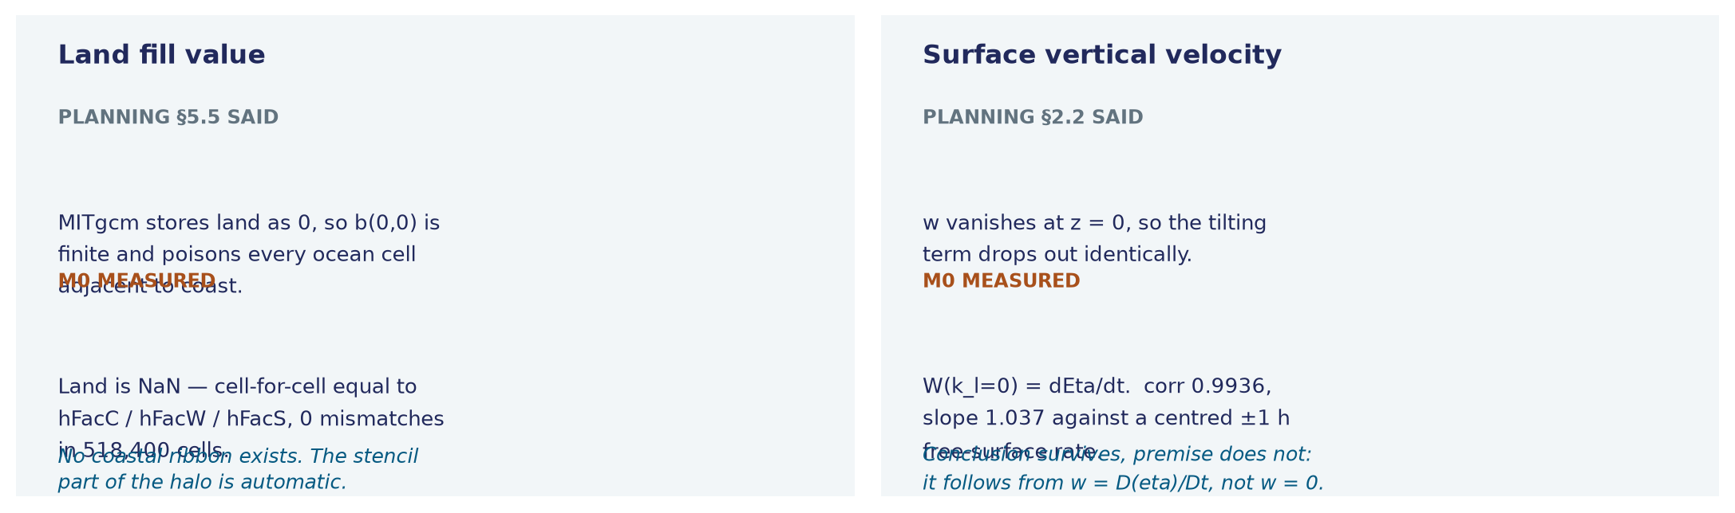
FINDING
What M0 overturned
The most valuable output of a reconnaissance milestone
Neither breaks the study.
Land being NaN makes the halo cheaper, not harder. And the surface budget still follows — from the kinematic condition w = D(eta)/Dt rather than from w = 0, so the conclusion survives even though the sentence does not.

Slide 7
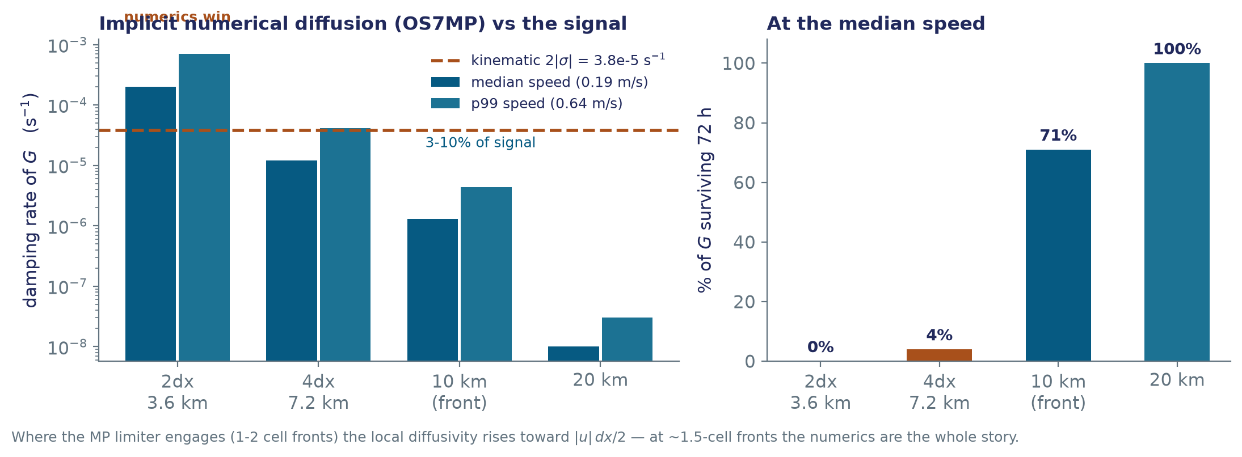
FINDING
Numerical diffusion, quantified
The leading rival explanation for any slope below 1
Planning §2.3 guessed κ ~ 6-60 m²/s and 0.1-1 f. That is the 4dx number, and it holds there — but it does not transfer to 10 km, where the same scheme is an order of magnitude gentler.
Consequence: the discriminator in Figure 2b is needed at front scales, not merely prudent.

Slide 8
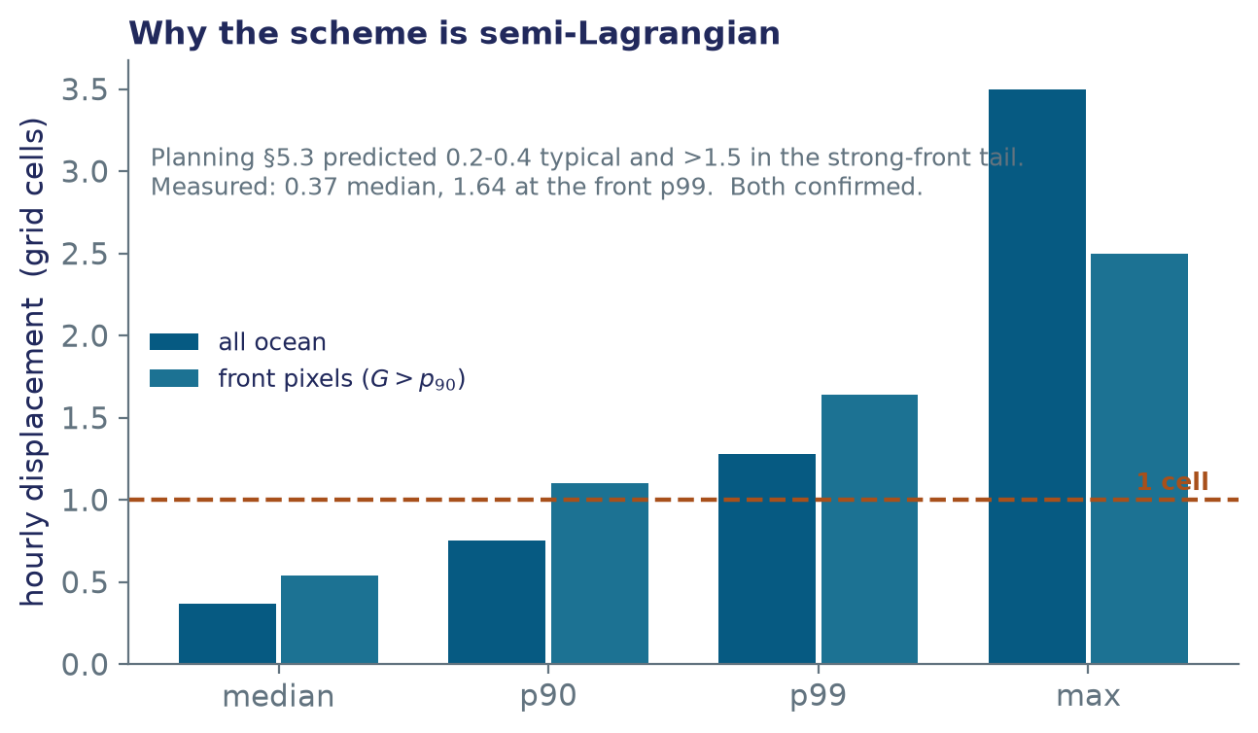
FINDING
Hourly displacement
Why the measured side is semi-Lagrangian
WHAT THIS SETTLES
• Planning §5.3 predicted 0.2-0.4 cells typically and >1.5 in the strong-front tail. Measured: 0.37 median, 1.64 at the front p99. Both confirmed.
• 30% of ocean cells exceed half a cell; 3.4% exceed one. An Eulerian split would cancel two large terms exactly where the signal lives.
• `follow(km_per_px=2.3)` is 25% too large for this tile — should be ~1.8 (M4).
Speeds at cell centres: median 0.19, p90 0.38, p99 0.64, max 1.74 m/s.

Slide 9
TASK 4
tile330_grid.zarr and two hours
The static store everything downstream reuses
tile330_grid.zarr
tile330_raw_20120702T00_2h.zarr
1.8 MB on disk (29.1 MB in memory). Twelve §3.1 variables plus hFacW, hFacS and the 0-d drF, Z, Zl. Orientation and measured spacing stored as attrs.
21 MB on disk. Two consecutive hours from both OSN stores — M1's gate 3 needs a midpoint velocity, which one hour cannot give.
DECISIONS WORTH KNOWING
• The face dim is dropped on disk and kept as a scalar coord, so `expand_dims('face')` restores the layout the dbof operators expect.
• One (1, 720, 720) chunk per hour per variable — the append unit for M2's `pull_series`.
• `write_grid` asserts SN = −1 and |CS| < 1e-6 before writing the orientation attr, so the string cannot outlive a change of tile.
• `data/.gitignore` added: the repo ignores *.nc and *.png but not *.zarr.

Slide 10
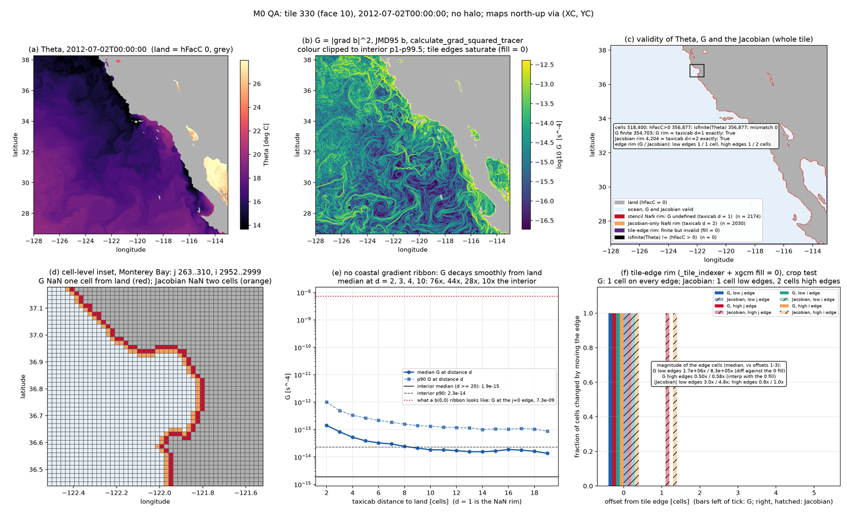
TASK 5
QA plot
Stencil rims, the ribbon test, and the tile-edge crop test
WHAT IT SHOWS
• G's NaN rim is exactly 1 cell along the coast; the Jacobian's is 2 — the brief's "~3" was one cell conservative.
• No gradient ribbon. Median G rises smoothly over ~10 cells: that is the coastal upwelling front, not an artefact.
• A b(0,0) ribbon would be ~1e7× the interior — and the tile's own j = 0 edge, where xgcm pads with 0, shows exactly that.
• All four tile edges are invalid and finite, not NaN.
figs/m0_qa_tile330_20120702T00.png · py/m0_qa_plot.py, py/m0_qa_checks.py

Slide 11
TASK 6
This deck
Reproducible from the logged numbers alone
Every number in these slides is quoted from the M0 task logs in `frontogenesis_prompts.md`.
Nothing is recomputed, and no network or data store is touched — so the deck can be rebuilt anywhere, and it cannot silently drift from the log it summarises.
IN `dev/frontogenesis/deck/`
make_m0_figs.py
generates the three deck figures and downscales the QA plot
build_m0_deck.py
builds this .pptx
figs_m0/
the four images used here
README.md
the work log for this task
Requires python-pptx in the frontogenesis env; figures need only matplotlib and PIL.

Slide 12
M0 acceptance
Every criterion audited in the task-5 log entry
✓
Two consecutive hours load end to end, from both OSN stores, in a reproducible env
✓
tile330_grid.zarr written, with hFacW/hFacS and the 0-d drF/Z/Zl
✓
All five questions answered with numbers
✓
All four §2 traps confirmed against real data
✓
QA plot written; stencil rim present, gradient ribbon absent
Next: M1 — operators and validation. A hard gate.
Its discrete null test must return slope = 1 ± 0.05 before any real data is touched; C-grid interpolation attenuation alone can bias the headline slope 0.7-1.4.

