Slide 1
MILESTONE M2 · DATA PULL · TWO SOURCES, ONE WINDOW
Frontogenesis in the
LLC4320 California Current
The 72-hour window on disk, one time-dimensioned store per source — resumably, and verified hour by hour.
M2 closed 2026-10-04 — all seven criteria PASS; 72 / 72 hours in both stores
J. Xavier Prochaska · tile 330, face 10 · 2026-10-03 / 04

Slide 2
Contents
One summary, six tasks and one Q&A finding, the audit, and what M3 inherits
M2
The answer: M2 in one slide
4
Chunk-store reconnaissance
1
pull_series and verify_series
5
load_chunk_levels and the chunk pull
2
The 72-hour OSN pull
6
M2 acceptance — the audit
3
QA of the series
→
Carried to M3
3+
The V3 baseline across the window
§
Glossary
Q7
Tile-edge margin test
7
This deck

Slide 3
MILESTONE M2 · DATA PULL · CLOSED 2026-10-04
The answer: M2 in one slide
Goal: the 72-hour window on disk, one time-dimensioned store per source, resumably
72 / 72 hours
bit-identical
0 mismatches
in both stores: OSN surface, 765 MiB in 27.3 min; chunk k = 0..2, 973 MiB in 7.03 h
chunk k = 0 Theta / Salt / W and Eta equal OSN's in all 72 hours — one model output
land-NaN vs hFacC / W / S in every hour and level; both re-runs a no-op, every file sha256-identical
WHAT WAS FOUND
HANDED TO M3
• Flux attrs say +=down but the data are upward-positive: negated at write, stored downward-positive (M2-Q6 a).
• V3 gate: 64 of 71 pairs pass (0.972 ± 0.020) — a real front, not the tile edge; edge_cells stays 7 (M2-Q7).
• Two stores sharing time, niter, j, i, XC, YC; a plain xr.merge fails — rename or subset first.
• W.isel(k_l=1); drF 1.0 / 1.14 / 1.30 m; 6-hourly forcing; displacement max 2.27 cells on the mask.
All seven criteria PASS — 127 passed, 3 xfailed, smoke tests pass. M2 closed 2026-10-04.

Slide 4
TASK 1 · CRITERION 2 IN CODE, PROVEN ON REAL DATA IN TASKS 2 AND 5
pull_series and verify_series
Resumable and atomic per hour; 'present' is the store's own time coord, never a side file
ATOMICITY — MEASURED, THEN BUILT
STOP AT THE FIRST GAP
• to_zarr(append_dim='time') is not atomic: a kill after the third array left time at length 2 and Salt / Eta / niter at 1 — the half-hour the prompt warns about.
• So: stage the hour in memory and write once; append only the time-dimensioned variables; repair on resume — truncate to the shortest array, drop trailing slabs that are unwritten, unreadable or all fill.
• Retries: 3 attempts, backoff 5 / 20 / 60 s. An hour that still fails is recorded and the run returns — criterion 1 is 'no gaps', and an append-along-time store cannot take a middle hour later.
• The next run retries that hour first: an interrupted pull is restarted, not debugged.
zarr_series.py (247 lines) is generic, so task 5 reuses it. 20 offline tests + 1 network smoke test (22 s for one real hour); suite 104 passed + 3 xfailed.

Slide 5
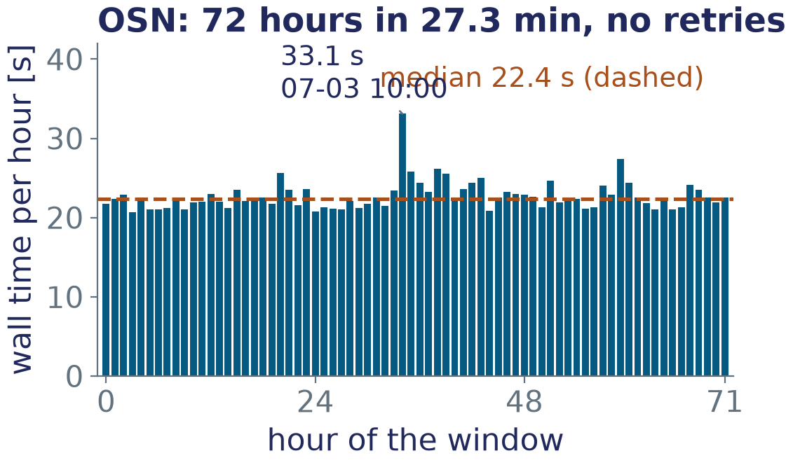
TASK 2 · CRITERIA 1, 2, 3 AND THE OSN HALF OF 7
The 72-hour OSN pull
data/tile330_raw_20120702T00_72h.zarr — launched detached, finished on the first launch
• 72 hours in 27.3 min: median 22.4 s per hour, range 20.7-33.1 s; 0 retries, 0 failures, 0 repairs.
• 765 MiB on disk (11.1 MB/hour, 834 files). verify_series OK in 0.9 s: no gaps, §3.2 schema, land-NaN = hFac in all 72 hours, niter steps 144, KPPhbl present.
• No-op proof: re-run 0.9 s, 0 pulled / 72 skipped; sha256 + stat of all 834 files, 0 differing lines.
• Hours 0-1 identical to M0's 2-hour store, which is kept (M2-Q4). Scale-up: the 504-hour series ~3.2 h, 5.6 GB.
data/m2_pull_done_run1.json
OSN was uniformly fast: a 21-33 s band, none of the 90-192 s stalls M0 saw. Network-bound; writing an hour is ~0.2 s.

Slide 6
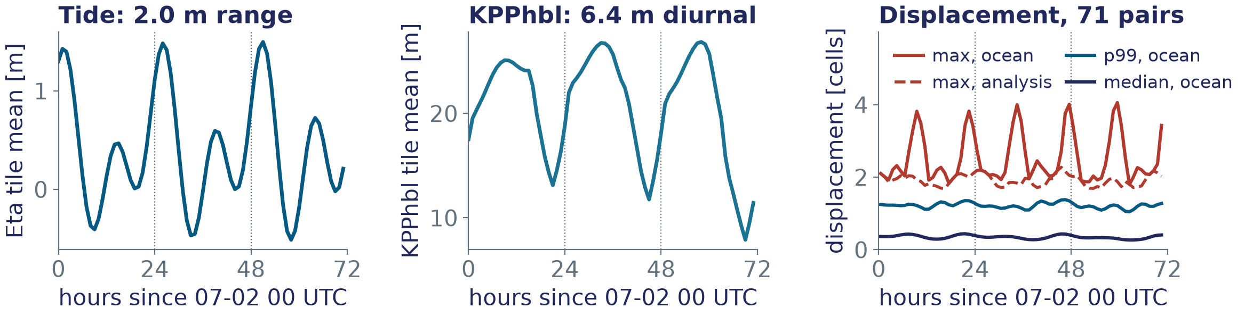
TASK 3 · figs/m2_qa_series.png, RE-PLOTTED FROM ITS CACHED SUMMARIES
QA of the series
Tide, diurnal mixed layer, constant land-NaN, and the displacement envelope for M3
• Eta range 2.009 m, M2 0.619 + K1 0.494 m (r² 0.989). KPPhbl amplitude 6.4 m, maximum at ~01 h local solar; the afternoon minimum deepens 13 → 12 → 8 m as |tau| falls 0.11 → 0.06 N m⁻².
• Land-NaN constant, 0 mismatches vs hFac in every hour; oceTAU* 922 / 565 finite on land → 0 after re-masking; no frozen field, NaN change or outlier.
• Displacement: ocean median 0.27-0.44, p99 1.05-1.38, max 4.05 cells (Gulf of California jet, outside the mask); mask_analysis max 2.27. At L = 8, 7-34 cells per pair lose support: edge_cells = 7 kept, isfinite required.

Slide 7
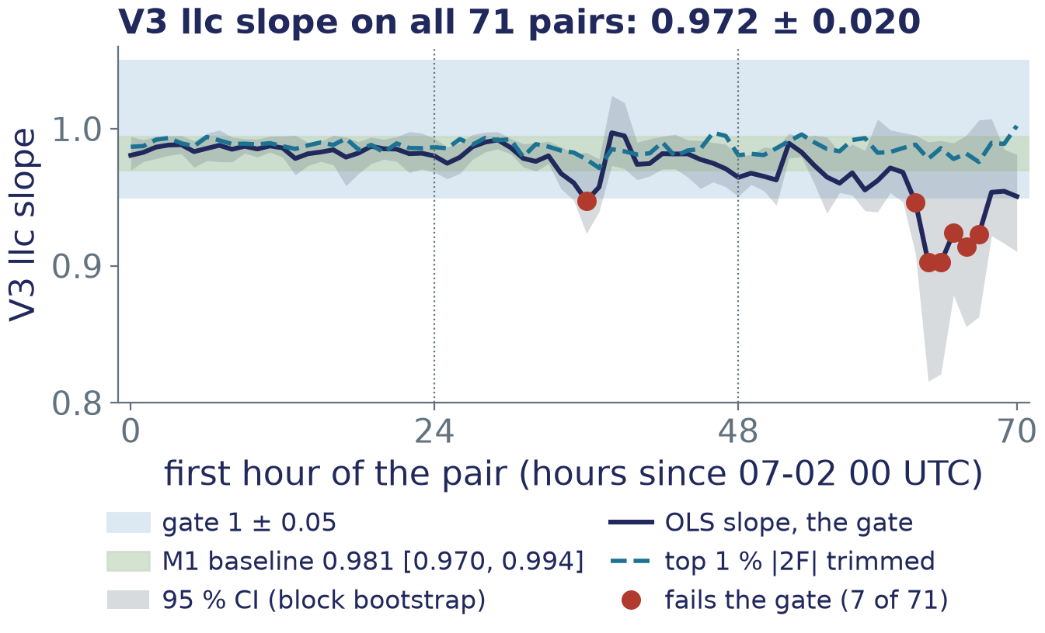
TASK 3, EXTRA STEP (M2-Q3) · figs/m2_v3_stability.png
The V3 baseline across the window
0.981 is a property of the operators, with a leverage-driven tail on day 3
• Pair 0-1 reproduces M1: 0.9806 [0.9698, 0.9942].
• All 71 pairs: 0.902-0.997, mean 0.972 ± 0.020, weighted 0.983; 64/71 pass; every CI overlaps the baseline band.
• Top 1 % |2F| trimmed: 0.971-1.002, 0.987 ± 0.005 — leverage from one sharp front, not a drift of the kinematics.
• Figure 2 keeps 0.981 [0.970, 0.994]; M3 quotes the window spread as the temporal systematic.
m2_v3_stability.json; fails: 36, 62-67

Slide 8
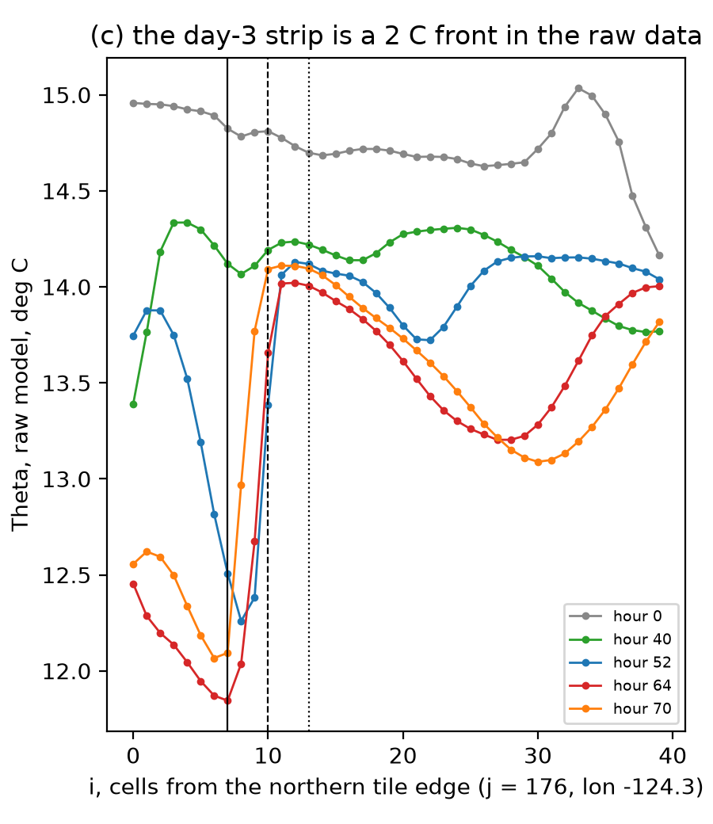
M2-Q7 · JXP: OPTION (a), TEST IT NOW · figs/m2_q7_edge_margin.png
Tile-edge margin test
Hypothesis: the day-3 dips are tile-edge contamination. Verdict: a real 2.2 °C front; edge_cells stays 7
edge_cells
pass
failing pairs
mean ± std
trimmed
7
64/71
36, 62-67
0.972 ± 0.020
0.987 ± 0.005
10
69/71
36, 63
0.979 ± 0.013
0.988 ± 0.005
13
69/71
36, 70
0.980 ± 0.012
0.987 ± 0.005
16
68/71
36, 69, 70
0.978 ± 0.013
0.986 ± 0.005
• Crop test: moving the edge 4-16 cells inward changes values only within 3-5 cells of the new edge (as NaN); beyond that, ≤ 4e-12 — round-off.
• A wider margin clears 62-67 only by excluding the front; 36 fails at every width, and 69-70 start failing at 13-16 from interior fronts.
• Raw Theta: 11.84 → 14.02 °C across i = 7-11 at hour 64. The 13-cell row goes to M3 as a sensitivity.
panel (c), j = 176

Slide 9
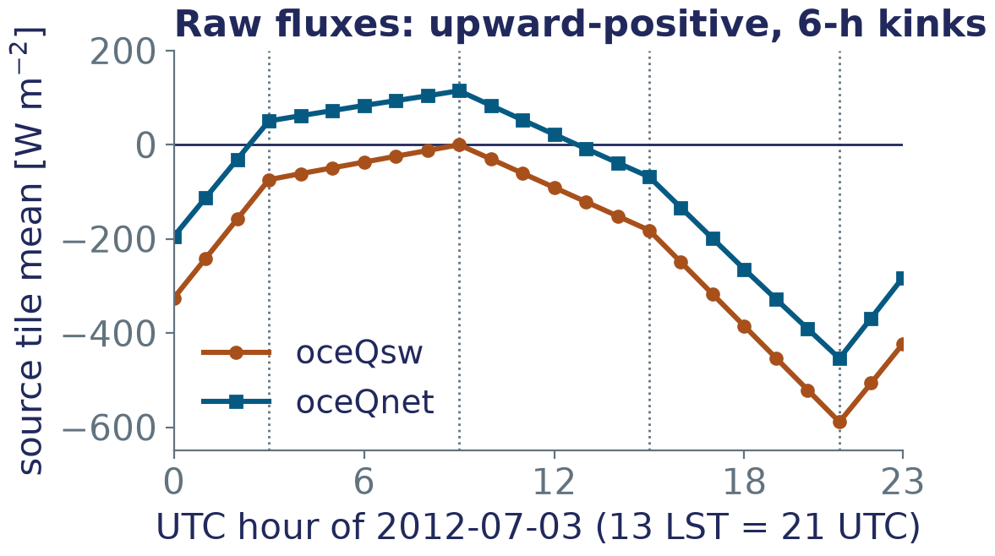
TASK 4 · SOURCE B · CRITERION 6 AND THE HOUR INVENTORY FOR 5
Chunk-store reconnaissance
s3://dbof/LLC4320_RAW/CHUNKS/monterey_bay/ on Nautilus: 72 / 72 hours, exactly tile 330
• One zarr v3 store per hour, 51 levels, oceQsw and oceFWflx present; grid bit-identical to tile330_grid.zarr. W sits on k_p1 (52): k_p1 = n is the top face of cell n.
• Not level-selective: one 51-level zstd object per variable per hour, so k = 0..2 fetches 174 MB/hour, 12.5 GB; at 0.55 MB/s here, ~6.3 h.
• drF[0] = 1.0 m and Z[0] = −0.5 m confirmed; drF 1.0 / 1.14 / 1.30 m. k = 0 fields and W(k_p1=0) bit-identical to OSN; Eta identical in all 72 hours.
• Flux attrs say +=down, the data are upward-positive (oceQsw ≤ 0, −589 W/m² at 13 LST); the forcing is 6-hourly, linearly interpolated.
data/m2_chunk_recon.json, 07-03
Per hour on the store: Theta 57.2, Salt 47.5, U 63.8, V 64.2, W 65.4 MB, each 2-D field ~1.2 MB — 306 MB compressed, 22 GB for 72 hours.

Slide 10
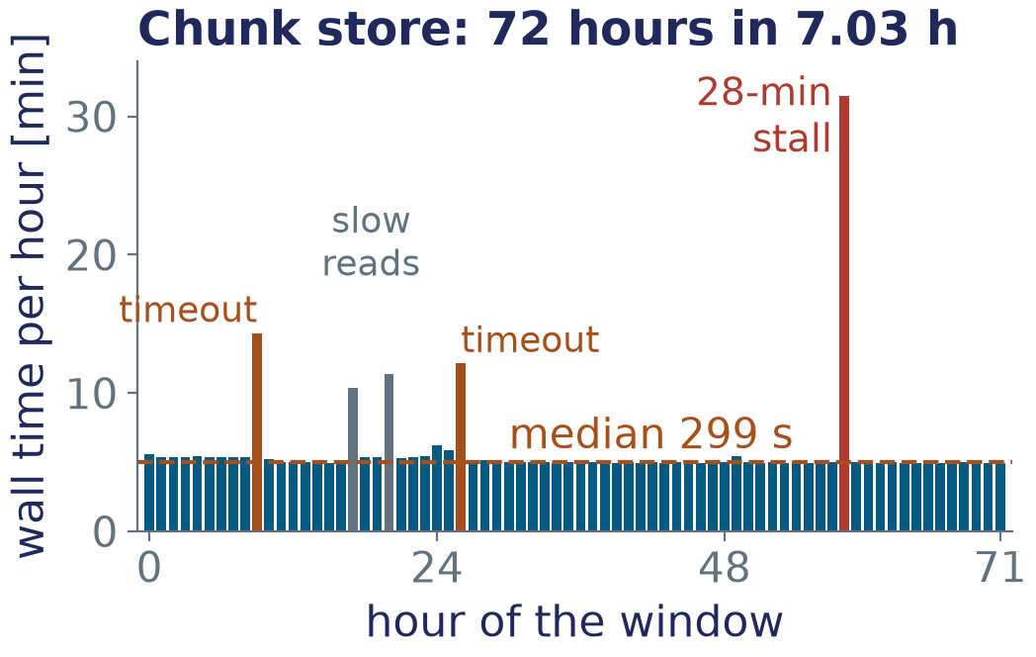
TASK 5 · CRITERIA 5, 6 AND THE CHUNK HALF OF 7
load_chunk_levels and the chunk pull
data/tile330_chunk_20120702T00_72h.zarr — §3.3; fluxes negated to downward-positive (M2-Q6 a)
• 72 / 72 hours, 0 missing, in 7.03 h: median 299 s per hour, range 297-1887 s; 12.6 GB fetched, 973 MiB on disk.
• Two FSTimeoutErrors on W, recovered on attempt 2; two slow reads; one 28-min stall from idle sleep — caffeinate -i -s next time.
• Every object validated before any write: decode, size, shape, NaN = (hFacC == 0), plausibility, time / iteration attrs, chunk Eta bit-identical to OSN.
• verify_chunk_series OK: 0 land-NaN mismatches over 72 h × 3 levels, oceQsw ≥ 0. Re-run a no-op, all 692 files sha256-identical. 23 offline tests + 1 network.
data/m2_chunk_pull_done_run1.json
First launch stopped at hour 0 by a Salt bound (0, 45): the Gulf of California reaches 48.6 psu. Bound widened; stop-at-gap proven on real data.

Slide 11
TASK 6
M2 acceptance — the audit
All seven criteria, as audited in the task-6 log entry; the 'Do not' list checked on disk
✓
72 steps, no gaps, schema both stores 72 / 72, steps 3600 s; both verifies re-run fresh, OK
✓
No-op re-run 0 pulled, 72 skipped; sha256 of 834 + 692 files identical
✓
KPPhbl present every hour, finite on every ocean cell; 6.4 m diurnal
✓
Land-NaN = hFac 0 mismatch cells, 72 hours × 3 levels: M1's masks hold
✓
Chunk k = 0..2, fluxes, drF 72 / 72 hours, missing: none; downward-positive
✓
drF[0] confirmed 1.0 m (then 1.14, 1.30); Z[0] = −0.5 m
✓
Volume and wall time OSN 765 MiB, 27.3 min; chunk 973 MiB, 7.03 h, 12.6 GB fetched
127 passed, 3 strict xfailed; both smoke tests pass. M2 closed 2026-10-04.

Slide 12
FOR M3 · THE RULES THE DATA IMPOSE
Carried to M3
The task-6 audit's carried-forward list, for frontogenesis_prompt_4.md
THE DATA
THE STATISTICS
• Merge: a plain xr.merge of the two stores fails on Theta / Salt / W (2-D vs 3-D). Rename them (16 vars) or subset to the fluxes, drF and W.isel(k_l=1) (14 vars).
• The fluxes are already downward-positive: surface_flux_term must not negate again.
• W.isel(k_l=1) is the cell-base velocity; W(k_l=0) = dEta/dt is a free-surface signal.
• Forcing is 6-hourly, linearly interpolated: the shortwave diurnal is a triangle peaking at 13 LST. Phase Figure 6 on the mixed-layer minimum.
• isfinite(DGDt) & mask_analysis at L = 8; edge_cells = 7 kept; the 13-cell row (0.980 ± 0.012) as a sensitivity.
• Trimmed and orthogonal fits beside the OLS gate for every pair; 0.972 ± 0.020 as the temporal systematic; show 07-04 14-20 UTC separately, not dropped.
• Displacement envelope: analysis max 2.27 cells; ocean 4.05 in the excluded Gulf.
• Pending: the note to Lauren on the flux attrs, for JXP to forward; caffeinate -i -s for long pulls on the laptop.

Slide 13
GLOSSARY · NOTATION AS ON THE SLIDES
Glossary — the M2-specific terms
Stop-at-gap the pull records the first hour that still fails after 3 retries and returns, so the store stays a contiguous prefix of the series; the next run retries that hour.
Repair-on-resume before trusting the store's time coord, repair_trailing truncates every time-dimensioned array to the shortest and drops trailing slabs that are unwritten, unreadable or all fill.
No-op re-run a second run pulls nothing and leaves every file sha256-identical — criterion 2, proven on both stores.
k_p1, k_l the source puts W on 52 interfaces k_p1; k_p1 = n is the top face of cell n, i.e. k_l = n, renamed at write. W(k_l=1) is the cell-base velocity.
niter, mit_iteration niter is the OSN iteration (steps of 144 per hour); mit_iteration = niter − 10368 is the chunk source's selected_iteration.
Sign convention the source attrs say +=down but the data are upward-positive; the store negates oceQnet / oceQsw / oceFWflx so that into the ocean is positive, and says so in sign_convention and source_sign_convention.
Trimmed slope the OLS gate recomputed with the top 1 % |2F| front pixels dropped — a leverage diagnostic (0.987 ± 0.005), not the gate.

Slide 14
TASK 7 · 2026-10-04
This deck
Reproducible from the logged numbers and the tasks' JSON summaries; nothing below 20 pt; 14 slides
Every number here is quoted from the M2 task logs in frontogenesis_prompts.md, from frontogenesis_prompt_3.md, or read from the tasks' small JSON done-files.
Nothing is recomputed and no zarr store is opened.
IN dev/frontogenesis/deck/
make_m2_figs.py
one panel crop from ../figs/ and five large-font re-plots
build_m2_deck.py
builds this .pptx
check_m1_deck.py
reused: every run ≥ 20 pt, plus the text-box geometry
figs_m2/
the six images used here
README.md
the work log for this task
Rendered with LibreOffice and inspected page by page before hand-over.

