Slide 1
MILESTONE M1 · OPERATORS AND VALIDATION · A HARD GATE
Frontogenesis in the
LLC4320 California Current
Operators that are known correct, not assumed correct — and a figure for every methodological choice.
M1 closed 2026-09-30 — all seven criteria PASS; gate V3 at 1.004 / 0.981
J. Xavier Prochaska · tile 330, face 10 · 2026-09-28 / 30

Slide 2
Contents
Nine task sessions, then the audit and what it leaves behind
1
Masking, tile330_masks.nc and V6
7a
test_nan_finding.py
2
operators.py and the regression oracle
7
Decisions applied and the audit
3
semilag.py and V5
✓
M1 acceptance
4
coarsegrain.py
⚑
Findings for the writeup
5
Gates V1, V2 and V4
⚑
Decisions and open issues
6
Gate V3 — the discrete null
8
This deck
6b
V3b — the finite-volume null

Slide 3
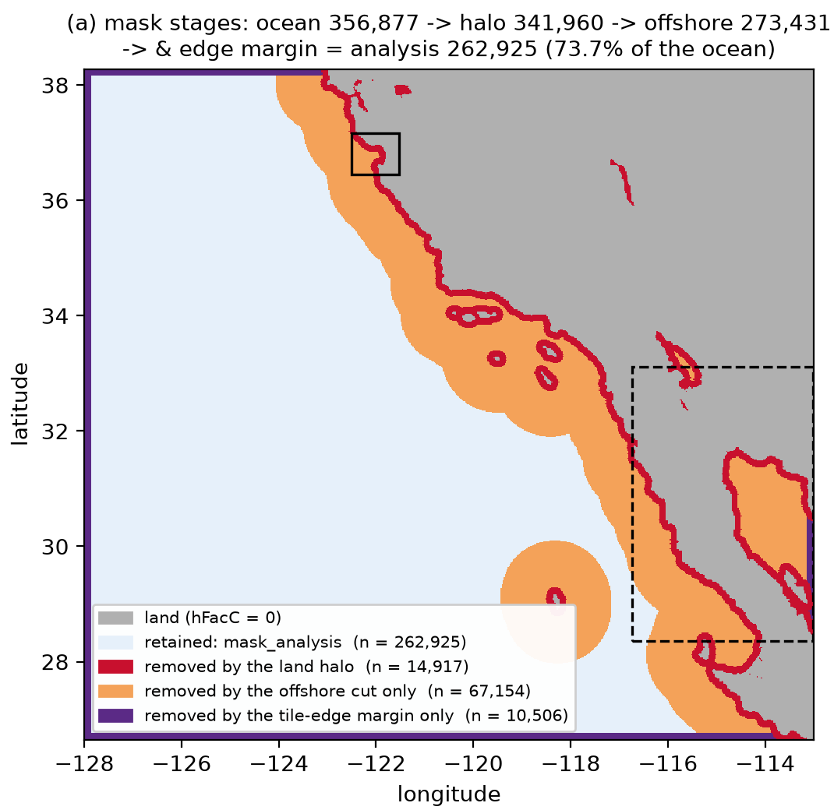
TASK 1 · V6
Masking and tile330_masks.nc
Halo = 7 × the measured dxC = 12.57 km; the 100 km cut removes the Gulf, no polygon
• 518,400 cells → ocean 356,877 → halo 341,960 → offshore ≥ 100 km 273,431 → analysis 262,925 (73.7% of the ocean): one connected component.
• Gulf of California is its own ocean component (9,891 cells), max coast distance 73.9 km — 0 cells survive the cut.
• The tile-edge rim is finite, not NaN: ~1e6x on the low edges, ~0.5x on the high. edge_cells = 7 covers it (minimum 2).
• 17 tests. ocean_mask == isfinite(Theta) cell for cell at both hours; both halo_mask defects guarded.
figs/V6_land_halo_tile330.png, panel (a)

Slide 4
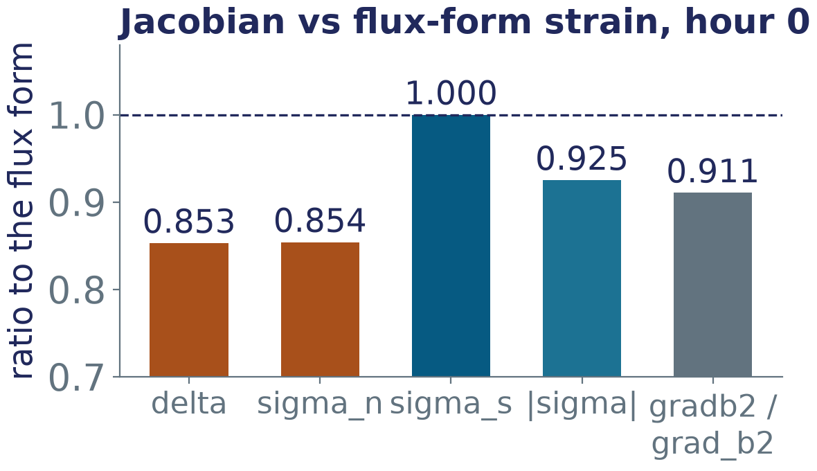
TASK 2 · CRITERION 7
operators.py and the regression oracle
One shared operator for both sides; the oracle checks the wiring bit for bit
• Criterion 7: unfiltered F vs frontogenesis_tendency — max |dF| = 0.0 on all 352,673 finite cells, both hours.
• lowpass: a top-hat of half-width L/2; NaN propagates, never renormalised. F is finite on all 262,925 analysis cells at every L.
• Planning §2.4 had the strain-term sign wrong: F = −½δG + ½|σ|G cos 2θ, θ from the compressional axis.
• 21 tests; the dims guard turns the 4-D broadcast into a ValueError before dbof.
The interpolated Jacobian is 0.85x the flux-form strain on the analysis mask (M0's 0.80 included the coast). The 0.911x gradb2 ratio is confirmed.

Slide 5
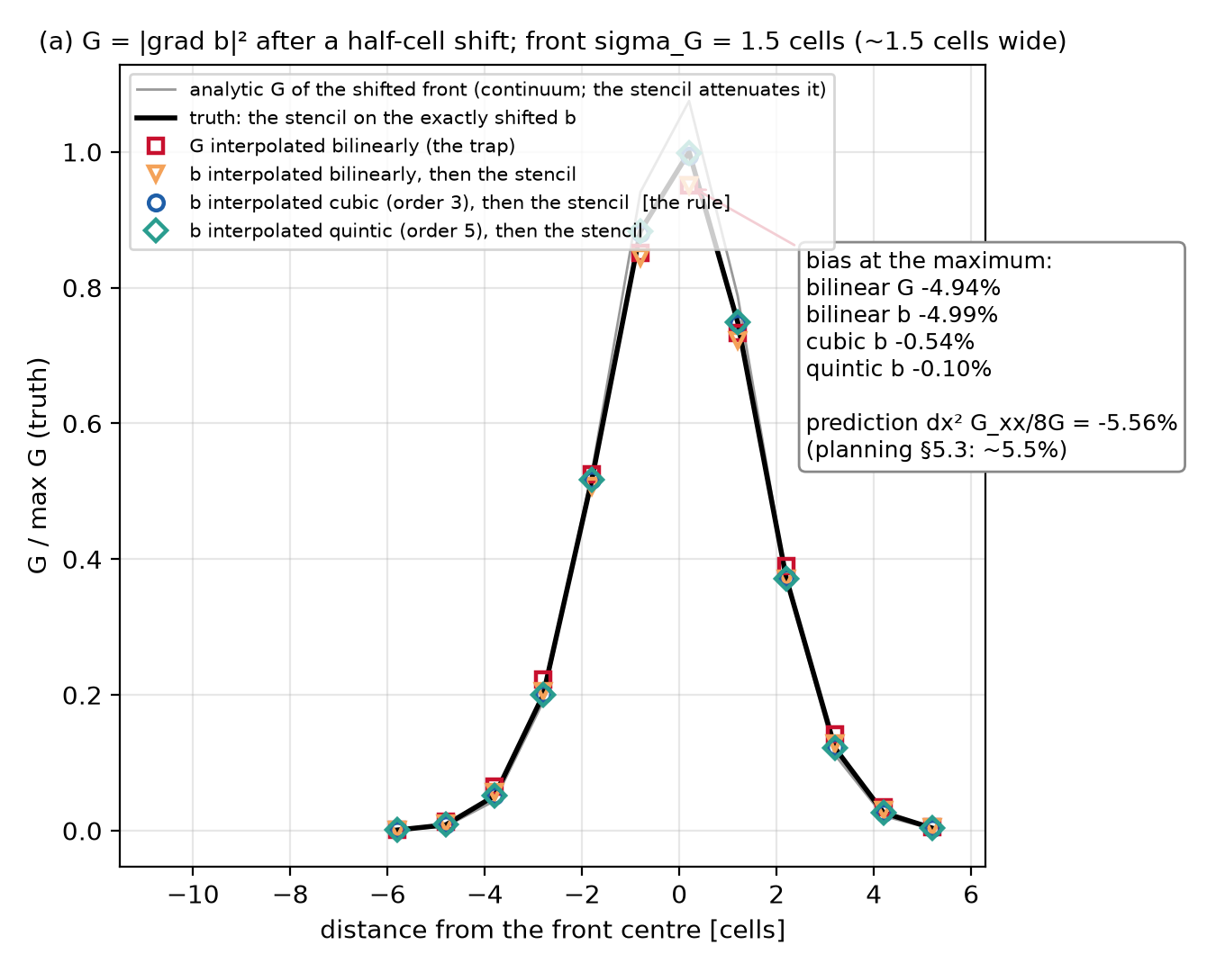
TASK 3 · V5, THE FIGURE LAUREN ASKED FOR
semilag.py and V5
Interpolate b (order ≥ 3) onto the departure stencil — never G
• Half-cell shift, 1.5-cell front, bias at the maximum: bilinear G −4.94%, bilinear b −4.99%, cubic b −0.54%, quintic b −0.10% (prediction −5.56%).
• The trap: shifting b and calling gradb2 measures DG/Dt − 2F ≈ 0. The stencil is built at the departure point instead.
• Local Lagrange, not map_coordinates: a filled NaN leaks 46 / 12 / 3.3% at 1 / 2 / 3 nodes through the spline prefilter.
• Real hour: order 1 fabricates +5.2% of G per hour on front pixels. 15 tests.
figs/V5_interp_half_cell.png, panel (a)

Slide 6
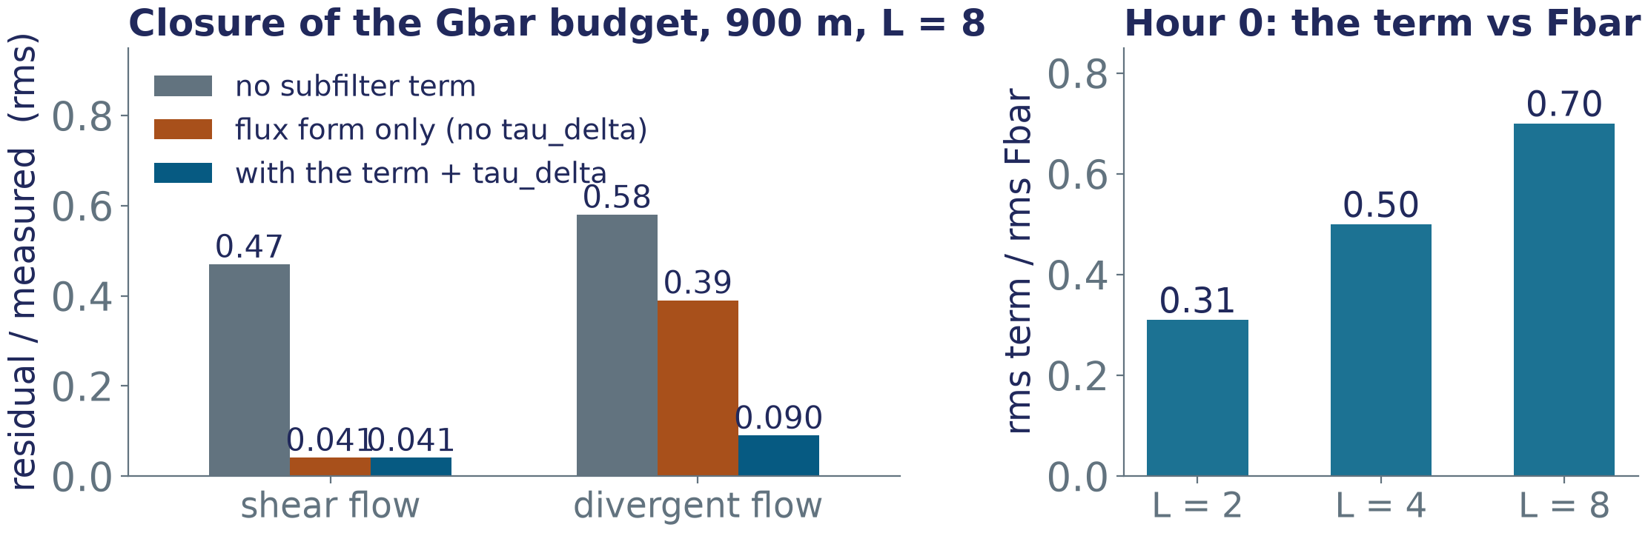
TASK 4
coarsegrain.py
The subfilter term closes the coarse-grained budget — with its divergent part τ_δ
• Germano holds to 4e-16 for the composite filter; τ is exactly 0 at L = 0 and O(L²) after — it does not become the numerical-diffusion term.
• Returned in F units (M3's subfilter field = 2 × term). The flux form without τ_δ overstates it 2.2x on hour 0. 10 tests; task 6's discrete F improved the 900 m residuals to 0.037 / 0.088.

Slide 7
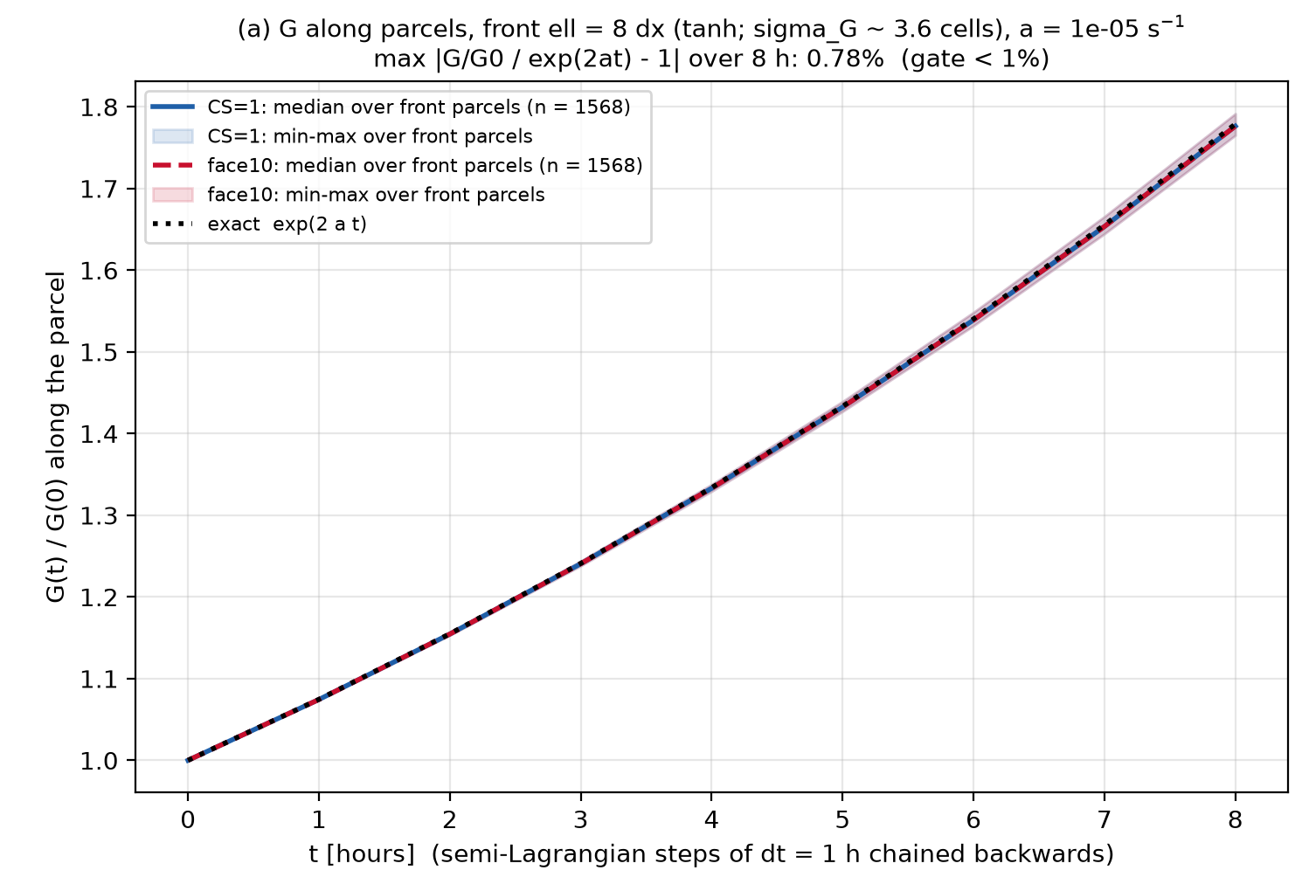
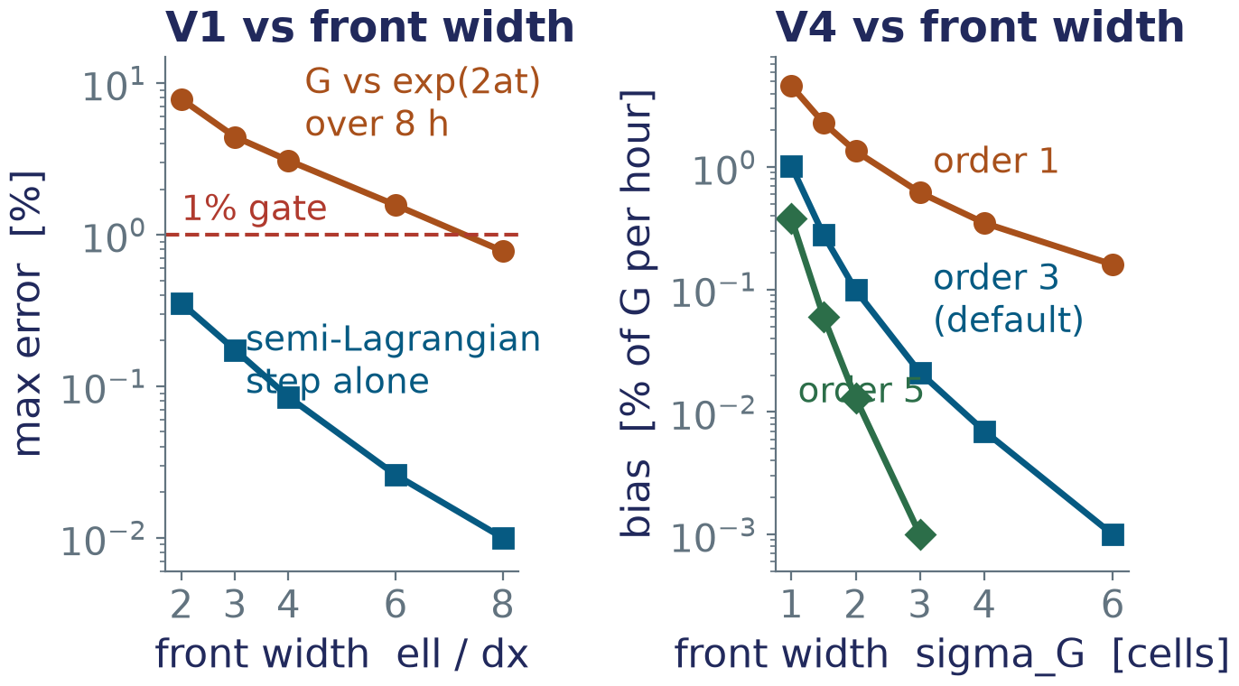
TASK 5 · CRITERIA 1, 2, 4
Gates V1, V2 and V4
Two gates pass by a wide margin; V4 is the permanent error bar on every slope
V1 — PASS, 0.78%
V2 — PASS, 0.077%
V4 — 0.28 to 1.0%
8 chained hours at ell = 8 dx; the step alone < 0.36%.
b_x max; b_y 0.041%; metric alone 0.012%; swapped 87%.
of G per hour, order 3, 1.5- to 1-cell front. Order 5: 0.06%.

Slide 8
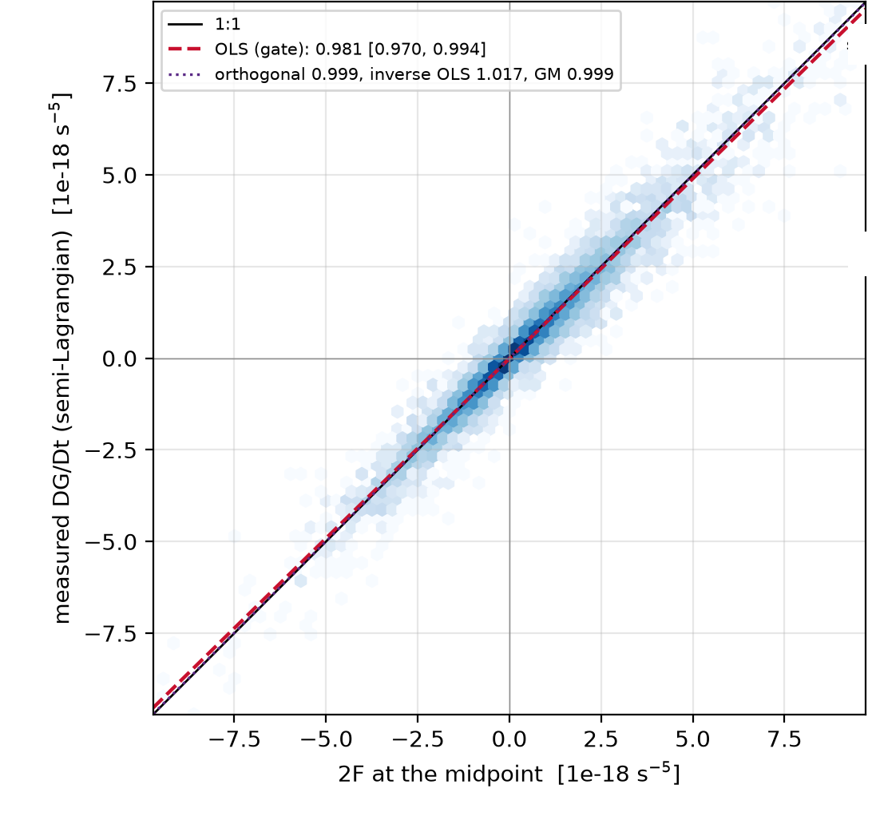
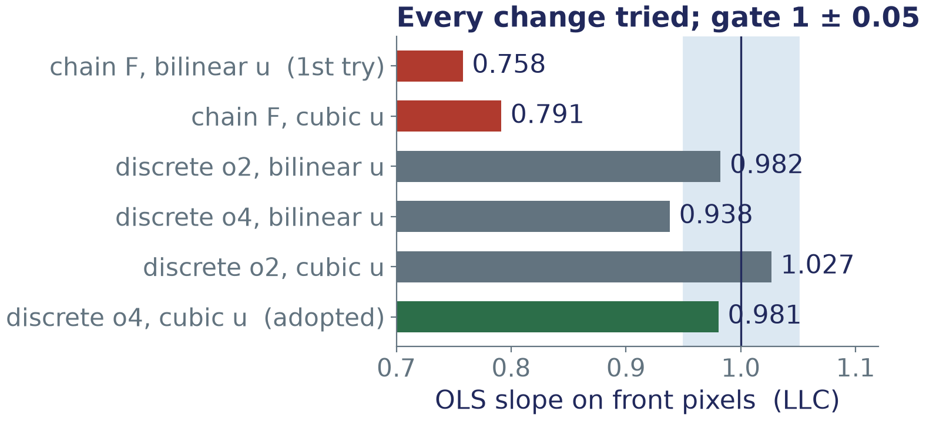
TASK 6 · THE HARD GATE, CRITERION 3
Gate V3 — the discrete null
First attempt FAIL 0.950 / 0.758 → PASS 1.004 [0.995, 1.017] / 0.981 [0.970, 0.994]
The chain-rule product fails on the grid by (2/3)(dx/ell)². The consistent F = −Σ (L_k b)[L_k, u·∇] b is now the default (form='discrete'); the departure velocity is cubic.
Both sides of this null see the same centred velocity, so the 0.85x Jacobian attenuation cannot appear here. 70 tests, 0 skipped.
V3 panel (d): LLC, n 26,293, corr 0.982

Slide 9
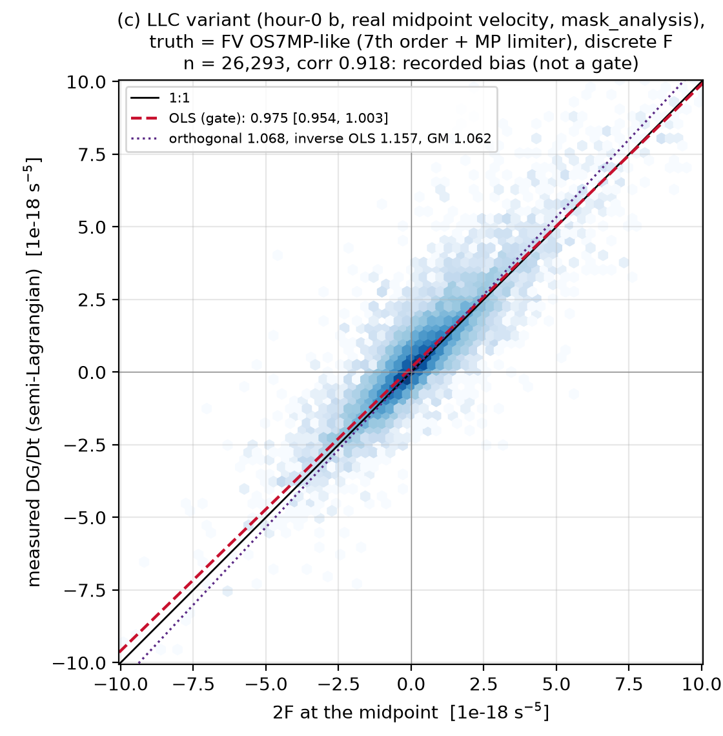
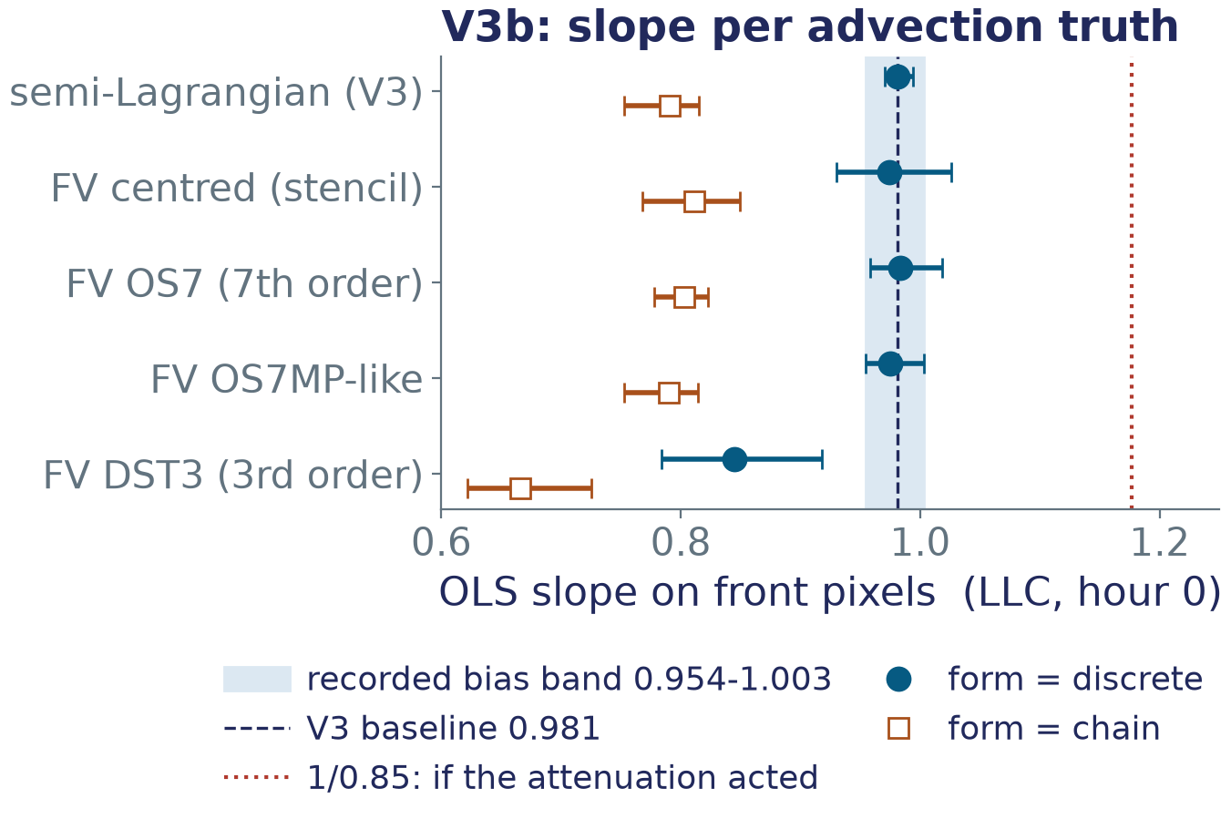
TASK 6b · M1-Q2, OPTION (a)
V3b — the finite-volume null
A recorded bias, not a gate: 0.975 [0.954, 1.003] on the real hour, −0.006 ± 0.025 from V3's 0.981
V3b panel (c): OS7MP-like truth, discrete F
fvadvect.py: flux-form C-grid advection with MITgcm face transports; centred, DST3, OS7 and OS7MP-like.

Slide 10
TASK 7a · CRITERION 6
test_nan_finding.py
fronts_from_gradb2 under config D on NaN land: 14 tests, 11 pass, 3 strict xfails
WHAT WORKS
WHAT BREAKS (xfail, strict)
• A NaN land block: 0 front pixels on NaN; fronts ≥ 10 cells from the coast equal the land-free field pixel for pixel.
• Real hour 0: 11,836 front pixels in 7 s, 0 on NaN, 878 (7.4%) inside the halo.
• The three threshold modes agree bit for bit; no coastal bias in the window.
• thresh_mode 'pool' with the default n_workers=None → TypeError: config D does not run as written.
• remove_small_holes fills an enclosed NaN island: 6 front pixels on land.
• despur on an empty skeleton → ValueError in skan.
• M4 recipe: pass NaN as-is (never fill), explicit n_workers, despur off, then fronts &= isfinite(gradb2).

Slide 11
TASK 7 · THE AUDIT
Decisions applied and the M1 audit
M1-Q1..Q8 written into the docs on 2026-09-30; every criterion audited; M1 closed
APPLIED TO THE DOCS
THE AUDIT
• Prompt 2: criteria 1, 3, 4, 5, 7 restated; Q&A header.
• Prompt 4 (M3) and 6 (M5): both forms of F, the baseline and its bands, order 5 as a sensitivity, Figure 2 at 0.981.
• Coding §2.5, §4.3, §4.4, §4.9, §4.10, §6 M1 and M3; planning §2.4 (sign final), §6 tests 1 and 3, §7.
• V3b figure: clipped titles and the legend fixed; every number identical.
• Suite: 84 passed, 3 xfailed in 98 s; offline 66 passed, 18 deselected.
• Seven PNGs in figs/: five tracked (9be37dc), V3 and V3b untracked and shown; none ignored.
• Criteria 1-7 each PASS with the numbers of the next slide; every 'Discharges' line honoured, nothing claimed twice.
• Open issues carried to M2-M4: the fronts bugs, prompt 5's tile_find path, the NaN recipe, M3's requirements, the V3b band.

Slide 12
M1 acceptance
All seven criteria, as audited in the task-7 log entry
✓
V1 Cartesian deformation 0.78% at ell = 8 dx over 8 h (< 1%)
✓
V2 native-grid metric b_x max 0.077%, b_y 0.041% (< 1%)
✓
V3 discrete null 1.004 [0.995, 1.017] strain, 0.981 [0.970, 0.994] llc (1 ± 0.05); V3b recorded 0.975 [0.954, 1.003]
✓
V4 interpolation bias recorded: 0.28-1.0% of G per hour at order 3
✓
PNGs V1-V6 (+ V3b) all seven in figs/ and in git status; V6 shows the edge rim
✓
Tests 84 passed, 3 strict xfailed, incl. test_nan_finding.py
✓
Regression oracle form='chain' bit-for-bit frontogenesis_tendency, max |dF| = 0
M1 closed 2026-09-30. Next: M2 pulls the 72-hour series; M3 computes the budget.

Slide 13
FINDINGS
Findings for the writeup
Five things the discretisation taught us
Discrete F. The chain-rule product −(∇b)ᵀ(∇u)(∇b) fails on the grid by (2/3)(dx/ell)²; the consistent form passes V3 and is ~0.79x the chain F on real front pixels — about the size of the effect being measured.
Stencil at the departure point. Shifting b and differentiating measures the residual DG/Dt − 2F (≈ 0 under pure strain); the departure stencil measures DG/Dt.
The divergent subfilter correction τ_δ. Without it the flux form leaves 38-44% of the budget unclosed on a divergent flow and overstates the term 2.2x on hour 0.
V3b closes the 0.85x question. A flux-form OS7MP-like truth shifts the slope by −0.006 ± 0.025: the Jacobian attenuation is the resolved G's consistent view of the strain, not a bias. Shortfall per width: −2 / −4 / −11% at 2 / 1.5 / 1 dx.
Planning §2.4 sign. F = −½δG + ½|σ|G cos 2θ with θ from the compressional axis (plus, not minus). Final, M1-Q3.

Slide 14
M1-Q1 .. Q15
Decisions and open issues
What shapes M3 and M4, and the fronts fixes JXP chose to make on this branch
SHAPES M3 / M4
NEXT: fronts FIXES — not yet applied. Q9: on this frontogenesis branch; JXP tells Lauren.
• Q1: both forms of F; discrete primary, chain as a stated systematic.
• Q2 / Q4: Figure 2 at 0.981 with its band; systematic 0.954-1.003; no upward correction.
• Q5 / Q6: V1 at 8 dx; V4 bar 0.28-1.0% of G/h at order 3; order 5 as a sensitivity.
• Subtract the numerics shortfall first: −2 / −4 / −11% at 2 / 1.5 / 1 dx.
• Pass τ_δ to subfilter_term; split the ratio estimator by the sign of 2F.
• Q10: n_workers=None → os.cpu_count(); document the __main__ guard.
• Q11: fronts &= isfinite(gradb2) after cropping and dilation.
• Q12: despur returns early on an empty skeleton.
• Q13 / Q14: max_size = min_size − 1; silence the All-NaN warnings.
• Q15: prompt 5 → fronts_from_gradb2 + the NaN recipe; two docstrings.

Slide 15
TASK 8
This deck
Reproducible from the logged numbers alone; nothing below 20 pt
Every number here is quoted from the M1 task logs in frontogenesis_prompts.md and from frontogenesis_prompt_2.md.
Nothing is recomputed and no data store is touched.
IN dev/frontogenesis/deck/
make_m1_figs.py
five panel crops from ../figs/ and five large-font re-plots
build_m1_deck.py
builds this .pptx
check_m1_deck.py
verifies every run is ≥ 20 pt and the text-box geometry
figs_m1/
the ten images used here
README.md
the work log for this task
Rendered with LibreOffice and inspected page by page before hand-over.

