Slide 1
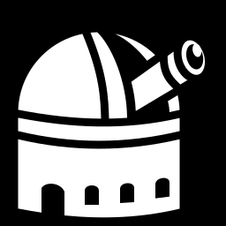
Why a night planner
Turning a night of observing from recalled expertise into a reproducible plan
CHIME/FRB host spectroscopy · Keck I / LRIS · Shane 3m / Kast
J. Xavier Prochaska & Claude

Slide 2
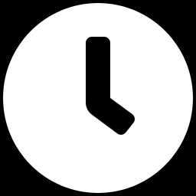
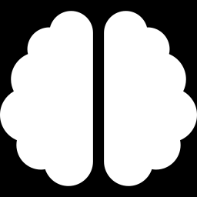
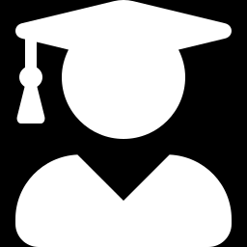
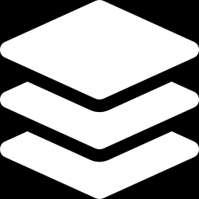
Why we need it
Four problems, only one of which is about saving time
Planning a night eats a day
The constraints live in your head
Twilight, LST, airmass windows, hour-angle limits, slews, exposure times — all recomputed by hand for every run, every date, every change of plan.
Keck I's Nasmyth deck vignettes a fixed azimuth band. Shane's hour angle wraps asymmetrically. Masks need weeks of lead time. Forget one and the plan looks fine but cannot be executed.
Observing is easy; planning is not
Queue and ToO work needs plans on demand
A well-made plan lets someone with no experience of the instrument run a productive night. The expertise should sit in the plan, not in the person holding it.
Non-classical modes need many candidate plans, replanned as conditions change. That is only practical if a plan costs seconds rather than an afternoon.
night-planner
2

Slide 3
What it refuses to forget
Every one of these silently produced a wrong-but-plausible plan at least once
Keck I Nasmyth deck
az 5.3–146.2° needs alt ≥ 33.3°; rising targets in the NE/E must climb before they clear. Keck II is blocked on the opposite side.
Hour-angle / wrap limits
Shane: −5.0h to +3.75h, asymmetric, and a mount limit rather than a horizon one. Keck: ±5.5h.
Declination limits
Shane cannot go above +82°, which is precisely what makes those targets Keck opportunities.
Mask lead time
A mag > 21 host needs a pre-milled slitmask — weeks ahead, not on the night.
Real exposure times
A magnitude-bucket heuristic carried from another telescope was wrong by ~15x. Exposures now come from the live LRIS ETC.
Slew and overheads
10 min base, 20 min crossing Dec +20 — enough to decide whether a target fits its window.
night-planner
3

Slide 4
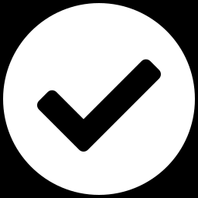
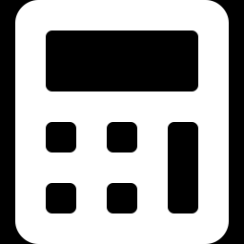
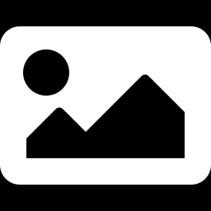
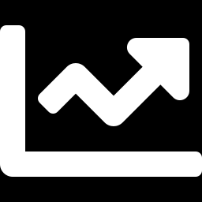
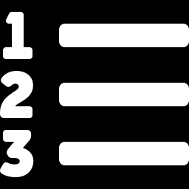
What it does
From any table of targets to a plan you can observe from
Any target table
Real exposure times
Schedules around reality
FFFF-PZ pulls or your own spreadsheet. Columns are detected automatically and it refuses to guess when a guess could point the telescope elsewhere.
Live UCO/Lick ETC per target: S/N 10 per exposure, 3 exposures minimum. MOS blocks budgeted by magnitude.
Manual start times for a late handback, blocked windows for a ToO, and forced partial exposures when a short spectrum beats none.
Finders and starlists
Shows its reasoning
Browser front end
Image cutout, Gaia offset star, and the slit drawn at the dispersion-weighted parallactic angle — no external service required.
Every target carries the stage it was accepted or rejected at, with numbers. Airmass tracks, idle time, twilight marks.
Pick instrument and date, load targets, generate, inspect, export the whole run as a zip.
night-planner
4

Slide 5
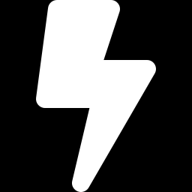
Nights it has planned
Including one replanned mid-night around a ToO
Lick-2026B-01
Lick-2026B-02 N1
Lick-2026B-02 N2
Keck-2026B-02
Shane / Kast · Aug 13–14
Shane / Kast · Sep 14
Shane / Kast · Sep 15–16
Keck I / LRIS · Oct 6
6 targets
4 of 12
6 repeats + 2 spares
9 targets
7.0h science, no deadtime
250 / 517 min (48%)
402 min science (77%)
6.9h on target (77%)
A ToO took the first 50 minutes of Oct 6
Replanned from a 20:00 handback in seconds. One target lost to its closing window; a mag 25.6 host that had been dropped was forced in for a partial 80-minute exposure as it rose into the best airmass of the night. On target went 336 → 416 min, 62% → 77%, idle down to 8 min.
night-planner
5

Slide 6
Beyond classical observing
The same machinery that replans a ToO plans a queue
Plans as a commodity
Replan on interruption
When a plan costs seconds, you can generate one per candidate date and compare, instead of defending the first one you built.
Manual start times and blocked windows mean a ToO, a weather hold or an instrument fault is a parameter, not a restart.
Feasibility before submission
Hand the night over
Answer "is this programme observable in this semester, and for how long" with real windows rather than an estimate.
A plan carrying its own reasoning, finders and starlist can be executed by someone who has never used the instrument.
night-planner
6

Slide 7
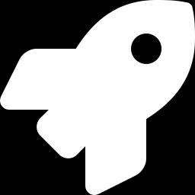
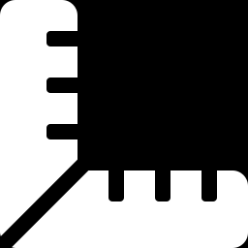
Where it goes next
The hard parts are already instrument-independent
DEIMOS on Keck II
The multi-object case in earnest: mask design drives the plan rather than following it. Keck II also vignettes on the opposite side to Keck I — the geometry is already parameterised, so it is a configuration, not a rewrite.
More instruments at the same telescopes
KCWI, ESI, HIRES. Each needs its own exposure model and overheads; everything else — twilight, windows, scheduling, finders, starlists — is shared.
More telescopes
The site, pointing limits and timezone are already data rather than code. A new observatory is a site entry plus an exposure calculator.
Generalise the Lick path
Keck takes any target table and any date today; the Lick pipeline is still tied to one run. Bringing it level is the next real piece of work.
Queue-mode tooling
Rank and re-rank a target pool across many nights, not just schedule one.
night-planner
7

