Slide 1
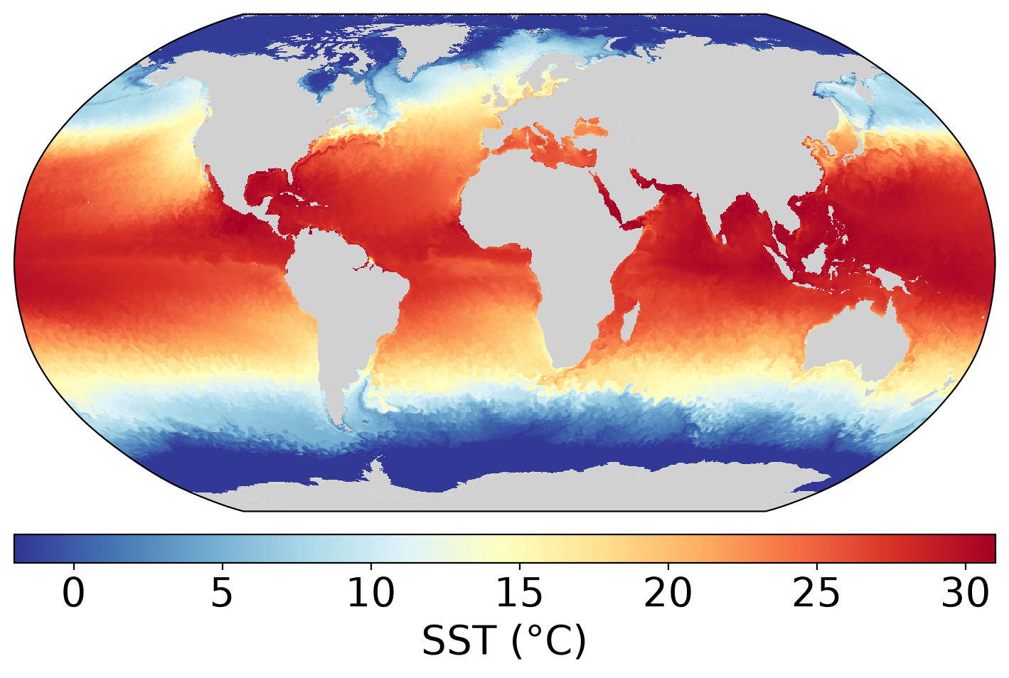
LLC4320 v2
surface fields on Nautilus
Raw MITgcm output on NASA Pleiades → hourly Zarr stores in s3://llc4320-v2
J. X. Prochaska · 2026-10-02
Notes:
Summary of the LLC4320 v2 extraction work: what the run is, how the pipeline works, what the data look like, and where the full SST run stands.

Slide 2
The v2 simulation
A new LLC4320 run by Dan Whitt (NASA Ames), not the v1 data in s3://dbof
• Global LLC grid, 1/48°
• Same horizontal grid as v1; new bathymetry, 173 levels
• Hourly snapshots from 2023-01-01; the run is still going
• 83+ folders on Pleiades; model ΔT 5–20 s
• Goal: all surface fields on Nautilus, SST first
9,503
83
hourly fields
folders
13×4320²
58 %
cells per field
ocean
970 MB
474 MB
raw per hour
Zarr per hour
2
Notes:
13 faces x 4320 x 4320 = 243 M cells; 58 % ocean. 970 MB is one raw SST file; 474 MB is one compressed hourly Zarr store on S3. Data on disk run to 2024-02-08.

Slide 3
Two raw formats; the easy one covers the surface
Surface: .data
3-D: .shrunk
• SST, SSS, SSU, SSV, Eta, fluxes, sea ice
• Uncompressed, big-endian float32
• In all 83 folders
• Used now
• Theta, Salt, U, V, W on 173 levels
• Wet points only + bitmasks
• Jan–Jun 2023 moved to NAS export2
• Decoder ready for the depth phase
3
Notes:
Surface files: SST/SSS/SSU/SSV.<iter>.data, MITgcm compact 4320 x 56160 real*4, identical to k=0 of the 3-D fields (Dan Whitt). 3-D files: <field>.<iter>.shrunk with hFacC/S/W.bits masks; only ~33 folders on POSIX. The decoder is a NumPy port of Kaitlin Zhang's llc_shrunk_mex.c, round-trip tested.

Slide 4
The pipeline: wrangler.ogcm.llc_v2
One process on a Pleiades login node, streaming to Nautilus
Discover
Read
Mask
Write
Publish
date = start + (n+1) h
SST.<iter>.data → 13 faces
hFacC.bits → NaN on land
Zarr v3, verified
one store per hour on S3
Command-line tools
Built to be restarted
wr_llc_v2_inventory
wr_llc_v2_surface
wr_llc_v2_inspect
• Finished stores are skipped
• Unreadable folders are skipped
4
Notes:
Discover: list segment folders, date each file as folder start + (n+1) h, strict file-count check. Write: chunks (1, 720, 720), read back and verified; complete=True is set last, so partial stores are rewritten. Stores are s3://llc4320-v2/SURFACE/YYYYMMDDTHH.zarr; grid.zarr holds 23 static fields. Tools: inventory = what is in each folder; surface = extract (--fields, --dry-run, --limit); inspect = per-face stats, mask check, PNG.

Slide 5
Problems found and fixed along the way
1
Dates one hour early
2
Unreadable folders
Fixed: 9,503 hours, no gaps or repeats
The live run and a locked data/ dir are now skipped
3
Missing 3-D output
4
3,477 wet cells = 0
Jan–Jun 2023 .shrunk moved to export2
0.0025 % of ocean; mask vs. bathymetry
5
Notes:
1. ExtractFields.m dated files as start + n h; Dan: the first file is one hour after the folder start. 9,503 files now fill 2023-01-01 01:00 to 2024-01-31 23:00. 2. The newest folder is a symlink into the live run; one folder has an unreadable data/ directory. 3. Theta.*.shrunk was missing from early folders: it moved to the export2 object store (mc + NAS access). 4. Cells the bitmask calls wet but the run wrote as 0 (bathymetry mismatch or ice-shelf cavities); left as 0.0.

Slide 6
On Nautilus: one hour of global SST
• 2023-07-01 12:00 UTC
• Every 4th point, binned to 0.25°
• −2.1 to 32.4 °C
6
Notes:
Read from s3://llc4320-v2/SURFACE/20230701T12.zarr by docs/slides/llc4320_v2_figures.py. Range and mean (11.85 C) are from the first S3 store; nothing outside the plausible range.

Slide 7
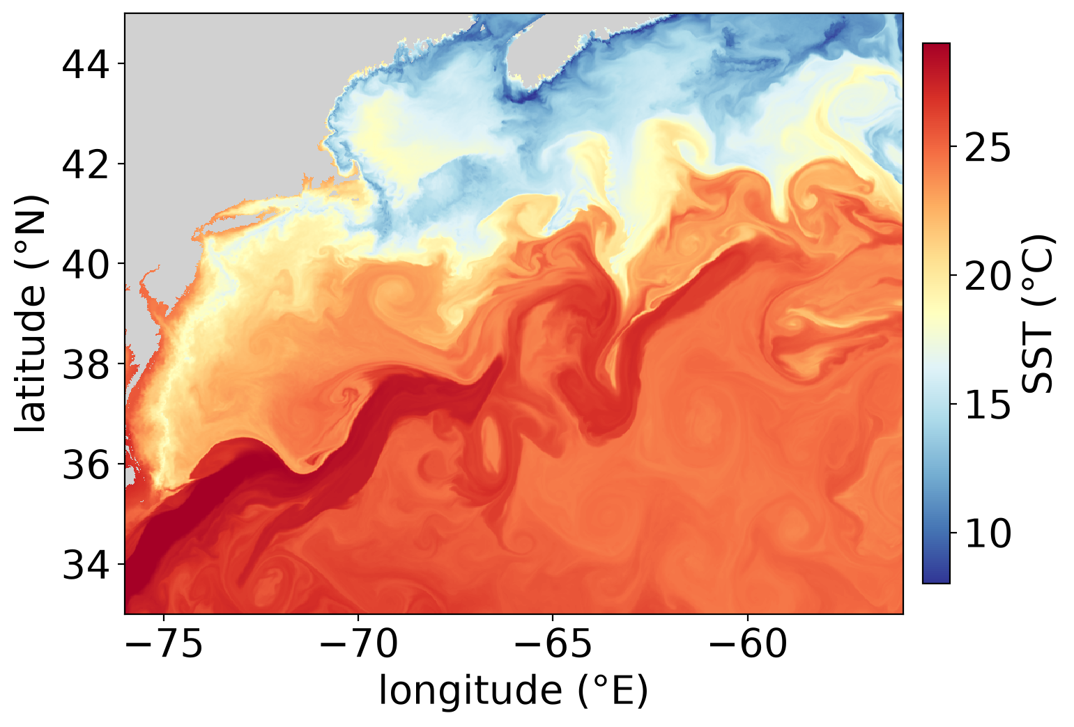
At full resolution: the Gulf Stream
• Every cell, ~2 km
• Same hour
• Fronts, filaments and eddies
7
Notes:
960 x 804 cells of face 10, no subsampling. Small-scale structure like this is the reason to keep the native grid.

Slide 8
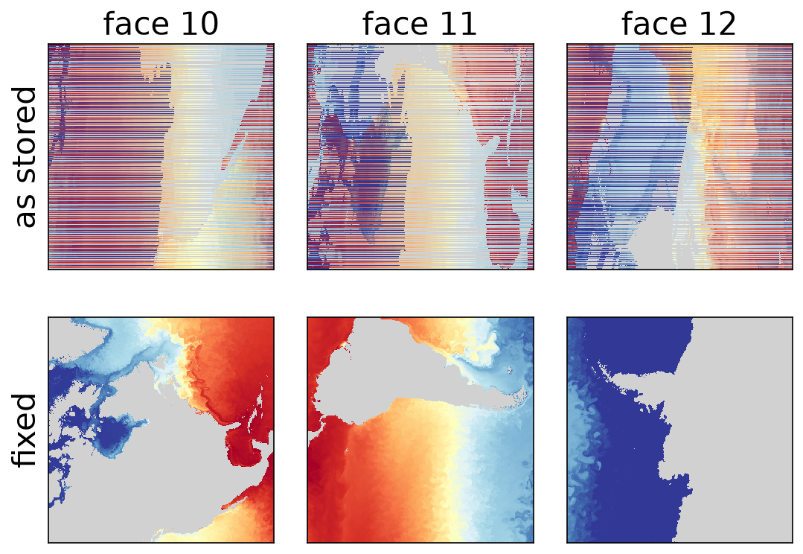
Found this week: faces 7–12 were scrambled
• Cause: wrong reshape of the rotated faces
• Nothing lost: values are only permuted
• Fixed: matches v1's grid exactly
• To do: repair 5,493 stores
8
Notes:
Top row: faces 10-12 of the 2023-07-01 12 UTC store as written. Bottom row: after llc_v2.compact_to_faces. The compact file was reshaped straight to (13, 4320, 4320); that is right for faces 0-6, but faces 7-12 are stored as (4320, 12960) blocks. The fix reproduces XC/YC of s3://dbof grid.zarr with max difference 0. Fixed stores carry face_layout = "llc_faces". The global map was unaffected because it bins by XC/YC.

Slide 9
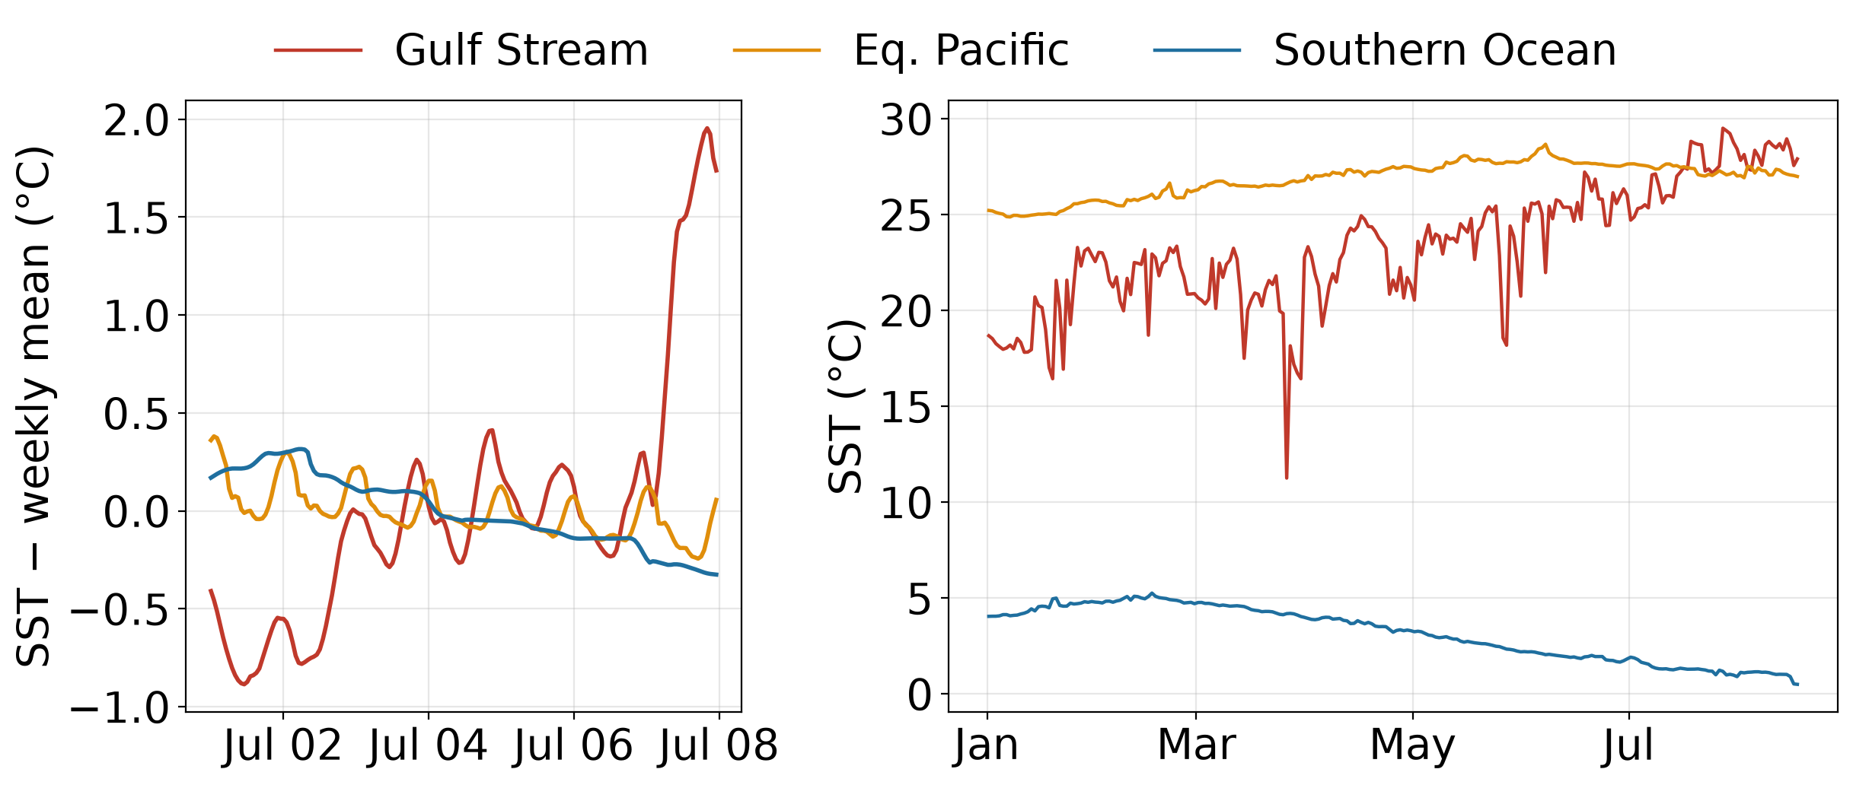
Through time: the dates line up
Left: hourly for one week. Right: daily at 12 UTC, 2023-01 to 08
9
Notes:
Single grid cells read from the hourly stores. A smooth diurnal cycle and a seasonal cycle with no jumps at folder boundaries both support the dating rule.

Slide 10
The full SST run: past halfway, now stalled
5,493
of 9,503 stores (58 %)
Jan 1 → Aug 17
model dates, no gaps
4.5 TB
projected total
Nothing new since
Sep 30 23:04 UTC
10
Notes:
Read directly from S3 on 2026-10-02. Launched 2026-09-24 with --fields SST. ~75 s and 474 MB per store while running. It stopped on 09-29 14:03 UTC after 20230817T16; 5 more stores were written 09-30 23:01-23:04 UTC, then nothing.

Slide 11
Next steps
1
Restart with the fix
2
Repair old stores
git pull on Pleiades first
rewrite faces 7–12 on S3
3
Bucket quota
4
SSS / SSU / SSV?
4.5 TB for SST; ~18 TB for 4 fields
each later pass is ~8 days
5
Depth phase
6
Vectors
needs NAS export2 access
rotate SSU/SSV to east/north
11
Notes:
Repair option: rewrite faces 7-12 of each existing store in place from a workstation (~2.6 TB of S3 traffic, no Pleiades reads), or re-extract them (~4.7 more days on Pleiades). Adding fields later rewrites every store. Vectors need AngleCS/AngleSN from grid.zarr.

