Slide 1
Lecture 4:
Splines
Ilia State University
Computer Graphics
George Partskhaladze

Slide 2




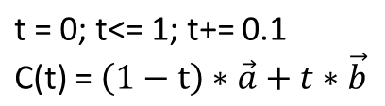
struct point
{
double x, y, z
};
point A, B;
point C;
y
A
t=0
C
A = (A.x, A.y, A.z)
B = (B.x, B.y, B.z)
t=1
B
t
x
z

Slide 3
Line Modeling and Drawing
y
1. Analytical (Mathematical) Curves
(x, y) where y = f(x)
In professional graphic systems, parametric curves are almost never used for shape modeling.
y = f(x)
x
2. Parametric Curves (splines)
Projection of a segment [0,1] into a plane (X,Y) or into the space (X,Y,Z) :
x = fx(t); y = fy(t); z = fz(t)
Widely used in CG.
y =fy(t)
t
0
1
x = fx(t)

Slide 4
line: x = 1 + t; y = 2 – t; t ∈ [0,1]
examples:
y
x
circle:
x = R cos(t)
y = R sin(t)
t ∈ [0, 2π]
y
R
x

Slide 5
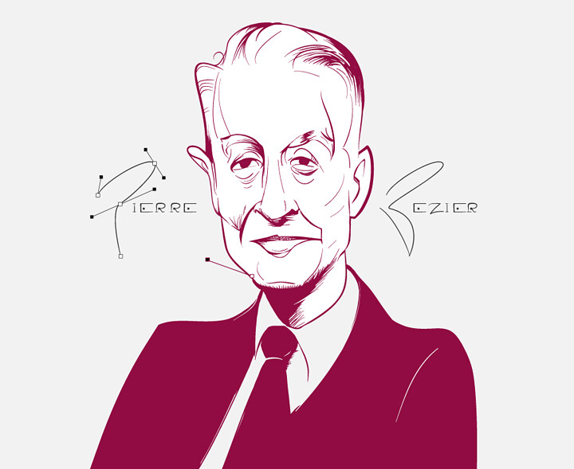
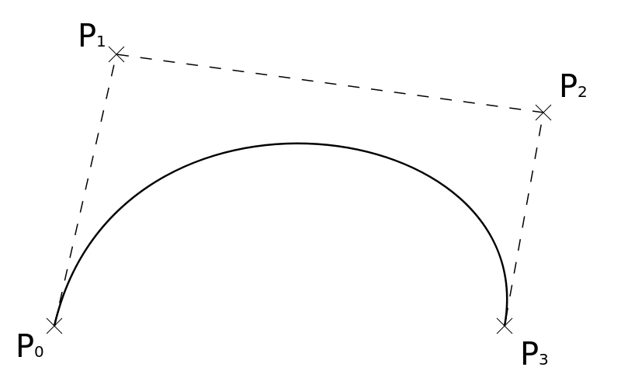
Bezier (Bezier curves)
Bezier (Pierre Étienne Bézier 1910-1999) - French engineer. Worked at Renault from 1933 to 1975.
In 1960, he described a simple method for curve modeling.
A Bézier curve is constructed using several so-called control points
(Pi)

Slide 6
Bernstein polynomials are used as a parametric function.
For three points (degree-2):
B(t) = (1-t)² *P₀ + 2(1-t)*t *P₁ + t² *P₂ where t ∈ [0,1]
P0, P1 და P2 – are control points (vectors). B(t) - the vector of a point located on the curve for t∈ [0,1] .
B_{x}(t) = (1-t)² *P_{0x} + 2(i-t)*t*P_{1x} + t²*P_{2x}
B_{y}(t) = (1-t)² *P_{0y} + 2(i-t)*t*P_{1y} + t²*P_{2y}
B_{z}(t) = (1-t)² *P_{0z} + 2(i-t)*t*P_{1z} + t²*P_{2z}
y
P₁
B(0)=
B(0,3)
P₀
B(0,9)
P₂
B(1)=
x

Slide 7
Degree-3 curve, 4 control points:
B(t) = (1-t)³ *P₀ + 3(i-t)²*t* P₁ + 3(1-t)*t² *P₂ + t³ *P₃
y
P₁
A polygon, which is formed by control points, is called a control polygon (shown with a dashed line on the diagram).
B(1)=
B(0,3)
P₃
B(0)=
P₀
B(0,9)
Bezier Curve starts in the first Control point B(0) = P₀ and ends in the last Control point B(1) = P_{N}
x
P₂
In the starting and ending control points, the curve is tangent to the first and last edges of the control polygon.

Slide 8
Other features of Bezier curves:
A Bezier curve is always completely inscribed in a convex polygon circumscribed around its control points.
The projection of the three-dimensional Bézier curve and its control points onto a plane is also a Bézier curve
A small movement of the control point does not cause the curve to uncontrollably ‘run-out'.

Slide 9
Bernstein polynomials
In the description above, the Bernstein polynomials were used:
B_{0,0}(t) = 1 // a point. 0-degree curve
B_{0,1}(t) = 1 – t; B_{1,1}(t) = t // a line. 1-degree curve. Two end points.
B_{0,2}(t) = (1-t)²; B_{1,2}(t) = 2*t*(1-t); B_{2,2}(t) = t²; // 3-degree curve. 3 cont. points..
B_{0,3}(t) = (1-t)³; B_{1,3}(t) = 3*(1-t)²*t; B_{2,3}(t) = 3*(1-t)*t²; B_{3,3}(t) = t³;
// 4-degree curve, 4 cont. points.

Slide 10
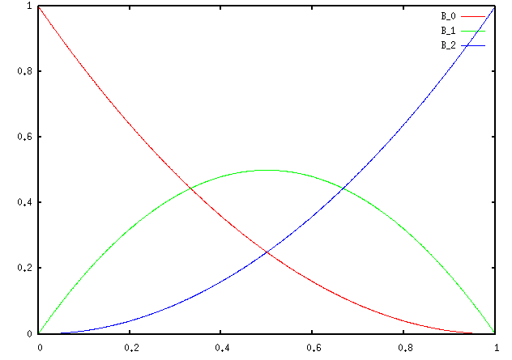
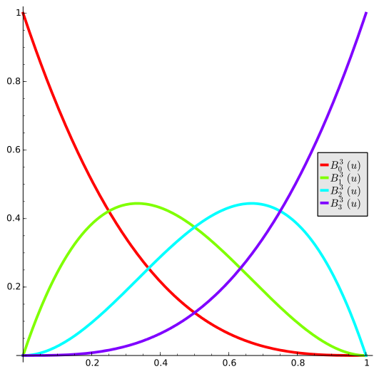
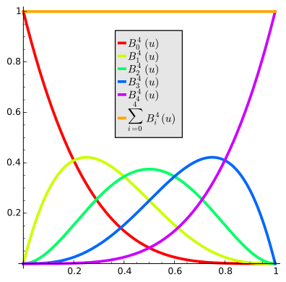
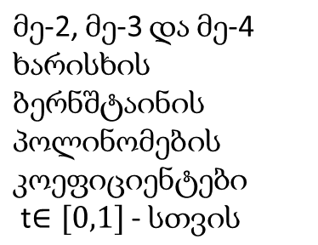
Bernstein polynomials, in this case, ensure that the total influence of all control points on the curve is always equal to 1 throughout the entire length of the curve (0 < t < 1), while the shares of their influence gradually change.
At the beginning, at the starting point, the first control point has full control (its share is equal to one, and all other points have a share of 0). In other words, the corresponding point on the curve is located at the first control point . Then, as soon as t starts increasing, the influence of the first point gradually decreases, while the influence of all other points increases, initially especially the second point, then the next points, and so on, until t becomes equal to one, and at the final point, the curve reaches the last control point of the polygon.
That is, each control point has a prioritized 'period' of influence on the curve, but only the first and last points have the 'full influence' privilege at the points t = 0 and t = 1.

Slide 11
As you can see, with the increase in the number of control points, the degree of the Bernstein polynomials increases, and accordingly, the complexity of the formulas and their computation time grows.
Therefore, in graphical systems, curves composed of several lower-degree Bézier curves (e.g., fourth-degree Bézier curves) are often used. For this purpose:
The last point of the first curve coincides with the first point of the second curve. The penultimate point of the first curve, the common point, and the second point of the second curve must be on the same line.

Slide 12
Typically, in graphical programs, it is not necessary to display the entire control polygon. For each individual Bézier fourth-degree segment, only the first and third lines of the polygon are shown, which are sometimes called 'handles.'

Slide 13
De Casteljau's algorithm
Let’s repeat that modeling with Bernstein polynomials becomes more complex as the number of control points increases:
Either higher-degree polynomials must be used,
or a composition of fourth-degree polynomials must be created. In both cases, the program becomes more complex, and the number of computations increases.

Slide 14




Paul de Casteljau, like Pierre Bézier, was born in France and also worked in the automotive industry, but at the competitor firm of Pierre Bézier's employer, Renault – at Citroën.
De Casteljau's algorithm constructs the same Bézier curves, but instead of calculating Bernstein polynomials, it uses simple iterations.
From this comes the joke that the design difference between 'Renault' and 'Citroën' is due to the fact that the first used polynomials, while the second did not.

Slide 15
De Casteljau's algorithm:
For each t value:
At each segment of the control polygon, we get a point that divides the segment into two parts in the ratio t/(1-t)
We connect these points with new segments (there will be one less segment then on the control polygon).
On the newly obtained polygon, we again get points in the same ratio.
We continue this process until we obtain a single segment, on which we will again take a point in the same ratio.
This point will be a Bezier point for given t: B(t)
B(0.3)
t = 0.3

Slide 16
De Casteljau's algorithm:
De Casteljau's method is simple, fast and stable.
For each t we can find the point easily: If endpoints are vectors P_{i} and P_{j}, then:
P_{t} = P_{i}*(1-t)+P_{j}*t
t
1- t
P_{i}
P(t)
P_{j}

Slide 17

struct point_2D
{
double x;
double y;
};
int bezier_casteljahu_4p(point_2D p0, point_2D p1, point_2D p2, point_2D p3, double step )
{
double t; // parameter t
point_2D p10, p11, p12, p20, p21, p30;
circle(p0.x,p0.y,5); circle(p1.x,p1.y,5); circle(p2.x,p2.y,5); circle(p3.x,p3.y,5); // sakontrolo tsertilebi
int xt,yt;
moveto(p0.x,p0.y); // start drawing
setcolor(COLOR(40,40,40));
line(p0.x,p0.y,p1.x,p1.y); line(p3.x,p3.y,p2.x,p2.y); // poligonis pirveli da bolo monakveTebi
setcolor(COLOR(140,240,40));
for(t = 0; t <= 1; t += step)
{
p10.x = p0.x*(1-t) + p1.x*t; p10.y = p0.y*(1-t) + p1.y*t;
p11.x = p1.x*(1-t) + p2.x*t; p11.y = p1.y*(1-t) + p2.y*t;
p12.x = p2.x*(1-t) + p3.x*t; p12.y = p2.y*(1-t) + p3.y*t;
p20.x = p10.x*(1-t) + p11.x*t; p20.y = p10.y*(1-t) + p11.y*t;
p21.x = p11.x*(1-t) + p12.x*t; p21.y = p11.y*(1-t) + p12.y*t;
p30.x = p20.x*(1-t) + p21.x*t; p30.y = p20.y*(1-t) + p21.y*t;
lineto(p30.x, p30.y);
}
}

Slide 18
Let's modify the above-mentioned function so that it can work with an arbitrary number of control points
int main()
{
initwindow(800,700); setbkcolor(COLOR(0,0,0)); cleardevice();
double X[] = { 300, 400, 550, 600, 400, 100, 140 };
double Y[] = { 550, 320, 600, 200, 90, 300, 580 };
int i, n = sizeof(X)/sizeof(X[0]);;
double x,y,t;
setcolor(COLOR(50,170,50));
for (i = 0; i<n; i++) circle (X[i], Y[i], 6);
for (i = 0; i<n-1; i++) line (X[i], Y[i], X[i+1], Y[i+1]);
setcolor(COLOR(170,170,40));
moveto (X[0], Y[0]);
for( t = 0.01; t<1; t+= 0.005 )
{ DeCast(X, Y,x,y, n, t); lineto (x,y); }
getch();
closegraph();
}
#include "stdio.h"
#include "graphics.h"
int DeCast ( double X[], double Y[], double &x, double &y, int n, double t )
{
int i;
for( ; n>1; n--)
for (i=0; i<n-1; i++)
{
X[i] = X[i]*(1-t) + X[i+1]*t;
Y[i] = Y[i]*(1-t) + Y[i+1]*t;
}
x = X[0]; y = Y[0];
return 1;
}

Slide 19
Bezier surface
t₂ = 0
t₃ = 0
The shape of a Bézier surface is determined by its control mesh. The mesh plays the same role for the Bézier surface as the control polygon does for the Bézier curve.
t₃ = 0.25
t₂ =
0.25
A Bézier surface (Bézier patch) touches its control mesh at four points — at the corners of the mesh.
t₃ = 1
t₁ = 0
tt = 0.3
Visualization of the Bézier surface, or even triangulation, is done easily:
By adjusting one direction of the mesh, individual Bézier curves are calculated with a fixed increment and parameter t.
t₁ =
0.25
t₂ = 1
t₁ = 1
For certain values of the parameter t (e.g., t = 0.25), we connect the points of the curves (shown as green points in the image), and on the resulting polygon, we calculate the Bézier curves using the tt coefficient. For all pairs of t and tt values, the computed x, y, and z coordinates are stored in the [t][tt] array.

