Slide 1
Ilia State University Prof. Dr. George Partskhaladze
Computer Graphics and
Computational Geometry
Lecture 1.
Color Models

Slide 2
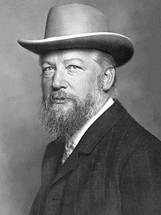
Color Models
Grassmann's Laws:
For every color, there is another homogeneous color which, when mixed with it, produces colorless light.
Any color can be obtained using three other colors, none of which can be derived from the other two (i.e., three independent colors).
C = K_{r}(R) + K_{g}(G) + K_{b}(B)
Where K_{r} , K_{g} , K_{b} are the coefficients of each component.
2. The result of combining any two colors can be obtained by combining the individual components of these colors, i.e.:
C3(C3) = K₁(C1) + K₂(C2) = [K_{1*}K_{r1}+K_{2*}K_{r2}]+ [K_{1*}K_{g1}+ K_{2*}K_{g2}] + [K_{1*}K_{b1}+ K_{2*}K_{b2}]
i.e. if C₁ = 0.3 R, 0.5G, 0.1 B and C₂ = 1.0R, 0.5G, 1B,
then, if C₃ = 0.5C₁+0.2C₂ =>
C3 = (0.15+0.2)R, (0.25+0.1)G, (0.05 + 0.2)B = 0.35R, 0.35G, 0.25B

Slide 3
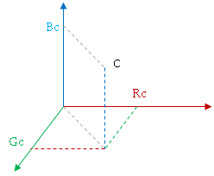
3. A gradual change in any component results in a gradual (continuous) change in the outcome.
Based on these three laws, we can represent any color as a point in a three-dimensional space, where the coordinate axes correspond to three independent colors (e.g., red, green, and blue).

Slide 4
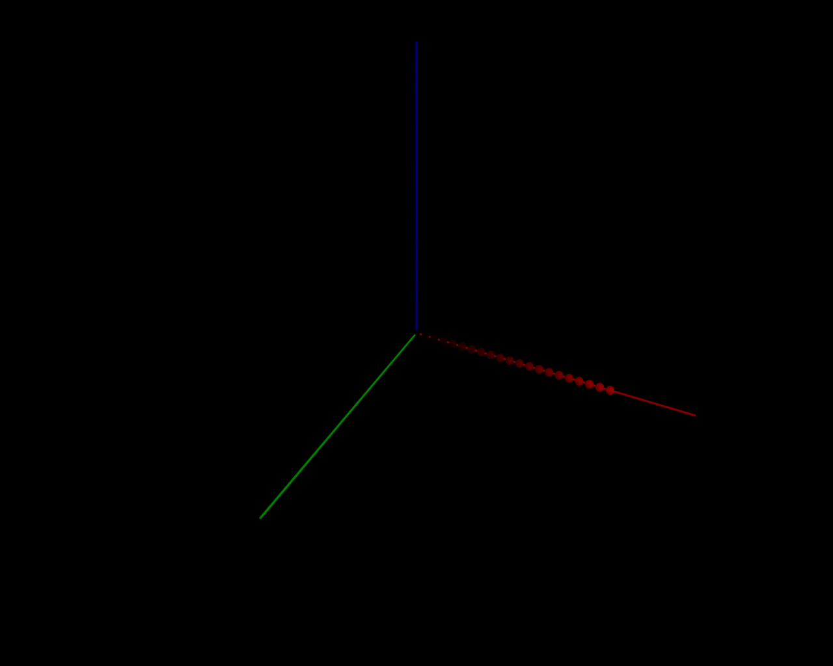
Additive Color Mixing
Here, color represents light that "shines in the darkness."
RGB Coordinates:
The emission of red light
(0 at one end – weak, meaning a very dark color, almost black; 1 at the other end – maximally intense).

Slide 5
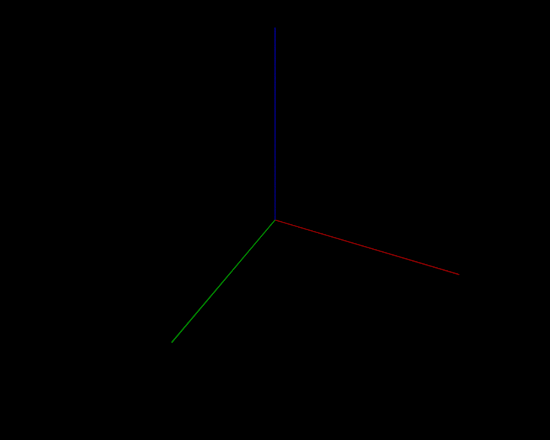
Additive Color Mixing
Here, color represents light that "shines in the darkness."
RGB Coordinates:

Slide 6
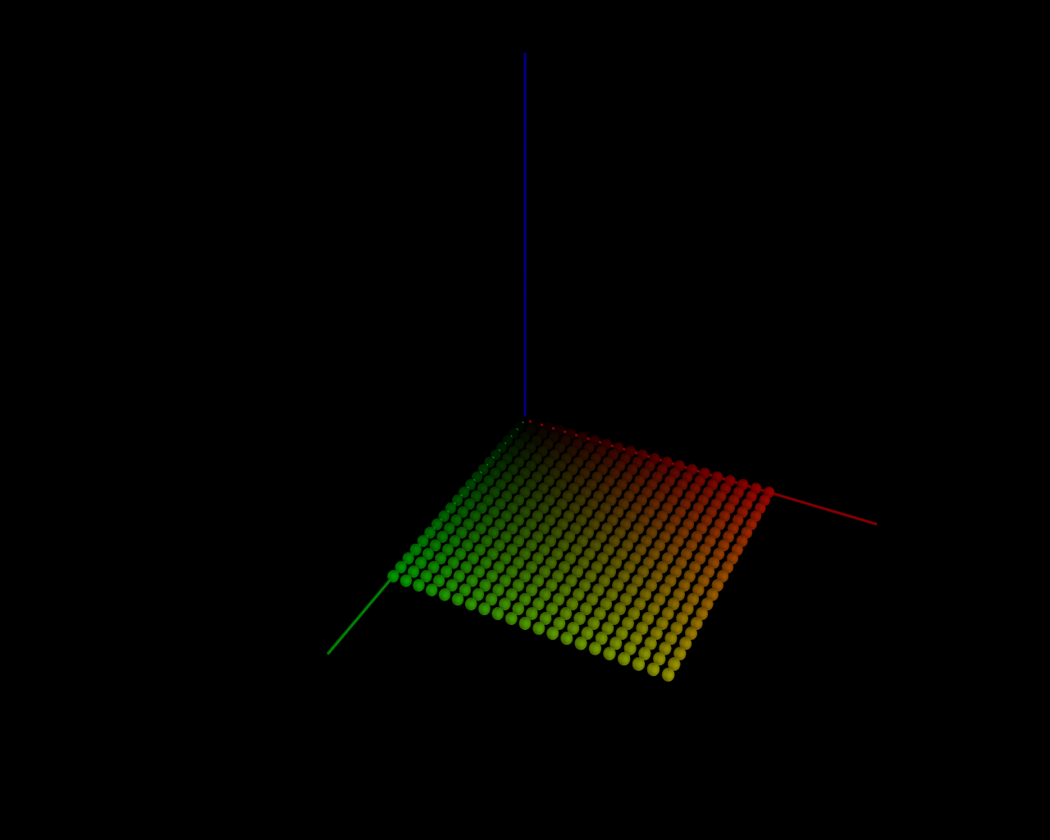
Additive Color Mixing
Here, color represents light that "shines in the darkness."
RGB Coordinates:
RG Plane (Square)

Slide 7
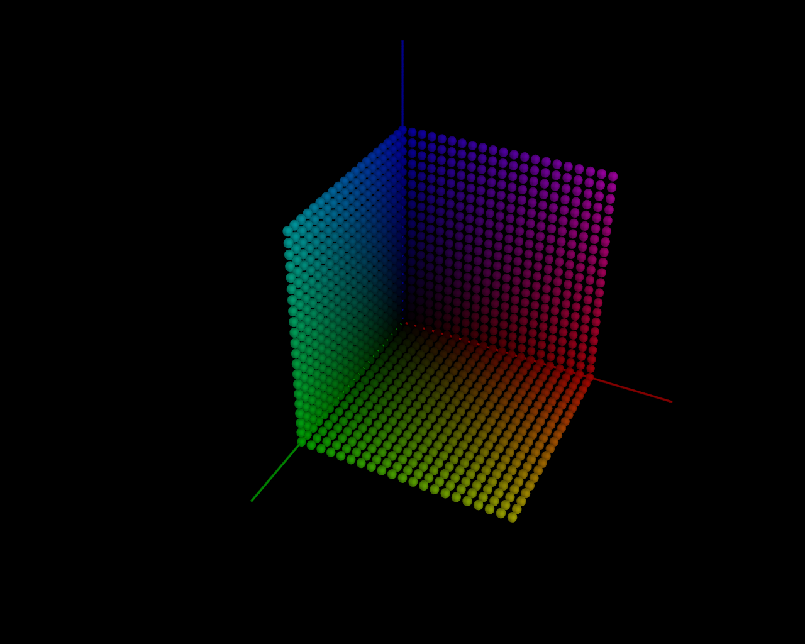
Additive Color Mixing
Here, color represents light that "shines in the darkness."
RGB Coordinates:
The three "walls" represent the result of combining two components at a time (either RG, RB, or GB).

Slide 8
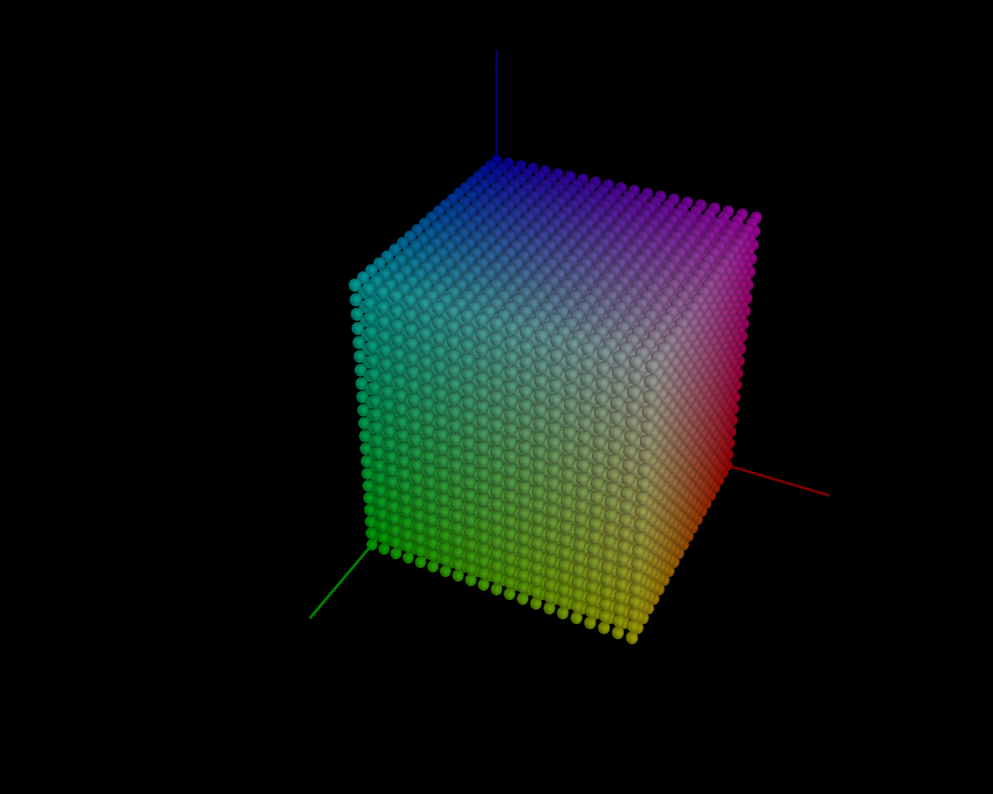
Additive Color Mixing
Here, color represents light that "shines in the darkness."
RGB Coordinates:
RGB Cube: Represents the result of combining all three components. When all three are at maximum intensity, the result [1,1,1] is white.

Slide 9
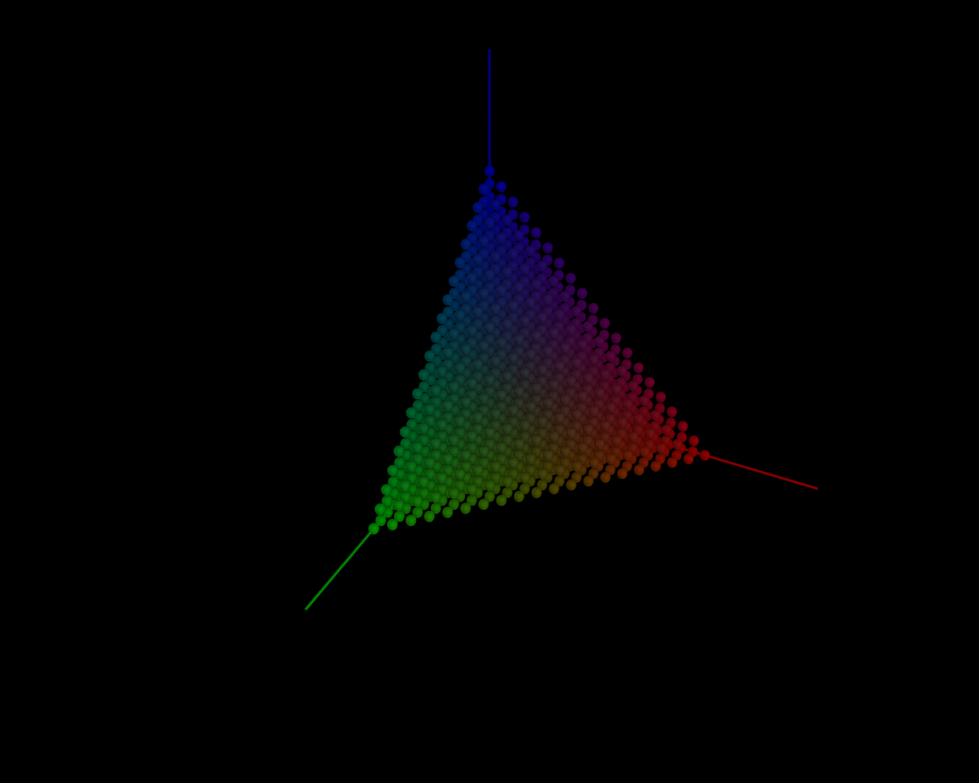
Additive Color Mixing
Here, color represents light that "shines in the darkness."
RGB Coordinates:
A cross-section of the RGB cube with a plane where R+G+B=1, meaning that all points in this section have the same overall intensity.

Slide 10
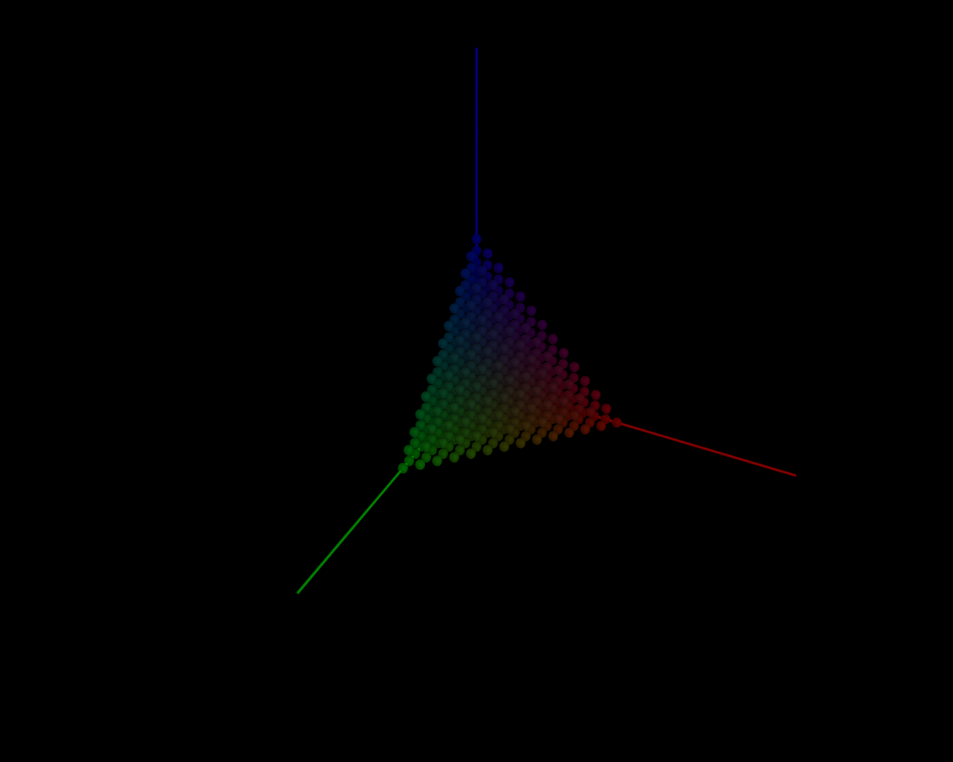
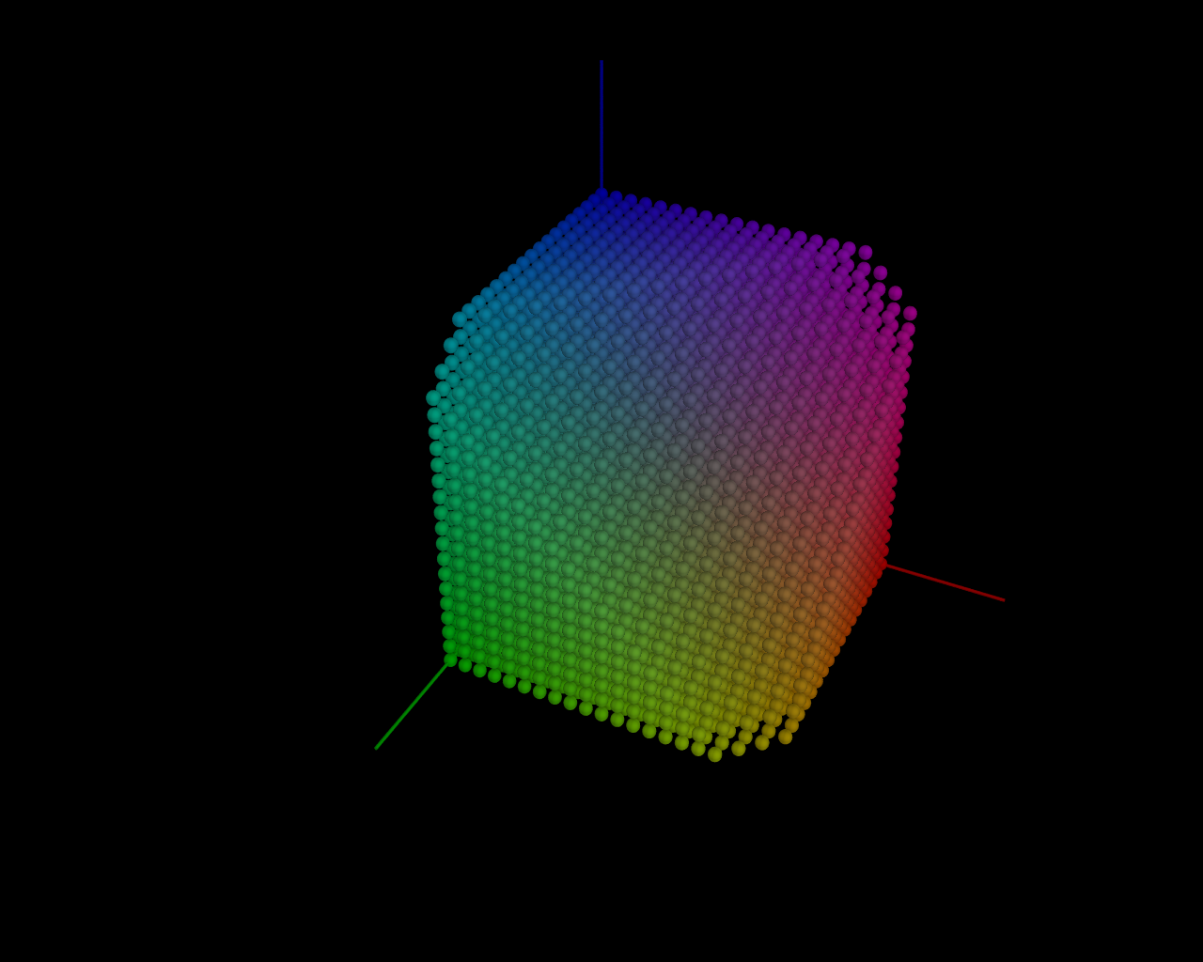
Additive Color Mixing
Here, color represents light that "shines in the darkness."
A cross-section of the RGB cube with a plane where R+G+B = k, meaning that all points in this section have the same overall intensity.
Other cross-sections of the RGB cube represent colors with lower intensity on the left and higher intensity on the right.
Other cross-sections of the RGB cube represent colors with lower intensity on the left and higher intensity on the right.
K = 0.7
K = 1.2

Slide 11
Тheoretically, if we take three colors (red, green, and blue) as three coordinates, we can obtain any other color. For example, yellow is created by combining red and green.
That is, if you turn on red and green lamps next to each other in the dark, from a distance, it will appear as if a single yellow light is shining. (This is exactly how a monitor works—what we perceive as a yellow pixel is actually red and green LEDs lit up side by side.)
=
This means that two electromagnetic waves — one with a wavelength corresponding to red light and the other with a wavelength corresponding to green light — together produce a wave of yellow light.
But the thing is, a "pure" electromagnetic wave with a frequency corresponding to yellow light will produce a more intense color, which cannot be achieved by mixing our red and green waves. Therefore, no device that uses three (or more) primary colors can display all colors at the maximum intensity available to our eyes.

Slide 12
C₃
The color range that can be obtained by mixing colors C₁, C₂, and C₃.
The color range that can not be obtained by mixing colors C₁, C₂, and C₃.
C₁
C₂

Slide 13
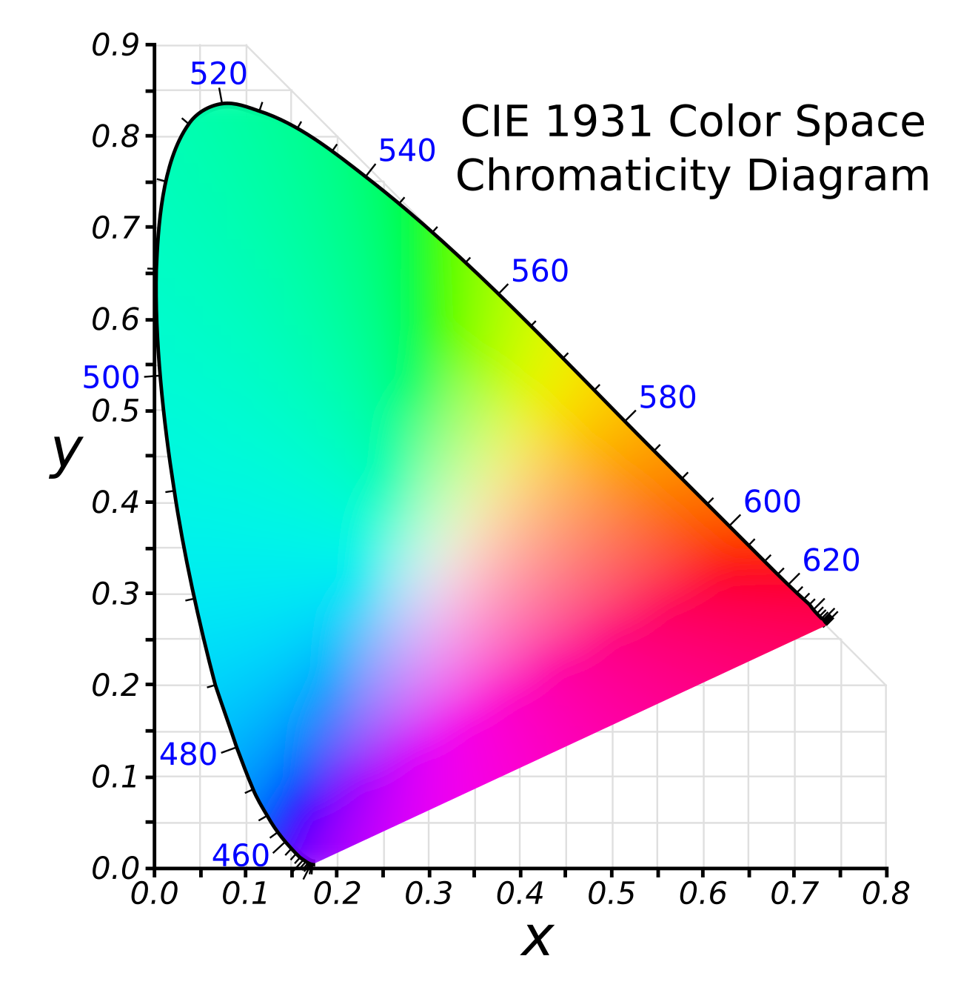
Color Gamut
https://en.wikipedia.org/wiki/Gamut
In color reproduction and colorimetry, a gamut, or color gamut /ˈɡæmət/, is a convex set containing the colors that can be accurately represented, i.e. reproduced by an output device (e.g. printer or display) or measured by an input device (e.g. camera or visual system). Devices with a larger gamut can represent more colors. Similarly, gamut may also refer to the colors within a defined color space, which is not linked to a specific device. A trichromatic gamut is often visualized as a color triangle.

Slide 14
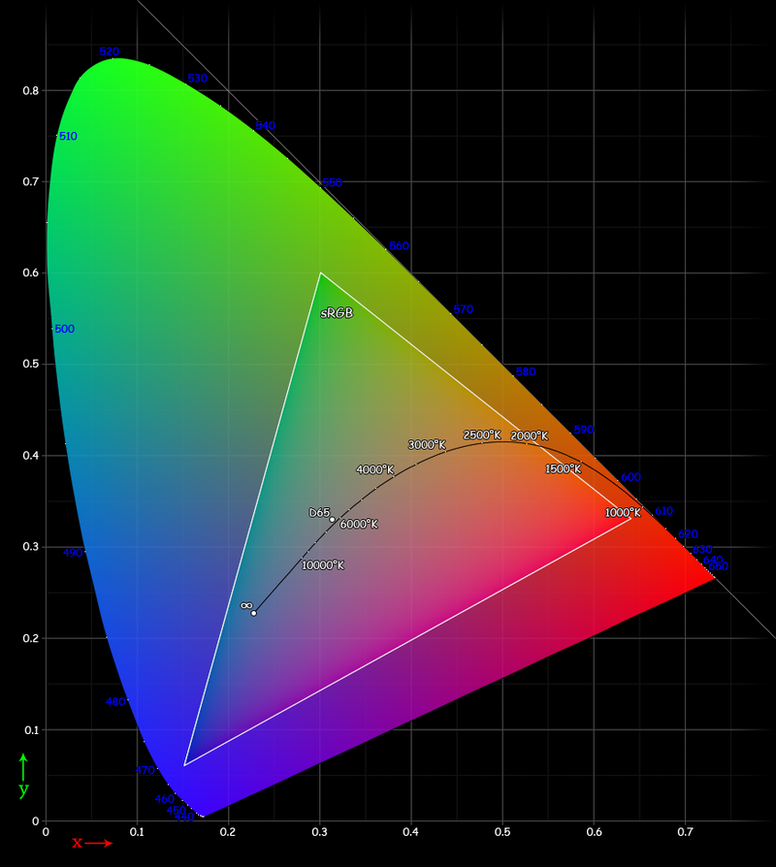
Color Gamut

Slide 15
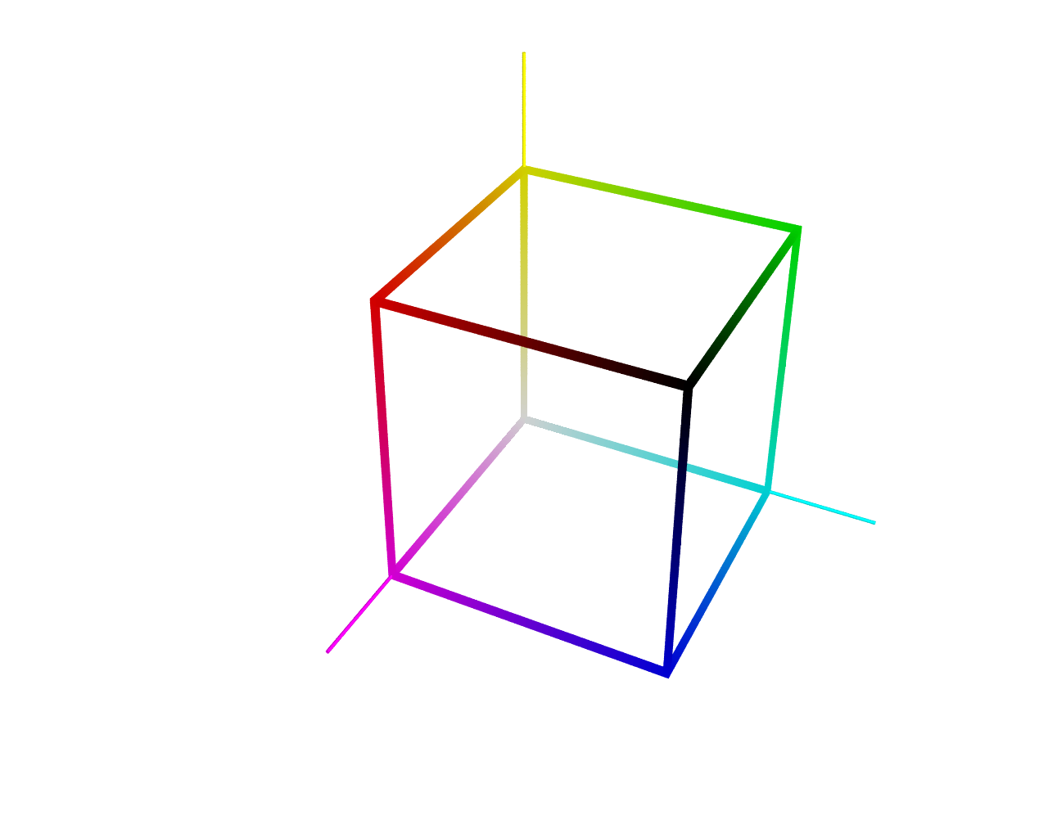
Subtractive Color Mixing
The physical analogy here is applying paints to white paper. In other words, the result of adding colors becomes darker.
Yellow
Cyan
Magenta
The spaces RGB and CMY
are mutually opposite.
[C, M, Y] = [1-R, 1-G, 1-B]
[0.5, 1, 0.3] = [0.5, 0, 0.7]

Slide 16
Thank You!

