Slide 1
Lecture 5:
Some useful Geometry methods
Ilia State University
Computer Graphics
George Partskhaladze

Slide 2
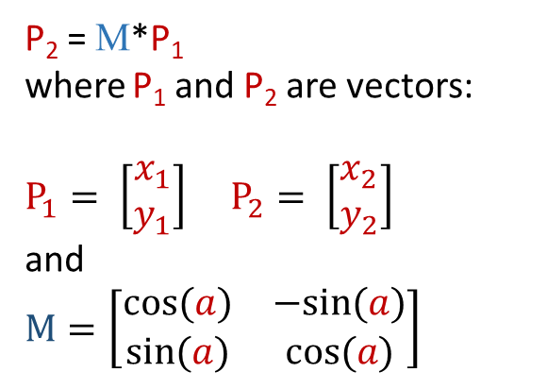
Some basic equations of computer graphics
1. Point Rotation
y
Given an angle α. The point P1(x1, y1) with coordinates needs to be rotated by this angle around the coordinate origin."
P₂
y₂
P₁
y₁
The result (point P2) will be calculated as follow:
α
x₂
0
x₁
x
x₂ = x₁*cos(α) - y₁*sin(α)
y₂ = x₁*sin(α) + y₁*cos(α)

Slide 3
If rotation around another point is needed:
y
We move the point and the center of rotation to the origin of the coordinate system
We perform a rotation by an angle of α
Then, we return the center of rotation (and the rotated point along with it) to its original position."
y
P₂
P₁
α
y₀
x
0(x₀,y₀)
x
x₀
y
y
y
y
y
P₁
P₂
P₁
x
P₂
x
P₁
α
x
x
x

Slide 4
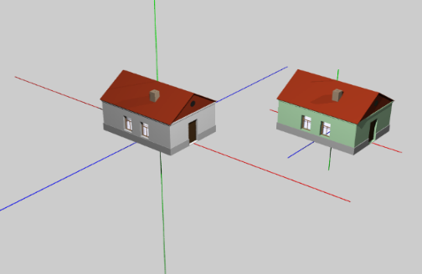
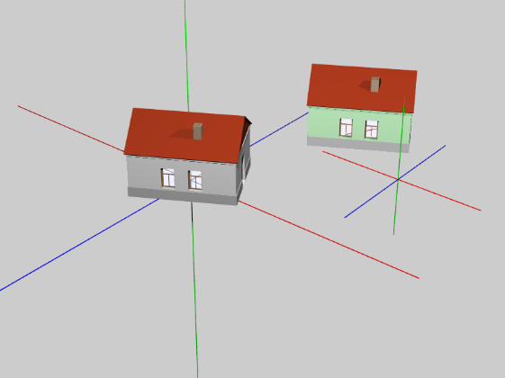
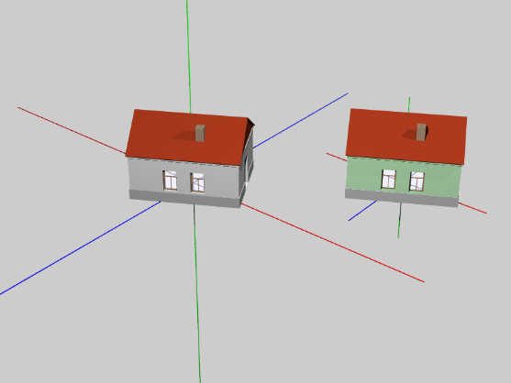
Example:
Two objects are given: a gray house (whose center coincides with the origin of the coordinate system) and a green house, whose center is located elsewhere.
In the second image, both houses are rotated around the point (0, 0). It is evident that the green house not only rotated but also changed its position.
In the third image, both houses are rotated around their own centers.

Slide 5
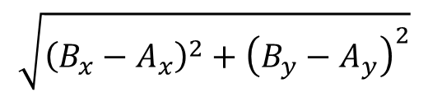
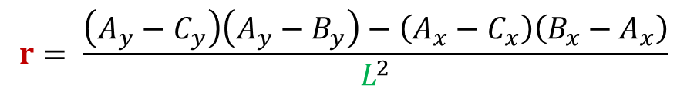
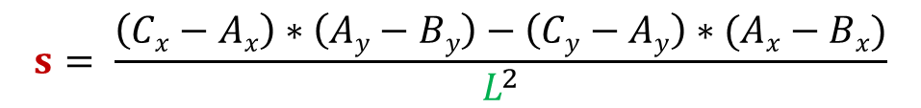
Positioning of a Point and a Line Segment
A line segment [AB] (A_{x}, A_{y}, B_{x},B_{y}) and a point C (C_{x},C_{y}) are given.
The length of [AB] is:
C
|AB| = L =
A
I
[C I] – The perpendicular dropped from point C to the segment [AB]
B
|AI| = r * L
|CI| = s * L
where:

Slide 6
If r<0 – Then point I is located outside the segment AB, closer to point A.
If r>1 – Then point I is located outside the segment AB, closer to point B.
If 0≤r≤1 – Then point I is between points A and B.
If s<0 – Then point C is located to the left of vector AB.
If s>0 – Then point C is located to the right of vector AB.
If s=0 – Then point C is located on the line (AB).
C
A
I
B

Slide 7
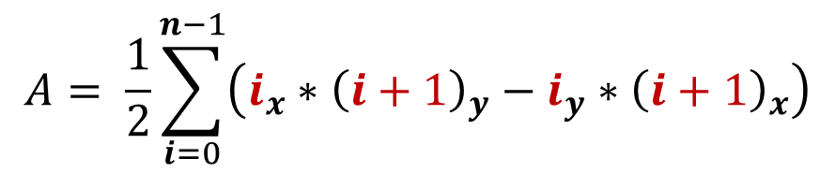
Calculating the Area of a Polygon:
6
5
2
1
7
4
The area of a polygon can be calculated easily without the need to divide it into triangles (triangulation). It is sufficient to multiply the coordinates of its vertices according to the following formula:
3
12
0
11
10
8
9
The alternative form of the same equation — if we write the coordinates in the index instead of the vertex numbers, we obtain the following formula:

Slide 8
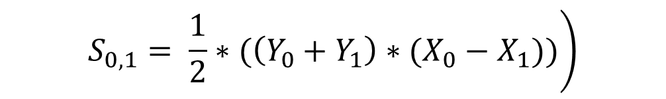
This simple and robust algorithm for calculating the area of a polygon was developed by Carl Friedrich Gauss as early as the late 18th century. This method is sometimes referred to as the geodesists' method.
y
x₀,y₀
x₁,y₁
x₄,y₄
y₀
Let the area of the polygon be imagined as the sum of the areas of trapezoids—each trapezoid is constructed on the vertices of the polygon such that the bases of the trapezoid represent the ordinate values of the polygon's boundary vertices: Yi and Yi+1, while the height of the trapezoid is the difference in the abscissas of these points:
y₁
x₂,y₂
x₃,y₃
x₁
X₀
x

Slide 9
The equation uses the difference (X₀ - X₁), so the area will be positive only if the X coordinate of the second vertex of the corresponding side is less than the X coordinate of the first vertex (X₁ < X₀). In other cases, the area will either be zero (the points coincide or the corresponding segment is vertical) or negative. These 'negative' trapezoids are what ensure the 'cutting off of the excess area' of the figure—that is, the portion between the figure and the OX axis.
y
x₀,y₀
x₁,y₁
x₄,y₄
x₂,y₂
x₃,y₃
x
It is important to note that the traversal of the vertices does not stop at the last vertex because there is still one side left—the side between the last and the first (in our example, the zero) vertex.
In the diagram, this is the trapezoid built on the segment (X4Y4, X0Y0).
The addition of this trapezoid can be done separately after the cycle. However, the first (i.e., zero) vertex can also be used as the additional, n-th vertex.
It is also possible to use the remainder of i+1 divided by n, which ensures the inclusion of the zero element in the calculation.

Slide 10
double poly_area(point* a, int num )
{
double area = 0;
for (int i = 1; i< num; i++)
area += a[i].y + a[int((i+1)%num)].y)*(a[i].x-a[int((i+1)%num)].x);
return 0.5*area;
}

Slide 11
It was previously mentioned that this method is robust. The robustness of the method with respect to 'extra points' means that it works for any configuration of vertices—including cases where a point is located not at a vertex of the polygon but along a side. In other words, this method does not require prior optimization of the geometry.
P_{i+2}
P_{i+1}
P_{i}

Slide 12



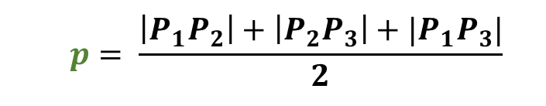
The area of planar figures. Oriented area.
The simplest planar figure is a triangle. If a triangle is given in space by the coordinates of three points P1(X1, Y1, Z1), P2(X2, Y2, Z2), and P3(X3, Y3, Z3), its area can be calculated by first determining the lengths of its sides.
Y
P₁
P₂
P₃
X
Z
The semiperimeter of this triangle will be:
And the Area:

Slide 13
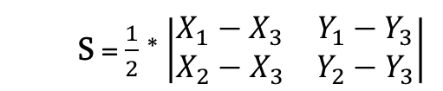

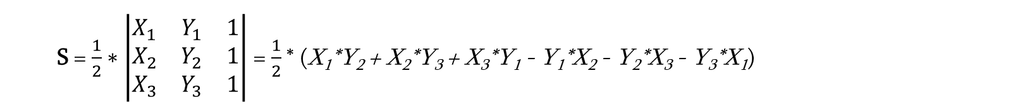
If the triangle is given on a plane by the points P1(X1, Y1), P2(X2, Y2), and P3(X3, Y3), then the area is easily obtained from the formula:
Or:
Or:
This formula calculates the so-called oriented area of the triangle, which will be positive if the points (vertices) are numbered in a counterclockwise direction, and negative otherwise. The absolute value of the area is the same in both cases.

Slide 14
The sign of the oriented area depends not only on the order in which the vertices are numbered but also on the orientation of the coordinate axes—that is, whether a right-handed or left-handed coordinate system is used.
 | Coordinate System
Point numbering: | Right-handed | Left-handed
Counter Clock-wise | + | -
Clock-wise | - | +
y
x
x
y

Slide 15
Calculation methods like this, where combinations of X and Y coordinates are used for different elements, are sometimes informally called shoelace methods or shoelace tying algorithms.
i | x | y
0
1
2
3
4
5
Σ(a[i].x*a[i+1].y - a[i+1].x*a[i].y)
+
-

Slide 16
The relative positioning of a triangle and a point on a plane.
We already know the formula used to determine the relative positioning of a vector and a point, i.e., whether the point is to the left, right, or on the vector’s line.
P₁
C
P₀
A point is located inside the triangle if it lies on the same side of all three vectors of the triangle. Furthermore, the direction of the numbering of the triangle's vertices does not matter, as long as the sign obtained from the orientation formula for all three vectors is the same.
D
P₂
P₂
C
In the both cases, point C is located to the same side from all three vectors, while the positioning of point D changes for different sides of this triangle.
P₀
D
P₁

Slide 17
Example: A function for determining the positioning of a point relative to a vector.
struct my_point
{
double x;
double y;
};
int side_sign(my_point P0, my_point P1, my_point C )
{
double M = (C.y-P0.y)*(P1.x-P0.x) - (C.x-P0.x)*(P1.y-P0.y);
if (M>0) return 1;
return 0;
}
If the point C is to the right of the vector, we return 1; otherwise, we return 0.

Slide 18
#include<graphics.h>
struct my_point
{
double x;
double y;
};
int side_sign(my_point P0, my_point P1, my_point C )
{
double M = (C.y-P0.y)*(P1.x-P0.x) - (C.x-P0.x)*(P1.y-P0.y);
if (M>0) return 1;
return 0;
}
main ()
{
my_point A[3], P;
int i, jami;
initwindow(500,500); setbkcolor(COLOR(20,20,20)); cleardevice(); setcolor(COLOR(60, 60, 100));
A[0].x = 80; A[0].y = 90; A[1].x = 290; A[1].y = 150; A[2].x = 150; A[2].y = 360;
for (i=0;i<3;i++) line(A[i].x, A[i].y, A[(i+1)%3].x, A[(i+1)%3].y ); // რისთვის არის აქ %3 ?
for (i = 0; i<1000; i++)
{
P.x = rand()%400, P.y = rand()%400;
jami = side_sign(A[0], A[1], P) + side_sign(A[1],A[2],P) + side_sign(A[2], A[0], P);
if (jami == 3) { setcolor(COLOR(0,250,0)); }
else { setcolor(COLOR(200,0,0)); }
circle(P.x, P.y, 2);
}
getch(); closegraph();
}
Change the direction of the point numbering. Will the program still work correctly? Why? Modify the code so that we get the correct result in all cases!

