Slide 1
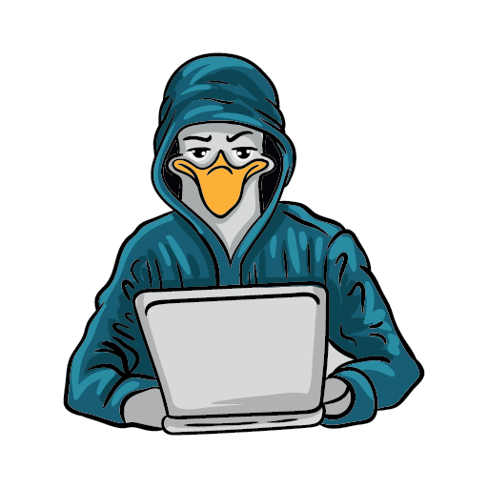

11th annual conference
SEATTLE GNU/LINUX
November 3rd & 4th, 2023
In-Person & Virtual
https://seagl.org
SeaGL is a community-focused free/libre/open source software, hardware, and culture event in Seattle.
This year we’ll meet in-person again, with the option to attend remotely for those who can’t make it!
Come enjoy talks
about:
ATTEND THE CONFERENCE
No Fee & No Registration required
Keynote presenters
Systems and Platforms, Open Source Careers, Community and Culture, Machine Learning
and Big Data,
Security and Privacy, Languages and Tools, Hardware, and more!
Deb Nicholson
  Executive Director Python Software Foundation & SeaGL Co-Founder
Hong Phuc Dang
  Founder of FOSSASIA
Kaylea Champion
  FLOSS Researcher & UW Ph.D. candidate
Sri Ramkrishna
  FLOSS communities advocate &
  longtime GNOME contributor
In-person Location:
University of Washington
Husky Union Building (HUB)
4001 E Stevens Way NE, Seattle, WA
Fediverse: @SeaGL@mastodon.social || X/Twitter: @SeaGL

