Slide 1
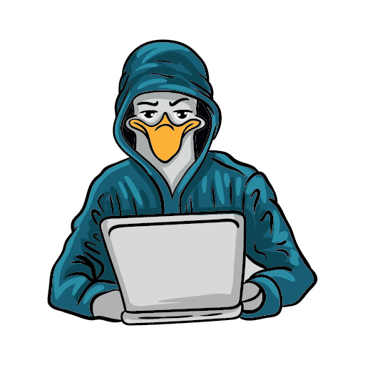

11th annual conference
SEATTLE GNU/LINUX
November 3rd & 4th, 2023
In-Person & Virtual
https://seagl.org
SeaGL is a community-focused free/libre/open source software, hardware, and culture event in Seattle.
This year we’ll meet in-person again, with the option to attend remotely for those who can’t make it!
Come enjoy talks
about:
ATTEND THE CONFERENCE
No Fee & No Registration required
Keynote presenters:
Systems and Platforms, Open Source Careers, Community and Culture, Machine Learning and Big Data, Security and Privacy, Languages and Tools, Hardware and others.
Hong Phuc Dang
  Co-founder FOSSASIA
Deb Nicholson
  Executive Director Python Software Foundation
Kaylea Champion
  FLOSS Researcher, Ph.D. student
Sri Ramkrishna
  FLOSS communities advocate veteran
In-person Location:
University of Washington
Husky Union Building (HUB)
4001 E Stevens Way NE, Seattle, WA
Fediverse: @SeaGL@mastodon.social || X/Twitter: @SeaGL

