Slide 1
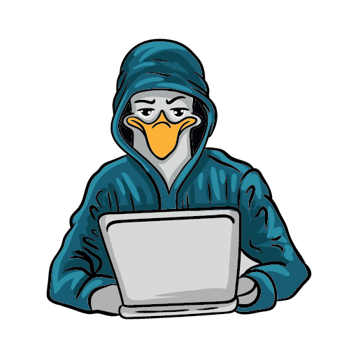
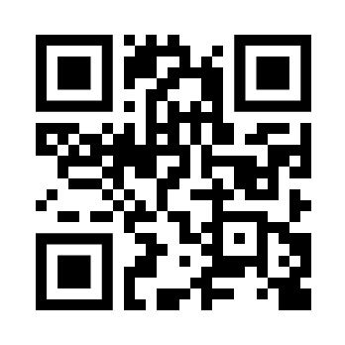

11th annual conference
SEATTLE GNU/LINUX
November 3rd & 4th, 2023
In-Person & Virtual
https://seagl.org
SeaGL is a community-focused free/libre/open source software, hardware, and culture event in Seattle.
This year we’ll meet in-person again, with the option to attend remotely for those who can’t make it!
WANT TO
HELP US OUT?
CALL FOR
PROPOSALS !
Submit by
06.30.2023
You can contribute in many different ways
such as joining the
all-volunteer staff
and becoming part
of the community!
Become a speaker! We encourage topics related to open source where you are engaged, such as:
Open Source Careers
Community and Culture
Machine Learning and Big Data
Security and Privacy
Education
Hardware
Languages and Tools
Performance Art
Everything Else
https://seagl.org/get_involved
https://seagl.org/cfp
Fediverse: @SeaGL@mastodon.social
Twitter: @SeaGL

