Slide 1
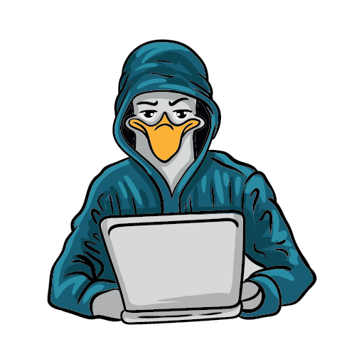


11th annual conference
SEATTLE GNU/LINUX
November 3rd & 4th, 2023
In-Person & Virtual
https://seagl.org
SeaGL is a community-focused free/libre/open source software, hardware, and culture event in Seattle.
This year we’ll meet in-person again, with the option to attend remotely for those who can’t make it!
WANT TO
HELP US OUT?
ATTEND THE CONFERENCE
No Fee & No Registration required
You can contribute in many different ways such as joining the all-volunteer staff and becoming part of the community!
Includes:
Keynotes, Presentations, Career Expo, Tea Swap, After Party, and more!
Talk topics:
https://seagl.org/get_involved
Open Source Careers, Community and Culture, Machine Learning and Big Data, Security and Privacy, Education, Languages and Tools, Hardware and others.
In-person Location:
University of Washington
Husky Union Building (HUB)
4001 E Stevens Way NE, Seattle, WA
Fediverse: @SeaGL@mastodon.social || Twitter: @SeaGL

