Slide 1

Notes:
![w:300 top right](./images/logo/logo_en.png)

Slide 2
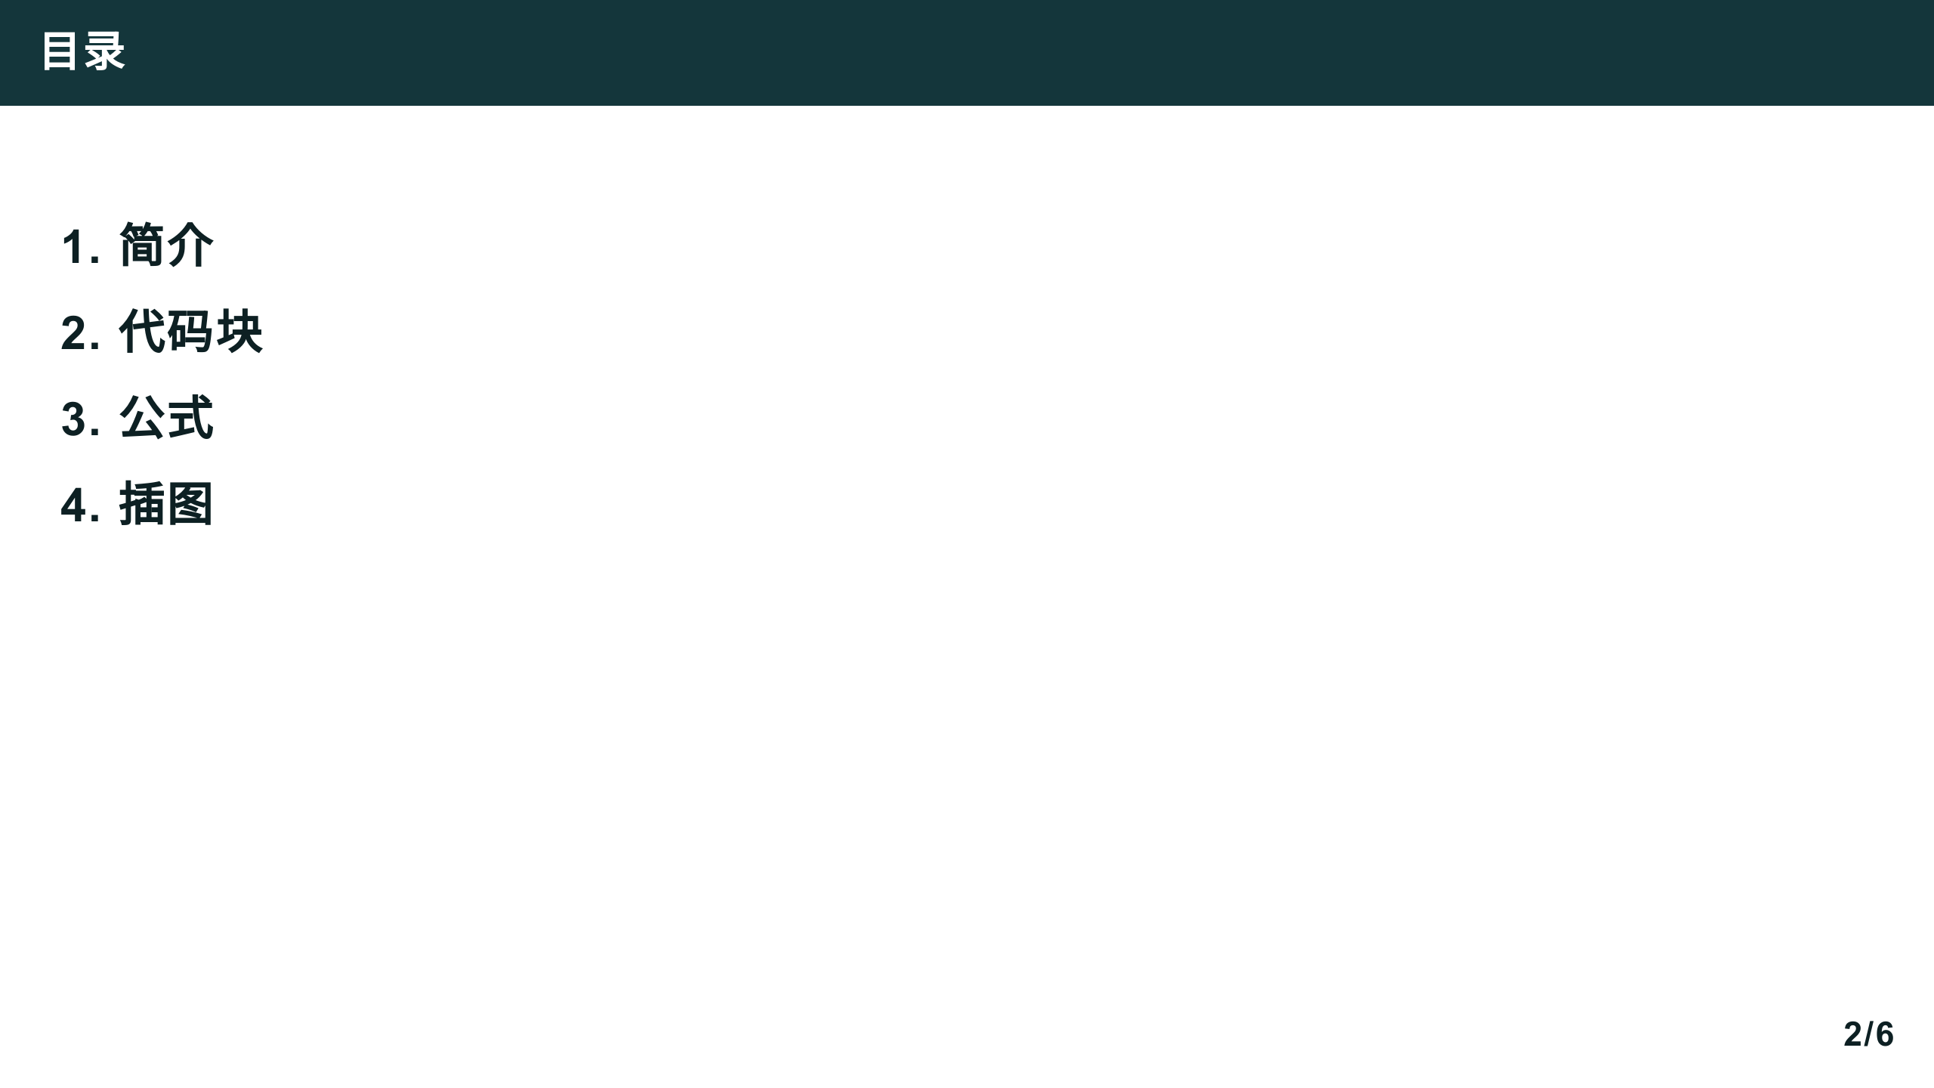

Slide 3


Slide 4
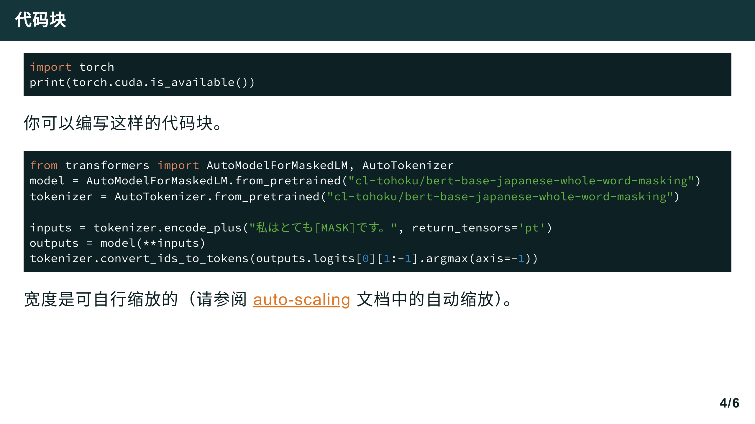

Slide 5
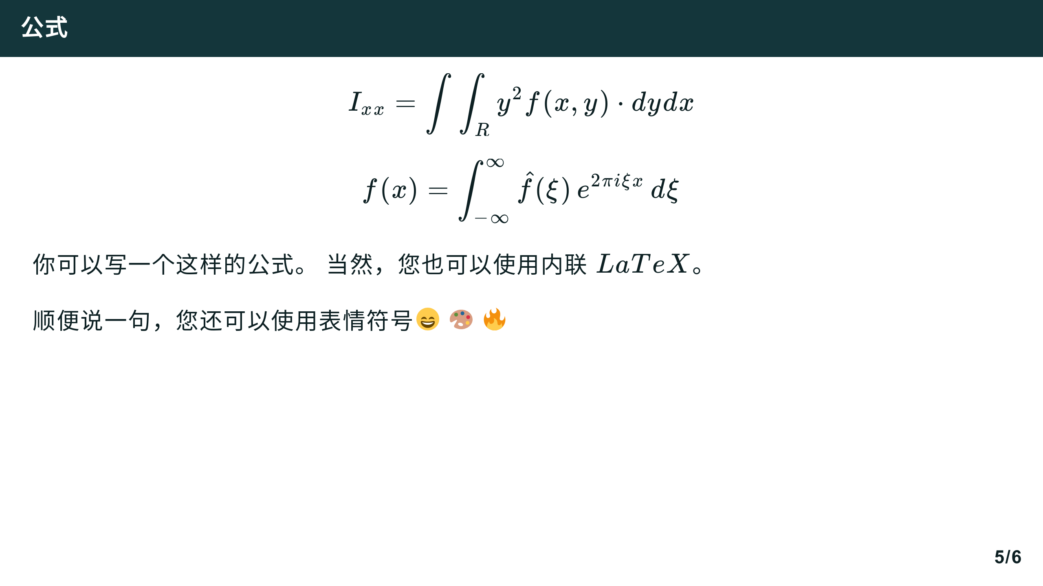

Slide 6
