Slide 1
SUSE-Manager Patch Lifecycle Management
With success, comes challenges…
As The IT infrastructure grows, and becomes more complex… You need a centralized solution to manage this in every growing IT infrastructure.

Slide 2
SUSE-Manager Patch Lifecycle Management
Challenges:
You need a standardized and systematic approach to patching servers to comply with regulatory audits, and maintain a secure and supported environment.
You require a solution to patch environments in a consistent and valid manner across dev, test, and production.
You require a solution that will automatically manage and deploy specific third party application packages to target hosts, thereby reducing administrative overhead.

Slide 3
SUSE-Manager Patch Lifecycle Management
What alternatives were evaluated to Suse Manager?
Spacewalk (also open source) –
It did not provide an enterprise level solution, or support.
Spacewalk also did not provide a centralized console for administration purposes.

Slide 4
SUSE-Manager Patch Lifecycle Management
Goals behind implementing SUSE Manager:
To secure and stabilize the server patching process using the tools that SUSE/SUSE-Manager provides.
Provide integrity of patch testing and implementation throughout the environments, i.e. sandbox, dev, production, and PCI-Compliant clients.
Include Customer-Specific packages and repositories to eliminate administrative manual maintaining those software applications and packages.

Slide 5
SUSE-Manager Patch Lifecycle Management
Benefit: Visibility
Provides ability to have an overview of your infrastructure in a centralized console. (example: list of all Linux servers, OS versions and service pack levels, security patches needed, etc)

Slide 6
SUSE-Manager Patch Lifecycle Management
Benefit: Security
SUSE Manager provides the ability to inventory and monitor the environment for available security patches and to automate the deployment of those patches
It is vital that your servers Never go outside your Corporate Network for ANY packages. The SUMA-Server has a direct line to the SCC for all the packages it provides to its clients.
The SUSE Manager Proxy provides the ability to patch the clients that are behind our fire-walled and locked-down PCI network through a secure connection to the SUSE Manager Server.

Slide 7
SUSE-Manager Patch Lifecycle Management
Benefit: Efficiency & Automation
SUSE Manager allows the ability to manage groups of clients as easily as managing a single client, from a centralized console.
SUSE Manager provides an overview of clients that are vulnerable to the latest threats and informs the user on the next steps for remediation

Slide 8
SUSE-Manager Patch Lifecycle Management
Benefit: Maintaining Customer-Specific software, tools, & packages
Collect and distribute custom software packages into manageable groups as defined by application specific needs.

Slide 9
SUSE-Manager Patch Lifecycle Management
The issues that I needed to solve:
1. Consistency of packages provided by SUSE(SCC) on a daily basis.
2. Installation and maintaining of Customer specific software packages (third party vendor software)

Slide 10
SUSE-Manager Patch Lifecycle Management
The script
This process requires 1 (one) parameter -- |b|d|p|h|g|s]
### [-b] Base-Pool Clones the SUSE base pools and their child-channels to 'dev' channels
### [-d] Promote-dev Promotes the 'dev' channel to the 'test' channel
### [-p] Production Promotes 'test' to 'Prod'
### [-h] Help Prints this list and exits (default if no parameter is passed)
### [-s] Custom Does ONLY the custom repo add to all channels and exits
### [-g] GPL Prints the GPL info and exits

Slide 11
SUSE-Manager Patch Lifecycle Management
The script- Generating Global Variables
Generates global variables for all SUSE Product Channels, and for all Cloned Product Channels

Slide 12
SUSE-Manager Patch Lifecycle Management
The script- Initial Cloning SUSE product channels and their child-channels to 'dev'-
This is done with simple for-loops & if statements, and the variables mentioned in the previous slide, using tools from the 'spacewalk-utils' package.

Slide 13
SUSE-Manager Patch Lifecycle Management
The script-
Promotes 'dev' to 'test' to patch the non-production clients
and once the non-production clients have been tested-
Promotes 'test' to 'prod' to patch the production clients

Slide 14
SUSE-Manager Patch Lifecycle Management
SUSE Manager Proxy
Provides security by confining incoming and outgoing traffic between SUSE Manager and it’s clients in protected VLANs
It reduces unnecessary bandwidth consumption by caching package content received from SUSE Manager.

Slide 15
SUSE-Manager Patch Lifecycle Management
SUSE Manager Groups
With multiple environments, you need separate groups to administer them, and SUSE Manager provides this functionality. (dev, test, prod)
The administrator can easily create custom groups for segregated patch scheduling and deployment.

Slide 16
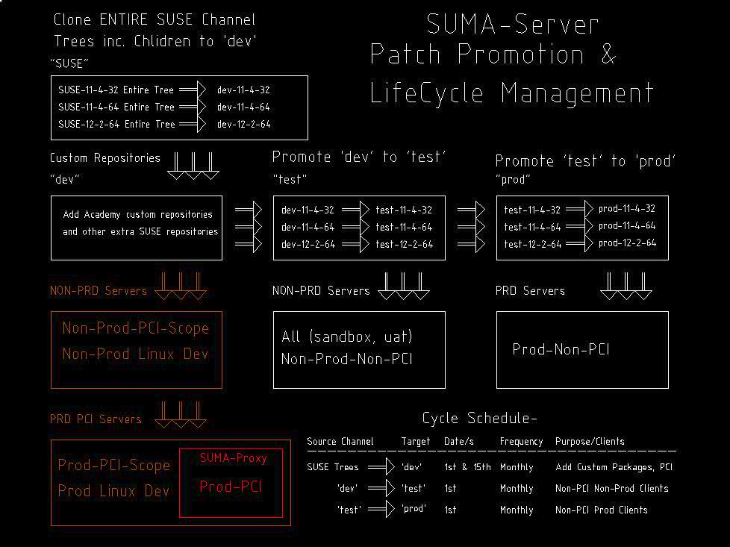
SUSE-Manager Patch Lifecycle Management

Slide 17
SUSE-Manager Patch Lifecycle Management
SUSE Manager upgrade from 2.1 – 3.0
Migration process was mostly painless
Only issue that I incurred was localized to Customer’s environment (no dhcp server on VLAN for registration upon installation to get the SUSE Manager add-on package)
I followed the online documentation provided by SUSE

Slide 18
SUSE-Manager Patch Lifecycle Management
Future Plans for SALT
Interest in moving workload from Puppet to SALT so that customers have a supported configuration management system.
To consolidate all server management into one supported solution (SALT is integrated with SUSE Manager)

Slide 19
SUSE-Manager Patch Lifecycle Management
Future Plans for SUSE Manager 3.1
OpenSCAP (OpenSCAP verifies the presence of patches by using content produced by the SUSE Security Team, checks system security configuration settings and examines systems for signs of compromise by using rules based on standards and specifications.)
I may implement scripts around this for system-wide audit.
Explore SUSE Manager capabilities in the Cloud.

Slide 20
SUSE-Manager Patch Lifecycle Management
References:
Based on the following SUSE Documentation;
Best Practices Guide, by Joseph Cayouette (All cloning/promoting management commands & API calls originated from spacewalk-utils & the following Document)
Advanced Patch Lifecycle Management with SUSE Manager, by Jeff Price (Principal Architect- SUSE Consulting)
https://wiki.microfocus.com/index.php?title=SUSE_Manager/Migration_23#Migration_from_SUSE_Manager_2.1_to_SUSE_Manager_3

