Slide 1

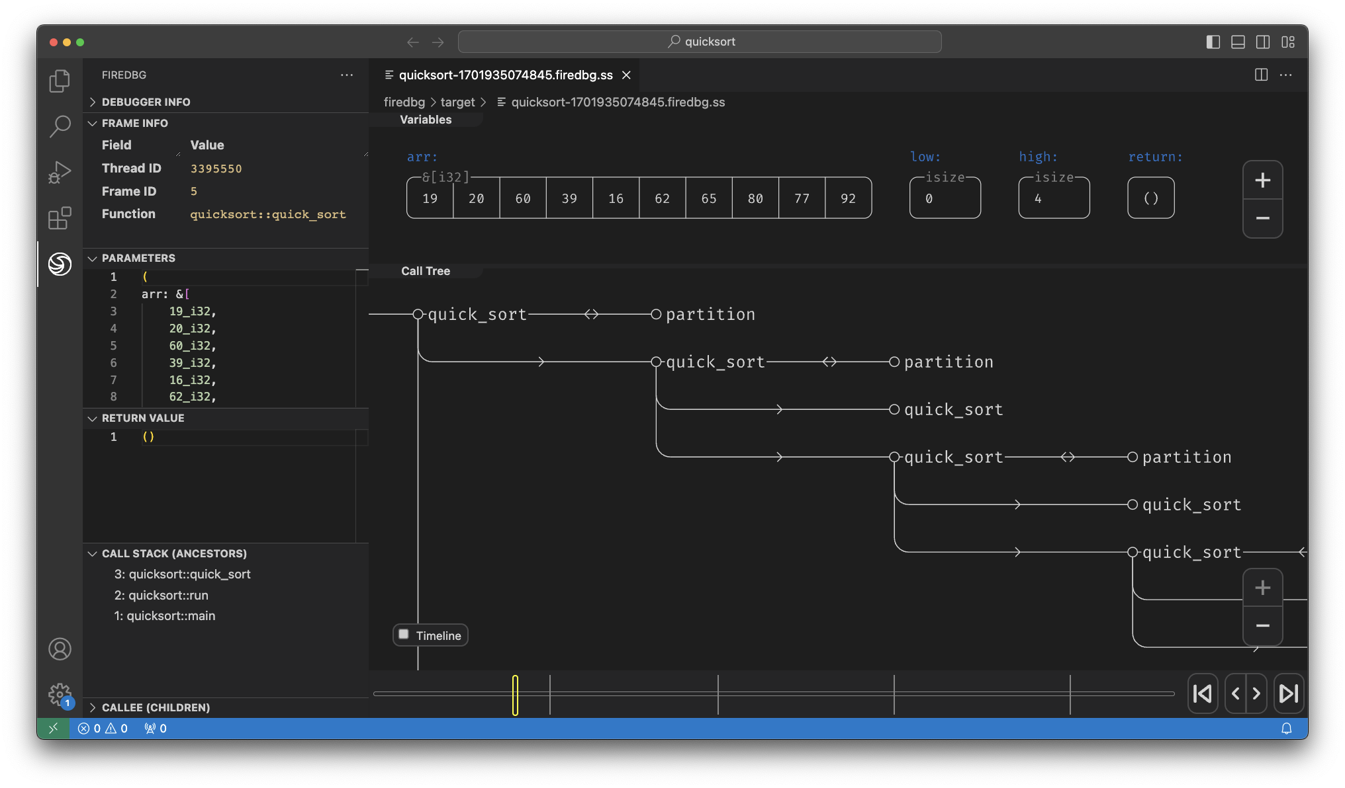
Time Travel Visual Debugger for Rust

