Slide 1
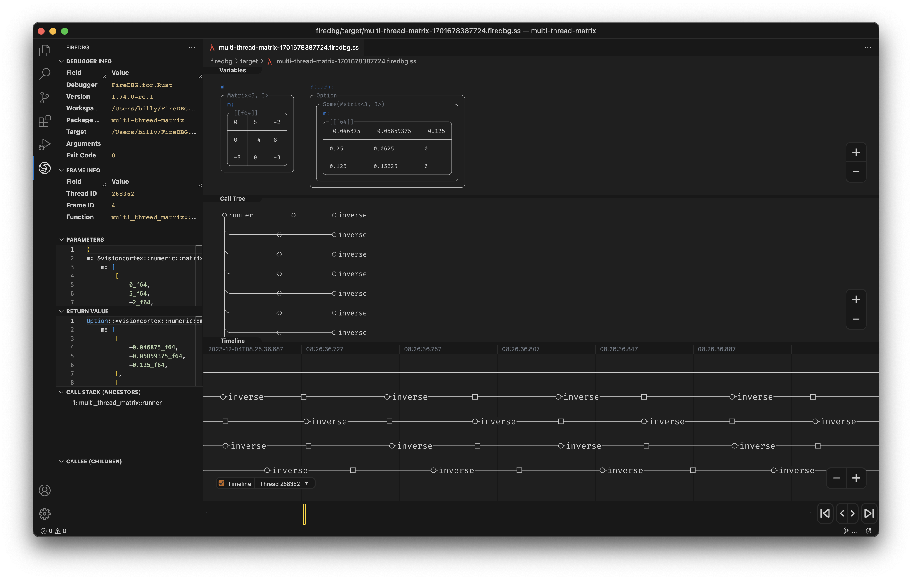





🔥 Time Travel Visual Debugger for Rust
Visualize and debug Rust programs with a new lens
Supported OS
Ubuntu 22.04
Ubuntu 20.04
Ubuntu 22.04
Ubuntu 20.04
Debian 12
Fedora 39
macOS 13
macOS 14
Extension available in

