Slide 1

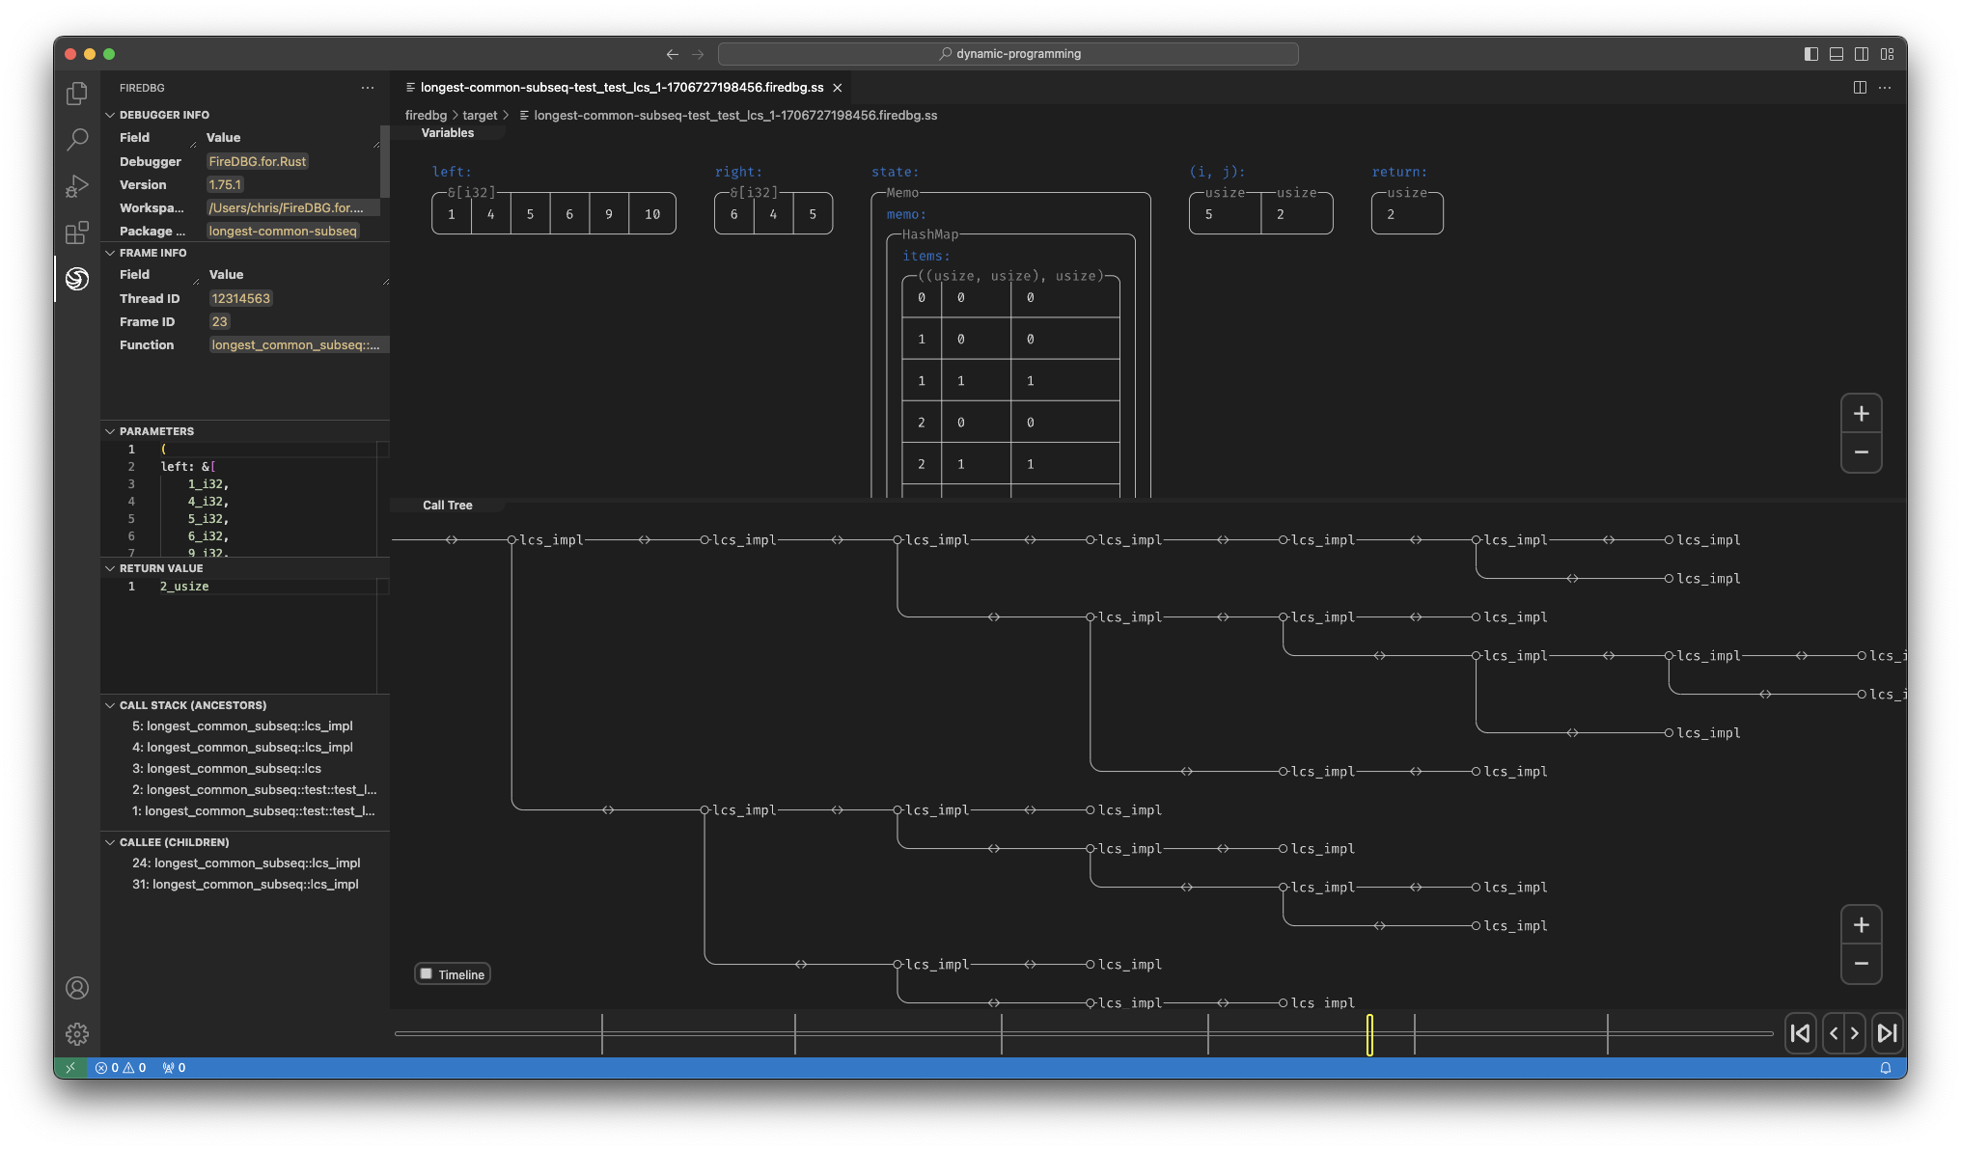
Visualizing Dynamic Programming

