Slide 1
MEXAUSA FOOD GROUP, INC.
DON AZUL
TEQUILA
Blanco · Reposado · Añejo · Reserva
JALISCO, MEXICO · 100% AGAVE · NOM/CRT CERTIFIED
GROWTH CAPITAL RAISE
Four Premium Expressions
Fully Certified Jalisco Production
$5,000,000 — $10,000,000 USD
Saul Garcia · Strategic Capital Representative · sgarcia@mexausafg.com
donazultequila.com

Slide 2
THE OPPORTUNITY
Premium Tequila Is One of the Fastest-Growing Spirits Categories
$16.3B
8.3%
#1
35M+
U.S. Spirits Market
Tequila Segment 2024
Tequila Category CAGR
2023 – 2028 Projected
Fastest-Growing Brown
Spirits Category USA
U.S. Hispanic Adults
Prime Tequila Consumers
KEY MARKET DRIVERS
TARGET U.S. MARKETS
Premiumization — consumers trading up to $50–$150+ bottles
California
San Diego · LA · Orange County · Monterey
Celebrity validation (818, Casamigos, Clase Azul) accelerating awareness
Texas
Houston · Austin · Dallas · San Antonio
U.S. Hispanic demographic growth — fastest-expanding consumer segment
Florida
Miami · Orlando · Tampa · Duty Free Intl
Cross-border trade expansion — Mexico–California corridor growing 12% YoY
Nevada
Las Vegas Hospitality · Casinos · Resorts
Retail expansion: Total Wine, Kroger, Duty Free all actively seeking new brands
National
Fine Dining · Duty Free · Cruise Lines

Slide 3
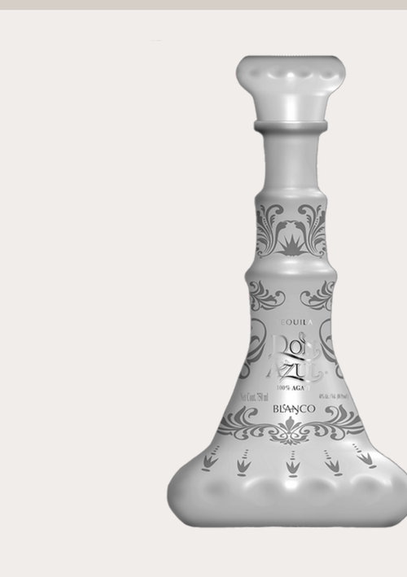
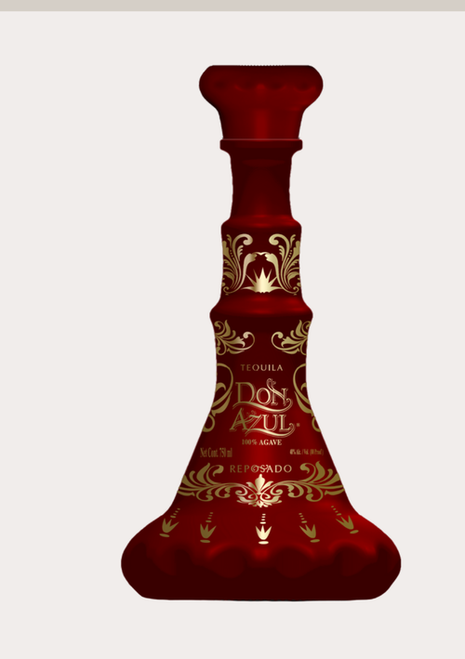
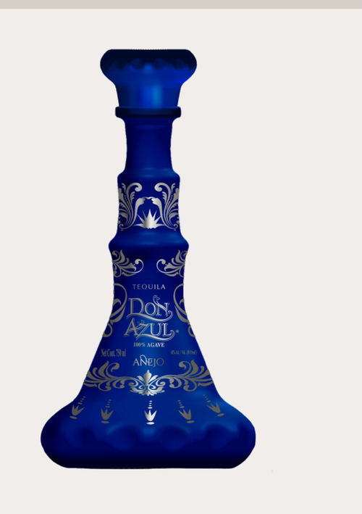
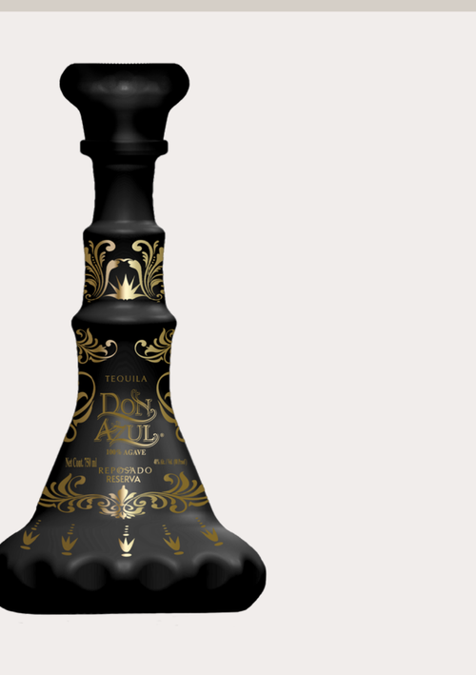
THE PRODUCT
Four Premium Expressions — One Unified Brand Vision
BLANCO
REPOSADO
AÑEJO
RESERVA
Premium
Premium
Premium
Reposado Reserve
Crystal clear. Agave-forward. Ultra-smooth. The entry to the Don Azul experience — unaged, pure Jalisco blue agave.
2–6 month oak aging. Rich, amber complexity. The brand's flagship expression — perfectly balanced for cocktails and sipping.
12+ month aging in American oak. Deep amber. Notes of vanilla, caramel, and dark agave. Ultra-premium sipping tequila.
The pinnacle. Extended aging, exclusive small-batch production. Positioned to compete with ultra-premium brands above $130.
DIST $39.99 MSRP $79.99
DIST $44.99 MSRP $99.99
DIST $58.99 MSRP $129.99
DIST $76.99 MSRP $139.99
Margin: 50%
Margin: 55%
Margin: 55%
Margin: 45%
Plant #1 Amatitan · Plant #2 Amatitan · Plant #3 Ayotlan — All Jalisco, Mexico · Prices verified by Kroger, Total Wine, Royal Caribbean, Norwegian Cruise Line, Gallo, Publix

Slide 4
COMPETITIVE ADVANTAGE
What Most Brands Spend Years & Millions to Build — Don Azul Already Has
RFC-Qualified Manufacturer
HOW WE COMPARE
✓
Fully registered, legally compliant Mexican entity — no risk of production shutdown
Don Azul
Avg Startup
✓
NOM / CRT Certification
Both production plants are Norma Oficial Mexicana and CRT certified — non-negotiable for import
Jalisco Mfg
✓
✗
✓
3 Production Facilities
Plants in Amatitan (×2) and Ayotlan, Jalisco — supply redundancy protects against single-source risk
CRT/NOM Cert
✓
✗
✓
Vetted Pricing Structure
4-SKU Ready
✓
✗
Distributor & MSRP pricing reviewed and approved by Kroger, Total Wine, Royal Caribbean, Gallo
✓
4-SKU Portfolio Ready
Vetted Pricing
✓
✗
Blanco, Reposado, Añejo, Reserva — full shelf presence from $34 to $140 MSRP
✓
U.S. Import Pathway
US Structure
✓
Pending
Bank-to-bank SWIFT to Don Azul Group LLC (Florida, USA) — clean U.S. corporate structure
Cross-Border Network
Buyer Network
✓
✗
✓
Mexausa Food Group: active Mexico–US–LATAM corridor, 3,000+ buyer relationships

Slide 5
UNIT ECONOMICS
Real Numbers — Verified Pricing as of May 2026
Expression
Vol
Btls/Case
Dist/Bottle
MSRP/Bottle
Dist/Case
Gross Margin
DON AZUL PREMIUM
Blanco Premium
750ml
6
$39.99
$79.99
$239.94
50%
Reposado Premium
750ml
6
$44.99
$99.99
$269.94
55%
Añejo Premium
750ml
6
$58.99
$129.99
$353.94
55%
Reposado Reserva
750ml
6
$76.99
$139.99
$461.94
45%
GENERACION XXI ORGANIC
Blanco Organico
750ml
6
$40.89
$69.99
$245.34
42%
Reposado Organico
750ml
6
$47.99
$81.99
$287.94
41%
Añejo Organico
750ml
6
$58.99
$98.99
$353.94
40%
DON AZUL MAYA
Blanco Maya 100% Agave
750ml
12
$18.99
$33.99
$227.88
44%
Reposado Maya 100% Agave
750ml
12
$19.99
$35.99
$239.88
44%
Source: Don Azul Group LLC — Distributor pricing sheet May 13, 2026. Ex-works Amatitan & Ayotlan, Jalisco, Mexico. · Pricing reviewed by Kroger, Total Wine, Royal Caribbean, Norwegian Cruise Line, Gallo, Publix.

Slide 6
GO-TO-MARKET
Phased U.S. Expansion — California to National
01
PHASE ONE
02
PHASE TWO
03
PHASE THREE
Year 1 — 2026/2027
Year 2 — 2027/2028
Year 3+ — 2028+
California Launch
Texas & Southwest Expansion
National & International
MARKETS
MARKETS
MARKETS
· San Diego / Baja Corridor
· Houston / Austin / Dallas
· Nationwide U.S. Distribution
· Los Angeles / Orange County
· San Antonio / El Paso
· Duty Free — U.S. Airports
· Monterey County / Salinas
· Phoenix / Las Vegas
· Cruise Lines (Royal Caribbean, NCL)
· Bay Area Fine Dining
· Florida — Miami / Orlando
· European & LATAM Markets
CHANNELS
CHANNELS
CHANNELS
· Independent liquor stores
· Regional distributor agreements
· National distributor partner
· Premium restaurant accounts
· Total Wine partnership
· Duty Free of Americas
· Agricultural industry events
· Kroger / H-E-B program
· Direct hospitality contracts
· Hispanic consumer events
· Casino & hospitality
· Export to Europe/Asia
25,000–50,000 Cases
75,000–125,000 Cases
200,000+ Cases

Slide 7
FINANCIAL PROJECTIONS
Revenue Potential Based on Verified Distributor Economics
KEY METRICS (Conservative Case)
Year
Volume
Revenue
Gross Profit
GM%
Year 1
50K cases
$3.0M
$1.35M
45%
Year 2
125K cases
$7.5M
$3.4M
45%
Year 3
250K cases
$15.0M
$6.75M
45%
Year 4
450K cases
$28.0M
$12.6M
45%
Year 5
750K cases
$48.0M
$21.6M
45%
Based on: avg selling price $60/case blended across SKUs. Gross margin 45–55% by expression. Conservative case — 40ft container = 20 pallets × 360 cases.

Slide 8
USE OF FUNDS
$5M — $10M Growth Capital Allocation
35%
25%
15%
10%
10%
Inventory & Production
Sales & Distribution
35%
25%
Initial containers, 3 SKU families. 60% on PO approval, 40% before loading.
U.S. sales director, CA & TX market managers, distributor agreements.
Brand & Marketing
Distribution Infrastructure
15%
10%
Bottle photography, brand activation, social, trade events, hospitality.
U.S. warehouse, bonded logistics, import compliance, TTB approvals.
Working Capital
Legal & IP
10%
5%
18-month operating runway. Logistics, freight, duties, cash-flow timing.
Trademark filings, import agreements, investor documentation, RFC/CRT.
TOTAL RAISE: $5,000,000 — $10,000,000 USD · Mexausa Food Group, Inc. · mexausafg.com

Slide 9
LEADERSHIP & STRATEGIC ASSETS
Cross-Border Expertise. Built Infrastructure. Ready to Scale.
PLATFORM & DISTRIBUTION ASSETS
SG
Saul Garcia
Strategic Capital Representative
MFG
AuditDNA Platform
EB
EnjoyBaja Real Estate
Mexausa Food Group, Inc.
65,000+ verified agricultural contacts. Live CRM. Buyer-grower intelligence across USA, Mexico, LATAM.
Active Baja California luxury market. Hospitality relationships for on-premise tequila placement.
Cross-border trade — U.S. · Mexico · LATAM
NMLS #337526 — Mortgage Banking & Real Estate
Agriculture intelligence platform (AuditDNA)
3,000+ verified buyer/grower network
WL
WeLink Network
DA
Don Azul Group LLC
SAM.gov registered — Federal contractor
Anonymous buyer-grower matching. 3,000+ verified produce buyers = premium spirits buyers.
Florida entity. U.S. receiving structure for SWIFT bank transfers from Jalisco plants.
Agri-Maxx wholesale rights — Mexico, C. & S. America
Tequila brand development since 2024

Slide 10
EXIT STRATEGY & INVESTOR RETURNS
Multiple Paths to Liquidity — Premium Tequila Is Highly Acquirable
Strategic Acquisition
Private Equity Recap
Diageo paid $1B for Casamigos (2017). Brown-Forman acquired brands at 3–5× revenue. Premium tequila continues attracting major spirits group acquisitions.
PE firms specializing in spirits (Constellation, Pernod, Suntory) actively seeking proven brands with distribution infrastructure. Target: $50M–$200M enterprise value.
5×–15× Revenue Multiple
3×–8× EBITDA Multiple
Brand Portfolio Roll-Up
International Licensing
Don Azul becomes anchor brand in a multi-SKU spirits portfolio — Blanco, Reposado, Añejo, Reserva, plus potential mezcal extension under the same production network.
Duty Free of Americas, cruise lines (Royal Caribbean, Norwegian), and European import partnerships established. License brand to regional operators for royalty income.
Platform Valuation Premium
Recurring Royalty Revenue
RECENT COMPARABLE TRANSACTIONS
Casamigos → Diageo $1B (2017) · 818 Tequila (Kendall Jenner) — Moët Hennessy stake · Código 1530 — Constellation Brands · El Tesoro — Beam Suntory · Tequila Herradura — Brown-Forman

Slide 11
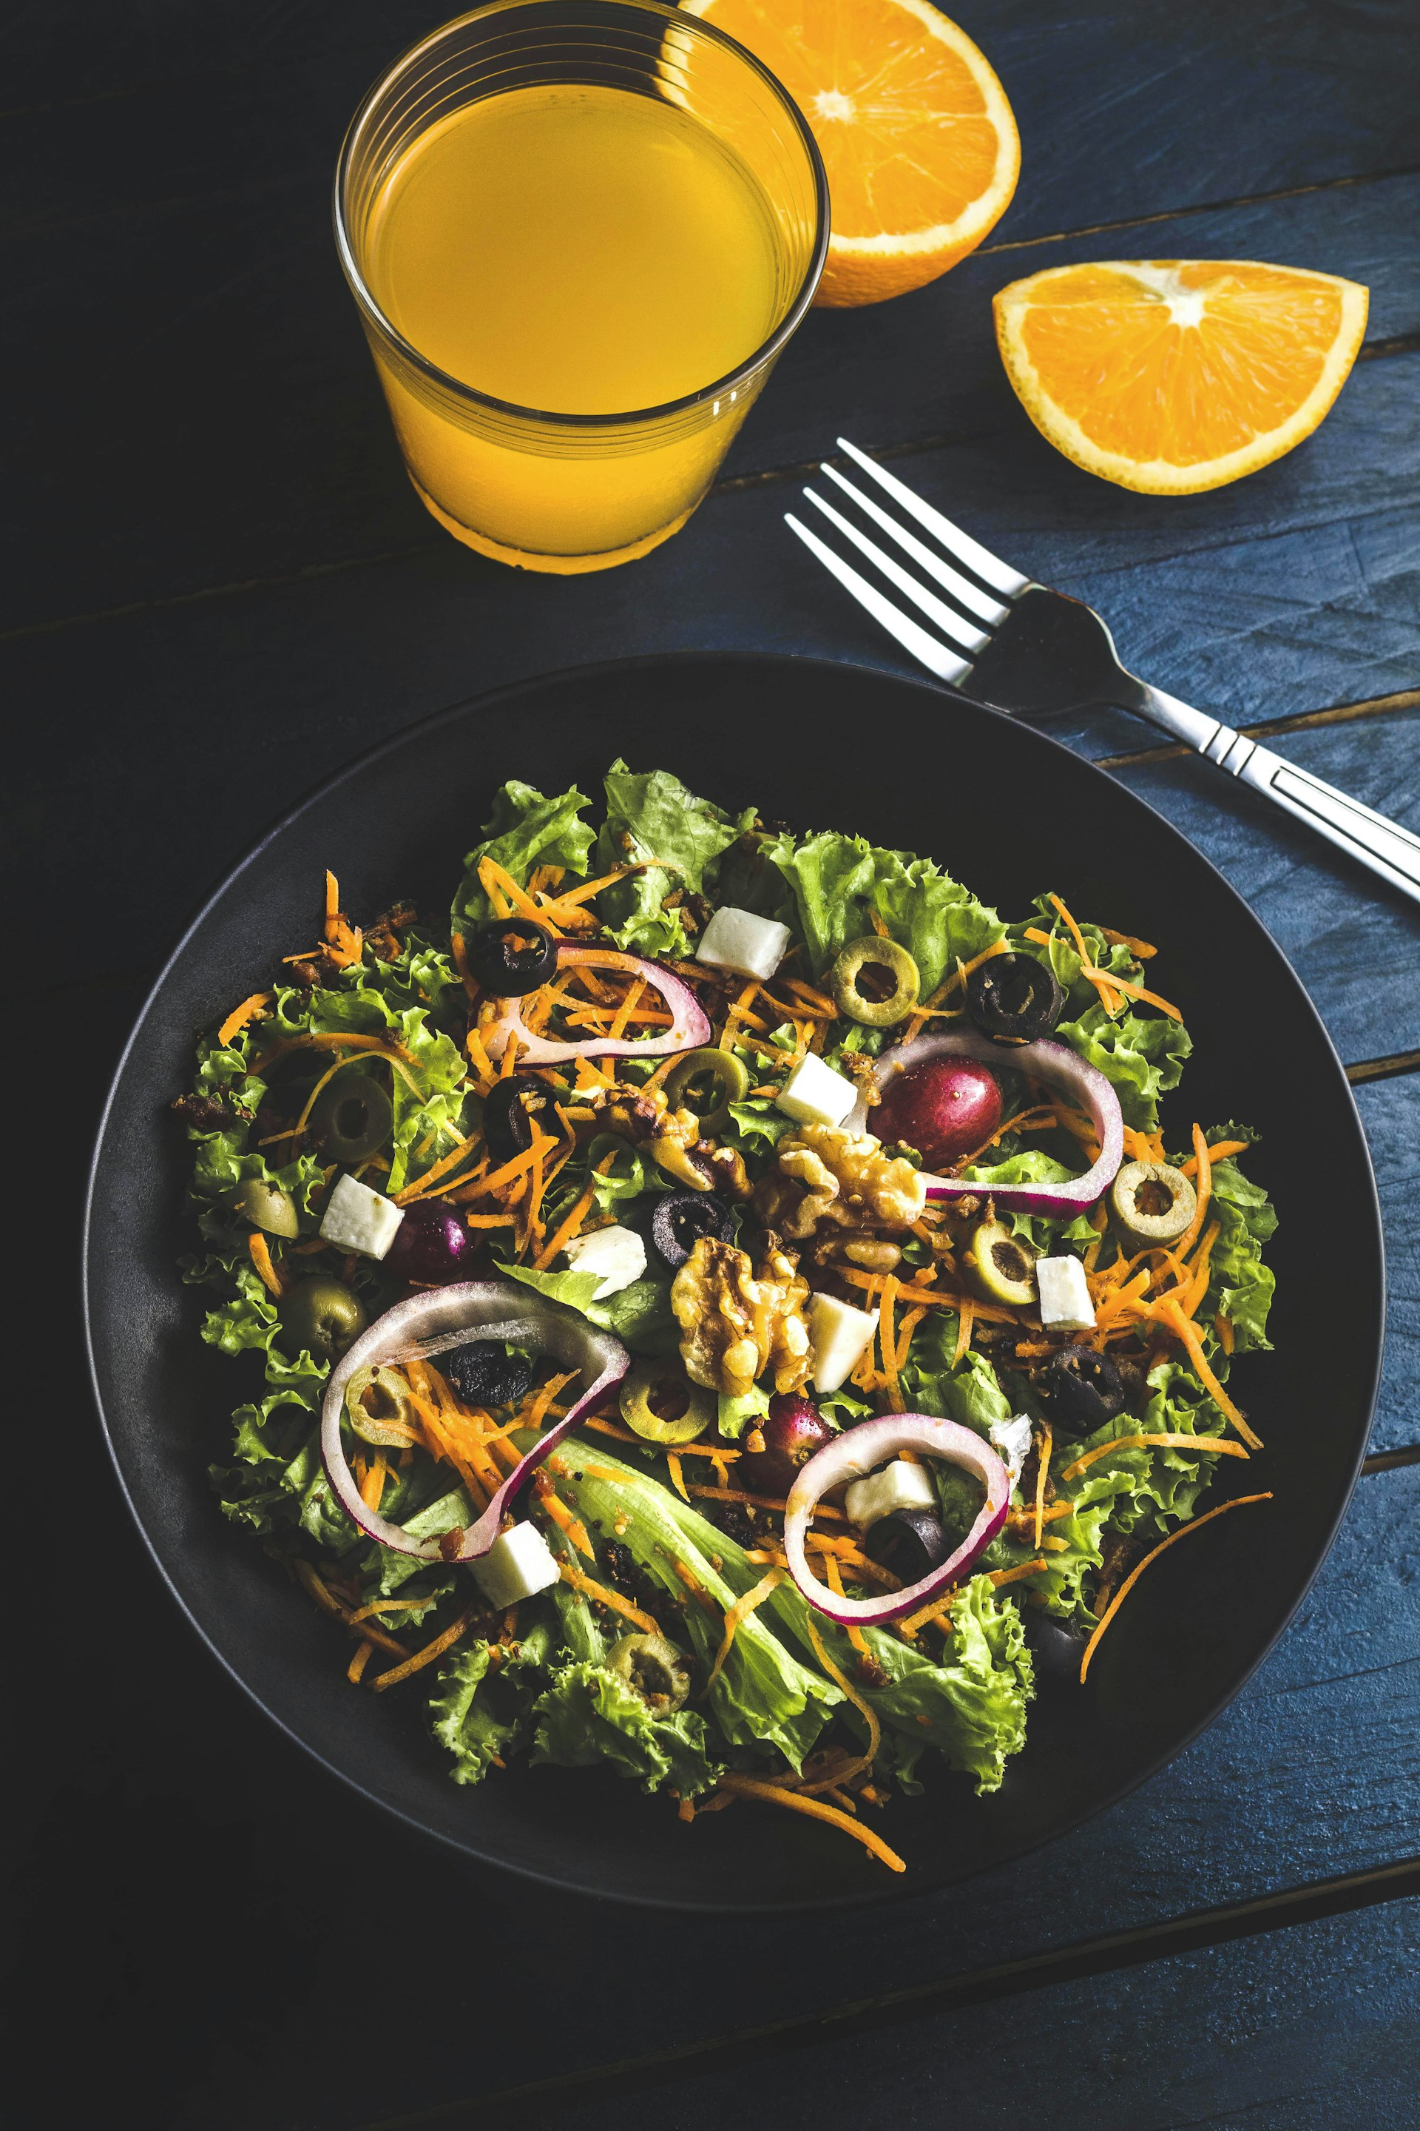
READY TO INVEST IN
THE NEXT PREMIUM
TEQUILA BRAND?
Mexausa Food Group, Inc. is seeking $5M–$10M in growth capital to launch Don Azul Tequila
into the California and national U.S. market with a vetted Jalisco manufacturer and full product line.
CONTACT
Saul Garcia — Strategic Capital Representative
sgarcia@mexausafg.com · +1 (831) 251-3116
mexausafg.com · donazultequila.com
CONFIDENTIAL — FOR AUTHORIZED RECIPIENTS ONLY — MEXAUSA FOOD GROUP, INC. — 2026

