Slide 1
DTM architecture
a very brief version

Slide 2
What is motr?
S3 client
GET, PUT (HTTP)
s3 object data
buckets, users,
acls, attributes
S3 server
motr api calls
libmotr
motr rpc
motr object data
key-value pairs
ios
cas
io service
dix service
io service
dix service

Slide 3
Meta-data layout: (1+K)/P
S3 server
K
V
libmotr
K
V
C
K
V
C
K
V
C
K
V
C
cas
cas
cas
cas
cas
cas

Slide 4
Data-layout, (N+K+S)/P
S3 server
D
D
libmotr
D
D
P
C
C
C
D
P
D
C
C
C
ios
ios
ios
ios
ios
ios
md
md
md
md
md
md

Slide 5
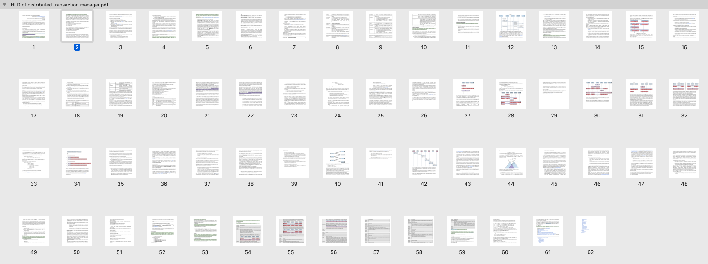
What is DTM?
It’s a distributed transaction manager…

Slide 6
Distributed transactions
Group multiple operations (like key-value record insertion in a replica) into transactions.
Transactions are atomic in the presence of failures:
Node or server restarts
Network partitions
But not all failures (permanent hardware loss is handled separately)
Guarantee that the system recovers to a consistent state (all-or-nothing)
Simplifies error handling
Not ACID

Slide 7
What is DTM, again?
The simplest way to think about it:
Reliable cluster-wide log replay mechanism
DTM on each motr instance (server and client) keeps log (FOL)
FOL records operations this instance is a part of:
Object writes
Meta-data creation (buckets, s3 objects)
Meta-data updates (object, bucket deletion)
When a server fails and restarts, other nodes replay their logs to complete potentially incomplete operations
Simple?

Slide 8
Multiple failures
3 servers: s0, s1 and s2
s2 fails and restarts
s2 gets PUT(key, value) from s0
s2 gets DEL(key) from s1
s2 must execute operations in the right order
This is possible because of previous failures
Can happen with completely synchronous server

Slide 9
Ordering
DTM orders operations using logical (vector) clocks
This is conceptually simple algorithm, but it requires book-keeping in logs
Guarantees: if the original order of operations was observed on any surviving node (including motr clients), replay will be done in this order
If original order hasn't survived anywhere, why care?

Slide 10
Clocks
Instead of logical clocks, use physical clocks
Assume clocks on s3 servers are loosely synchronised (within 1 sec)
Timestamp operations with CLOCK.CLIENTID
Always order operations by timestamp
Background log pruning
If abs(operation.CLOCK – server.CLOCK) > 5s: warning
If abs(operation.CLOCK – server.CLOCK) > 30s: return ELATE

Slide 11
What can go wrong?
An s3 server sends operation to motr, get ELATE, because of the clock drift
Do nothing: this is already legal in S3 (eventual consistency)
But: AWS just introduced strong consistency by default
Alternatively, repeat the operation with a later timestamp

Slide 12
Use cases
Node crashes and restarts in the middle of replicated meta-data modification (~minutes)
Node goes down for upgrade. Meta-data writes convert to degraded mode. When the node is back (~1hour) it has to catch up
Controller goes down (~1hour)...
Node goes down for catastrophic recovery (~days)
Network partition (router or NIC problem) (~seconds)
Network RAID repair

Slide 13
FOL uses
File operations log (FOL) is a central piece of motr
Log used by local transaction engine for recovery
Log used by DTM for distributed transaction recovery
Log used by FDMI for publish-subscribe
Can be used for global snapshots and rollbacks

