Slide 1
Seagull Framework
PhpCon Talk, December 2004
Demian Turner <demian@phpkitchen.com>
Michał Pawłowski <misza@weblab.com.pl>

Slide 2
Table of contents
Why use a framework and Seagull?
What does Seagull do?
Comunity
Seagull concepts
DB Support
PEAR usage
Demo
Performance

Slide 3
Why use a framework?
Workflow
Db abstraction
Class library integration
Form management
Component reuse

Slide 4
Why use a framework?
Is anybody in the audience a PHP beginner?
The result of using a framework is that 10–20% of the total code for a project is application specific, giving a huge reduction in code size, and improving readabilty and maintainability considerably.
Because it's useful to get standard foundations, the same way to build an app. It may be harder at the beginning but then everyone speaks the same language. It's a reason why Java is popular.

Slide 5
Why use Seagull?
Open Source project supported by a large developer community
Emphasis on usage of PEAR libraries
Use of design patterns

Slide 6






Community
Active Sourceforge project
15 Core developers
100 + People on 3 mailing lists
Wiki documentation project
62 users signed up
Range of skills

Slide 7
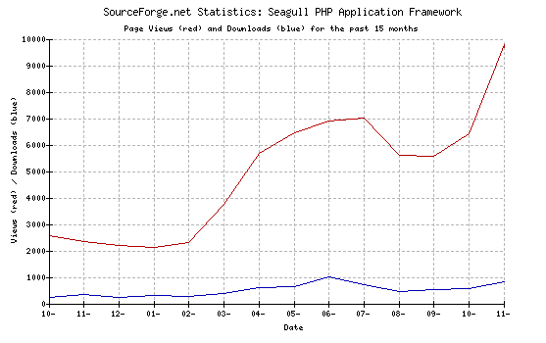
Sourceforge Growth

Slide 8
Refresher on OOP, design patterns
Why use OOP approach?
Frequently used patterns:
  Factory
  Singleton
  Template
  Composite
  Delegate

Slide 9
Introduction
What is Seagull?
  BSD licensed
  Translated into 16 languages
  Schemas provided for 4 DBs
  134, 931 LOC
  794 kb download with PEAR installer
Target audience
Notes:
MP licensing - DT

Slide 10
What does Seagull do?
Permissions handling and authentication
Facilitates team development environment
Internationalisation/localisation (demo)
Application config (demo)
Personalisation: preferences and themes
Cacheing and performance
Enhanced error handling

Slide 11
Seagull concepts
libs, modules, managers and controller
MVC, OOP, modular design
workflow:
  Validate
  Process
  Display

Slide 12
UML Overview
Seagull is built from a number of system objects
Overview diagram

Slide 13
System objects
Session
Config
DB
Cache
Preferences
User

Slide 14
DB Support
Support for MySQL, PostgreSQL, Oracle, MaxDB (mySAP)
Modified the way PEAR sequences work
Connection cacheing for multiple DSNs
Use of InnoDB foreign key constraints for data normalisation
http://seagull.phpkitchen.com/docs/wakka.php?wakka=DbQueryExamples
How many people use PEAR::DB?

Slide 15
Foreign Key Constraints
ALTER TABLE `role_permission`
ADD FOREIGN KEY (`role_id`)
REFERENCES `role` (`role_id`)
ON DELETE CASCADE;
User: roles, permissions, preferences
Typical user will have ~100 perms (10 modules, 10 actions each)

Slide 16
Demo/1
OBJECTIVE: Integrate new supplier, grant access to content management tools
  Create a new organisation
  Define the role of the new users

Slide 17
PEAR
Pros
Cons
High quality code base
Active peer review
Package manager
Responsive maintainers
Inconsistency of quality
Occasional package obesity

Slide 18
PEAR installable
Package generated with PEAR_PackageFileManager
Dependency resolution
Installable from remote source
Web-based wizard installer

Slide 19
Packages Used
Benchmark
Cache_Lite
Date
DB
DB_Pager
DB_DataObject
DB_NestedSet
HTML_Javascript
HTML_TreeMenu
HTML_Template_Flexy
Log
Mail
Net_UserAgent
PHPdocumentor
System
Text_Password
Text_Statistics
Validate

Slide 20
Demo/2
OBJECTIVE: Integrate new supplier, grant access to content management tools
  Use the module generator to create functionality
  Import users from CSV file
  Flexibility to change perms at role level
  Search for a particular user
  Change perms at user level

Slide 21
Performance
Without PHP cacheing or bytecode cache, around 12 reqs/sec
Typical configuration
  cpu: amd 1.4 Ghz
  ram: 512MB
  Apache/linux
  63 reqs/sec

Slide 22
Best practices: Standards
PEAR coding standards
Emphasis on library usage (see tutorials)
Profiling with Xdebug
Unit testing: SimpleTest
Self-generating documentation: phpDoc

Slide 23
Road Map
xml-rpc wizard for upgrading/installing modules like PEAR/webmin
separate core framework
write tests for all modules
3rd party application bridge
content versioning
increase db vendor support

Slide 24
Resources
Project homepage: http://seagull.phpkitchen.com
Documentation: http://seagull.phpkitchen.com/docs
SF project page: https://sourceforge.net/projects/seagull
Mailing list archive: http://marc.theaimsgroup.com/?l=seagull-general
PEAR packages: http://pear.php.net
Framework material: http://www.phpkitchen.com/index.php?topic=phpFrameworks
Xdebug: http://www.xdebug.org
PhpDocumentor: http://www.phpdoc.org
SimpleTest: http://www.lastcraft.com/simple_test.php
Kcachegrind: http://kcachegrind.sourceforge.net/cgi-bin/show.cgi
PEAR tutorials: http://www.phpkitchen.com/staticpages/index.php?page=2003041204203962

Slide 25
Profiling / 1
Typical Xdebug trace file output, cachegrind.out.2193401842:
version: 0.9.6
cmd: /usr/local/apache/htdocs/seagull/www/prefsUser.php
part: 1
events: Time Memory
fl=php:internal
fn=php::function_exists
0 378 16
fl=php:internal
fn=php::phpversion
0 38 0

Slide 26
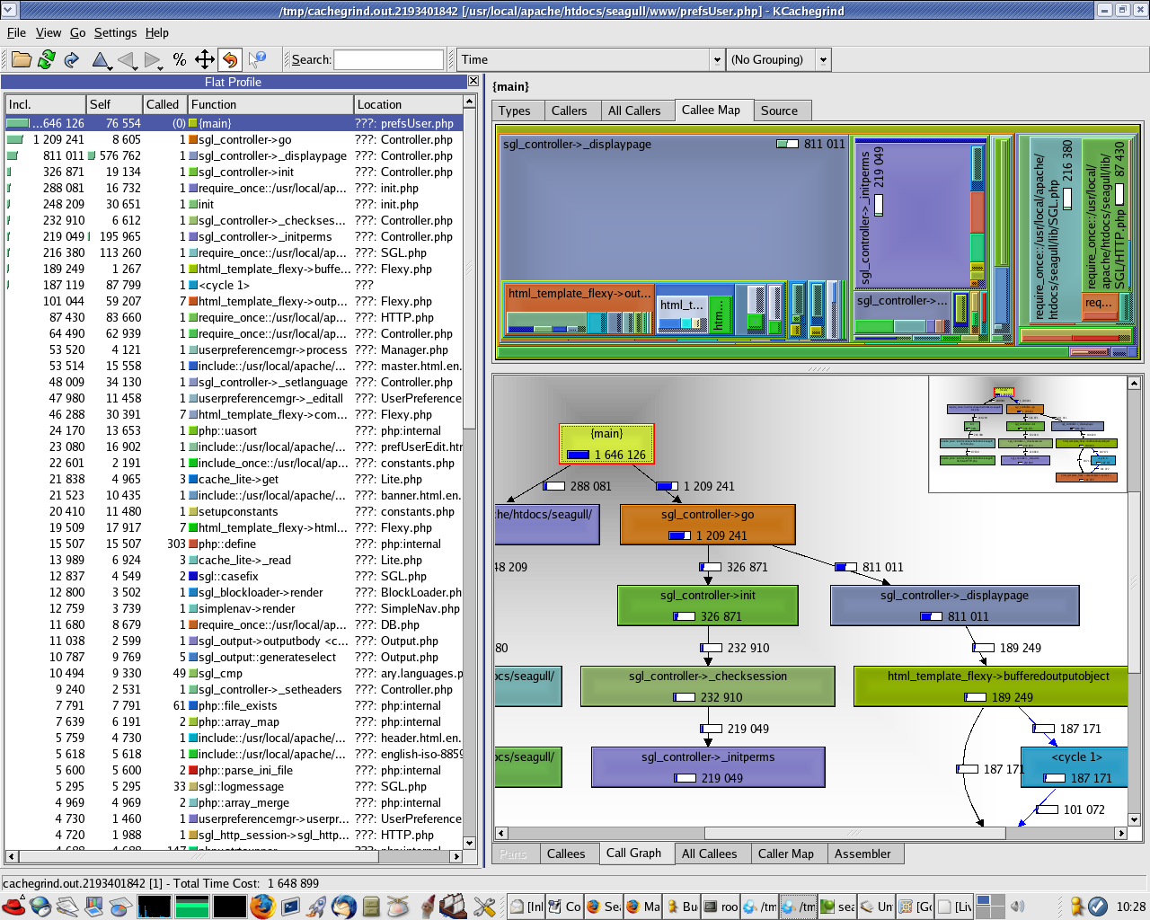
Profiling / 2

Slide 27
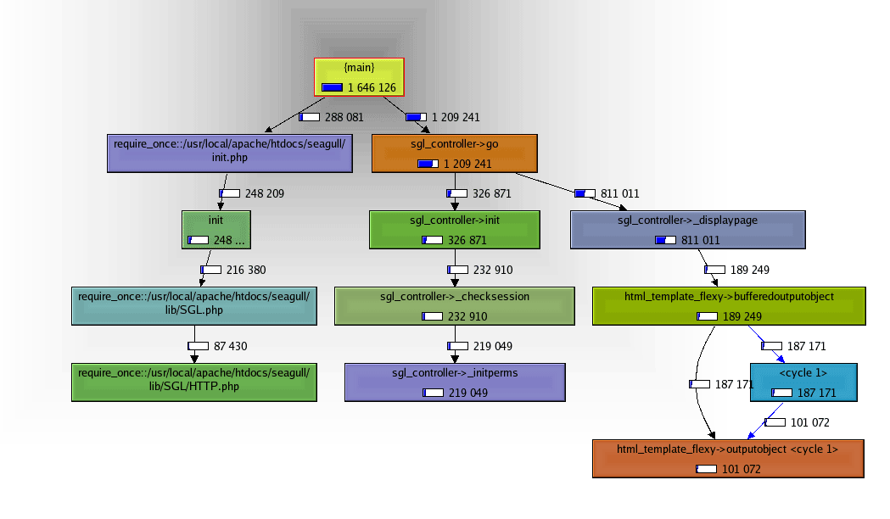
Profiling / 3

Slide 28
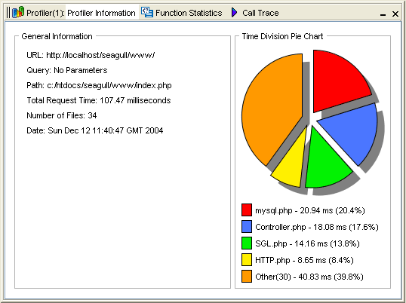
Profiling / 4
Notice the number of files per request, with caching this reduces to about 20

Slide 29
Questions?

Slide 30
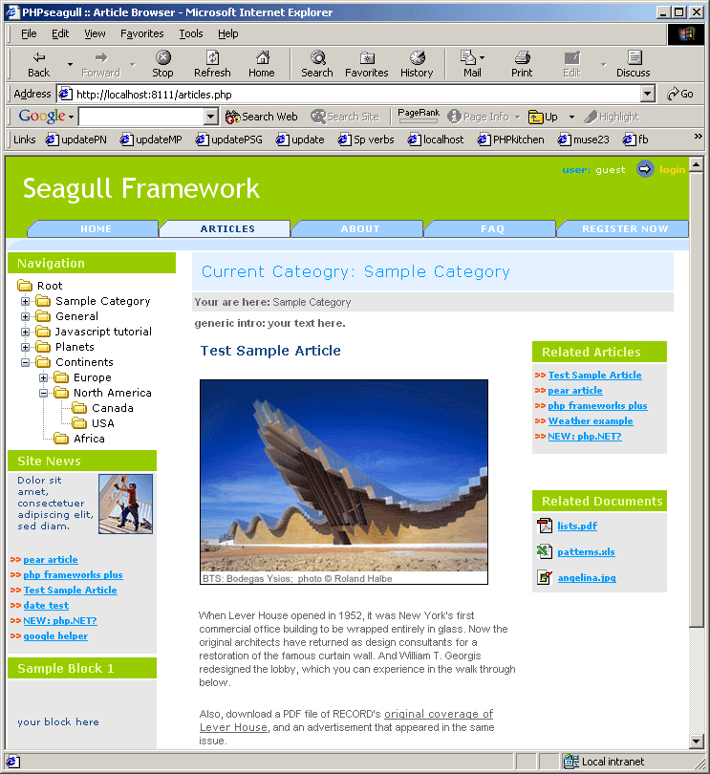
Figure 1: Typical screen

Slide 31
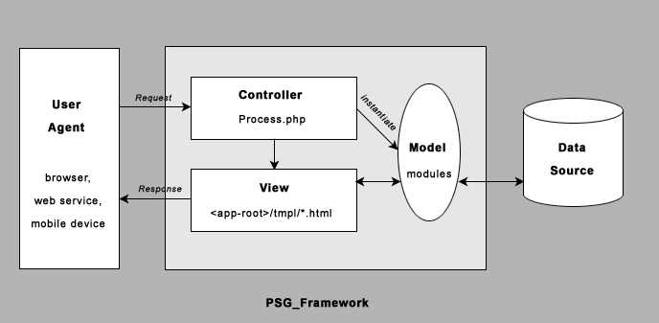
Figure 2: MVC

Slide 32
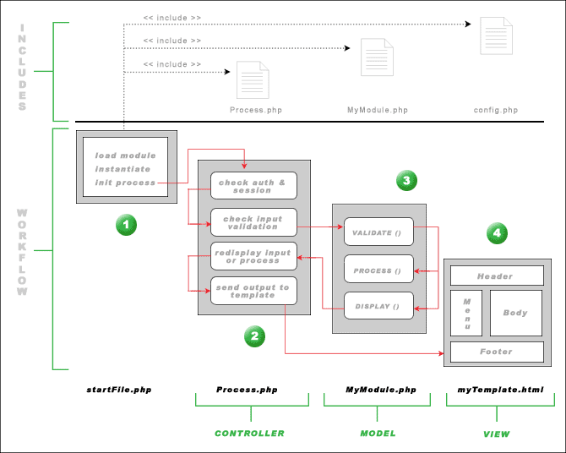
Figure 3: Workflow

Slide 33
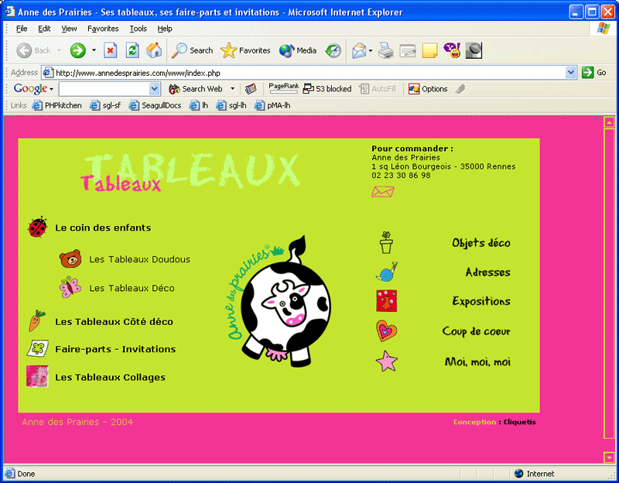
Projects using Seagull/1

Slide 34
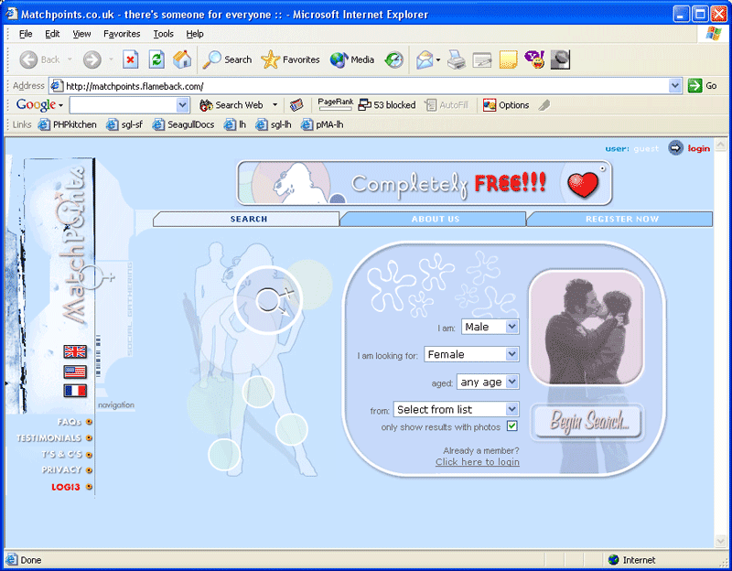
Projects using Seagull/2

Slide 35
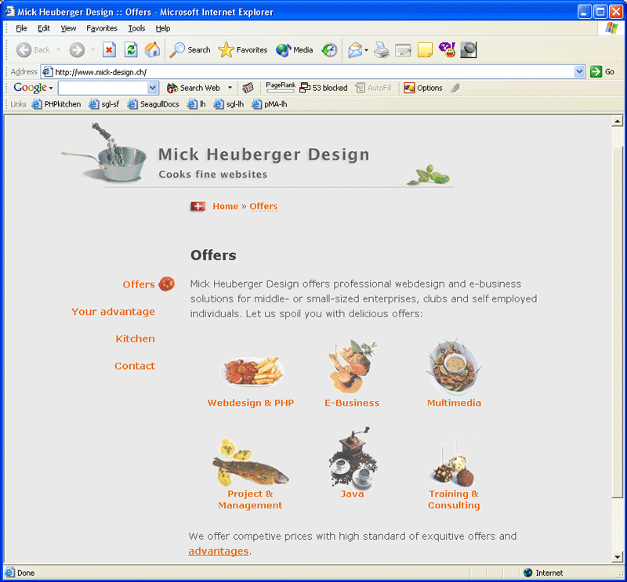
Projects using Seagull/3

Slide 36
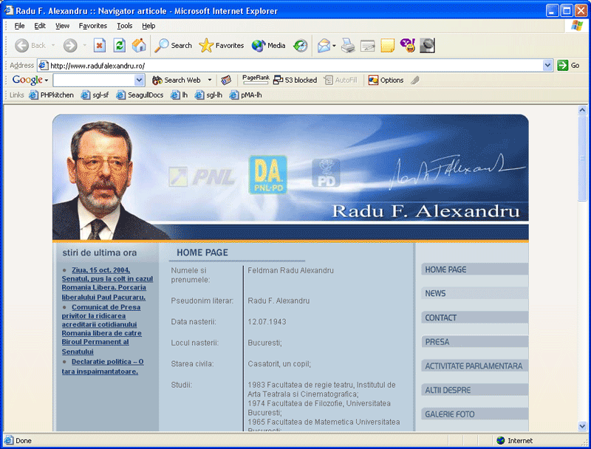
Projects using Seagull/4

Slide 37
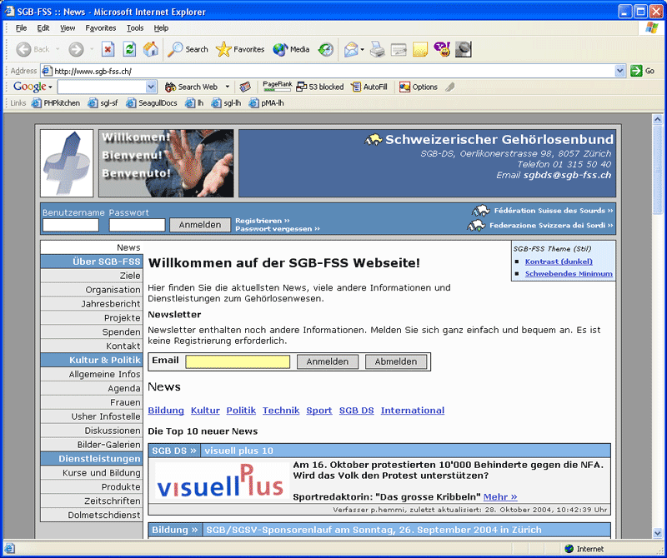
Projects using Seagull/5

Slide 38
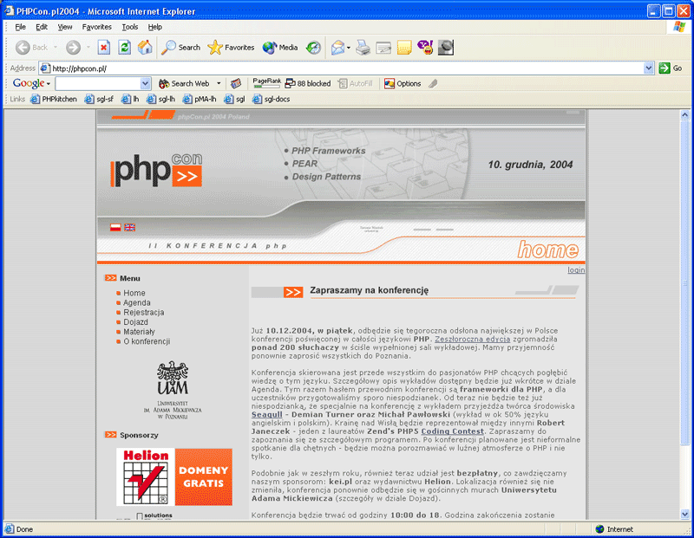
Projects using Seagull/6

Slide 39
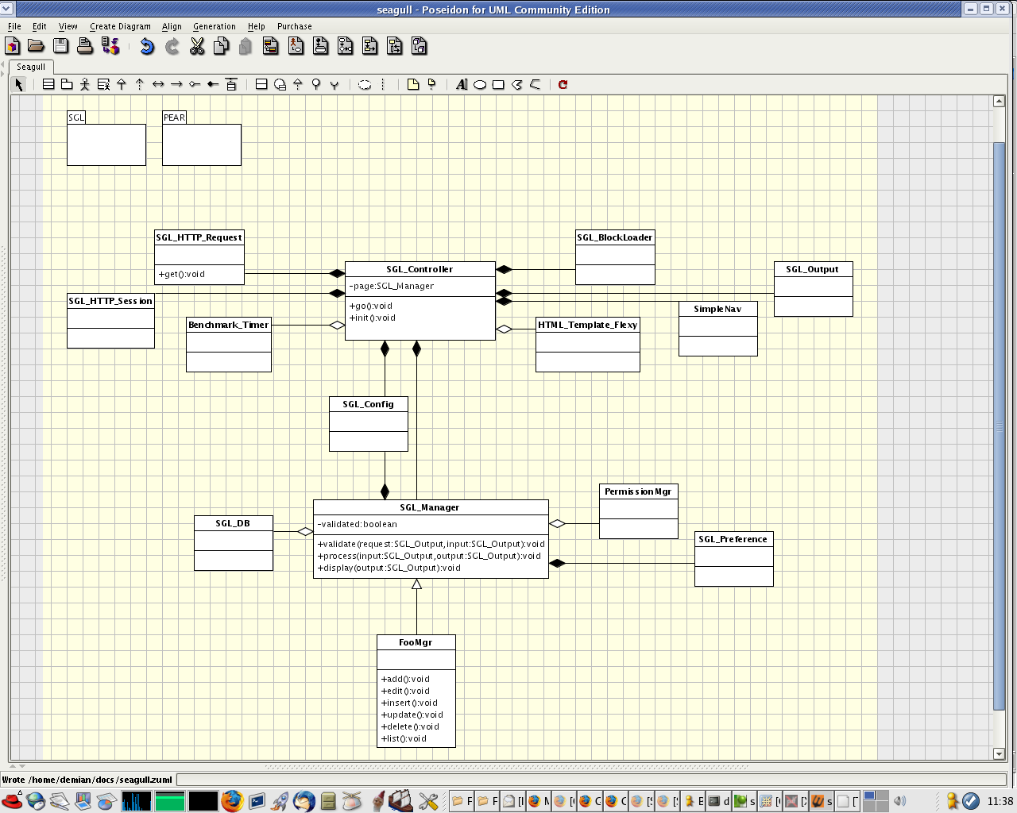
UML Class Diagram

