Slide 1
Seagull Application Framework
PhpLondon Talk, November 2004
Demian Turner <demian@phpkitchen.com>

Slide 2
Introduction
What is Seagull?
  1 year at Sourceforge, monthly releases
  100 developers on mailing list
  BSD licensed
  Translated into 16 languages
  134, 931 LOC
  794 kb download with PEAR installer
Project goals
Target audience
Background

Slide 3
Why use a framework?
The result of using a framework is that 10–20% of the total code for a project is application specific, giving a huge reduction in code size, and improving readabilty and maintainability considerably.
Because it's useful to get standard foundations, the same way to build an app. It may be harder at the beginning but then everyone speaks the same language. It's a reason why Java is popular.

Slide 4
What does Seagull do?
Permissions handling and authentication
Facilitates team development environment
Internationalisation/localisation
Application config
Personalisation: preferences and themes
Cacheing and performance
Simplified error handling

Slide 5
What does Seagull do? /cont.
Workflow
Db abstraction
Class library integration
Form management
Data validation
Component reuse

Slide 6
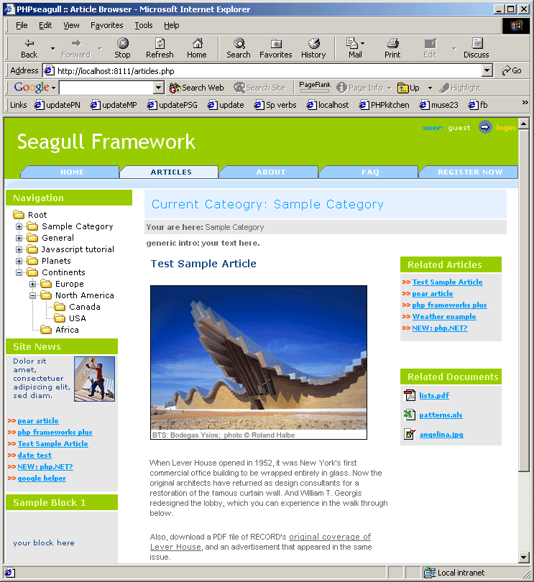
Figure 1: Typical screen

Slide 7
Refresher on OOP, design patterns
Why use OOP approach?
Benefits of MVC workflow
Frequently used patterns:
  Factory
  Singleton
  Template
  Delegate

Slide 8
PEAR
Pros
Cons
High quality code base
Active peer review
Package manager
Responsive maintainers
Inconsistency of quality
Occasional package obesity

Slide 9
Packages Used
Benchmark
Cache_Lite
Date
DB
DB_Pager
DB_DataObject
DB_NestedSet
HTML_Javascript
HTML_TreeMenu
HTML_Template_Flexy
Log
Mail
Net_UserAgent
PHPdocumentor
System
Text_Password
Text_Statistics
Validate

Slide 10
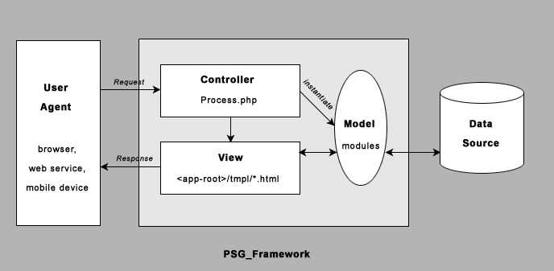
Figure 3: MVC

Slide 11
Seagull concepts
MVC, OOP, modular design
libs, modules, managers and controller
workflow:
  Validate
  Process
  Display

Slide 12
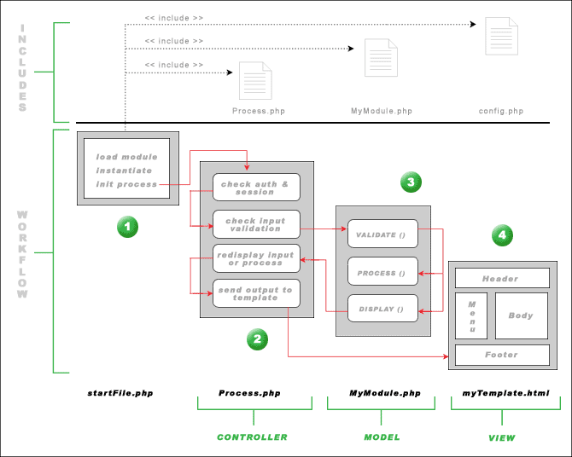
Figure 3: Worflow

Slide 13
System objects
Session
Config
DB
Cache
Preferences
User

Slide 14
Performance
Without PHP cacheing or bytecode cache, around 12 reqs/sec
Typical configuration
  cpu: amd 1.4 Ghz
  ram: 512MB
  Apache/linux
  63 reqs/sec

Slide 15






Community
Active Sourceforge project
15 Core developers
Mailing list
Wiki documentation project
Range of skills

Slide 16
Best practices
PEAR coding standards
library usage
unit testing: SimpleTest
template/business logic separation
security conscious
performance
self-generating documentation: phpDoc

Slide 17
Practical Example A
FAQ manager example (see http://muse23.com/cgi-bin/cvsweb.cgi/seagull/modules/faq/classes/FaqMgr.php)

Slide 18
Practical Example B
User manager example (see http://muse23.com/cgi-bin/cvsweb.cgi/seagull/modules/user/classes/UserMgr.php)

Slide 19
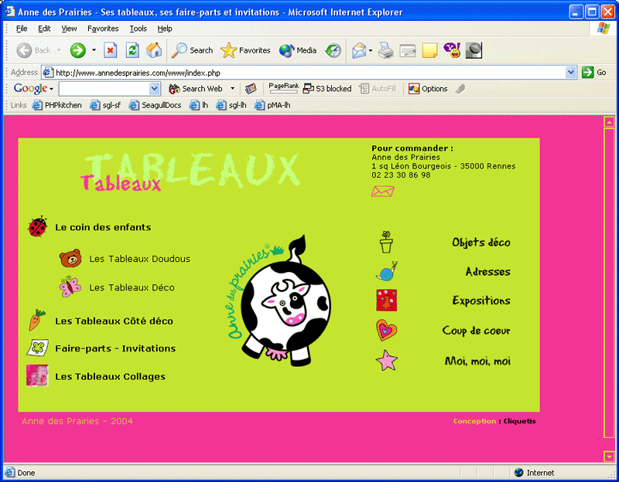
Projects using Seagull/1

Slide 20
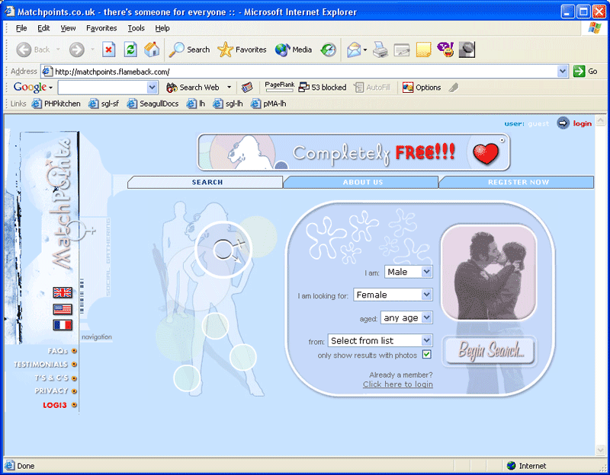
Projects using Seagull/2

Slide 21
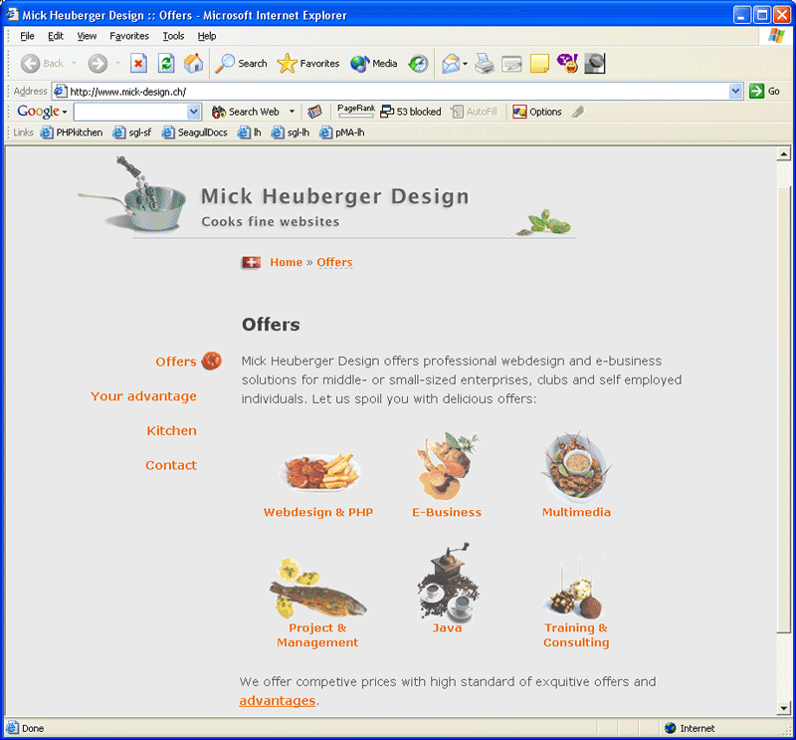
Projects using Seagull/3

Slide 22
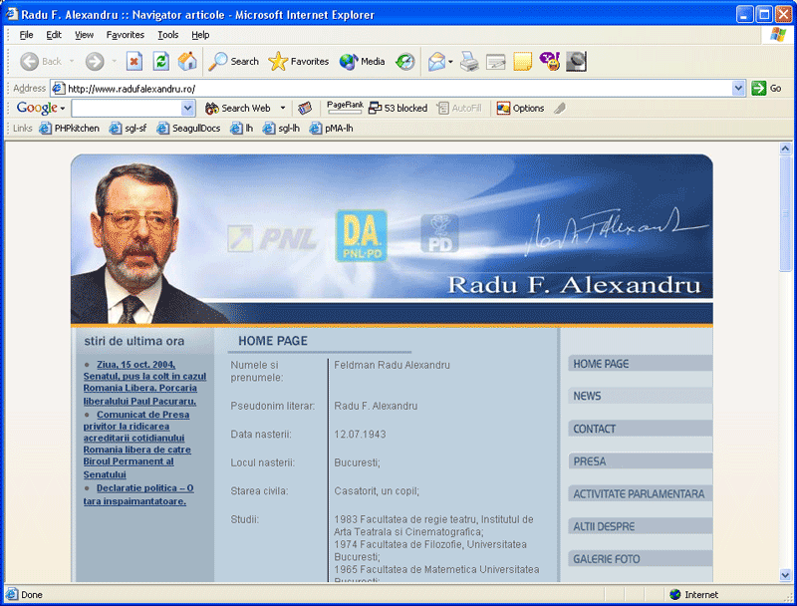
Projects using Seagull/4

Slide 23
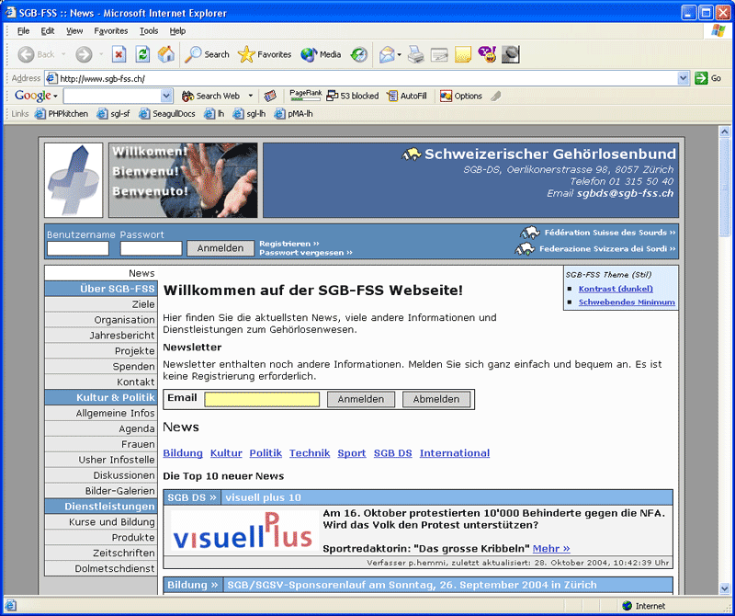
Projects using Seagull/5

Slide 24
Road Map
xml-rpc wizard for upgrading/installing modules like PEAR/webmin
separate core framework
write tests for all modules
3rd party application bridge
content versioning
increase db vendor support

Slide 25
Resources
http://seagull.phpkitchen.com
http://seagull.phpkitchen.com/docs
https://sourceforge.net/projects/seagull
http://marc.theaimsgroup.com/?l=seagull-general
http://www.phpkitchen.com/index.php?topic=phpFrameworks
demian@phpkitchen.com

Slide 26
Thank you

