Slide 1
Working with the Seagull Framework
  By Demian Turner, Seagull Systems

Slide 2
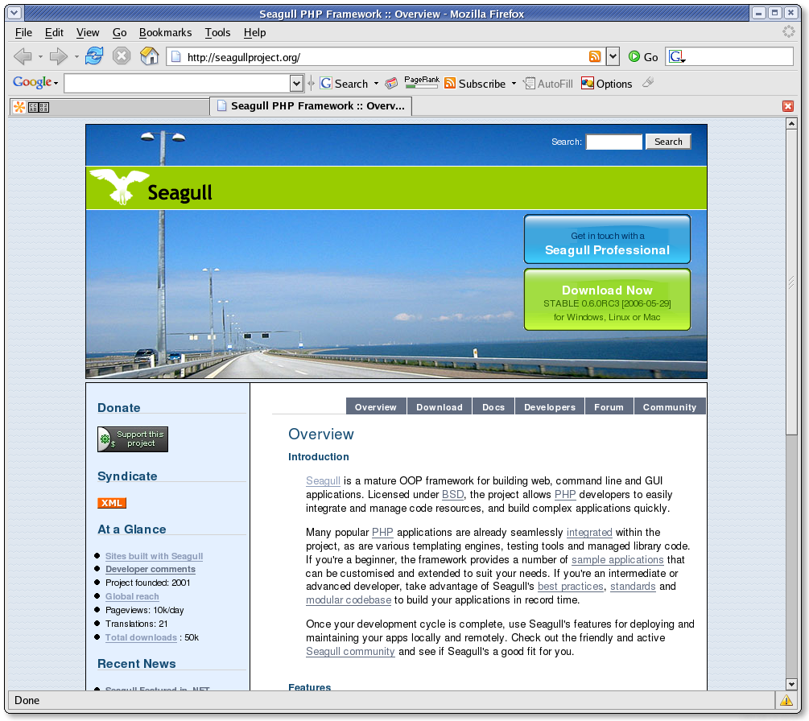
seagullproject.org

Slide 3
Who is Demian Turner?
Developing websites since 1996, using PHP since 1999
Committer on several open source projects: Seagull, SimpleTest, Max Media Manager
Involved in PEAR project submitting bug reports and bugfixes
Presented at and organised few conferences
Founding member of PHP-London

Slide 4
Seagull Project
Open Source framework project
Started in 2001
40 000+ downloads
1000 registered users in 72 countries
21 translations
Monthly releases for last 3 years
Approaching 1.0 release

Slide 5
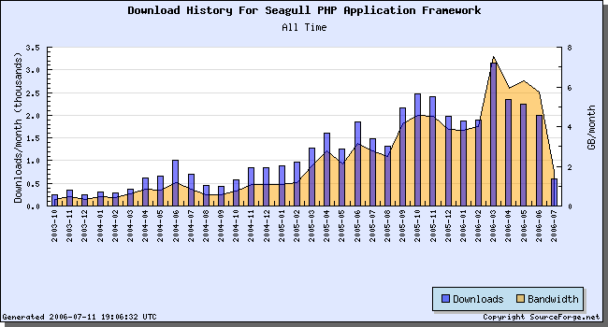
Downloads since 2003

Slide 6
What does Seagull do?
Rapid development toolkit
Framework tools and components
PHP 4/5 compatible
enterprise ready, scalable, performance conscious design
integration with PEAR libraries
User management tools: A & A
i18n, l10n
BSD licensed

Slide 7
Project values
Software Best practices
Coding standards
Web standards
OOP modular code
Exploit strengths of PHP while not pretending to be Java, Ruby, etc
Refactoring
Unit Testing
Agile/XP Methodology

Slide 8
Community
Mailing list
Trac/wiki
Forum
#seagull
Seagull Developer Network
http://frappr.com/seagull
http://seagullproject.org
http://seagullsystems.com

Slide 9
Why use a framework?
Do you have the sense you're cut and pasting a lot of code?
Are you grafting together bits of other peoples' solutions, ending up with a mish-mash of coding styles and approaches?
Have trouble getting new developers on the team up to speed with existing projects?
Problems dividing project tasks up amongst developers because there was code overlap?

Slide 10
Seagull framework features
Minimal requirements
Simple install
Modularity
Quality Control
Stability of codebase
Consistency and coding standards
Standards compliant
Multi platform/DB vendor support
Multiple input sources
Multiple output formats
Data validation
Front controller
Highly configurable
Third party integration
Skinable interface
Caching and performance
I18N, L10N
Authentication and authorisation
Specialised SQL data structures
Developer friendly
Designer friendly
Not developed in isolation
Open source advantage
Web based editing
Included modules

Slide 11
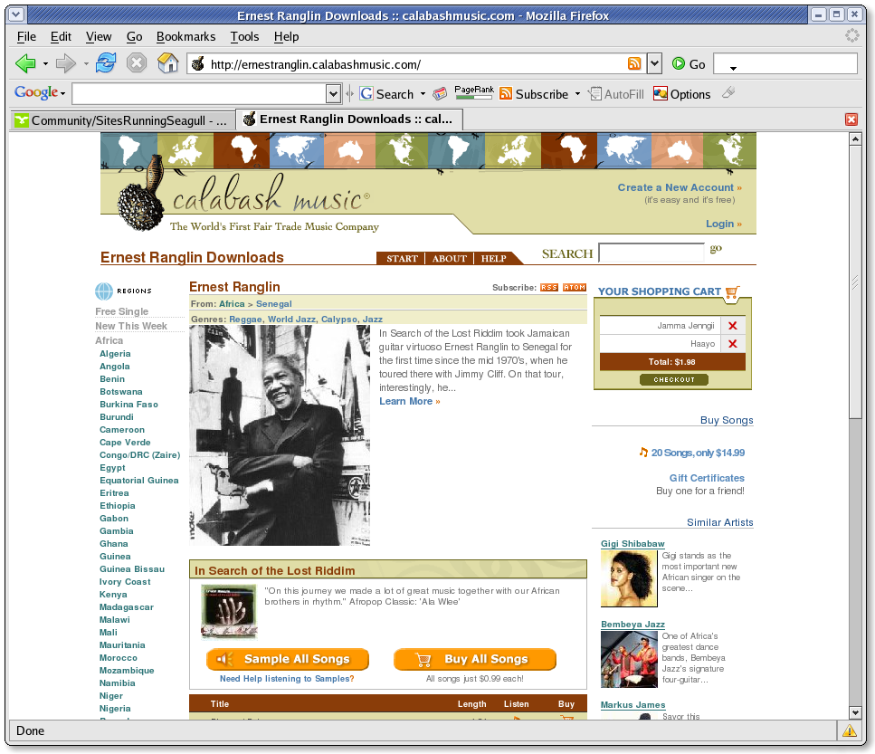
Example sites /1
http://ernestranglin.calabashmusic.com/

Slide 12
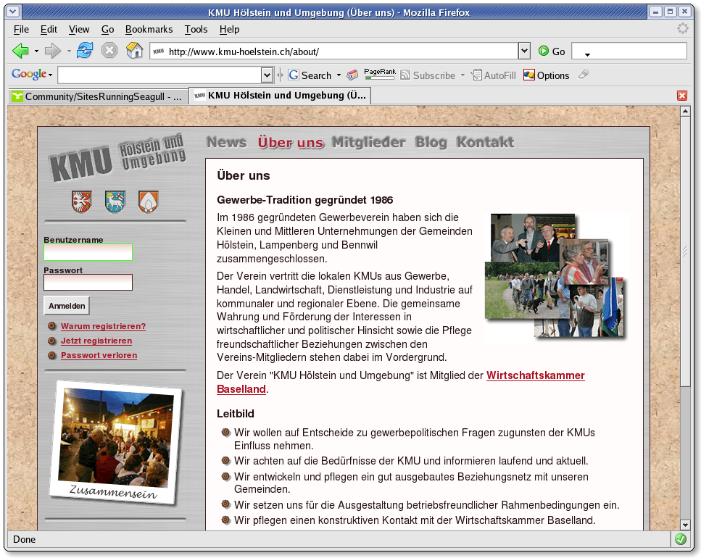
Example sites /2
http://www.kmu-hoelstein.ch/

Slide 13
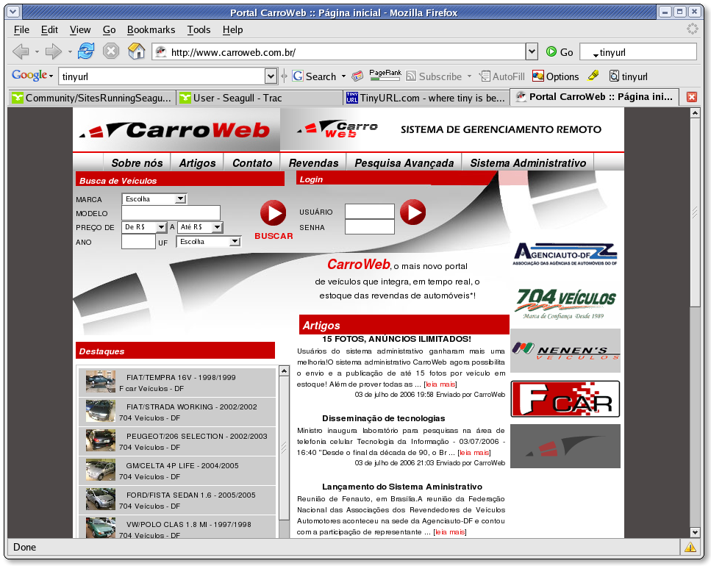
Example sites /3
http://www.carroweb.com.br/

Slide 14
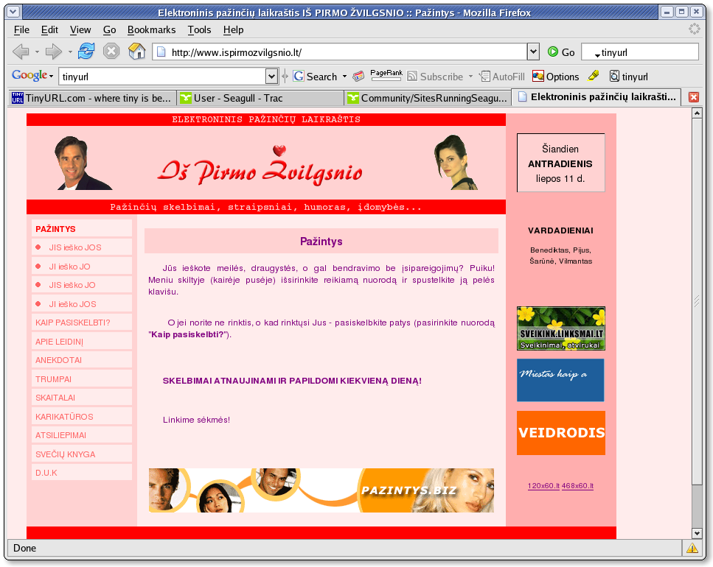
Example sites /4
http://www.ispirmozvilgsnio.lt/

Slide 15
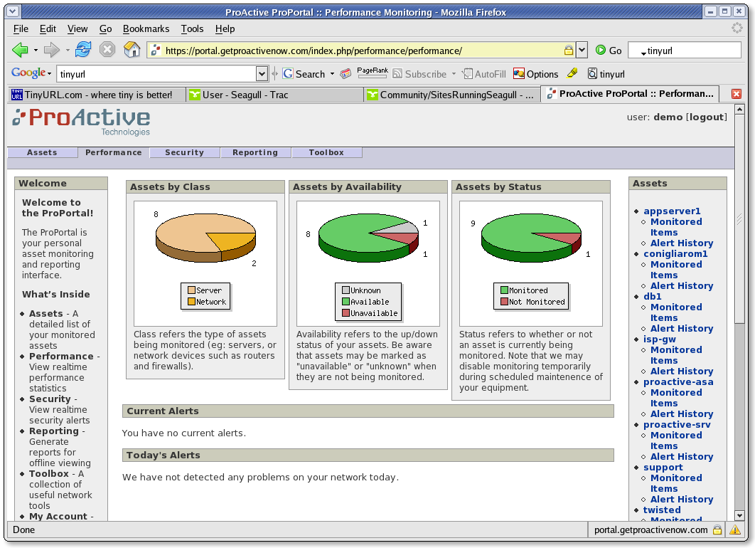
Example sites /5
https://portal.getproactivenow.com/index.php/performance/

Slide 16
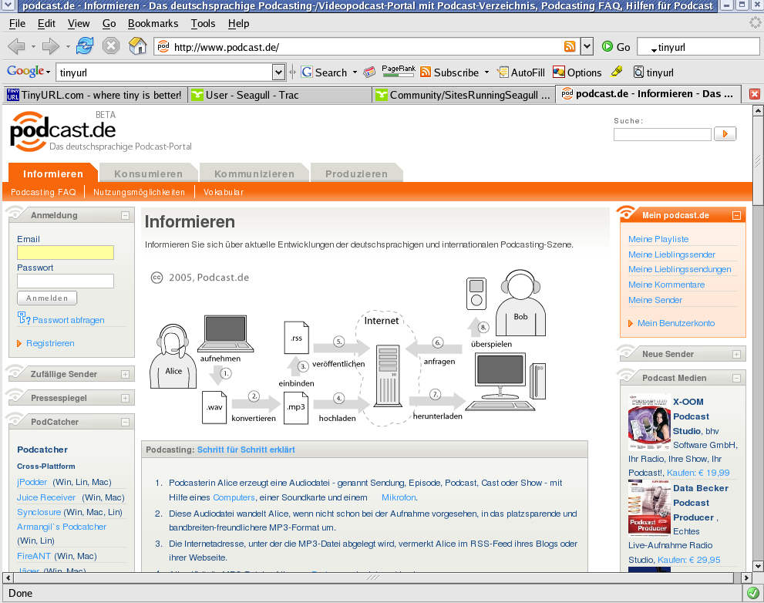
Example sites /6
http://www.podcast.de/

Slide 17
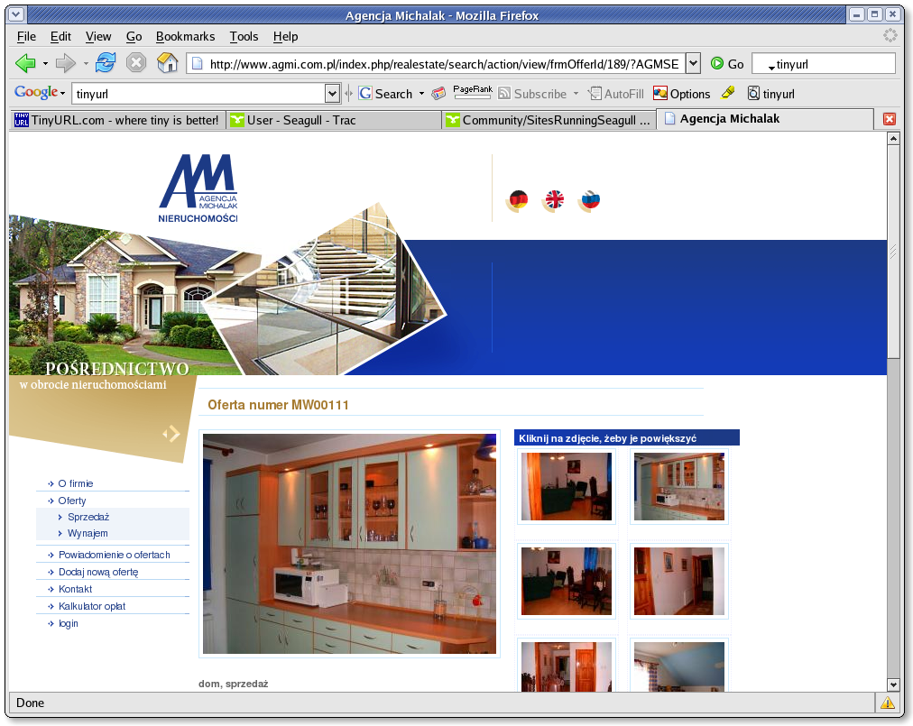
Example sites /7
http://www.agmi.com.pl/

Slide 18
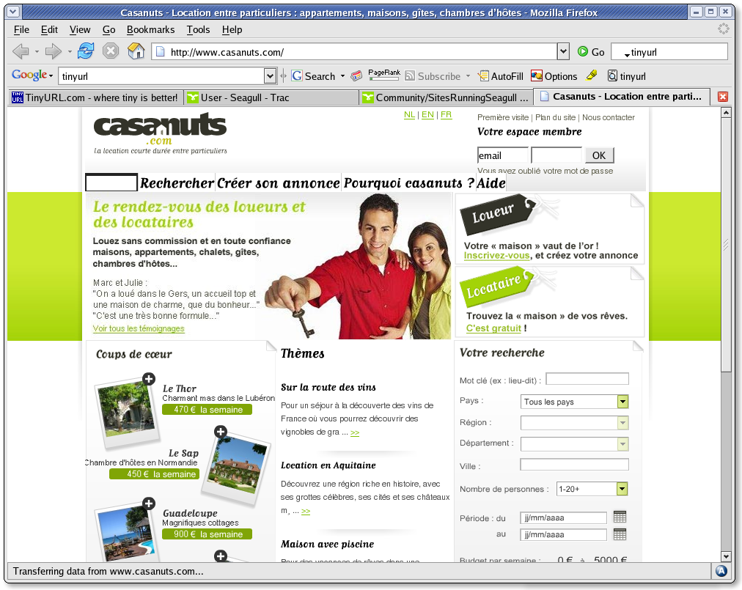
Example sites /8
http://www.casanuts.com/

Slide 19
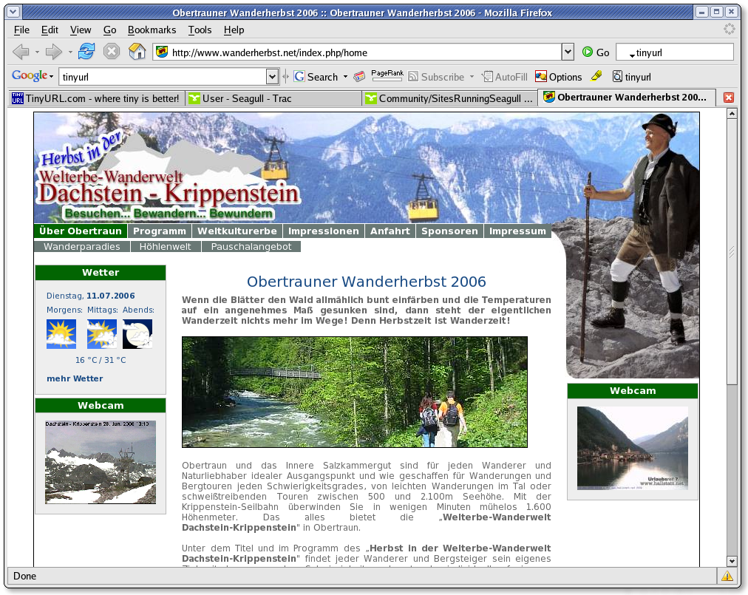
Example sites /9
http://www.wanderherbst.net/

Slide 20
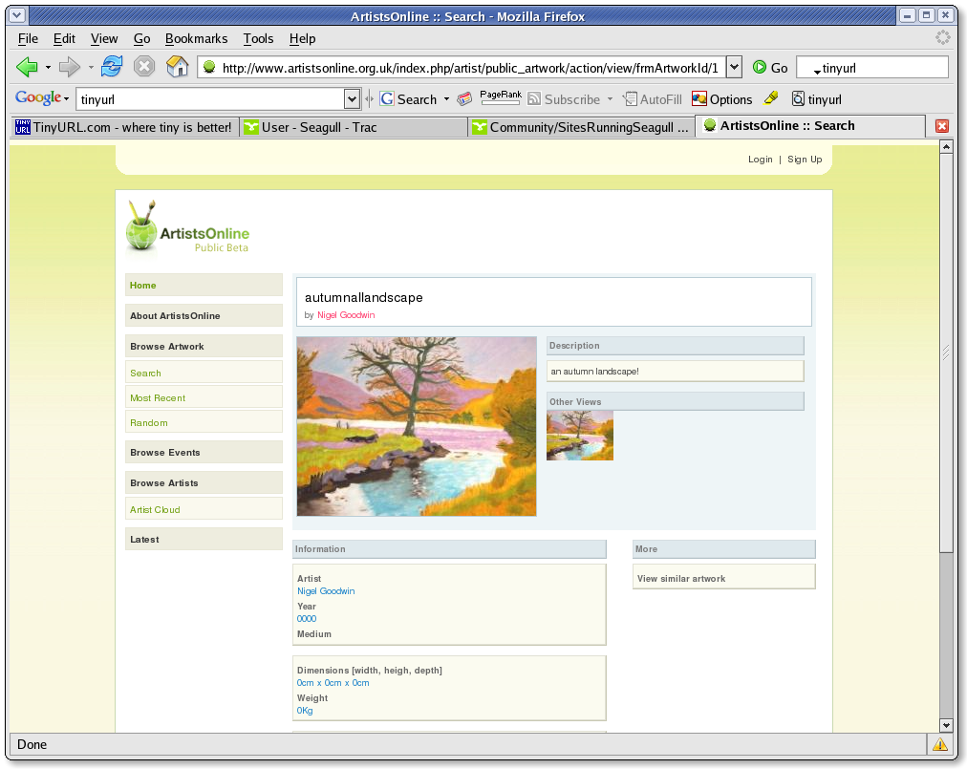
Example sites /10
http://www.artistsonline.org.uk/

Slide 21
Other example sites
http://www.c17.net/ - library application used by 530 libraries all over Spain
Power station monitoring app, Slovenia
http://tinyurl.com/s5utu Shoreditch TV, VOD app, UK

Slide 22
PEAR Integration
Project inspired by PEAR
Seagull acts as glue for PEAR components
PEAR Installer available since 2000
Useful for installing:
  PEAR packages
  Seagull application
  Seagull modules
44 PEAR libs currently bundled with Seagull
RAD spirit: focus on completing app ASAP
Don't reinvent the wheel

Slide 23
Other libraries
Seagull integrates favourably with well-designed libraries
Attention to namespacing, PHP coding standards
Recommended with:
  Zend Framework
  ezComponents

Slide 24
Testing
Simpletest package used by default
Built in test runner
Tests are easy and fast to develop
Encourage clean coding
TDD / XP
Web tests
Selenium
Example user module tests
Demo

Slide 25
Example Install
Install from svn
Using the installer
Default settings
Login as admin

Slide 26
Quick site example
Create homepage
About
FAQs
Contact Us
Register
Blocks

Slide 27
Seagull Concepts / Intro
  The Seagull project is a set of classes and suggested development approach that aims to make writing programs faster and easier. The belief is that by providing a methodology, and the tools required to handle arbitrary resources and workflow demands, the programmer can dedicate more time and energy to solving the key problems at hand, whether they are refining algorithms, imposing domain-specific logic, creating an attractive and user-friendly user interface, etc.

Slide 28
Seagull Concepts / Workflow
the program is initialised by executing an arbitrary list of tasks
the calling arguments, or request, are analysed and stored
a configurable set of filters are called on the program input (and later output)
the event implicit in the request is processed
Any observers listening to that event are triggered
the output is returned to the caller

Slide 29
Seagull Concepts / Tools
a taxonomy builder and nested set helper
configuration management
database abstraction
object relational mapping
object delegation
http upload/download helpers
an emailer
error management
filter management
front and application controllers
locale handling
configurable content objects
subject/observer mechanism
a parameter handler
a registry
request abstraction
session handling
string manipulation
task management
db and file-based translation tools
configurable URI parsing
a wizard helper

Slide 30
Library Organisation
Controllers – workflow
Core/PEAR libs – general
Tasks - mostly used to do setup tasks
Filters - modify the request and response objects as they pass through the filter chain
Detailed info: http://tinyurl.com/ou6p4

Slide 31
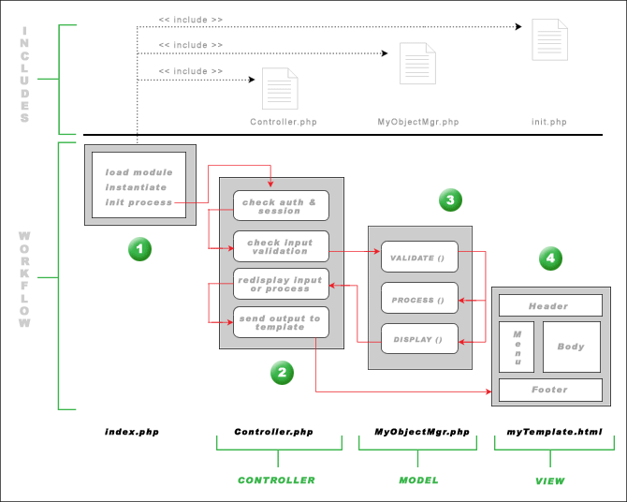
Workflow Diagram

Slide 32
Modules, Managers and Controllers /1
  The majority of work done by the developer when building as Seagull-based app is in implementing his/her own modules. A module is a logical grouping of functionality. In the User module, for example, you will find code that manages
  * users
  * preferences
  * permissions
  * roles

Slide 33
Modules, Managers and Controllers /2
  A module is made up of one or more managers. A manager is simply a page controller object which groups together a number of related actions that can be performed on a single entity or business object, for example a User, a Transaction, a ShoppingCart, etc. Typical actions that a manager controls are:
  * add * insert
  * edit * update
  * delete

Slide 34
Modules, Managers and Controllers /3
  Application Controller: All managers, or Page Controllers, inherit from SGL_Manager which acts as the Application Controller. The workflow set out in SGL_Manager is a good generic choice for most web applications. However you are not limited to implementing the validate/process/display workflow set out by this class. You could easily create another application controller, and have your page controllers extend that.

Slide 35
Modules, Managers and Controllers /4
  Exception: A good example would be in the case of building a REST server, where no template management is needed, no display() method, just XML to PHP transformation on the input stream, vice versa on the output, and data fetching. All permission checks could be replaced by simple HTTP authentication (see http://del.icio.us/help/api/), no session would be required, so you would end up with a very lightweight app.

Slide 36
Modules, Managers and Controllers /5
  Front Controller: Seagull also uses another higher level controller that helps simplify code responsibility, the Front Crontroller. This object is responsible for handling all requests from user agents and delegating responsibility to the Filter Chain, which is a simple list of input/output filters and the target Core Processor.

Slide 37
Modules, Managers and Controllers /6
  Front Controller: Various filters in the chain build and clean the request object, resolve the relevant manager and action details from the URI, execute the domain logic and finally send the appropriate headers.
  The Front Controller is also responsible for initialising the Seagull environment which involves setting up paths, parsing the config, etc.

Slide 38
Modules, Managers and Controllers /7
Code example of Front Controller

Slide 39
Modules, Managers and Controllers /8
Validate Process Display workflow
validate: the raw $_REQUEST array is passed to this method (wrapped in the SGL_Request object), validations performed, and acceptable data mapped to an $input object

Slide 40
Modules, Managers and Controllers /9
process
  if valid: if all data is valid, the $input object is passed to the process method, which redirects to the relevant action method derived from URI params.
  if invalid: if one or more validations have failed, the request is deemed to be invalid, and the data passed directly to the display() method with appropriate error messages, ie, to be presented back to the user for correction. The process method is bypassed.

Slide 41
Modules, Managers and Controllers /10
display: this method offers the opportunity to add some post-processing to the data that all actions have in common. For example, if you have 5 methods that all need to build combobox data for forms, here is the place to do it once for all of them.

Slide 42
Modules, Managers and Controllers /11
Practical example:
a contact form is posted with field data deemed to be valid
business logic executed to dispatch the details via email and save the request in the database
a confirmation message built for displaying to the user
the emailSent.html template specified
the HTML renderer instantiated, using the Flexy template engine as specified in the config
the template rendered with vars populated from $output data, or loaded from the cache if it exists
text/html headers generated and response sent to the browser client

Slide 43
Using Seagull Resources
Seagull site
API docs
Sourceforge
Wiki / Trac
Forum
#seagull

Slide 44
Working with Trac
Wiki / tutorials
Tickets
Registering
Submitting a ticket
Milestones
Bugs

Slide 45
Creating a Module /1
The test assignment will involve creating a Bounty module, duplicating the functionality of the one found at http://www.horde.org/bounties/
Bounties are an open source tradition and are used by many projects
Finished result will be used on Seagull project site

Slide 46
Creating a Module /2
Requirements:
List of active bounties
List of suggested bounties
Suggest a new bounty
Bounty detail screen
Sponsor a bounty
Admin screen (manage statuses)

Slide 47
Creating a Module /3
Analysis of requirements
Develop schema
Public and admin managers
Module generator
Create sample data
Using seagull-rebuild
Demonstrate error handling
Validation
Pair programming
Source code management

Slide 48
Creating a Module /4
Bounty enhancements:
Config options
Add captcha support
Using a data access object
Implement caching
Email notifications (observer)
Require authentication for edits
Localize
Write tests

