Slide 1
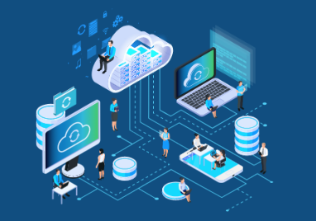
Intelligent Edge Telemetry Agent for Proactive System Support
Preventing Device Failures Through Smart Monitoring and Cloud-Enabled Rules
Seah Chen Khoon
30 May 2025

Slide 2
Why This Matters?
Unanticipated hardware failures at the edge are costly and disruptive.
Manual diagnostics are reactive, inconsistent, and not scalable.
We propose an intelligent, configurable, and privacy-aware telemetry solution.
Uses machine learning to classify risks and escalate when needed.

Slide 3
What Challenges Are We Solving?
Edge systems lack real-time diagnostics and intelligent alerting.
No unified mechanism to escalate issues beyond local processing.
Data privacy concerns limit centralized telemetry aggregation.
Lack of consistency in how telemetry is interpreted.

Slide 4
Strategic Value of Automated Diagnostics
Reduced hardware failure rates and downtime.
Improved responsiveness to critical issues through cloud escalation.
Enhanced trust with users through transparent, configurable privacy controls.
Foundation for broader telemetry-based predictive maintenance.

Slide 5
Smart Telemetry and Diagnostics System
Ingests a sample dataset from Hugging Face and applies preprocessing to prepare it for analysis.
Generates synthetic temperature values (20°C–120°C) and labels system states as Normal, Warning, or Critical.
Trains a Random Forest model to infer system health based on telemetry patterns.
Executes local actions for warnings and escalates critical cases to the cloud for advanced diagnostics using LLM.
Tailors behavior dynamically based on user-selected privacy mode and rule sets for edge or cloud handling.
Notes:
- Retrieve a sample dataset from HuggingFace.
- Apply preprocessing to clean and prepare the data.
- Generate a synthetic temperature column with random values ranging from 20°C to 120°C.
- Simulate outcome labels based on temperature thresholds:
- 0 (Normal): Temperature between 20°C and 60°C — No action required.
- 1 (Warning): Temperature between >60°C and 75°C — Handled locally on the edge device using lightweight ML models to monitor system health and user context, ensuring privacy while enabling quick response.
- 2 (Critical): Temperature above 75°C — Escalated to the cloud for in-depth analysis using powerful AI (e.g., LLMs or aggregated telemetry) to provide advanced diagnostics or decision support beyond local capability.
- Trains a Random Forest model to perform based on mocked temperature from machine (machine_config.yml).
- Adapts responses based on the selected privacy mode and rule sets (edge and host), which define temperature thresholds and actions for both edge and cloud environments.

Slide 6
What This System Does?
Flexible data ingestion via itemized device selection.
Machine learning model trained to detect risk thresholds.
Privacy-aware telemetry sharing modes (local_only, share_with_dell, disable_telemetry).
Rule-based local response + optional cloud escalation for CRITICAL conditions.

Slide 7

Privacy and Compliance
User prompted to select telemetry sharing mode.
Configurable via YAML with environment variable support.
The disable_telemetry mode prevents all telemetry processing, disabling both edge and cloud interactions.
The local_only mode restricts all operations to the edge device, with no interaction with the cloud.
The share_with_dell mode enables both edge and cloud interactions for telemetry processing and diagnostics.
Aligned with enterprise data protection standards.
Notes:
After the initial setting of the privacy settings via UI, subsequent changes can be made in the telemetry_config.yml by changing of the value of the key (Privacy->mode)

Slide 8
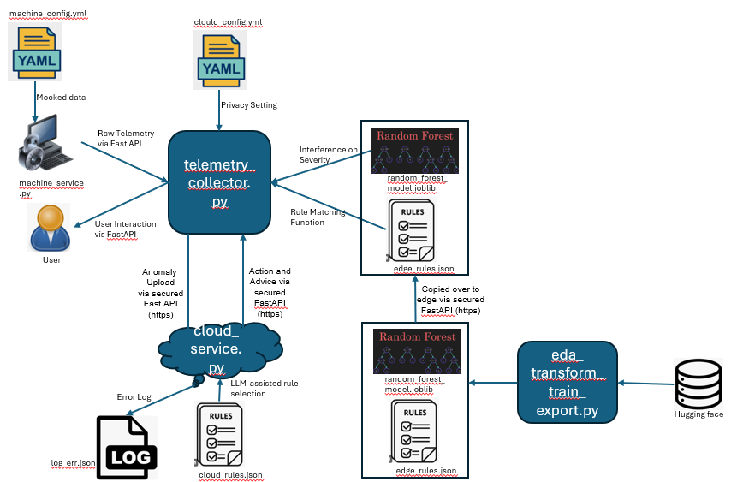
End-to-End Architecture
Edge device: telemetry collector, ML model, and rule engine.
Configuration layer: YAML + .env.
Cloud API : downloads models/rules, handles escalations.
Notes:
1> Train a Random Forest model using a dataset where the temperature feature is directly correlated with the outcome, enabling severity classification based on temperature ranges.
2> Deploy the model and rule files to the edge device via FastAPI over HTTPS for secure transmission.
3> Send mocked telemetry data (defined in machine_config.yml) to the telemetry collector using FastAPI under normal operating conditions.
4> Infer severity levels by processing telemetry data through the model, using temperature as the primary input for classification.
5> Tailor system responses dynamically based on the selected privacy mode, following the Decision Matrix to determine when local or cloud-based actions are permitted.
6> Log rule gaps to log_err.json if the telemetry data falls outside defined rule ranges—this occurs only when the privacy mode is set to share_with_dell.

Slide 9
Data Engineering Pipeline
Cleansing, encoding, and imputing missing values.
Feature engineering includes mocked temperature generation.
Multi-stage dataset split for robustness (train/val/test).
Exported model used in edge diagnostic flow.

Slide 10
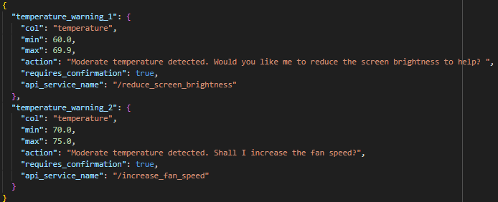
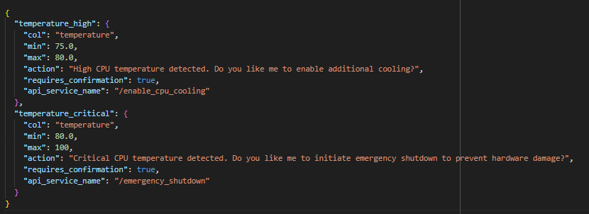
Rule-Based Decision Engine with Transparent Logic
Rules defined in JSON/YAML, matched against live telemetry.
If matched, triggers predefined local actions (e.g., reduce brightness).
Critical cases escalate via cloud API and return suggested actions.
Rule outcomes are explainable and auditable.
cloud_rules.json
edge_rules.json

Slide 11
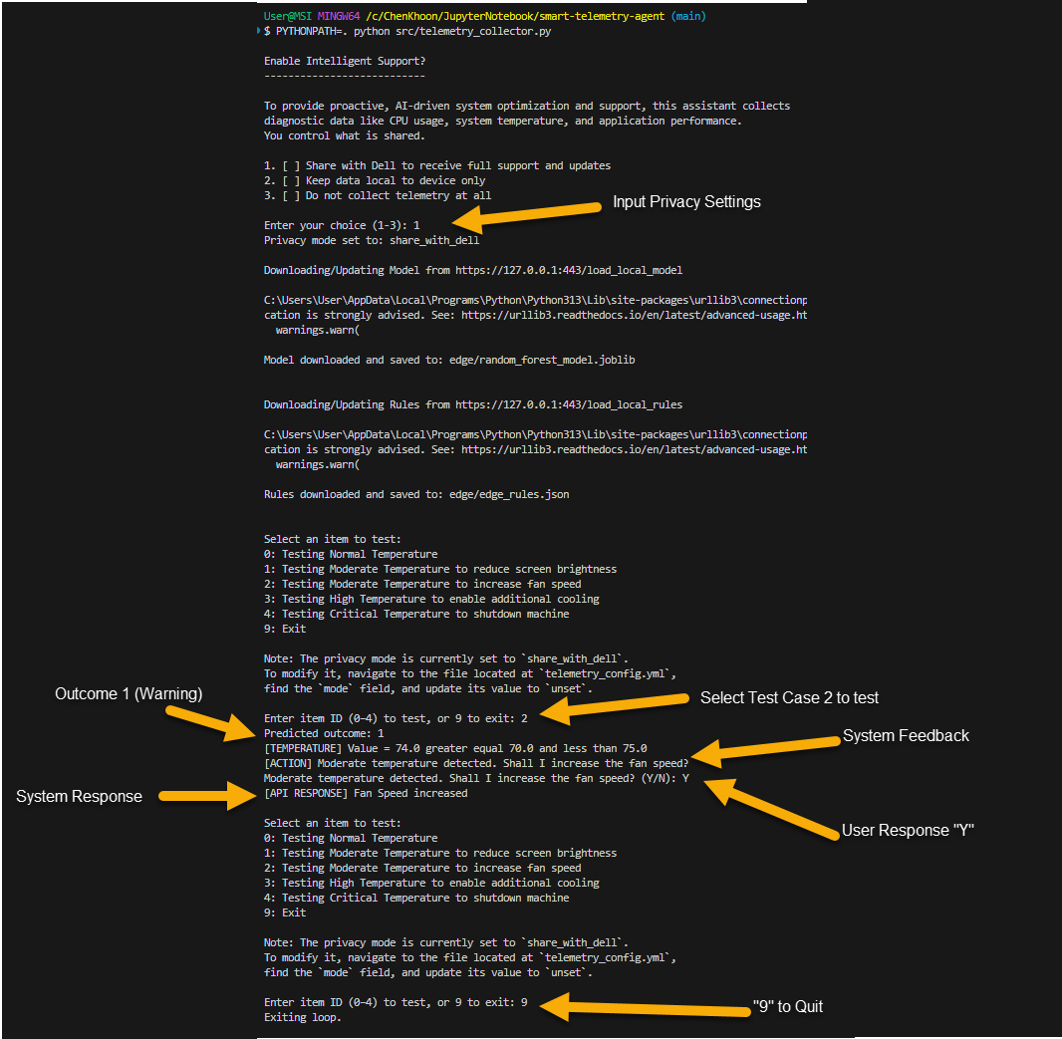
Simple CLI-Driven Interaction
Operator selects item from menu.
System shows predicted outcome and advice.
Privacy message printed for transparency.
Loop continues until exit.

Slide 12
Business Value and Roadmap
Reduced downtime through proactive diagnostics.
Cloud-assisted advice improves remediation speed.
Privacy-aware design increases user trust.

Slide 13
Strengths and Areas for Improvement
Strength
Modular, config-driven architecture (YAML + .env)
ML-powered classification with explainable rules
Local + cloud escalation paths
Built-in privacy modes aligned with data policies
Areas for Improvement
Current UX is CLI-based — no GUI yet
Limited User Interaction – implementation of chat would be better
ML model trained on mock data — real telemetry integration needed

Slide 14
Questions or Follow-Up
Open to discuss technical design or implementation details.

Slide 15
Thank you
Seah Chen Khoon
chenkhoon@yahoo.com

