Slide 1
Intelligent Edge Telemetry Agent for Proactive System Support

Slide 2

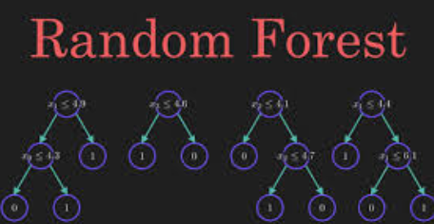

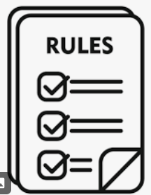

Architecture Overview
Raw Telemetry
via FastAPI
Telemetry Collection
Model
User Interaction
Model & Rules update, Advice
Anomaly
Upload
eda_
transform_train_
export.py
Cloud Service
Model
Hugging face

Slide 3
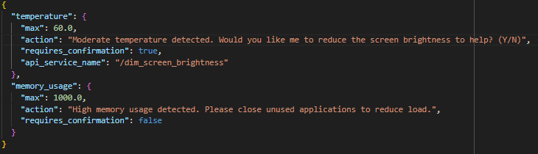
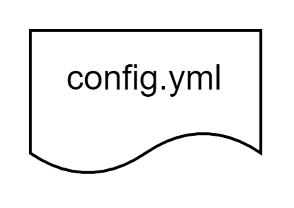
Step-by-Step Implementation (Model Creation)
eda_transform_train_export.py
Download dataset from Hugging Face
Perform Data Preprocessing
Perform Feature Engineering
Randomise value to create Temperature field
Perform OHE on nominal fields
Perform ordinal Encoding
Assign range of temperature to form target column
Prepare Train, Validation, Test dataset
Train random forest on train dataset
Perform Prediction on validation dataset
Output classification report on validation Set
Save model on folder in cloud
eda_
transform_train_
export.py
Model
Hugging face

Slide 4
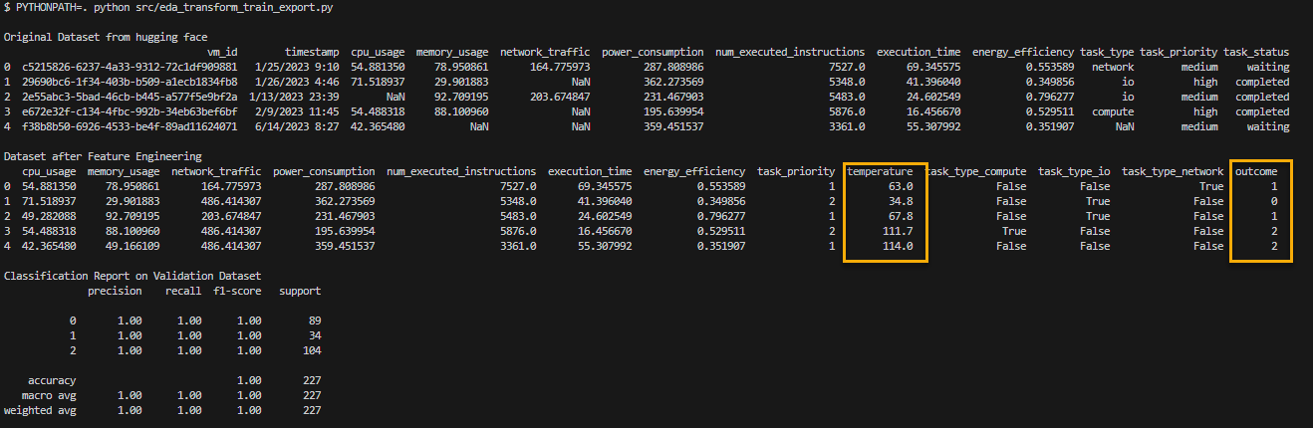
Step-by-Step Implementation (Model Creation)
Model Overview

Slide 5
Step-by-Step Implementation (Initial Setup)
telemetry_collector.py
Initial Setup
Download model from Cloud using https
Download Rules from Cloud using https
Ask user Privacy Question
Telemetry Collection
Model
Model & Rules update
eda_
transform_train_
export.py
Cloud Service
Model
Hugging face

Slide 6
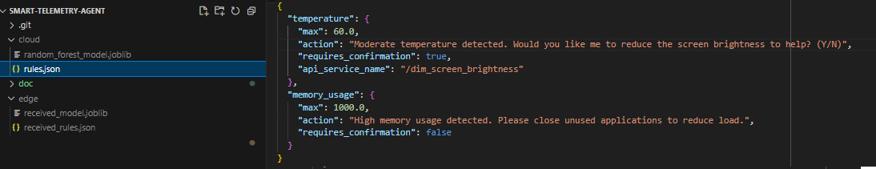
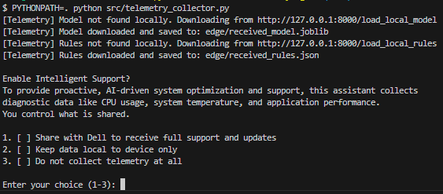
Step-by-Step Implementation (Initial Setup)
Download Model and Rules from Cloud
Ask User Privacy Question
telemetry_collector.py
Initial Setup
Download model from Cloud
Download Rules from Cloud
Ask user Privacy Question

Slide 7
Step-by-Step Implementation (Telemetry Collection)
machine_config.yml
Store variable test data in config file
Telemetery Collection
Invoke an API service to retrieve a specific dataset defined in the YAML configuration.
If not local_only
Refresh model and Rules from Cloud via https
Determine the severity level (Normal, Warning, or Critical) of telemetry data
If the outcome is Warning, it will refer to the Rules to invoke defined action to the user
Raw Telemetry
via FastAPI
Telemetry Collection
Model
User Interaction
Model & Rules update
eda_
transform_train_
export.py
Cloud Service
Model
Hugging face

Slide 8
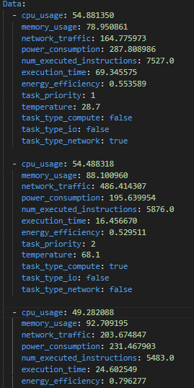

Step-by-Step Implementation (Telemetry Collection)
DataSet in Config file
Select the type of data for retrieval.
Detects moderate temperature, prompts user, dims screen on approval.

