Slide 1
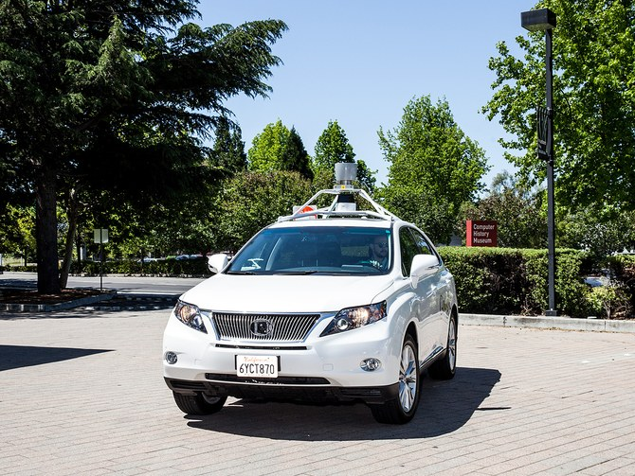
In an accident report filed with the California DMV on February 23 (and made public today), Google wrote that its autonomous car, a Lexus SUV, was driving itself down El Camino Real in Mountain View. It moved to the far right lane to make a right turn onto Castro Street, but stopped when it detected sand bags sitting around a storm drain and blocking its path. It was the move to get around the sand bags that caused the trouble

Slide 2
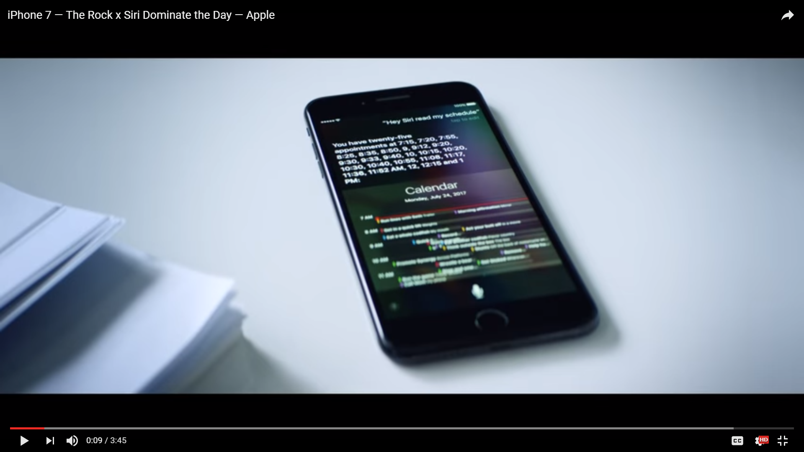
https://www.youtube.com/watch?v=ufBLI6bB9sg

Slide 3


