Slide 1




Image Compression
Image 1
Image 2
Image 3
Image 4

Slide 2

Why image compression？
Memory card
10MB
Only 400 such pictures can be stored in this card！

Slide 3
Why images can be compressed？
Redundancy between pixels
no difference
This area can be recorded by one pixel of information

Slide 4
Why images can be compressed？
Coding redundancy
Pixel values
Decimal | Binary
1 | 0000000 1
3 | 000000 11
7 | 00000 111
15 | 0000 1111
31 | 000 11111
63 | 00 111111
127 | 0 1111111
255 | 11111111

Slide 5



Why images can be compressed？
Psychovisual redundancy
$$v_{1}$$
$$v_{2}$$
Fade
.
.
.
No change
$$v_{k}$$
Replace the original n values with k values, where k is much smaller than n.

Slide 6
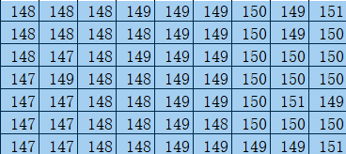
How to compress image？
(148,9)
(150,9)
(149,7)
The recording of a region can be completed with only one pair of data

Slide 7
Thank You！

