Slide 1
SAT Encoding
For Sudoku Puzzles
Will Klieber and Gi-Hwon Kwon

Slide 2
What is Sudoku?
Played on a n×n board.
A single number from 1 to n must be put in each cell; some cells are pre-filled.
Board is subdivided into
√n × √n blocks.
Each number must appear exactly once in each row, column, and block.
Designed to have a unique solution.
 |  | 6 | 1 |  | 2 | 5
 | 3 | 9 |  |  |  | 1 | 4
 |  |  |  | 4
9 |  | 2 |  | 3 |  | 4 |  | 1
 | 8 |  |  |  |  |  | 7
1 |  | 3 |  | 6 |  | 8 |  | 9
 |  |  |  | 1
 | 5 | 4 |  |  |  | 9 | 1
 |  | 7 | 5 |  | 3 | 2

Slide 3
Puzzle-Solving Process
SAT Sol'n
Puzzle Sol'n
Puzzle
Encoder
CNF
SAT Solver
Decoder
Mapping of SAT variables to Sudoku cells

Slide 4
Naive Encoding (1a)
Use n³ variables, labelled “x_{0,0,0}” to “x_{n,n,n}”.
Variable x_{r,c,d} represents whether the number d is in the cell at row r, column c.

Slide 5
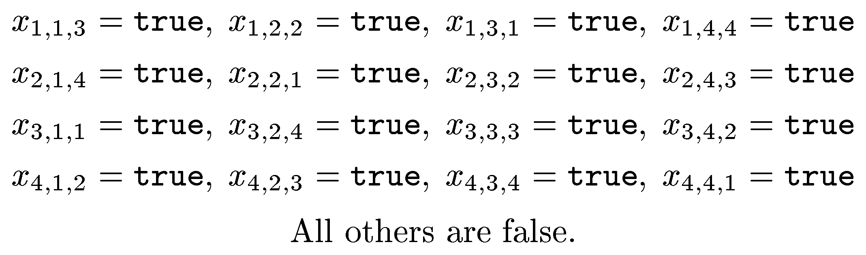
Example of Variable Encoding
3 | 2 | 1 | 4
4 | 1 | 2 | 3
1 | 4 | 3 | 2
2 | 3 | 4 | 1
Variable x_{r,c,d} represents whether the digit d is in the cell at row r,
column c.
digit
column
row

Slide 6
Naive Encoding (1b)
Use n³ variables, labelled “x_{0,0,0}” to “x_{n,n,n}”.
Variable x_{r,c,d} represents whether the number d is in the cell at row r, column c.
“Number d must occur exactly once in column c”
⇒ “Exactly one of {x_{1,c,d}, x_{2,c,d}, ..., x_{n,c,d}} is true”.
How do we encode the constraint that exactly one variable in a set is true?

Slide 7
Naive Encoding (2)
How do we encode the constraint that
exactly one variable in a set is true?
We can encode “exactly one” as the conjunction of “at least one” and “at most one”.
Encoding “at least one” is easy: simply take the logical OR of all the propositional variables.
Encoding “at most one” is harder in CNF.
Standard method: “no two variables are both true”.
I.e., enumerate every possible pair of variables and require that one variable in the pair is false.
This takes O(n^2) clauses.
[ Example on next slide ]

Slide 8
Naive Encoding (3)
Example for 3 variables (x1, x2, x3).
“At least one is true”:
x1 ∨ x2 ∨ x3.
“At most one is true”:
(~x1 ∨ ~x2) & (~x1 ∨ ~x3) & (~x2 ∨ ~x3).
“Exactly one is true”:
(x₁∨ x₂∨ x₃) & (~x₁∨ ~x₂) & (~x₁∨ ~x₃) & (~x₂∨ ~x₃).

Slide 9
Naive Encoding (4)
The following constraints are encoded:
Exactly one digit appears in each cell.
Each digit appears exactly once in each row.
Each digit appears exactly once in each column.
Each digit appears exactly once in each block.
Each application of the above constraints has the form:
“exactly one of a set variables is true”.
All of the above constraints are
independent of the prefilled cells.

Slide 10
Problem with Naive Encoding
We need n³ total variables.
(n rows, n cols, n digits)
And O(n⁴) total clauses.
  To require that the digit “1” appear exactly once in the first row, we need O(n²) clauses.
  Repeat for each digit and each row.
For your project, the naive encoding is OK.
For large n, it is a problem.

Slide 11

Better Encoding

Slide 12
A Better Encoding (1a)
Simple idea: Don’t emit variables that are made true or false by prefilled cells.
  Larger grids have larger percentage prefilled.
Also, don’t emit clauses that are made true by the prefilled cells.
This makes encoding and decoding more complicated.

Slide 13
A Better Encoding (1b)
Example: Consider the CNF formula
(a ∨ d) & (a ∨ b ∨ c) & (c ∨ ~b ∨ e).
Suppose the variable b is preset to true.
Then the clause (a ∨ b ∨ c) is automatically true, so we skip the clause.
Also, the literal ~b is false, so we leave it out from the 3rd clause.
Final result: (a ∨ d) & (c ∨ e).

Slide 14
New Encoding: Implementation
Keep a 3D array VarNums[r][c][d].
  Map possible variables to an actual variable number if used.
  Assign 0xFFFFFFF to true variables.
  Assign -0xFFFFFFF to false variables.
Initialize VarNums[r][c][d] to zeros.
For each prefilled cell, store the appropriate code (±0xFFFFFF) into the array elems for the cell.
For every cell in the same row, column, or block:
  Assign -0xFFFFFF (preset_false) to the var that would put the same digit in this cell.

Slide 15
Room for Another Improvement
It still takes O(n²) clauses to encode an “at most one” constraint.
When one of these vars becomes true, the SAT solver examines clauses that contain the newly true var.
This allows the SAT solver to quickly realize that none of the other vars in the “at most” set can be true.
But requires (n)(n-1)/2 clauses.
Improvement: Use ‘intermediary’ nodes (next slide).
8
1
7
2
6
3
5
4

Slide 16
Intermediary Variables
Idea:
Divide the n variables into groups containing only a handful of vars.
Add an intermediary variable to each group of vars.
An intermediary variable is to be true iff one of the (original) vars in its group is true.
Add a constraint to ensure that at most one intermediary variable is true.
If there are too many intermediary varibles, then they themselves may be grouped, forming a hierarchy.
8
1
7
2
i₅₋₈
i₁₋₄
6
3
5
4

Slide 17
Hierarchical Grouping
i₁₋₆
i₇₋₁₂
i₁₋₃
i₄₋₆
i₇₋₉
i₁₀₋₁₂
x1
x3
x4
x6
x7
x9
x10
x12
x2
x5
x8
x11

Slide 18
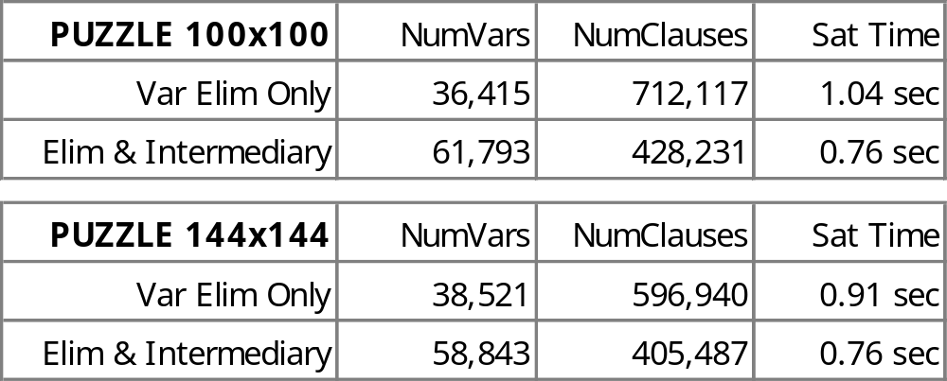
Results
Number of clauses for an “at most one” clause reduced from O(n²) to O(n log n).
But in the larger puzzles, most of the cells are prefilled, so this only offered a 10%-20% performance benefit.

