Slide 1
Neural Networks
Sean Eva, Jingyuan Chen

Slide 2
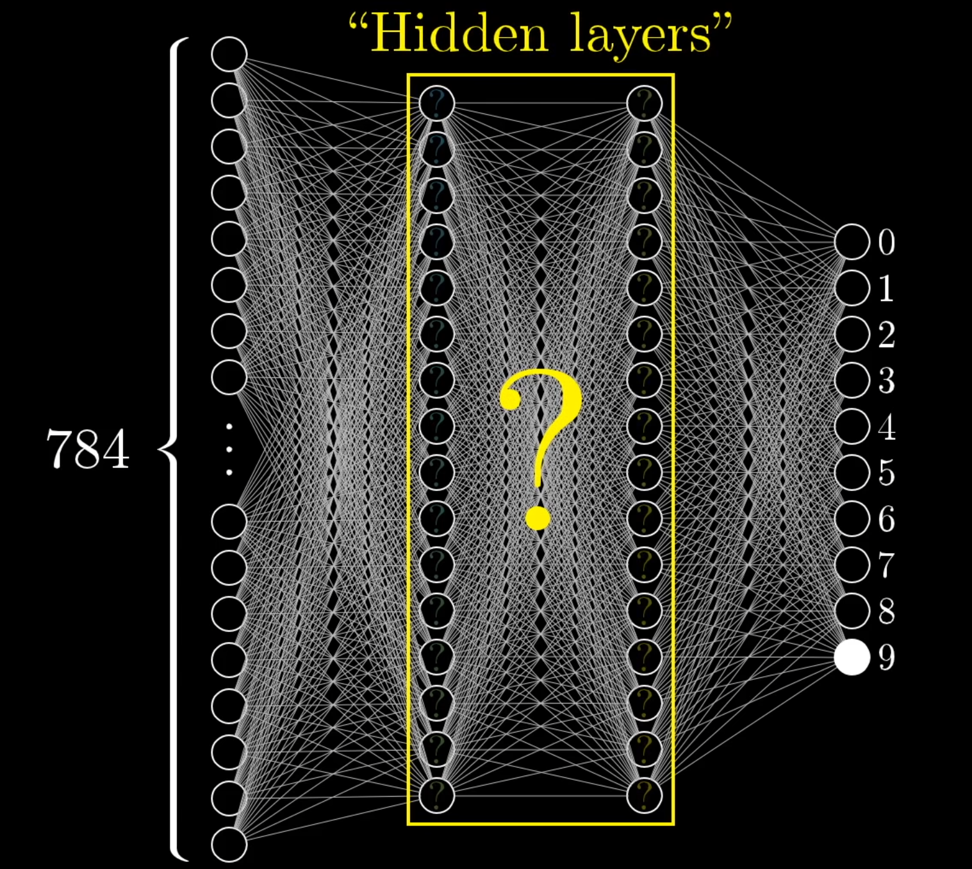
Basics
https://www.youtube.com/watch?v=aircAruvnKk

Slide 3
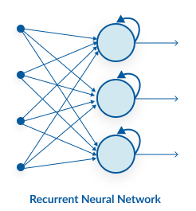
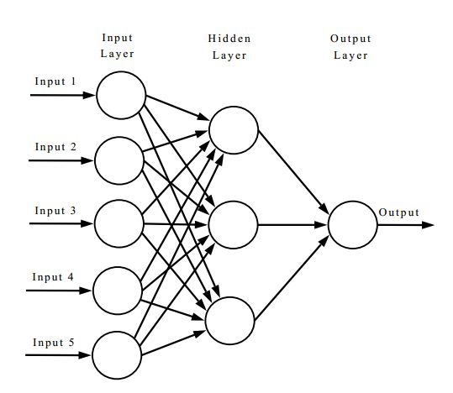
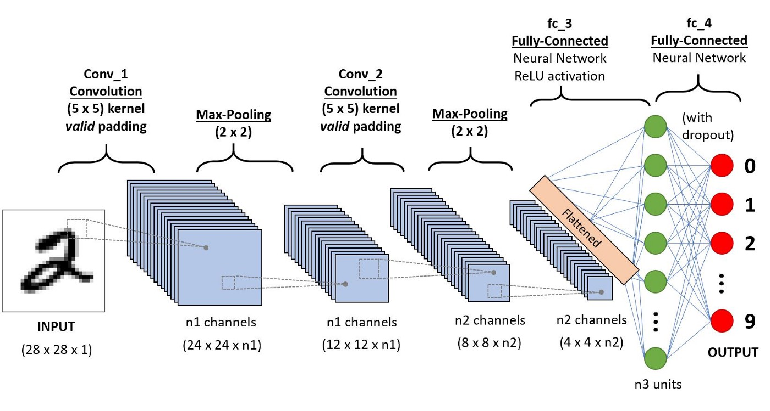
Types of Neural Networks
Recurrent Neural Network | Artificial Neural Network | Convolutional Neural Network

Slide 4


Python Packages for Neural Networks

Slide 5
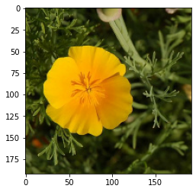
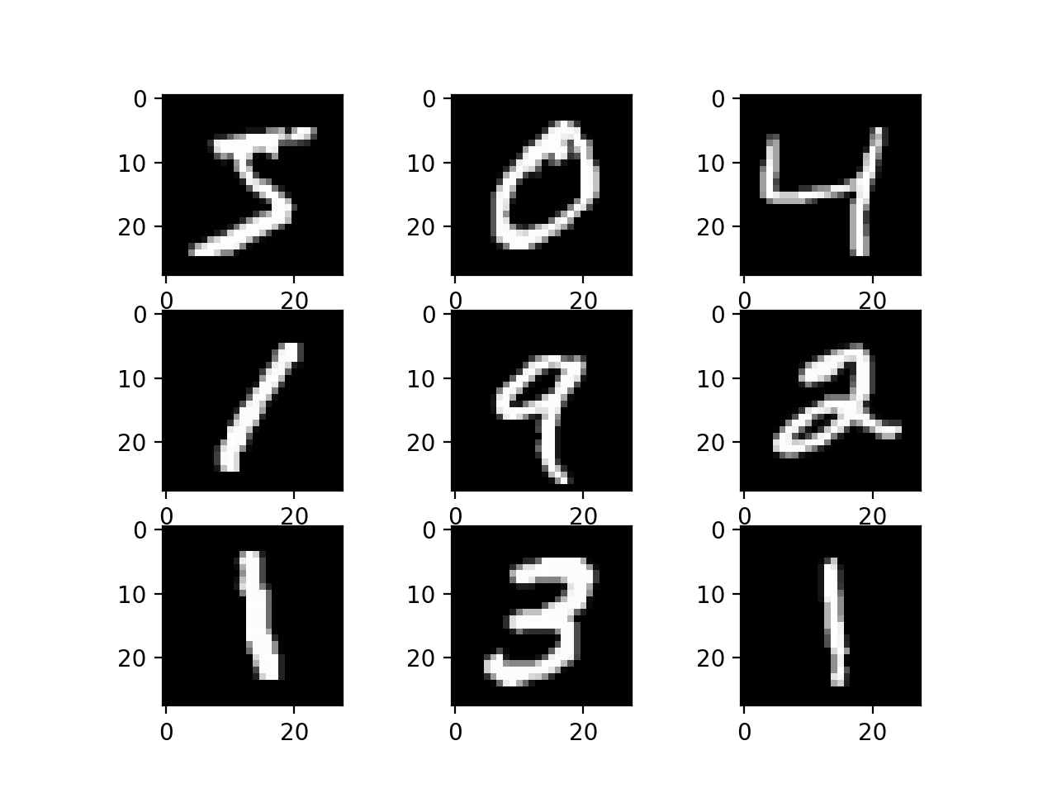
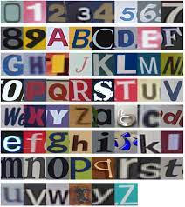
What data did we work with?
MNIST Database of Handwritten Digits
The Chars74K dataset
Petals to the Metal - Flower Classification on TPU

Slide 6
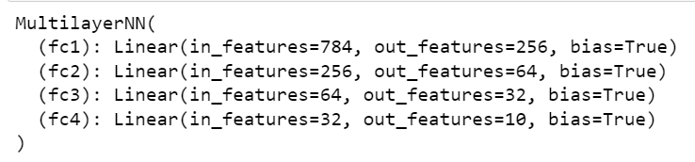
Multilayer Neural Networks
Notes:
We built the multilayers network for this project, this kind of network has the input and output and hidden layers in it. We try to add layers in the network and it works on the handwritten digits dataset with 75-90% accuracy.

Slide 7
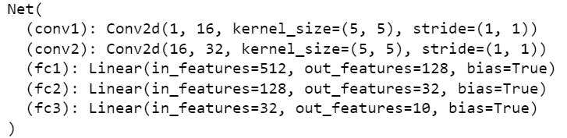
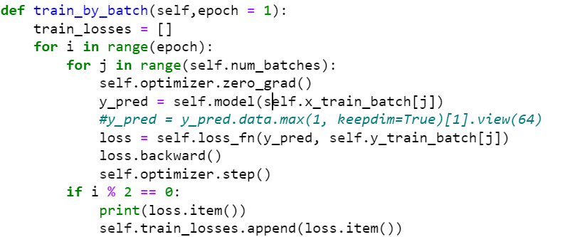
Convolutional Neural Networks
Notes:
We use the Adam optimizer, and choose the learning rate with 0.001. I use Cross Entropy Loss as the loss function. Then we split the train set with batch size as 64. We can get the accuracy about 98.5.

Slide 8
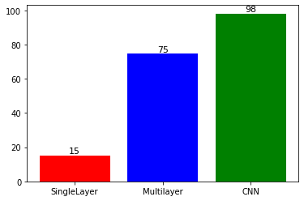
Test accuracy
The test accuracy for the three different
networks.

Slide 9
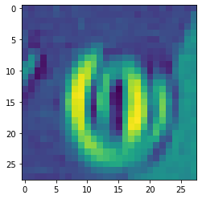
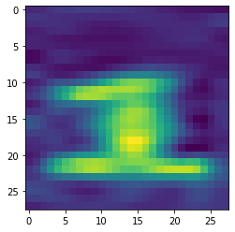
The Chars74K dataset
Image Processing

Slide 10
Flower Dataset
The dataset from kaggle competition
Train data with label,
and test data without label
Notes:
I use the same method for the flower dataset, the dataset gives train set with label, and the test set without label. To check the accuracy of our model, I split the train set then half of them is for training, and other half is for test the accuracy. After training, we found a terrible accuracy for the test dataset. In the future work, I consider to change the network stucture such as add the dropout or other conv layer to see if it will perform better or use other nn such as recurrent neural network. Also, we may want to do something for the image because the background color may influent our train.

Slide 11
Next Step
Recurrent neural network
Add dropout or add other conv layer
Process the image

