Slide 1
Predicting Subreddits
Sean Flanagan

Slide 2
Problem Statement
How can accurately predict which subreddit a post came from?
Positive = March Madness
Negative = Baseball
Notes:
Our problem statement is how can we accurately predict which subreddit a post came from based on the text of the post. I decided to compare two subreddits, baseball and march madness. We took 924 posts from baseball and 811 from March madness
To do this,I decided to use the words from the title of each post to predict which subreddit the post is for. I chose to use the title feature because a lot of reddit posts do not have any text in them especially in sports subreddits because a lot of the posts just have videos or highlights, however, the title must have some form of text.
To solve this problem statement I created models trying to optimize accuracy while trying to not overfit the model
Accuracy is how often is the model is correct in predicting which subreddit the text is from.
To do this we defined the baseball reddit as positive and the march madness reddit as negative.

Slide 3
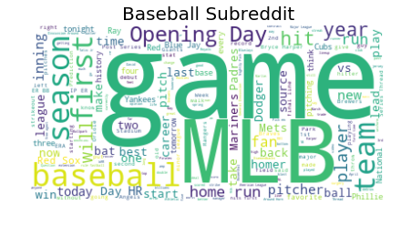
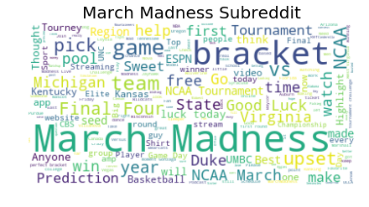
Most Common Words
Notes:
Before we got to the modeling, I decided to look at the most common words of each subreddit to see if there would be any words commonly used in both subreddits. Even though baseball and college basketball are both sports, it appears the most common words of each reddit can be found in both subreddits with the exception game. This conceptually makes sense because while they both are sports, they use different stats, different team names, ones a regular season, one is a tournament, one is professional while another is collegiate and so on.

Slide 4
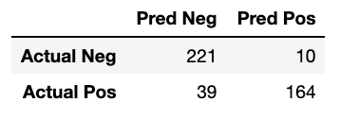
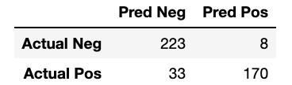
Model 1: Naive Bayes
CountVectorizer
TfidfVectorizer
Accuracy
CountVectorizer = 88.71%
TfidfVectorizer = 90.55%
Notes:
Positive = March Madness
Negative =Baseball
Stop words, max features, ngram range, min_df
Explain countvectorizer and TfidVectorizer
Countvectorizer :counts how often a word appears throughout the data frame
TfidfVectorizer: Is similirar to countvectorizer but it penalizes common words and gives more value to rare words.
Predicted Correctly
Top Left: Predicted March Madness subreddit and it was March Madness subreddit
Bottom Right: Predicted Baseball and it was baseball subreddit

Slide 5
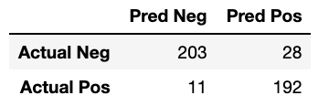
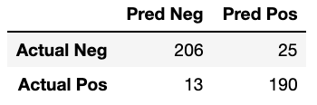
Model 2: Logistic Regression
CountVectorizer
TfidfVectorizer
Accuracy
CountVectorizer = 91.01%
TfidfVectorizer = 91.24%
Notes:
Explain Logistic Regression

Slide 6
Conclusion
Logistic Regression was a better predictor than Naive Bayes for these specific subreddits
Notes:
Logistic regression performed better than naive bayes and tfidfvectorizer seemed to perform slightly better than just using a countvectorizer for these subreddits. However, I would not conclude that logistic regression will always be the better model than naive bayes. I would recommend looking into both models when trying to compare different subreddits.

Slide 7
Questions?

