Slide 1
What to do on Fourth Down?
Sean Flanagan

Slide 2
Problem Statement
Should NFL teams punt or go for it on fourth down?

Slide 3
Detailed NFL Play-by-Play Data 2009-2018
Kaggle
449,371 rows and 255 columns
Notes:
Dataset from kaggle which included details of every play from every game in 2009-2018 including preseason and postseason.
-solo tackle, who ran the ball, down, time left in the quarter, possession, score...

Slide 4
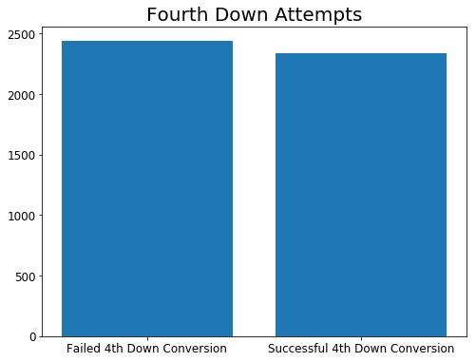
Number of Fourth Down Non-Punt Attempts
4,776 attempts
~49% Success Rate
Notes:
After cleaning the data I got rid of columns that had nothing to do with 4th down. I also made a binary column that had a 1 if a team successfully converted on fourth down and 0 if the team did not convert on fourth down. The failed to convert on fourth down did not include punt plays. The success rate is very close to 50 50, but falls at approximately 49%.
However, this cut down the number of observations by a good margin reducing my dataset to 4,776 observations. Since 4th down is the least common number of downs and most of them are either punts or field goals

Slide 5
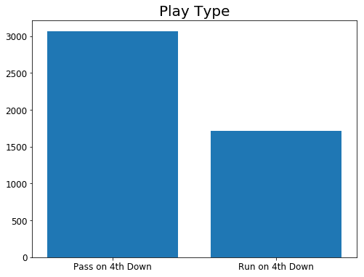
Play Type
Notes:
Most teams will throw the ball on fourth down. This is most likely because teams will throw when it is not a short distance to a fourth down or lots of times the defense is expecting a run play on 4th and 1
Can drop if presentation is running too long

Slide 6
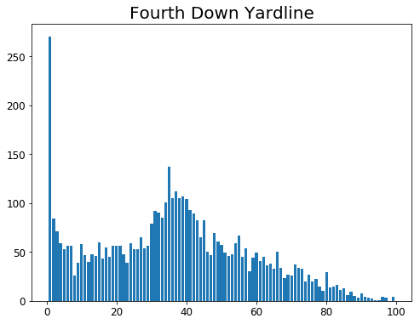
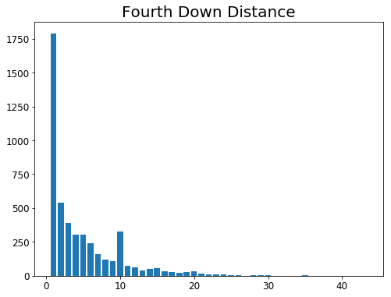
Yard Line
Notes:
Teams are more likely to go for a first down when a yard away especially when it is their opponent’s endzone . Otherwise teams will most likely go for it when they are in that too far for a field goal but too close to punt range

Slide 7
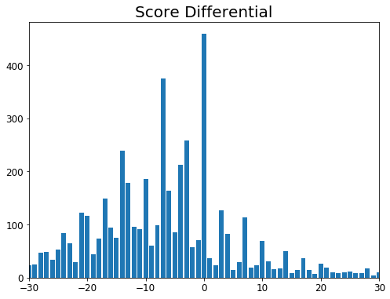
Score Differential
Notes:
The worst team (that day) is more likely to go for it on fourth down either because they need something to try and spark plug their team or they are desperate (down by a lot or down by 4+ with 30 seconds in the opponent’s redzone)
The spikes are because teams will not choose to kick a field goal when they are down by 4-7 when it is a one possession game and 11-14 when it is a 2 possession game

Slide 8
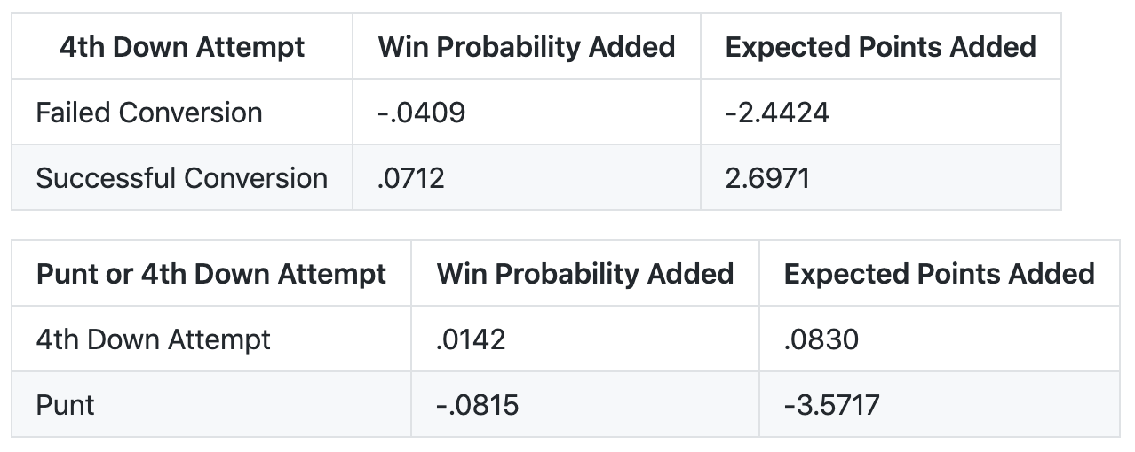
WPA and EPA
Notes:
It appears that teams increase their odds of winning when they attempt to go for it on fourth down compared to punting. However, some more digging needs to be done for this. EPA and WPA can be misleading. Most teams go for it in on fourth down when they are losing in the fourth quarter. Your win probability added for example is not going to drop that much that late in the game if you fail to convert when compared to punting the ball in the second quarter.

Slide 9
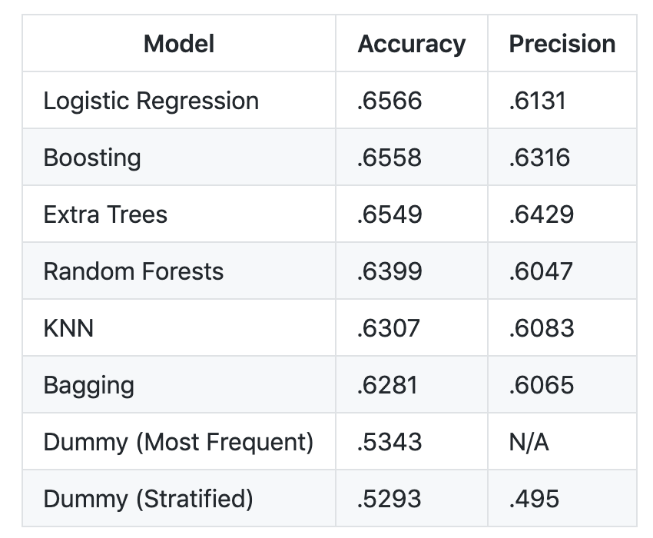
Model Results
Logistic Regression
Extra Trees
Notes:
The features I used were yards needed for a first down, whether or not the play was a run play, touchdown probability and goal to go. Features like playing on your home field and total scoring probability did not appear to have any significant correlation with converting on fourth down.
The classification models had accuracy scores ranging from 62% to 65% and precision scores ranging from 60% to 64%. This was approximately 10% better when compared to the dummy metrics. Logistic regression had the best accuracy score at 65.66% while boosting extra trees also had accuracy scores in the 65% range. Extra trees also had the best precision score at 64.29%. Extra trees did well with both metrics. I grid searched for best parameters for all models. Extra trees had a n_estimator of 44, max_depth of six and min_sample_split of 17.
Stratified: generates predictions by respecting the training set’s class distribution.
Most Frequent: always predicts the most frequent label in the training set.
The dummy (most frequent) model is N/A for precision is because you cannot divide 0/0. This dummy model only predicted false positives and false negatives. Precision is the positive predictive value (TP/(TP+TN)).
df[['ydstogo', 'run', 'td_prob', 'goal_to_go']]
array([[-0.10148679, 0.41490075, 1.58040654, -0.62648846]])

Slide 10
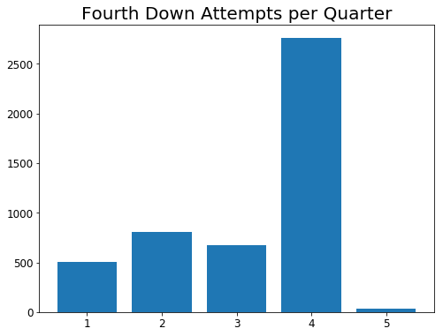
Conclusion
Is it worth it?
Add a predictor
Focus on 1st-3rd Quarters
Notes:
To conclude the data show that teams should go for it on fourth down given the right circumstances (high risk high reward). While teams successfully convert on fourth down approximately 49% of the time, more research will be done to see the effect of taking out the fourth quarter (or the last few minutes of the fourth quarter) and the last 30 seconds of the second quarter. A lot of times regardless of the yardage needed for a first down, a team will go for it on fourth down because they are down by more than 3 points with a minute left. What I am more interested about is a fourth and two at the fifty-yard line when punting and going for it are both feasible options.
My goal is to add a predictor that when provided with game information, it will give the probability that the team will get a first down. The question is will coaches be comfortable using a model to tell them if they should punt or go for it on fourth down. A lot of the game is stats, but there still is a gut factor and feel for how the game is going when watching. Also, lots of fans have a selective memory. Most fans will remember and criticize you if you go for it on fourth down and you fail to convert compared to remembering and praising your decision to go for it on fourth down when your team gets a first down.
My goal is to add a predictor that when provided with game information, it will give the probability that the team will get a first down.

Slide 11
Questions?

