Slide 1


COS711 Assignment 2
Segmenting solar filaments with deep learning
Sean Maritz - u23592274
Chisom Emekpo – u23533693
EthanWilke – u23577674

Slide 2
Team and Responsibilities
Sean Maritz (u23592274): Dataset Preparation
Chisom Emekpo (u23933693): Experimental Setup and Methodology
Ethan Wilke (u23577674): Results and Segmentation Enhancement
Notes:
Introduce the team. Clearly outline the responsibility of each team member; every member must be featured in the video.

Slide 3
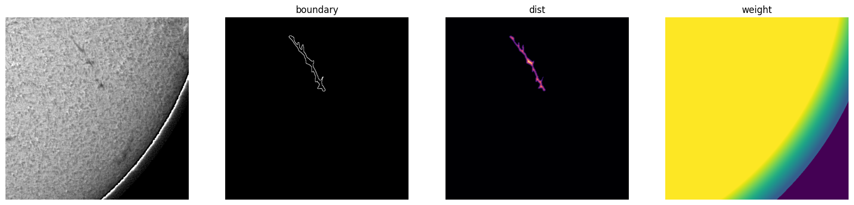
Dataset Preparation
What did you discover about the data, and how did you prepare it?
Preprocessing and scaling (e.g. resolution, normalisation)
Augmentation
Noisy samples and class imbalance
Training / validation split
Step 1: Parse and Group
Step 2: Split
Step 3: Geometry check
Step 4: Normalisation
Step 5: Build targets
Notes:
Firstly going into this what did we discover firstly and how we prepared for it. The data consists of 1,154 annotated image sets covering 707 distinct observations (train), taken from six instruments (Bh, Ch, Lh, Mh, Th, Uh) between 2011 and 2022. Many observations were annotated by more than one person (1 to 3 annotation sets each) so the first goal was to ensure these annotations were not noisy or subjective
Step 1: Parse and group. The COCO JSON is loaded and each file name is parsed into a 14-digit timestamp plus a 2-letter instrument code (Bh, Ch, Lh, Mh, Th, Uh). Images are matched to files on disk, and all four annotation categories are merged into a single “filament” class. Images are then grouped into observations (timestamp + instrument). Annotation cleaning is also done here where polygons with too few points are dropped, coordinates are clipped to 2048x2048 frame and tiny or duplicate polygons are removed
Cleaning found the labels largely sound: of 8,199 polygons, only one was removed (tiny), with no duplicates or degenerate shapes. The geometry analysis showed that filaments are thin: median mean-width is about 11 px and median spine length about 111 px. Fewer than 0.5% have mean width under 4 px, which is the key finding that guided the resolution decision. The test set spans the same date range as training (2011-2022), so no temporal extrapolation is required.
Step 2: Observations are assigned to train or validation in 7-day blocks, targeting about 15% validation per instrument. The split is 600 train and 107 validation observations the use of a 7-day blocks rather than random images prevented near-duplicate consecutive observations from leaking between train and validation. Blocks are chosen randomly (seed 1) while balancing per instrument, so each of the six instruments is represented in validation
Step 3: Each polygon is rasterised and its area, spine length, mean width and maximum width are measured, to decide whether downsampling would destroy thin structures.
We worked at full 2048×2048 resolution (scale 1.0) rather than downsampling, since the width statistics show that shrinking would erase thin filaments
Step 4: Normalisation, The solar disk is found by Otsu thresholding on a 512×512 copy, followed by a least-squares circle fit to the largest blob’s contour. Pixel intensities are clipped to the 1st-99th percentile inside the disk and rescaled to [0, 1]. Everything outside the disk is set to 0.
The only scaling is intensity normalisation: the solar disk is fitted with a circle, and percentile clipping (1-99%) is computed only from pixels inside the disk, so the background does not skew the contrast. This yielded consistent normalised statistics (mean about 0.61-0.69, std about 0.17-0.20) across instruments. Off-disk pixels are zeroed. Training uses 512×512 crops for memory efficiency, while validation uses full images.
Step 5: For every annotation set the notebook produces an instance map, plus a 5-channel target: foreground, boundary, contact (touching instances), a normalised distance transform, and the spine. The per-observation image, disk mask and a “soft” foreground are cached to disk. Augmentation is also done here which is deliberately light. random 90° rotations and random horizontal flips, applied identically to the image, targets and weight map. Rotation and flips are valid because the Sun has no canonical orientation in these crops. In addition, random crop placement acts as spatial augmentation, with a ±128 px jitter around the chosen filament centre. Some final cleaning was also done before parsing the data to the neural network where a z-score flags unusual observations per instrument, and 11 observations, all from Bh, failed the disk fit and fall back to a default centred circle. A limb weight map linearly down-weights pixels from 90% to 100% of the solar radius (to 0.3) and zeroes everything off the disk.
As shown in the image a final sanity check generates a figure for one training sample (cropped to 512 x 512) showing the input image next to the boundary which is used to teach the NN where object edges are, next to that is the normalised distance transform where each pixels value is its distance from the nearest edge divided by the maximum for that filament. Finally the per pixel loss weight map is shown which is a multiplier applied to the loss at each pixel during training. Yellow is the interior of the disk, green to teal is the region between 90% and 100% of the solar radius, dark blue is everything outside the disk.

Slide 4
Experimental Setup and Methodology
Tools and compute
Problem formulation
Python 3, PyTorch 2: mixed precision (fp16), AdamW
segmentation-models-pytorch: ImageNet ResNet-34 encoder
OpenCV, pycocotools: masks and connected components
Kaggle T4 GPU (16 GB): ~30 free GPU-hours a week
Checkpoint every epoch, resume across Kaggle's 12-hour sessions
GitHub: one notebook per stage, shared src/ package
Scored by Panoptic Quality (PQ = SQ × RQ): a split or merged filament counts as an error, like a miss.
So: bottom-up instance segmentation. One U-Net predicts five maps; instances are grouped afterwards.
Output map | Loss | Purpose
Filament mask | BCE + Dice | which pixels
Instance boundary | BCE ×3 + Dice | separate neighbours
Contact | BCE ×10 + Dice | cut merged ones
Distance to edge | MSE | instance centres
Spine | BCE ×3 + Dice | keep thin ones whole
Notes:
I was responsible for the experimental setup and methodology. We used PyTorch with mixed precision, and segmentation-models-pytorch for a pretrained encoder, and trained on Kaggle's free T4 GPUs. Every run saves a checkpoint each epoch, so it survives Kaggle's 12-hour session limit.
The competition is scored with Panoptic Quality, where splitting or merging filaments costs as much as missing one. So we treated this as bottom-up instance segmentation: one U-Net predicts the five maps Sean built. That's the filament mask, plus boundary, contact, distance and spine maps that help separate filaments and keep them whole. The thin, rare maps get extra weight in the loss.

Slide 5
Models, Training and Evaluation
Two U-Nets compared
Training
Evaluation
From scratch
6 levels, 32 → 512 channels, BatchNorm
20.6 M parameters
ImageNet ResNet-34 encoder
RGB filters summed to 1 channel
24.4 M parameters
Kept: +0.017 PQ and 1.5× faster
Both: output bias starts at p = 0.01, since under 1% of pixels are filament
768 × 768 crops, batch 4 (crop size tuned: 512 → 768)
AdamW, lr 3e-4 (tuned), weight decay 1e-4
1-epoch warm-up, then cosine decay over 50 epochs
fp16 mixed precision, gradient clipping at 1
~70 min per run on a T4, incl. validation
Crop sampling, augmentation and loss weights as in Dataset Preparation
Date-blocked split: 600 / 107 observations
Validate on the full 2048² disk, against every annotator
Keep the checkpoint with the best validation PQ, not the lowest loss
Also SQ, RQ, Dice, splits and merges
Same post-processing for every model
Notes:
We compared a U-Net trained from scratch with one using an ImageNet-pretrained ResNet-34 encoder. The pretrained one scored about 0.017 PQ higher and trained one and a half times faster, so we kept it. It trains on 768-pixel crops with AdamW, a short warm-up and cosine decay, in about 70 minutes per run, including validation.
We validate on the full disk against every annotator, using Sean's date-blocked split. We keep the checkpoint with the best validation PQ rather than the lowest loss, because the loss doesn't penalise splits and merges.

Slide 6
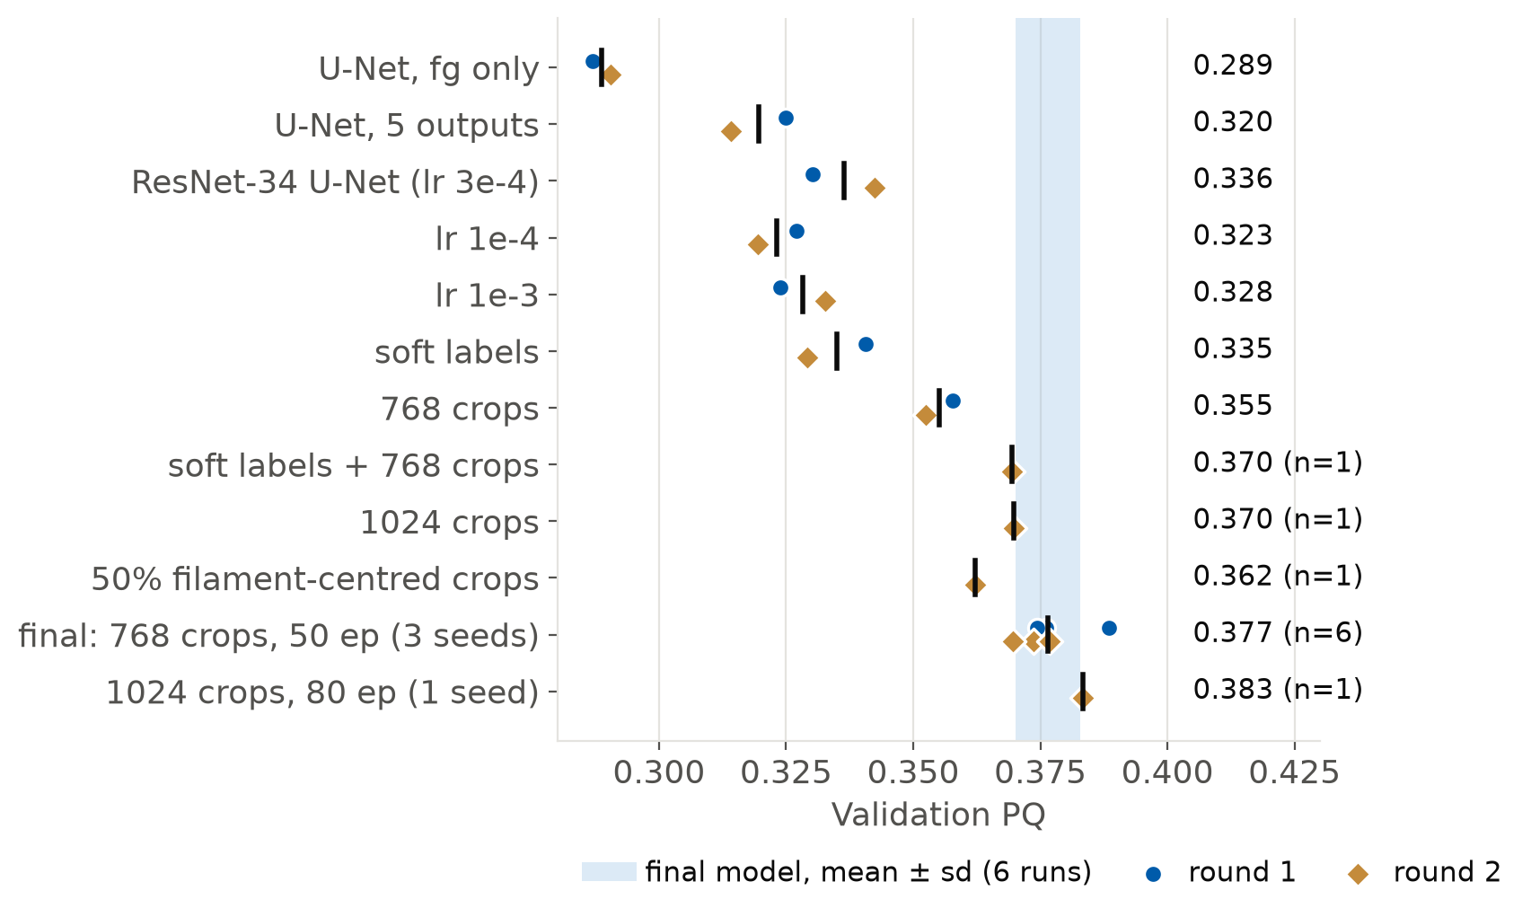
Tuning, and What Held Up
The whole search was run twice
One setup varies by ±0.007 PQ between runs
Held up: 5 outputs +0.031, 768 crops +0.019, pretrained +0.017, 50 epochs +0.021
Didn't: soft labels (+0.010, then −0.013)
1024 crops, 80 epochs: within the noise at 2.9× the cost, so we stopped
Final model: ResNet-34 U-Net, 768 crops, 50 epochs
Validation PQ 0.377 ± 0.006 (6 runs)
24.4 M parameters · ~70 min to train · 0.40 s per image end to end
Notes:
We tuned greedily: architecture first, then learning rate, then labels and crop size, then longer training. Then we ran the whole search a second time. Each dot is one run, blue for the first round and gold for the second.
That showed runs of the same setup differ by about 0.007 PQ. The extra outputs, larger crops, the pretrained encoder and longer training held up in both rounds. Soft labels didn't, so we dropped them. Even larger crops and 80 epochs stayed inside the noise at nearly three times the cost, so we stopped there.
The final model scores 0.377 plus or minus 0.006 over six runs, trains in about 70 minutes and takes 0.4 seconds per image. Its main errors, false positives and fragmented filaments, are what the enhancement section tackles next.

Slide 7
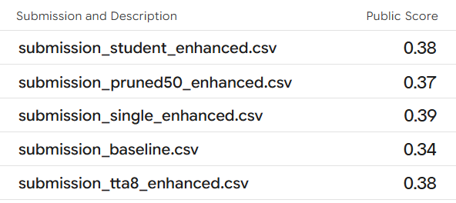
Results
Panoptic Quality: validation and Kaggle
Kaggle submissions (public scores)
Submission | Validation | Kaggle
Notebook 02 pipeline* (the baseline) | 0.405 | 0.34
Enhanced, single pass | 0.410 | 0.39
Enhanced + TTA ×8 | 0.414 | 0.38
ResNet-18 student | 0.407 | 0.38
50% pruned † | 0.386 | 0.37
Validation: seed 1, out-of-fold. * round-1 model, threshold tuned on the same validation images. † post-processing tuned for the full model.
Cross-fitted estimates held up: 0.02 lower on test, against 0.065 for in-sample tuning
TTA's small validation gain did not carry over to the test set
Final submission: enhanced single pass
Validation PQ 0.373 ± 0.004 → 0.404 ± 0.005 (3 seeds)
Kaggle 0.34 → 0.39
Final model size: 24.4 M parameters · trained in 61 min (50 epochs) · 0.52 s per image end to end, all on one T4
Notes:
I was responsible for the segmentation enhancement and will be speaking about how the results compared. Our final submission is the enhanced single-pass pipeline: which is the original U-Net with the post-processing. On validation, averaged over the three seeds and scored out-of-fold, PQ went from 0.373 to 0.404. On Kaggle's public test score, notebook 02's pipeline scored 0.34 and our enhancement model scored 0.39. The final model has 24.4 million parameters, took 61 minutes to train for 50 epochs on a single T4, and processes one image end to end, from the JPEG to the filament masks, in about half a second. The table compares every pipeline we submitted. Our cross-fitted validation estimates dropped only about 0.02 on the test set, while the threshold that was tuned and scored on the same validation images dropped 0.065. Test-time augmentation looked slightly better on validation but not on the test set, and the smaller models stayed within 0.01 to 0.02 of the full model.

Slide 8
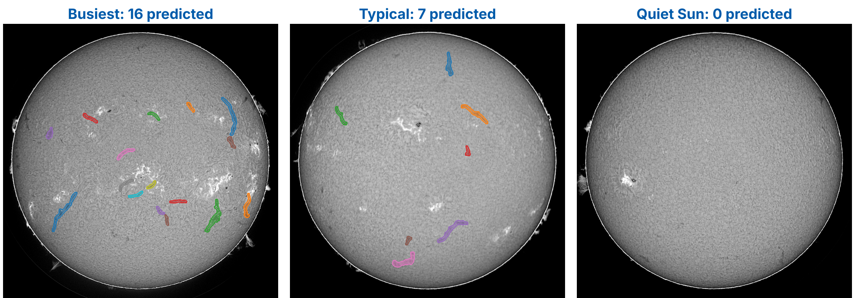
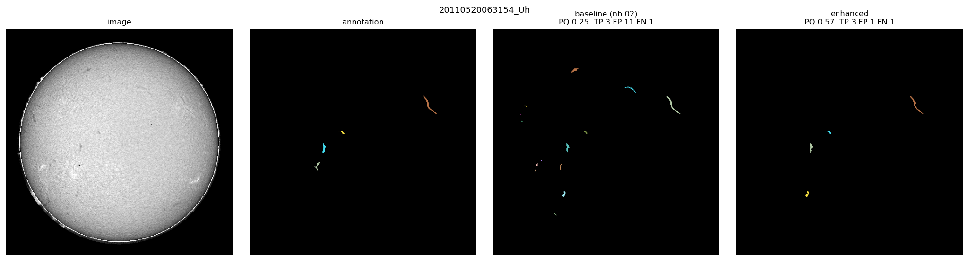
Results: Example Predictions
Test images, final pipeline
Where it fails, and why
Validation errors | Before | After
True positives | 848 | 685
False positives | 895 | 295
Missed filaments | 429 | 592
Broken filaments | 136 | 37
Merged filaments | 24 | 33
Main error now: misses. The filter also removes some real, faint filaments
Boundaries unchanged (SQ 0.65): the gain is in finding the right objects (RQ 0.56 → 0.59)
Annotators disagree: the same prediction's PQ varies by about 0.14 between annotators
Validation disk (image, annotation, notebook 02, enhanced): 11 false filaments → 1
Notes:
Here are predictions of the final pipeline on test images: the image with the most predicted filaments, a typical one, and one with none. On the busy and typical images the predictions sit on the long dark filaments you can see by eye, each as one object, and the bright active regions and sunspots are not picked up. The third image is a quiet Sun with only a few small, faint dark features near the edge of the disk; the model predicts nothing there. Most of those are probably too weak to count, but a short filament or two may be missed, which is the same weakness the table shows. Below is a validation disk where we can compare with the annotation: the base pipeline found 11 false filaments and our enhanced pipeline only found one. The table shows how the error types changed, averaged over the three seeds. False positives fell from about 900 to 300 and broken filaments from 136 to 37, but misses went up, because the filter also throws away some real, faint filaments. So the main remaining error is now missed filaments. Boundary quality hardly changed, so the gain comes from finding the right objects. Part of the remaining error is label noise: the same prediction's PQ varies by about 0.14 depending on which annotator it is compared with.

Slide 9
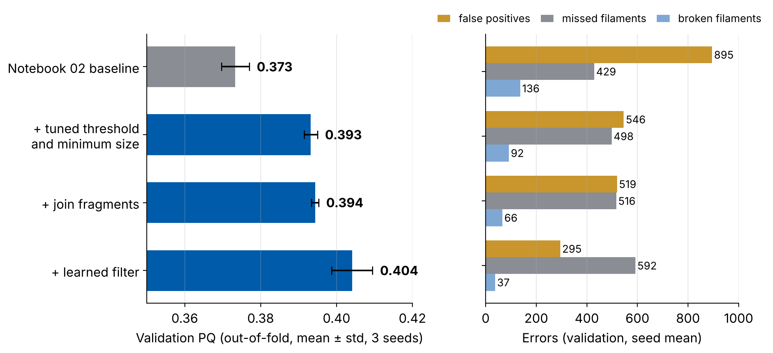
Segmentation Enhancement
Using all five outputs
Main error: false positives, 895 vs 848 true positives
Tuned threshold and minimum size: +0.020
Learned filter: boosted trees on 14 features per filament (size, confidence, shape, spine, position): +0.010
Joining fragments: fewer broken filaments, more merges, net ≈ 0
Hysteresis, splitting merges and a rule filter were switched off by the tuning
Enhanced post-processing
Validation PQ 0.373 → 0.404 (+0.031)
95% interval +0.013 to +0.049 · same network, no retraining
Tuned on one half of validation, scored on the other, all 3 seeds
Notes:
What we did for enhancement beyond a standard pipeline, and how much each idea helped. The network predicts five maps, but the baseline only used the filament mask. Its main error was false positives: about 895 false detections against 848 true ones. To measure each idea honestly, every setting was tuned on one half of the validation set and scored on the other half, on all three seeds. Tuning the threshold and minimum size gave plus 0.02. A small gradient-boosted classifier that scores each predicted filament on 14 features, like its size, confidence, shape and spine, gave another plus 0.01 and cut false positives to about 300. Joining fragments reduced broken filaments but caused merges, so it was roughly neutral, and splitting merged filaments were switched off by the tuning because merges were rare. Overall, validation PQ went from 0.373 to 0.404, with the same network and no retraining.

Slide 10
Enhancement: Cost and Compression
Accuracy against cost
What we learned
Pipeline | Size (params) | Training | s / img | Val PQ
Notebook 02 pipeline | 24.4 M | 61 min | 0.48 | 0.373
Enhanced post-proc. | 24.4 M | 61 min | 0.52 | 0.404
+ test-time augm. ×8 | 24.4 M | 61 min | 1.47 | 0.410
3-seed ensemble | 73.3 M | 184 min | 0.79 | 0.407
50% channels pruned | 6.1 M | +14 min | 0.43 | 0.404
ResNet-18 student | 14.3 M | 31 min | 0.47 | 0.407
Distilled student | 14.3 M | 63 min‡ | 0.42 | 0.394
Structured pruning (L1 norm, iterative): remove 25%, then 50% of channels, fine-tune 8 epochs each
75% fewer parameters and FLOPs, same PQ; before fine-tuning PQ was 0
Unstructured pruning (50% zeros): 12.2 M non-zero weights, but the same layers, so no faster
Distillation from the 3-seed ensemble did not beat training the same student on labels alone
TTA and ensembles: within run-to-run noise, for 1.5–3× the time
fp16 runs the network 1.5× faster than fp32; half resolution drops PQ to 0.17
All with enhanced post-processing tuned for that model, except the first row; it needs no retraining. Training and timing on one Kaggle T4; seconds per image end to end (JPEG → instances). Pruning: fine-tuning added to the 61 min. ‡ plus training the 3-model teacher.
Notes:
Next, more complex versus smaller models. Each row has its post-processing tuned for that specific model and the table gives each one's size, training time on one T4 and end-to-end time per image. Averaging eight rotated and flipped copies, or three seeds, added at most 0.006 to the score, which is within the run-to-run noise, at one and a half to three times the time. For compression, we used iterative structured pruning: remove a quarter of every layer's channels with the smallest L1 norm, fine-tune, then prune to half and fine-tune again. That kept PQ at 0.404 with 75 percent fewer parameters and FLOPs, for only 14 extra minutes of fine-tuning, but straight after pruning PQ was zero, so retraining is essential. Unstructured pruning zeroed half the weights but kept every layer the same shape, so it was no faster. A ResNet-18 student matched the full model, but distilling from the ensemble did not help in our setup. fp16 resolution is 1.5 times faster than fp32, however this loses the thin filaments.

Slide 11
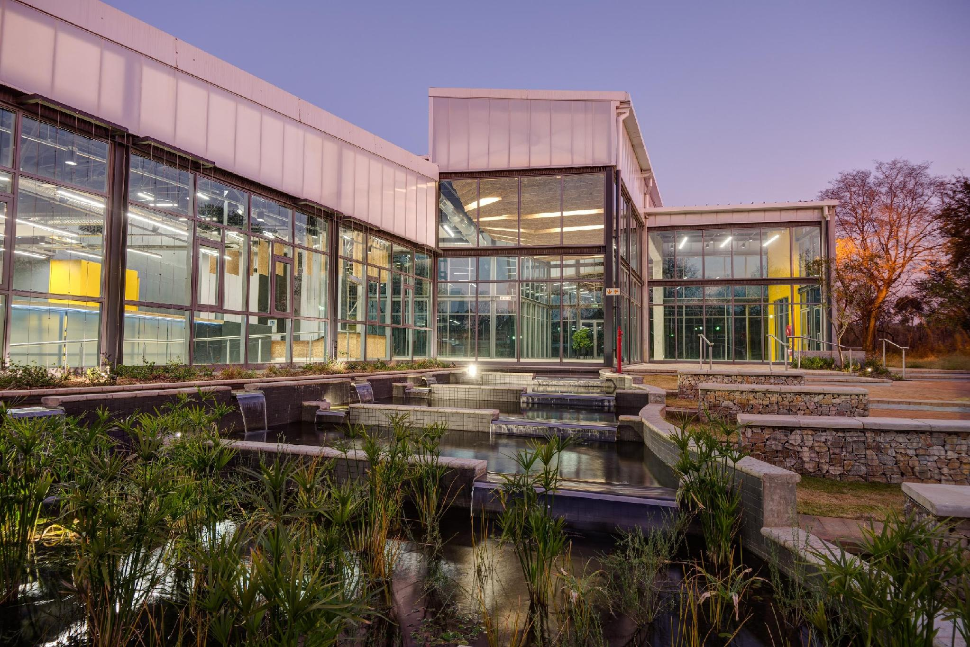
Conclusions
Summarise the main take-aways from your experiments.
Highlight the biggest roadblocks.
Reflect on what you would do differently if you had to do the same task again.

Slide 12
Bibliography
Paper 1
Paper 2
Website 3

