Slide 1
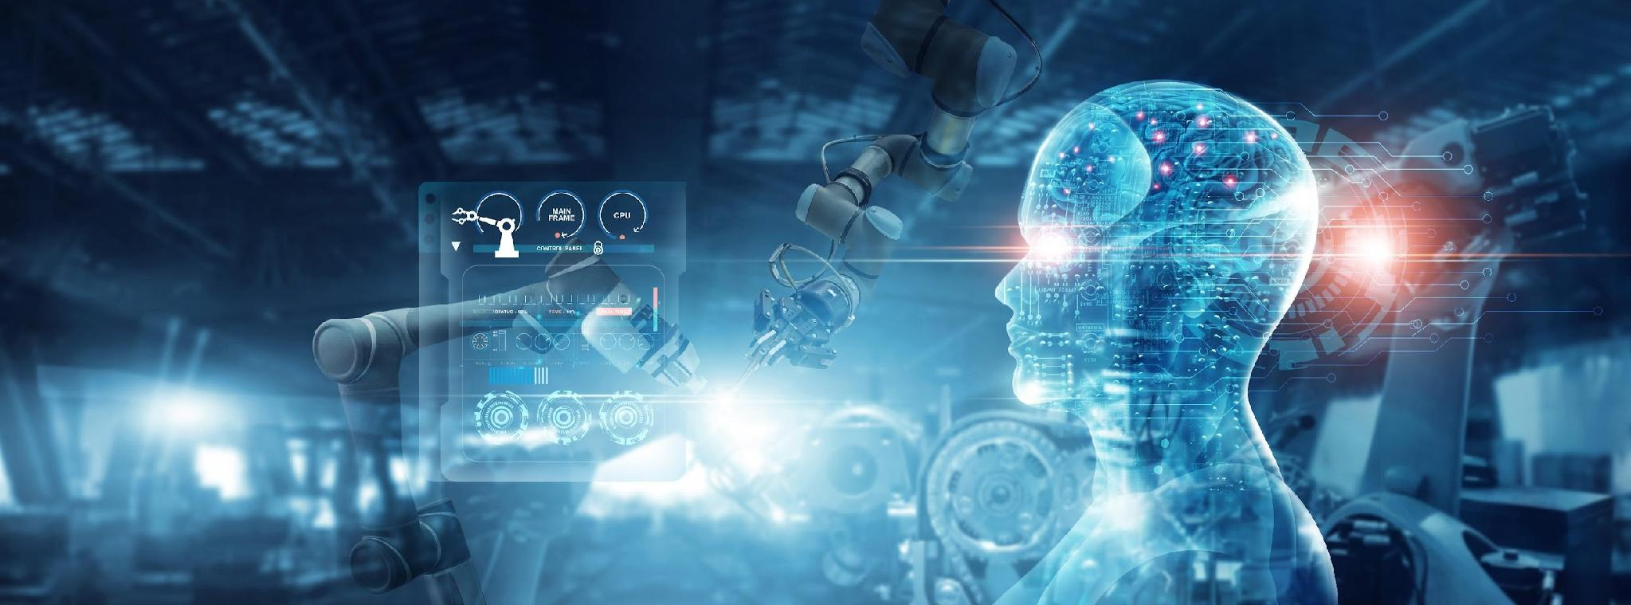

COS711 Assignment 3
Segmenting solar filaments with deep learning
Sean Maritz - u23592274
[Team member names and student numbers]

Slide 2
Team and Responsibilities
Sean Maritz (u23592274): Dataset Preparation
Name Surname (student number): responsibility
Name Surname (student number): responsibility (delete if not needed)
Notes:
Introduce the team. Clearly outline the responsibility of each team member; every member must be featured in the video.

Slide 3
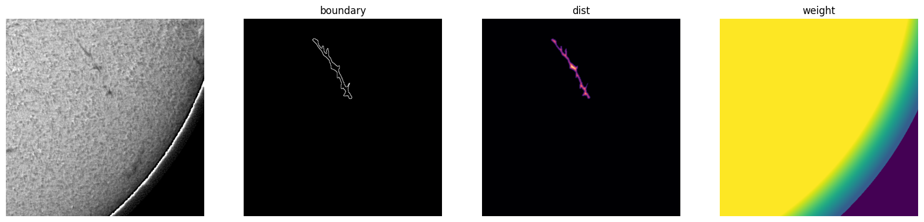
Dataset Preparation
What did you discover about the data, and how did you prepare it?
Preprocessing and scaling (e.g. resolution, normalisation)
Augmentation
Noisy samples and class imbalance
Training / validation split
Step 1: Parse and Group
Step 2: Split
Step 3: Geometry check
Step 4: Normalisation
Step 5: Build targets
Notes:
Firstly going into this what did we discover firstly and how we prepared for it. The data consists of 1,154 annotated image sets covering 707 distinct observations (train), taken from six instruments (Bh, Ch, Lh, Mh, Th, Uh) between 2011 and 2022. Many observations were annotated by more than one person (1 to 3 annotation sets each) so the first goal was to ensure these annotations were not noisy or subjective
Step 1: Parse and group. The COCO JSON is loaded and each file name is parsed into a 14-digit timestamp plus a 2-letter instrument code (Bh, Ch, Lh, Mh, Th, Uh). Images are matched to files on disk, and all four annotation categories are merged into a single “filament” class. Images are then grouped into observations (timestamp + instrument). Annotation cleaning is also done here where polygons with too few points are dropped, coordinates are clipped to 2048x2048 frame and tiny or duplicate polygons are removed
Cleaning found the labels largely sound: of 8,199 polygons, only one was removed (tiny), with no duplicates or degenerate shapes. The geometry analysis showed that filaments are thin: median mean-width is about 11 px and median spine length about 111 px. Fewer than 0.5% have mean width under 4 px, which is the key finding that guided the resolution decision. The test set spans the same date range as training (2011-2022), so no temporal extrapolation is required.
Step 2: Observations are assigned to train or validation in 7-day blocks, targeting about 15% validation per instrument. The split is 600 train and 107 validation observations the use of a 7-day blocks rather than random images prevented near-duplicate consecutive observations from leaking between train and validation. Blocks are chosen randomly (seed 1) while balancing per instrument, so each of the six instruments is represented in validation
Step 3: Each polygon is rasterised and its area, spine length, mean width and maximum width are measured, to decide whether downsampling would destroy thin structures.
We worked at full 2048×2048 resolution (scale 1.0) rather than downsampling, since the width statistics show that shrinking would erase thin filaments
Step 4: Normalisation, The solar disk is found by Otsu thresholding on a 512×512 copy, followed by a least-squares circle fit to the largest blob’s contour. Pixel intensities are clipped to the 1st-99th percentile inside the disk and rescaled to [0, 1]. Everything outside the disk is set to 0.
The only scaling is intensity normalisation: the solar disk is fitted with a circle, and percentile clipping (1-99%) is computed only from pixels inside the disk, so the background does not skew the contrast. This yielded consistent normalised statistics (mean about 0.61-0.69, std about 0.17-0.20) across instruments. Off-disk pixels are zeroed. Training uses 512×512 crops for memory efficiency, while validation uses full images.
Step 5: For every annotation set the notebook produces an instance map, plus a 5-channel target: foreground, boundary, contact (touching instances), a normalised distance transform, and the spine. The per-observation image, disk mask and a “soft” foreground are cached to disk. Augmentation is also done here which is deliberately light. random 90° rotations and random horizontal flips, applied identically to the image, targets and weight map. Rotation and flips are valid because the Sun has no canonical orientation in these crops. In addition, random crop placement acts as spatial augmentation, with a ±128 px jitter around the chosen filament centre. Some final cleaning was also done before parsing the data to the neural network where a z-score flags unusual observations per instrument, and 11 observations, all from Bh, failed the disk fit and fall back to a default centred circle. A limb weight map linearly down-weights pixels from 90% to 100% of the solar radius (to 0.3) and zeroes everything off the disk.
As shown in the image a final sanity check generates a figure for one training sample (cropped to 512 x 512) showing the input image next to the boundary which is used to teach the NN where object edges are, next to that is the normalised distance transform where each pixels value is its distance from the nearest edge divided by the maximum for that filament. Finally the per pixel loss weight map is shown which is a multiplier applied to the loss at each pixel during training. Yellow is the interior of the disk, green to teal is the region between 90% and 100% of the solar radius, dark blue is everything outside the disk.

Slide 4
Experimental Setup and Methodology
Tools and compute
Problem formulation
Python 3, PyTorch 2: mixed precision (fp16), AdamW
segmentation-models-pytorch: ImageNet ResNet-34 encoder
OpenCV, pycocotools: masks and connected components
Kaggle T4 GPU (16 GB): ~30 free GPU-hours a week
Checkpoint every epoch, resume across Kaggle's 12-hour sessions
GitHub: one notebook per stage, shared src/ package
Scored by Panoptic Quality (PQ = SQ × RQ): a split or merged filament counts as an error, like a miss.
So: bottom-up instance segmentation. One U-Net predicts five maps; instances are grouped afterwards.
Output map | Loss | Purpose
Filament mask | BCE + Dice | which pixels
Instance boundary | BCE ×3 + Dice | separate neighbours
Contact | BCE ×10 + Dice | cut merged ones
Distance to edge | MSE | instance centres
Spine | BCE ×3 + Dice | keep thin ones whole
Notes:
I was responsible for the experimental setup and methodology. We used PyTorch with mixed precision, and segmentation-models-pytorch for a pretrained encoder, and trained on Kaggle's free T4 GPUs. Every run saves a checkpoint each epoch, so it survives Kaggle's 12-hour session limit.
The competition is scored with Panoptic Quality, where splitting or merging filaments costs as much as missing one. So we treated this as bottom-up instance segmentation: one U-Net predicts the five maps Sean built. That's the filament mask, plus boundary, contact, distance and spine maps that help separate filaments and keep them whole. The thin, rare maps get extra weight in the loss.

Slide 5
Models, Training and Evaluation
Two U-Nets compared
Training
Evaluation
From scratch
6 levels, 32 → 512 channels, BatchNorm
20.6 M parameters
ImageNet ResNet-34 encoder
RGB filters summed to 1 channel
24.4 M parameters
Kept: +0.017 PQ and 1.5× faster
Both: output bias starts at p = 0.01, since under 1% of pixels are filament
768 × 768 crops, batch 4 (crop size tuned: 512 → 768)
AdamW, lr 3e-4 (tuned), weight decay 1e-4
1-epoch warm-up, then cosine decay over 50 epochs
fp16 mixed precision, gradient clipping at 1
~1 hour per run on a T4
Crop sampling, augmentation and loss weights as in Dataset Preparation
Date-blocked split: 600 / 107 observations
Validate on the full 2048² disk, against every annotator
Keep the checkpoint with the best validation PQ, not the lowest loss
Also SQ, RQ, Dice, splits and merges
Same post-processing for every model
Notes:
We compared a U-Net trained from scratch with one using an ImageNet-pretrained ResNet-34 encoder. The pretrained one scored about 0.017 PQ higher and trained one and a half times faster, so we kept it. It trains on 768-pixel crops with AdamW, a short warm-up and cosine decay, in about an hour per run.
We validate on the full disk against every annotator, using Sean's date-blocked split. We keep the checkpoint with the best validation PQ rather than the lowest loss, because the loss doesn't penalise splits and merges.

Slide 6
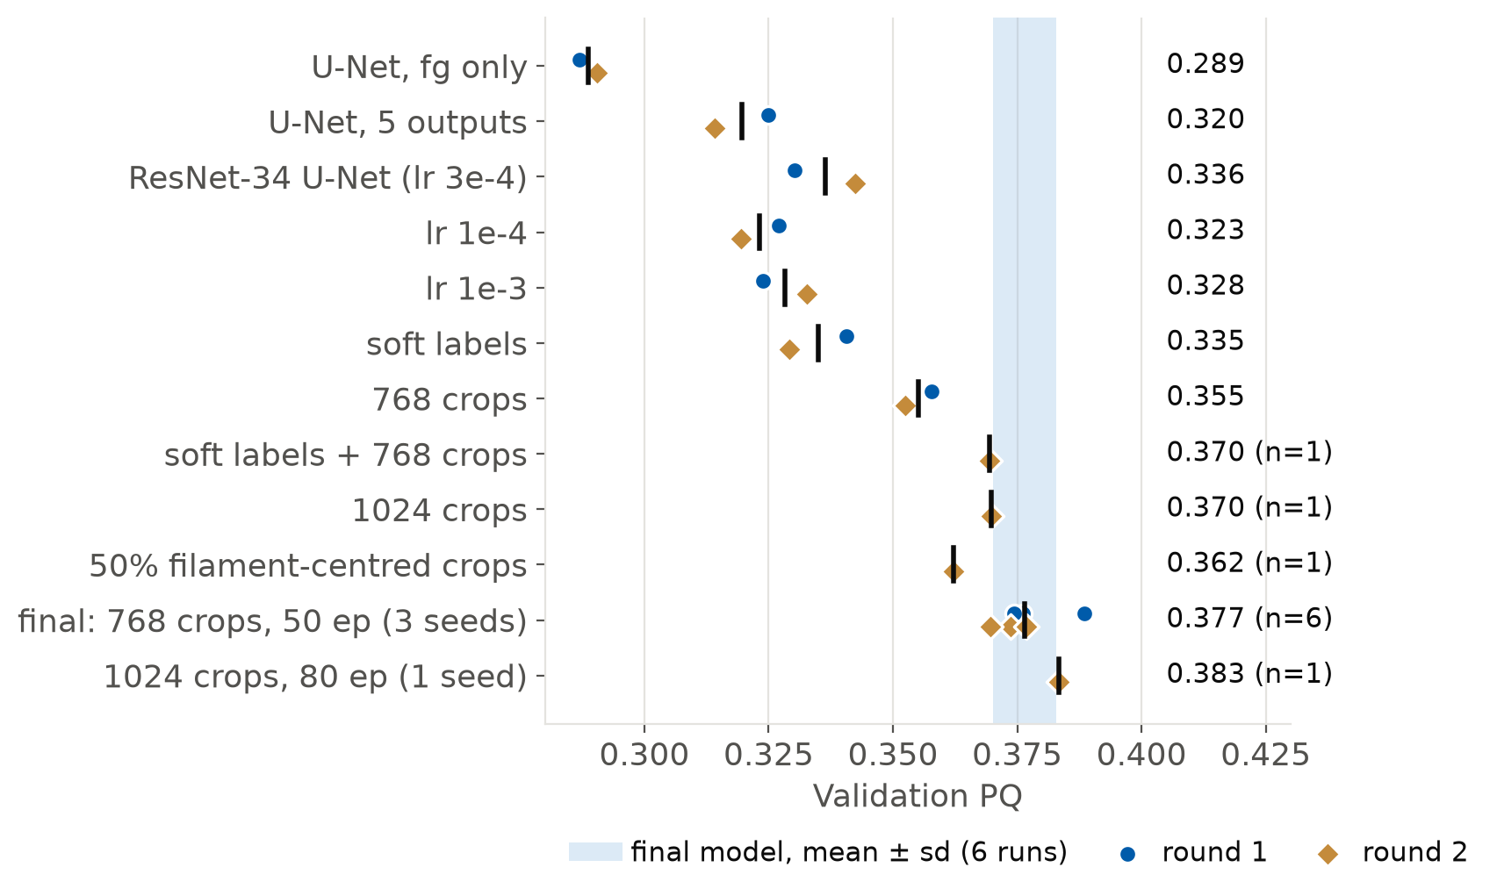
Tuning, and What Held Up
The whole search was run twice
One setup varies by ±0.007 PQ between runs
Held up: 5 outputs +0.031, 768 crops +0.019, pretrained +0.017, 50 epochs +0.021
Didn't: soft labels (+0.010, then −0.013)
1024 crops, 80 epochs: within the noise at 2.9× the cost, so we stopped
Final model: ResNet-34 U-Net, 768 crops, 50 epochs
Validation PQ 0.377 ± 0.006 (6 runs)
24.4 M parameters · about 1 hour to train · 0.40 s per image end to end
Notes:
We tuned greedily: architecture first, then learning rate, then labels and crop size, then longer training. Then we ran the whole search a second time. Each dot is one run, blue for the first round and gold for the second.
That showed runs of the same setup differ by about 0.007 PQ. The extra outputs, larger crops, the pretrained encoder and longer training held up in both rounds. Soft labels didn't, so we dropped them. Even larger crops and 80 epochs stayed inside the noise at nearly three times the cost, so we stopped there.
The final model scores 0.377 plus or minus 0.006 over six runs, trains in about an hour and takes 0.4 seconds per image. Its main errors, false positives and fragmented filaments, are what the enhancement section tackles next.

Slide 7
Results
How well did your model do? Include your Kaggle leaderboard screenshot.
Panoptic quality locally and on the Kaggle leaderboard (means and standard deviations over multiple runs where feasible)
Comparison between approaches
Kinds of errors: missed filaments or fine-scale structure, noise, fragmentation, merging

Slide 8
Results: Example Predictions
Show input images next to your predicted filament masks for a sample of test images.
Do the predictions seem viable?
Where do they fail, and why?
Best case VS worst case examples

Slide 9
Segmentation Enhancement
What did you do beyond a standard segmentation pipeline, and how much did each idea help?
Your own ideas, e.g. instance separation, keeping filaments intact, capturing fine-scale structure
Quantify the effect of each idea
Model size, training time and inference time, compression methods and their effect on quality

Slide 10
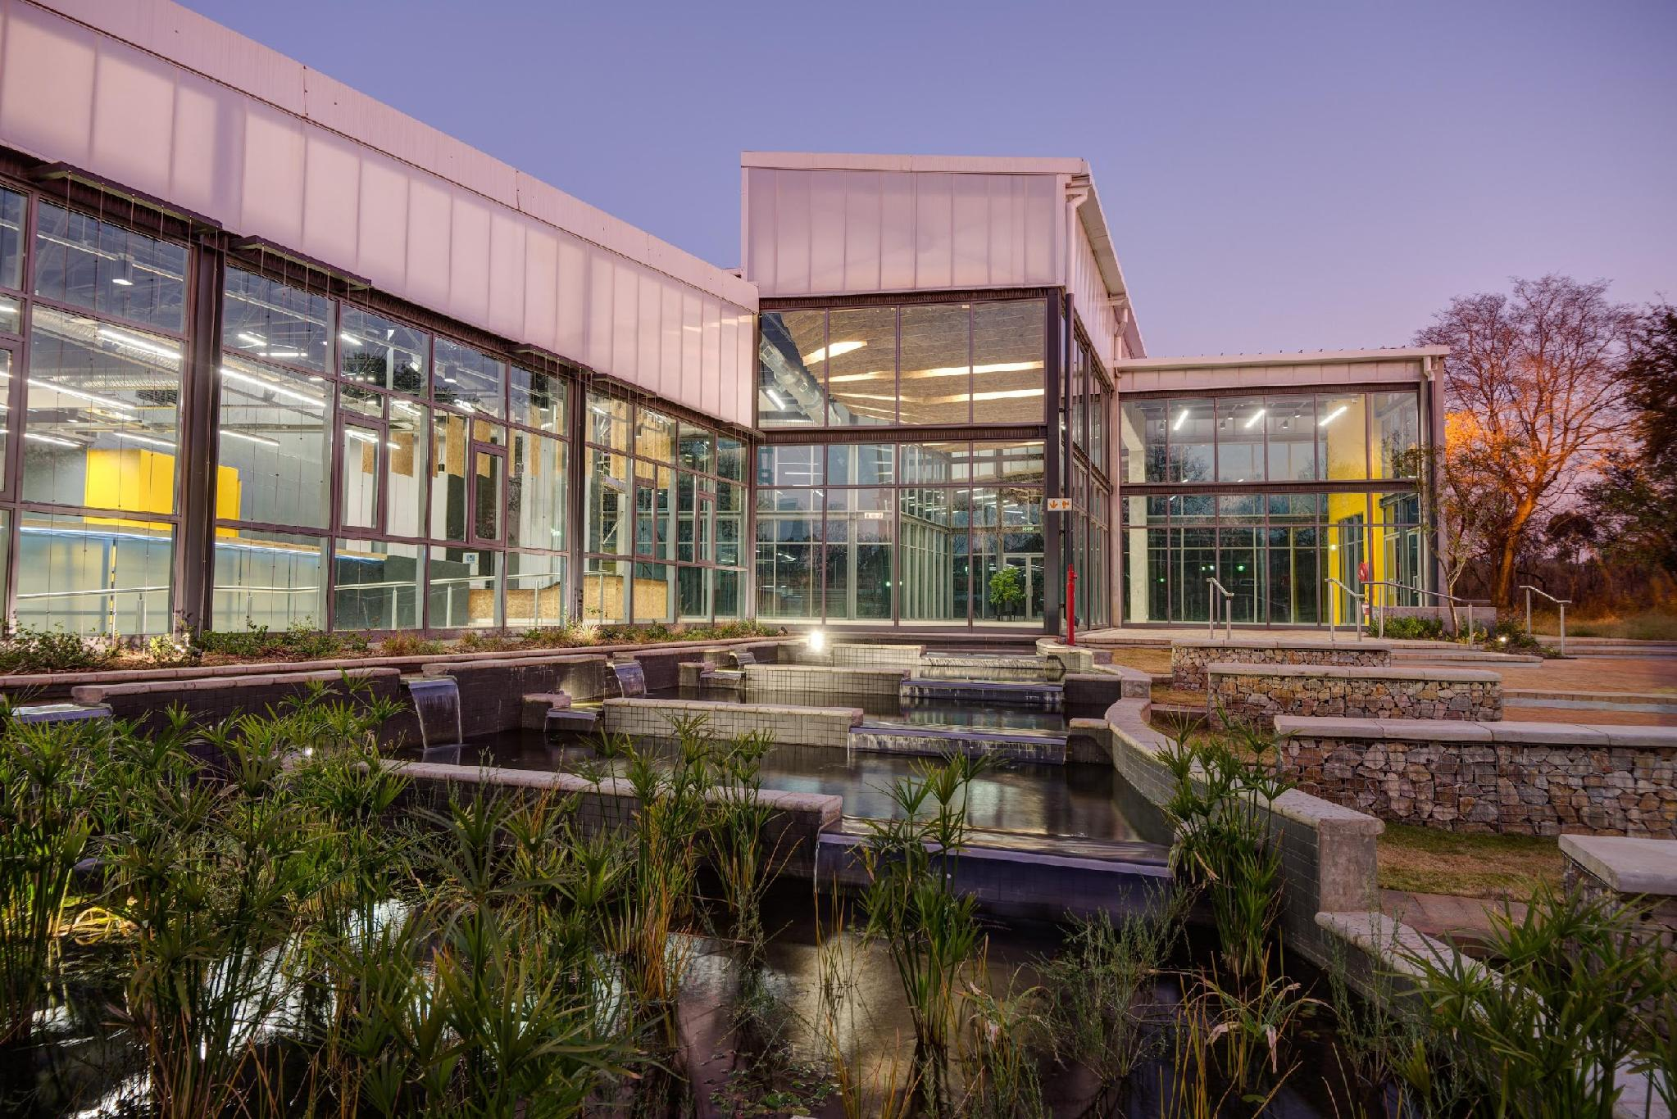
Conclusions
Summarise the main take-aways from your experiments.
Highlight the biggest roadblocks.
Reflect on what you would do differently if you had to do the same task again.

Slide 11
Bibliography
Paper 1
Paper 2
Website 3

