Slide 1
Predict. Prioritise. Retain.
A customer-retention decision engine for Meridian Trust Bank
Team Meridian — Person A (Data) · Person B (Model) · Person C (Strategy)
1

Slide 2
OUR APPROACH
A four-stage pipeline, each step defensible
DATA
UNDERSTANDING
PREDICTION
RECOMMENDATION
Clean · checksum · scale to 50k
EDA with 95% CIs · driver ranking
Calibrated model · holdout-tested
Tiers · playbook · measured pilot
• Raw data kept read-only; one shared loader; fixed seed 42 — every number reproducible.
• Split before synthesising, holdout touched once — no leakage into evaluation.
2
Notes:
Our method mirrors how a bank would deploy this. We clean and checksum the data, understand churn with confidence intervals, predict with a calibrated and holdout-tested model, and turn that into prioritised action proven by a pilot. Every step is reproducible from code with a fixed seed.

Slide 3
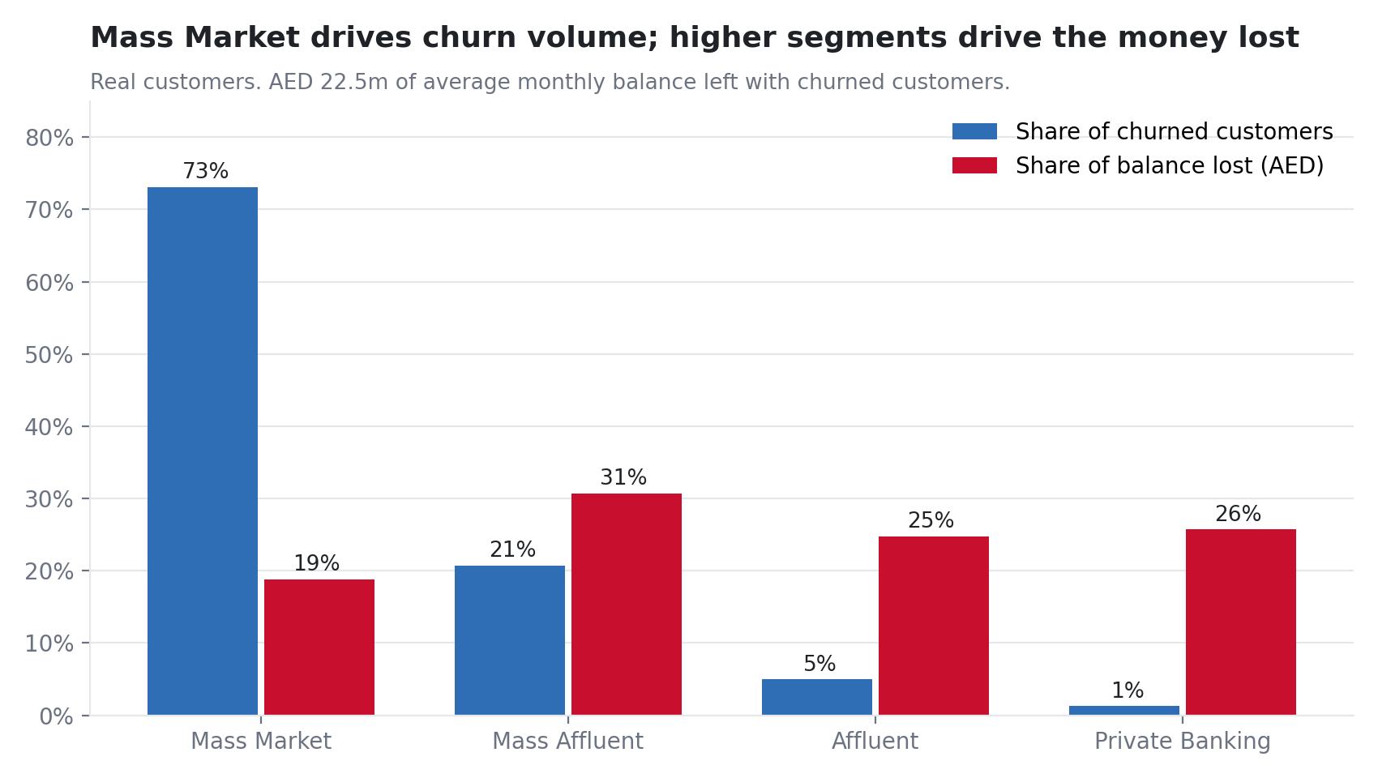
THE PROBLEM IN AED
AED 22.5m of balances sit with churned customers
• 1,578 of 10,000 customers have churned — 15.8% of the base.
• That is AED 22.5m in average monthly balances (6.6% of deposits).
• Mass Market = 73.1% of churners, but value concentrates at the top:
• Affluent + Private Banking = 50% of the balance lost.
Source: eda_findings.json; chart 08_segment_volume_vs_value. Real customers, n=10,000.
3
Notes:
Churn is 15.8% of customers but the money is what matters. Roughly AED 22 million in balances sits with customers who have left. Mass Market drives the count of churners, but the Affluent and Private Banking segments drive half the balance lost. That split is why we prioritise by balance at risk, not by probability alone.

Slide 4
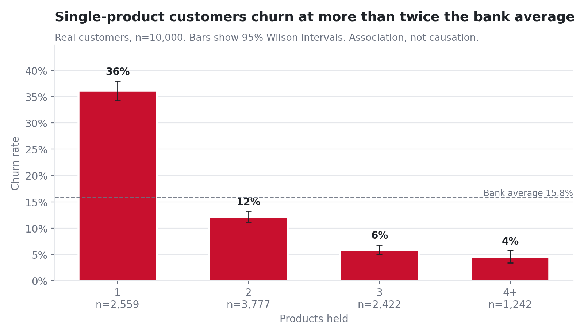
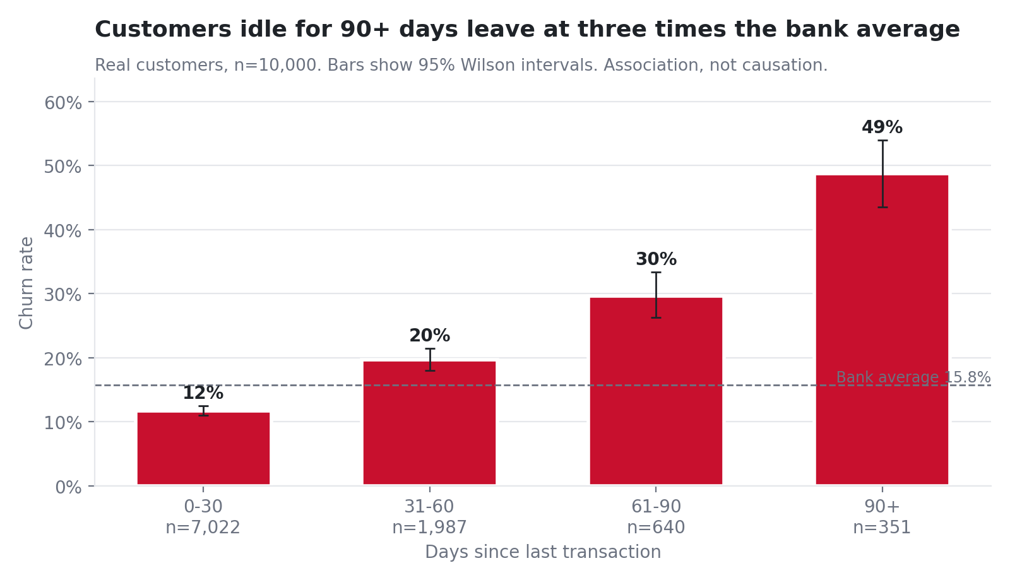
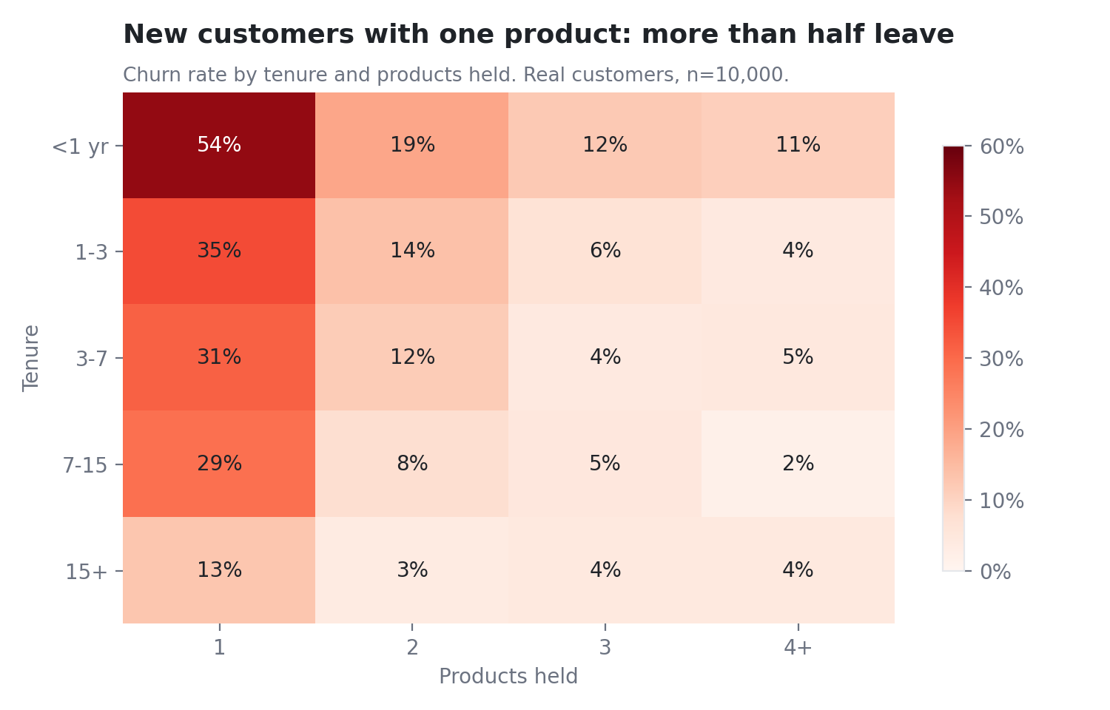
WHY CUSTOMERS LEAVE — DESCRIPTIVE
New, single-product and inactive customers leave hardest
• Single-product customers churn at 36.1% vs 12.2% for two products.
• 90+ days inactive: 48.7% churn. New customers: 28.1% vs 5.0% at 15+ yrs (5.64×).
• Association, not causation — bars show 95% Wilson intervals with sample sizes.
Source: eda_findings.json; charts 02, 03, 07. Real customers, n=10,000.
4
Notes:
These are the strongest patterns. Customers with one product churn at over triple the rate of those with two. Ninety days of inactivity is a near-50% churn signal. And the first year is decisive — new customers churn more than five times as often as 15-year customers. Every bar carries a confidence interval, and we are careful to call these associations, not causes.

Slide 5
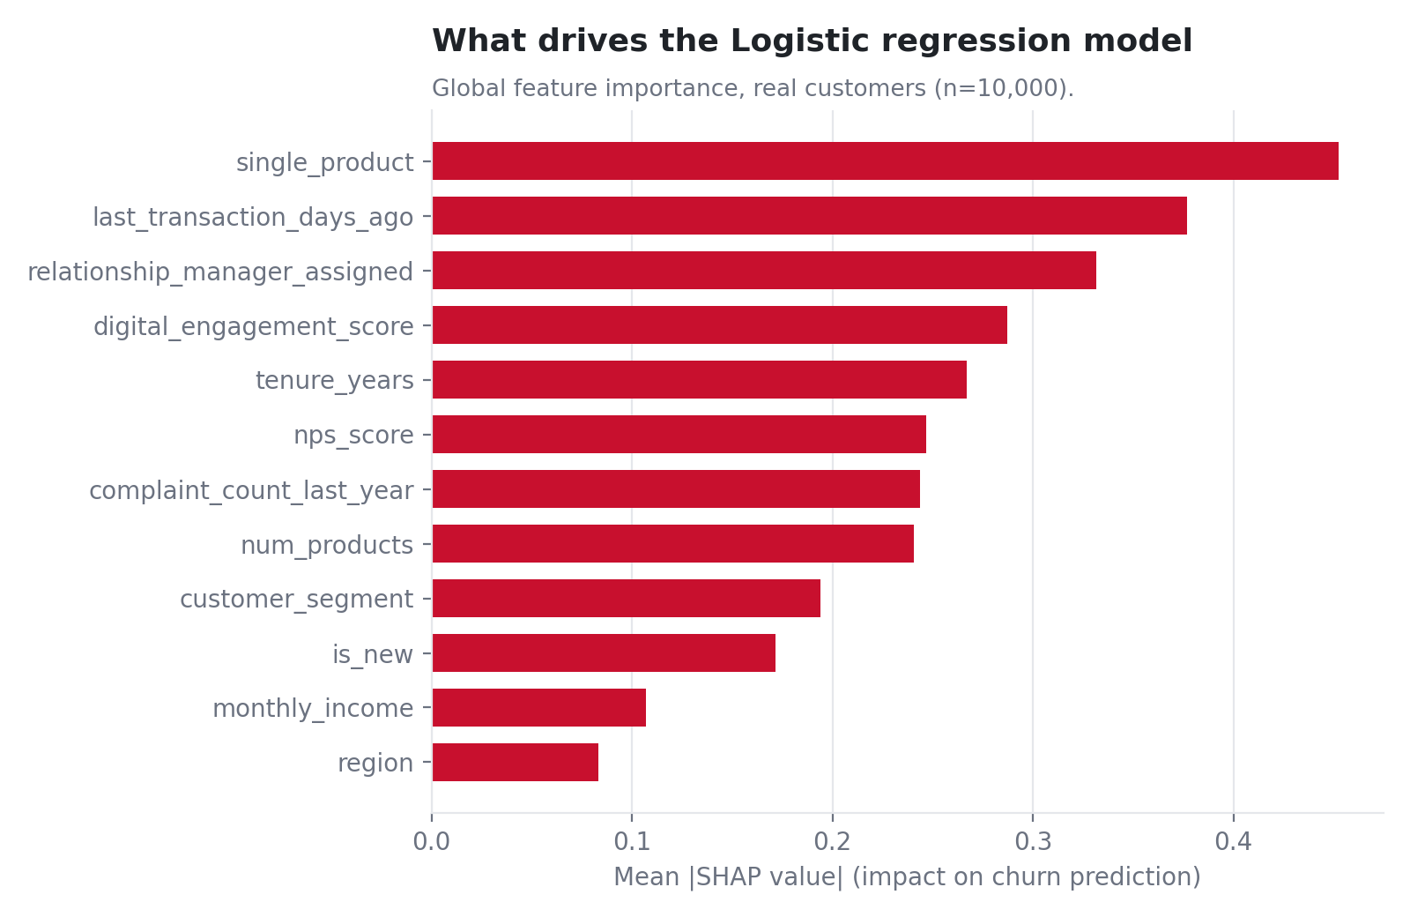
PREDICTING WHO WILL LEAVE — PREDICTIVE
A Logistic regression that beats the naive rule 0.559 vs 0.158 PR-AUC
model | cv_pr_auc | holdout_pr_auc | holdout_roc_auc
Baseline (tenure<1yr rule) | 0.1578 | 0.1578
Logistic regression (with recency) | 0.5207 | 0.5624 | 0.8444
LightGBM (with recency) | 0.4874 | 0.5416 | 0.8318
Logistic regression (no recency / deployed) | 0.4747 | 0.5017 | 0.8176
• Holdout PR-AUC 0.559 (95% CI 0.507–0.611), ROC-AUC 0.844.
• Top decile of scores captures 39% of all leavers.
• Isotonic-calibrated; leakage tested (drop 0.061 without recency).
Source: model_comparison.csv, metrics.json, SHAP figure. Trained on real data only.
5
Notes:
We trained on real data only, with a held-out 2,000 customers touched once. The model — a logistic regression chosen on cross-validated PR-AUC — far outperforms the naive new-customer rule. Its top decile catches almost 40% of all leavers. Probabilities are calibrated so that probability times balance is real money, and SHAP gives every customer a plain-English reason.

Slide 6
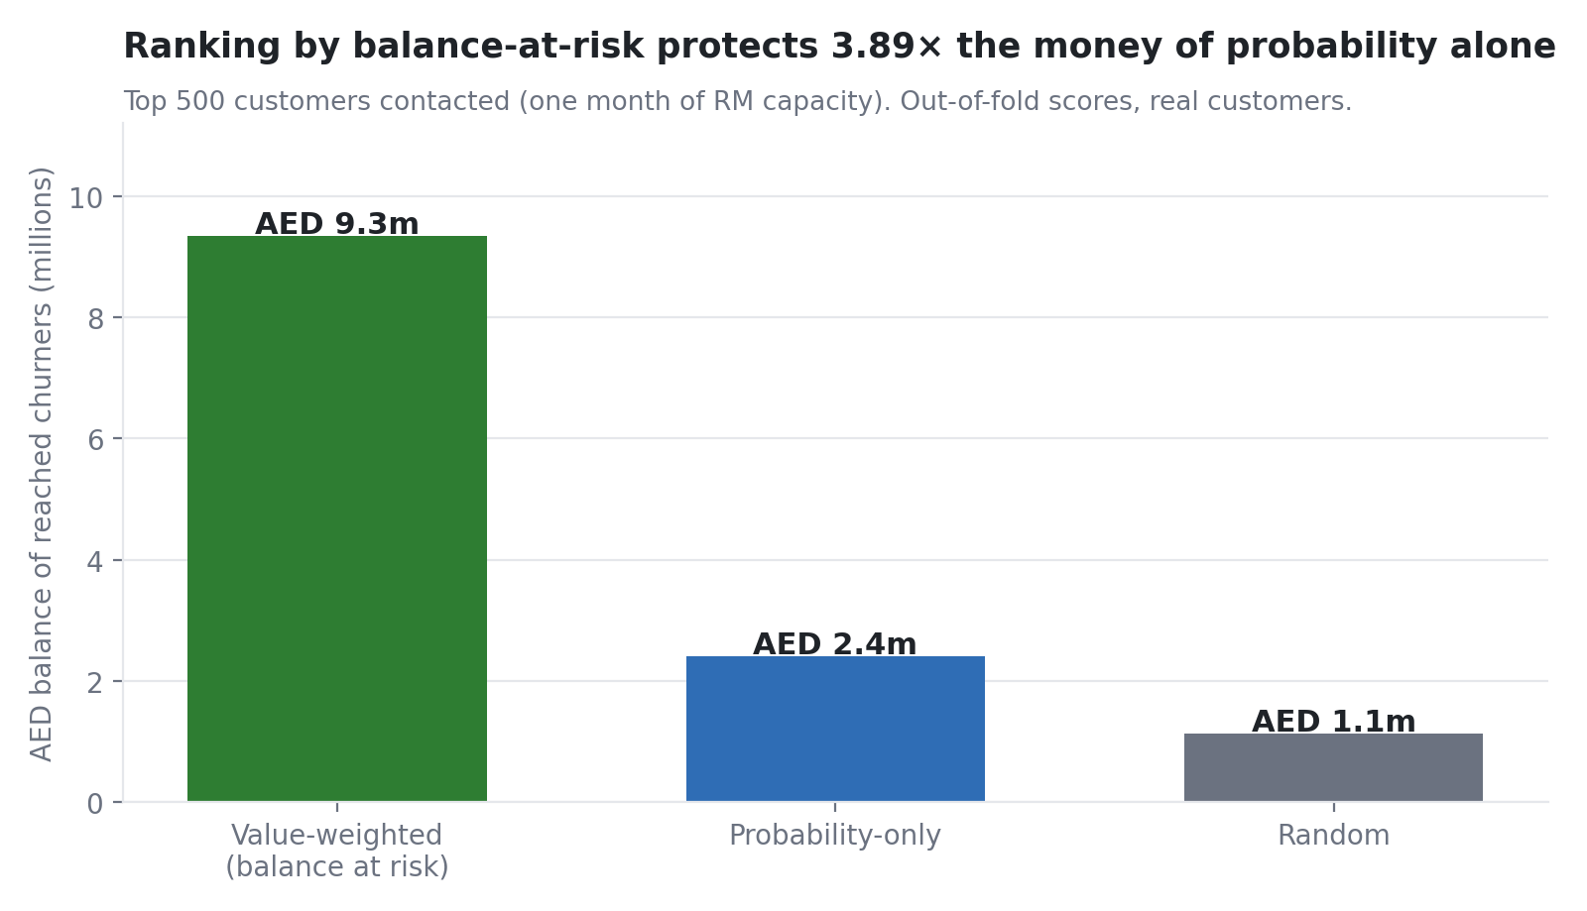
WHO TO SAVE FIRST
Ranking by balance-at-risk protects AED 9.3m vs 2.4m
T1 Save now
High risk · High value
48 customers
T2 Protect
Low risk · High value
2,452 customers
T3 Automated save
High risk · Low value
972 customers
T4 Monitor
Low risk · Low value
6,528 customers
Source: metrics.json tier_counts; value-capture chart. Capacity 500 contacts/month.
6
Notes:
We sort customers into four tiers on risk and value. High value means a balance in the top quartile. With only 500 RM contacts a month, how we rank matters enormously: ranking by expected balance at risk protects several times the money that ranking by probability alone would, and far more than random outreach. Same effort, much more deposit base retained.

Slide 7
RECOMMENDATIONS
From prediction to measured action
• Playbook by tier: onboarding journey (new/disengaged); priority complaint resolution + RM call;
• RM assignment / priority upgrade (high-balance, no RM); cross-sell bundle (single product); reactivation offer (dormant).
• Pilot: randomised controlled trial on T1 & T3, treatment vs BAU control, stratified by tier and segment.
• Power calc (40%→32% churn, α=0.05, power 0.8) sizes each arm; 90-day treatment, read at 90 & 180 days.
• KPIs: churn-rate uplift (primary); AED retained, ROI, products/customer, NPS (secondary).
• Decision rule: scale if uplift significant AND ROI>1; otherwise retire or redesign.
• The ask: approve the 90-day T1/T3 pilot and the RM capacity to contact the top-ranked customers.
7
Notes:
Each risk signal maps to a concrete intervention. Crucially, we do not claim these will work — we propose to prove it. A randomised controlled trial on the high-risk tiers, sized by a power calculation, will measure churn uplift and ROI. We scale only what works. The ask is approval for a 90-day pilot and the RM capacity to run it.

Slide 8
Appendix — methodology & practices
For technical Q&A: how we did each step.
8

Slide 9
A1
Data understanding & cleaning
• 10,000 retail customers, 19 numeric + 4 categorical fields, AED amounts.
• Target `churned` is imbalanced: 1,578 leavers (15.8%).
• `Aging` is a pre-binned tenure label — used for display, never as a model feature.
• No missing values and no duplicate IDs in the 10,000 clean rows.
• Raw file kept read-only; one shared loader removes all source quirks.
• Dropped junk title row, empty `Unnamed:` column, and the embedded summary block.
• Parsed comma-formatted balances to float; cast 12 columns to int.
• Extreme balances kept — Private Banking value is real signal, not noise.
9

Slide 10
A2
Validation, checksums & data quality
• Loader asserts 10,000 unique IDs before any analysis runs.
• Tenure-band counts and churn checksummed against the raw summary block (5/5 bands pass).
• Range checks on age, credit score, engagement, NPS, money — all clean.
• Flag-don't-drop: 1,009 tenure-vs-age and 199 products-vs-flags inconsistencies carried as columns.
• Raw data read-only; single shared loader; checksum against the source summary.
• Flag-don't-drop validation preserves the sample and surfaces data-quality findings.
• Split before synthesising (no leakage); `is_synthetic` + `data_split` lineage flags.
• Fixed seed 42; every number reproducible from code output.
10

Slide 11
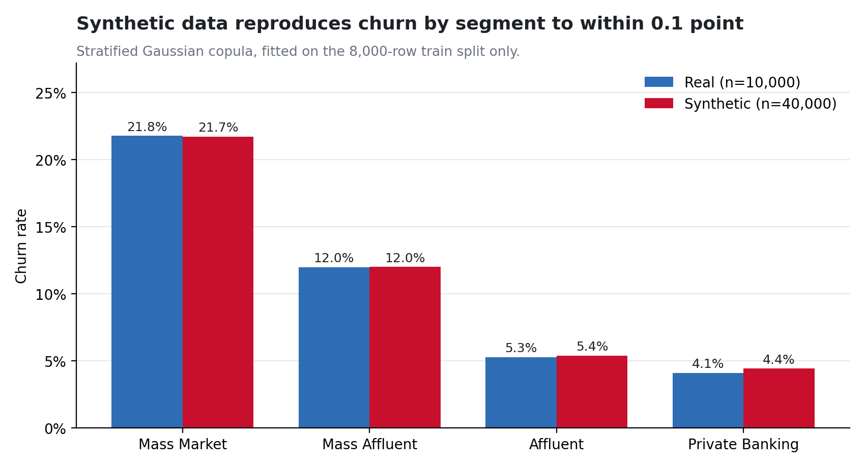
A3
Synthetic data: method & fidelity
• Stratified Gaussian copula — explainable in one slide, no heavy library.
• Fitted on 8,000 train rows only; 2,000-row holdout never seen (no leakage).
• 8 cells (segment × churned), each sampled 5× → segment mix and churn exact.
• Ranks→normal scores→correlated draws→back through each cell's quantiles.
• Churn rate 15.78% real vs 15.78% synthetic.
• Max KS distance 0.0060; max correlation gap 0.075.
• 0 synthetic rows identical to a real customer; 0 values out of range.
• Caveat: synthetic rows add volume, not information — headlines use the real 10,000.
11

Slide 12
A4
EDA method
• Churn rate with n and 95% Wilson intervals across 11 customer dimensions.
• Driver ranking by Cramér's V (p-values alone mean little at n=10,000).
• Columns charted on evidence; weak/redundant columns excluded and justified.
• Top drivers: num_products (0.336), last_transaction_days_ago (0.202), digital_engagement_score (0.197), customer_segment (0.186), avg_monthly_balance (0.172).
12

Slide 13
A5
Feature engineering & models compared
• Added log_balance, balance_to_income, is_new, single_product, has_complaint.
• gender excluded from the model (used only for the fairness check).
• Aging and customer_id dropped; one ColumnTransformer (scale + one-hot).
• Recency feature isolated so its leakage risk can be tested.
• Baseline rule (tenure<1yr): precision 0.30, recall 0.31.
• Logistic regression (balanced) and LightGBM (small grid, 5-fold CV).
• Selected by CV PR-AUC: Logistic regression.
• LightGBM grid: num_leaves {15,31} × learning_rate {0.05,0.1}, 300 trees.
13

Slide 14
A6
Validation design, leakage & robustness
• 80/20 stratified split, seed 42; holdout touched once.
• 5-fold stratified CV on train for model selection.
• Holdout PR-AUC 0.559 (95% CI 0.507–0.611), ROC-AUC 0.843.
• Top-decile capture 39% of all leavers.
• Recency may be an effect of churn, not a cause.
• With vs without recency: holdout PR-AUC drop 0.061.
• Deployed with recency (material drop).
• Synthetic data excluded from training by design.
14

Slide 15
A7
Explainability, fairness & responsible AI
• SHAP global bar + per-customer top-3 reasons in plain English.
• Strongest drivers: single_product, last_transaction_days_ago, relationship_manager_assigned, digital_engagement_score.
• Reasons map to actions (new, single-product, inactive, complaints, no RM).
• Logistic odds ratios available as a cross-check.
• Recall and false-positive rate reported by gender and age band.
• Gender kept out of the model entirely.
• Model informs outreach, never eligibility or pricing.
• Monthly re-scoring, PSI drift check, quarterly retrain (handover to pilot).
15

Slide 16
A8
Prioritisation logic & unseen-data demo
• expected_balance_at_risk = calibrated probability × balance.
• Isotonic calibration so AED figures are trustworthy.
• Tiers T1–T4 on risk (≥0.4) × value (≥AED 26,867).
• Out-of-fold scores so no customer is scored by a model trained on them.
• score.py scores 200 untouched holdout rows in raw format.
• Outputs id, probability, balance-at-risk, tier, top-3 reasons.
• Holdout metrics on the 200 match the reported holdout metrics.
• Proves the pipeline runs end-to-end on data it has never seen.
16

Slide 17
A9
Power BI model design + dashboard
• Star schema: `fact_customers` (50k) + `dim_segment` + `dim_tenure`, pre-sorted bands.
• 22 DAX measures in display folders; high-value threshold = 75th pct balance (AED 26,867).
• 5 pages: executive, drivers, value-at-risk, data quality & lineage, retention priority.
• Expected-values table lets every dashboard number be checked before presenting.
[missing: page1.png (Power BI screenshot)]
17

Slide 18
A10
Pilot design & power calculation
• RCT on high-risk tiers (T1, T3), treatment vs BAU control, stratified.
• Power calc in code: detect 40%→32%, α=0.05, power=0.8 → 564/arm.
• KPIs: churn uplift (primary), AED retained, ROI, NPS, products/customer.
• Decision rule: scale if uplift significant and ROI>1; else retire/redesign.
18

Slide 19
A11
Limitations, next steps & AI disclosure
• **Claude Code** assisted in writing the data-processing, modelling, charting and reporting code.
• All code is committed and reproducible; no numbers were hand-typed into documents.
• **Data:** the shared loader asserts 10,000 unique IDs and checksums tenure-band counts and churn
• **Synthetic data:** fidelity re-computed independently (KS, correlation gap, duplicate check,
• **Model:** evaluated once on an untouched 2,000-row holdout; PR-AUC reported with a bootstrap CI;
• **Charts:** every chart regenerated from code with 95% Wilson intervals and sample sizes shown.
• **Report & deck:** numbers injected from `metrics.json` and `eda_findings.json` via
• Gender excluded from the model; recall and false-positive rate reported by gender and age band.
• Correlation is never presented as causation; only the pilot (an RCT) can show cause.
• The model informs **outreach**, never credit, pricing or eligibility decisions.
19

