Slide 1




LLC@FRCRCE
WEBSITE PRESENTATION
By,
Sean Prerira (10272)
Devansh Nayak (10268)
Tanish Parkar (10264)

Slide 2

ABOUT OUR PROJECT
LLCFRCRCE is a digital course registration platform designed to streamline student enrollment and course management and make students learn and understand their courses better. It provides intuitive interfaces for both students and teachers, reducing administrative workload, minimizing errors, and ensuring a smooth, transparent registration process through automated preference handling and centralized data management.

Slide 3
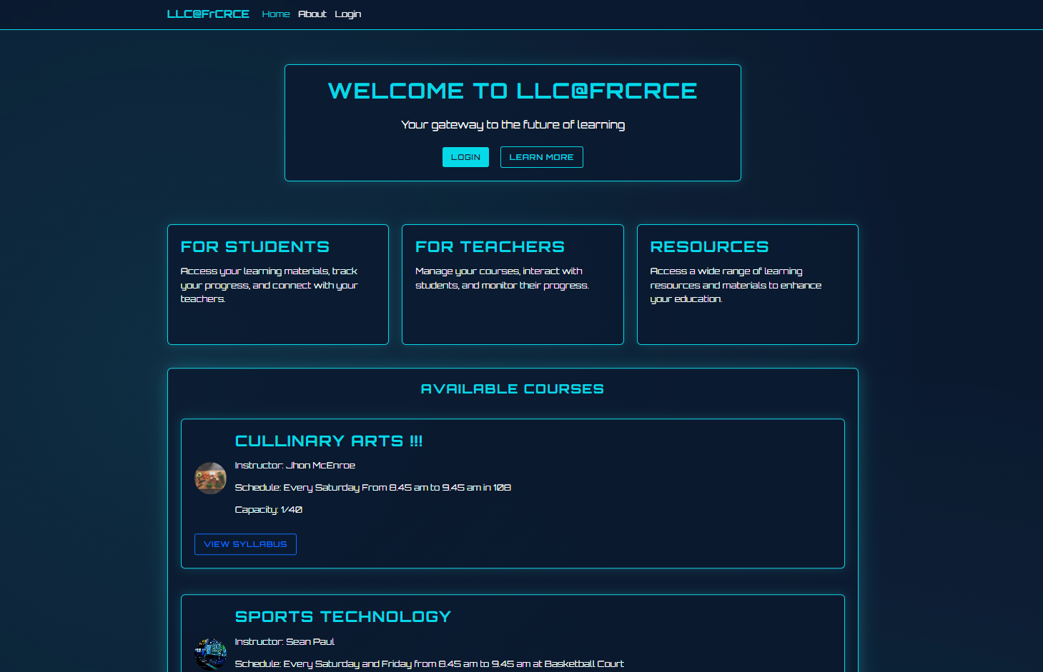
Welcome/Home Page on Desktop

Slide 4
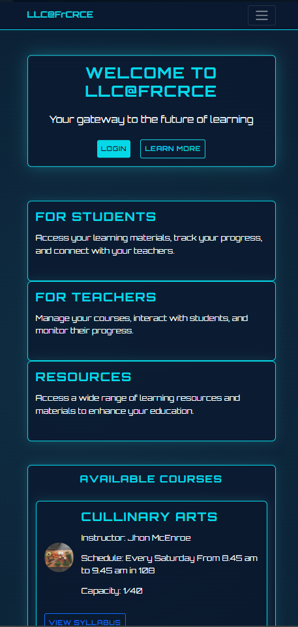
Home Page on Mobile Phone

Slide 5
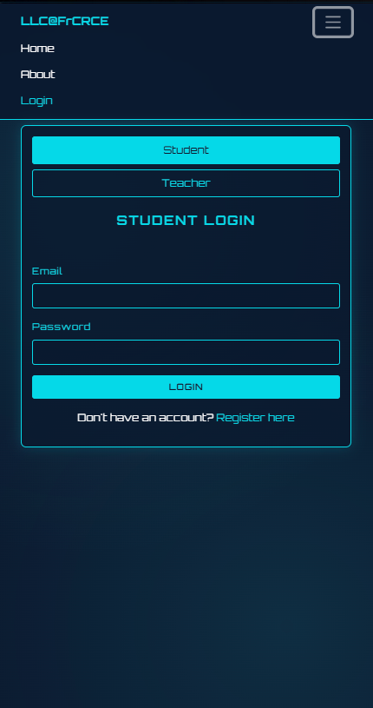
Student Registeration Page

Slide 6
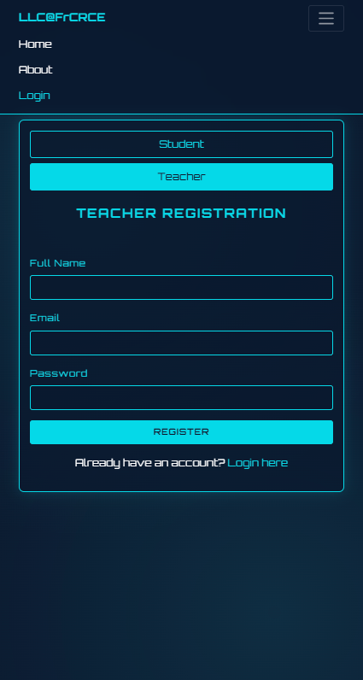
Teacher Registeration Page

Slide 7
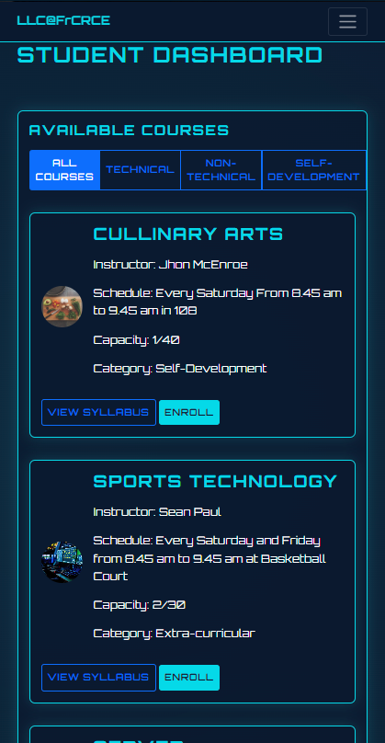
Student Dashboard

Slide 8
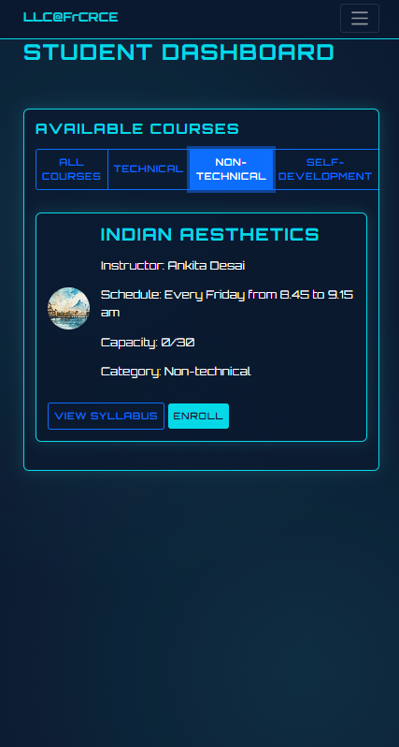
Using Course Filter

Slide 9
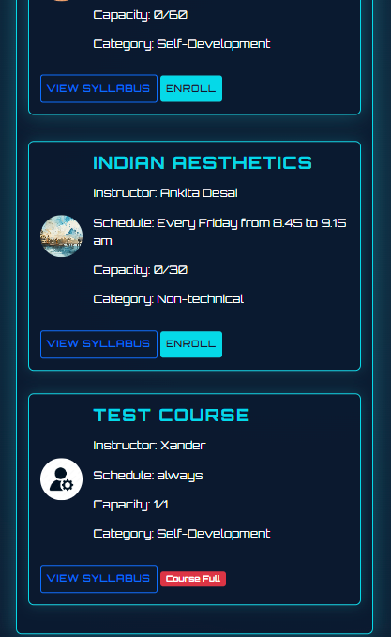
Student Dashboard: batch enrollment regulation for a course

Slide 10
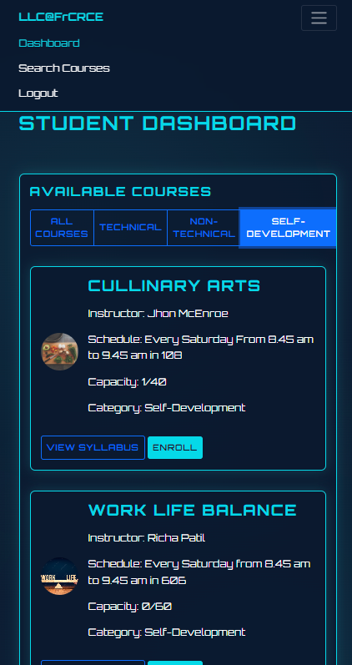
Drop Down Functionality

Slide 11
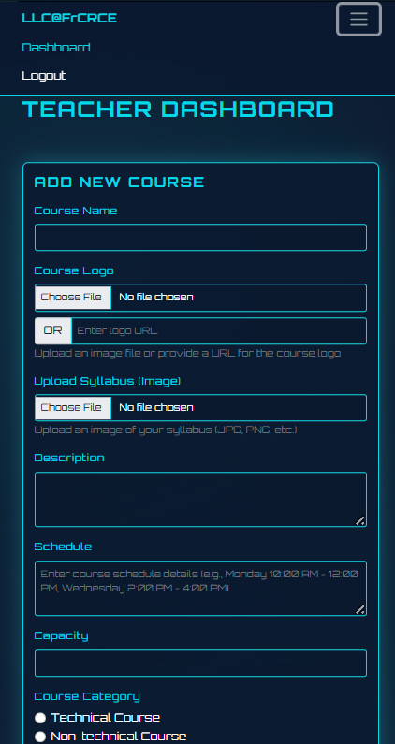
Teacher Dashboard: Creating a Course

Slide 12
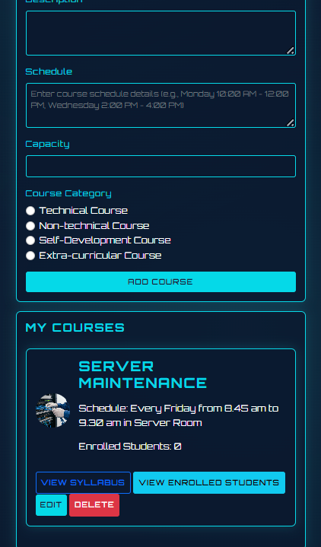
Teacher Dashboard: Maintaining and Editing Course

Slide 13
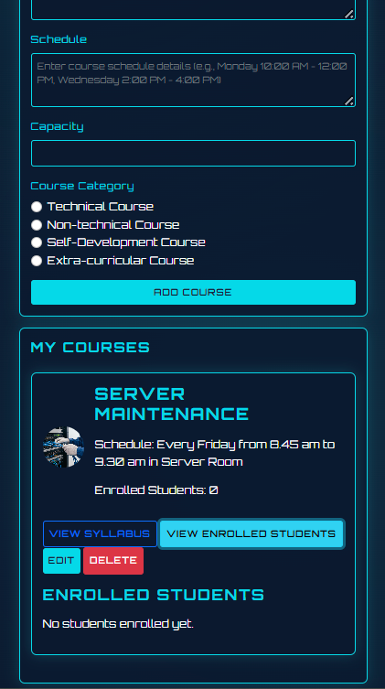
Teacher Dashboard: Checking list of enrolld students in a Course

Slide 14
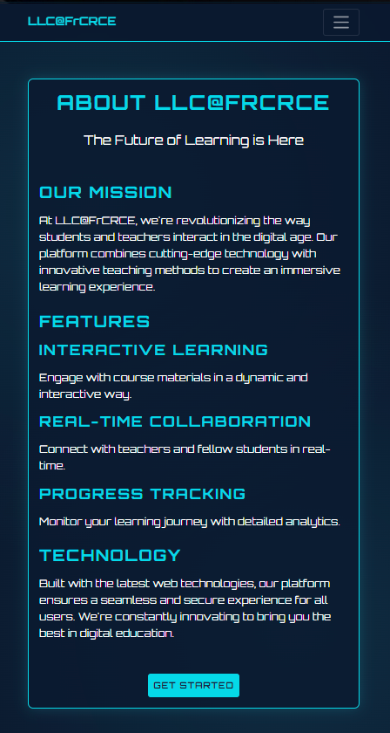
About Page

Slide 15
THANK YOU

