Slide 1

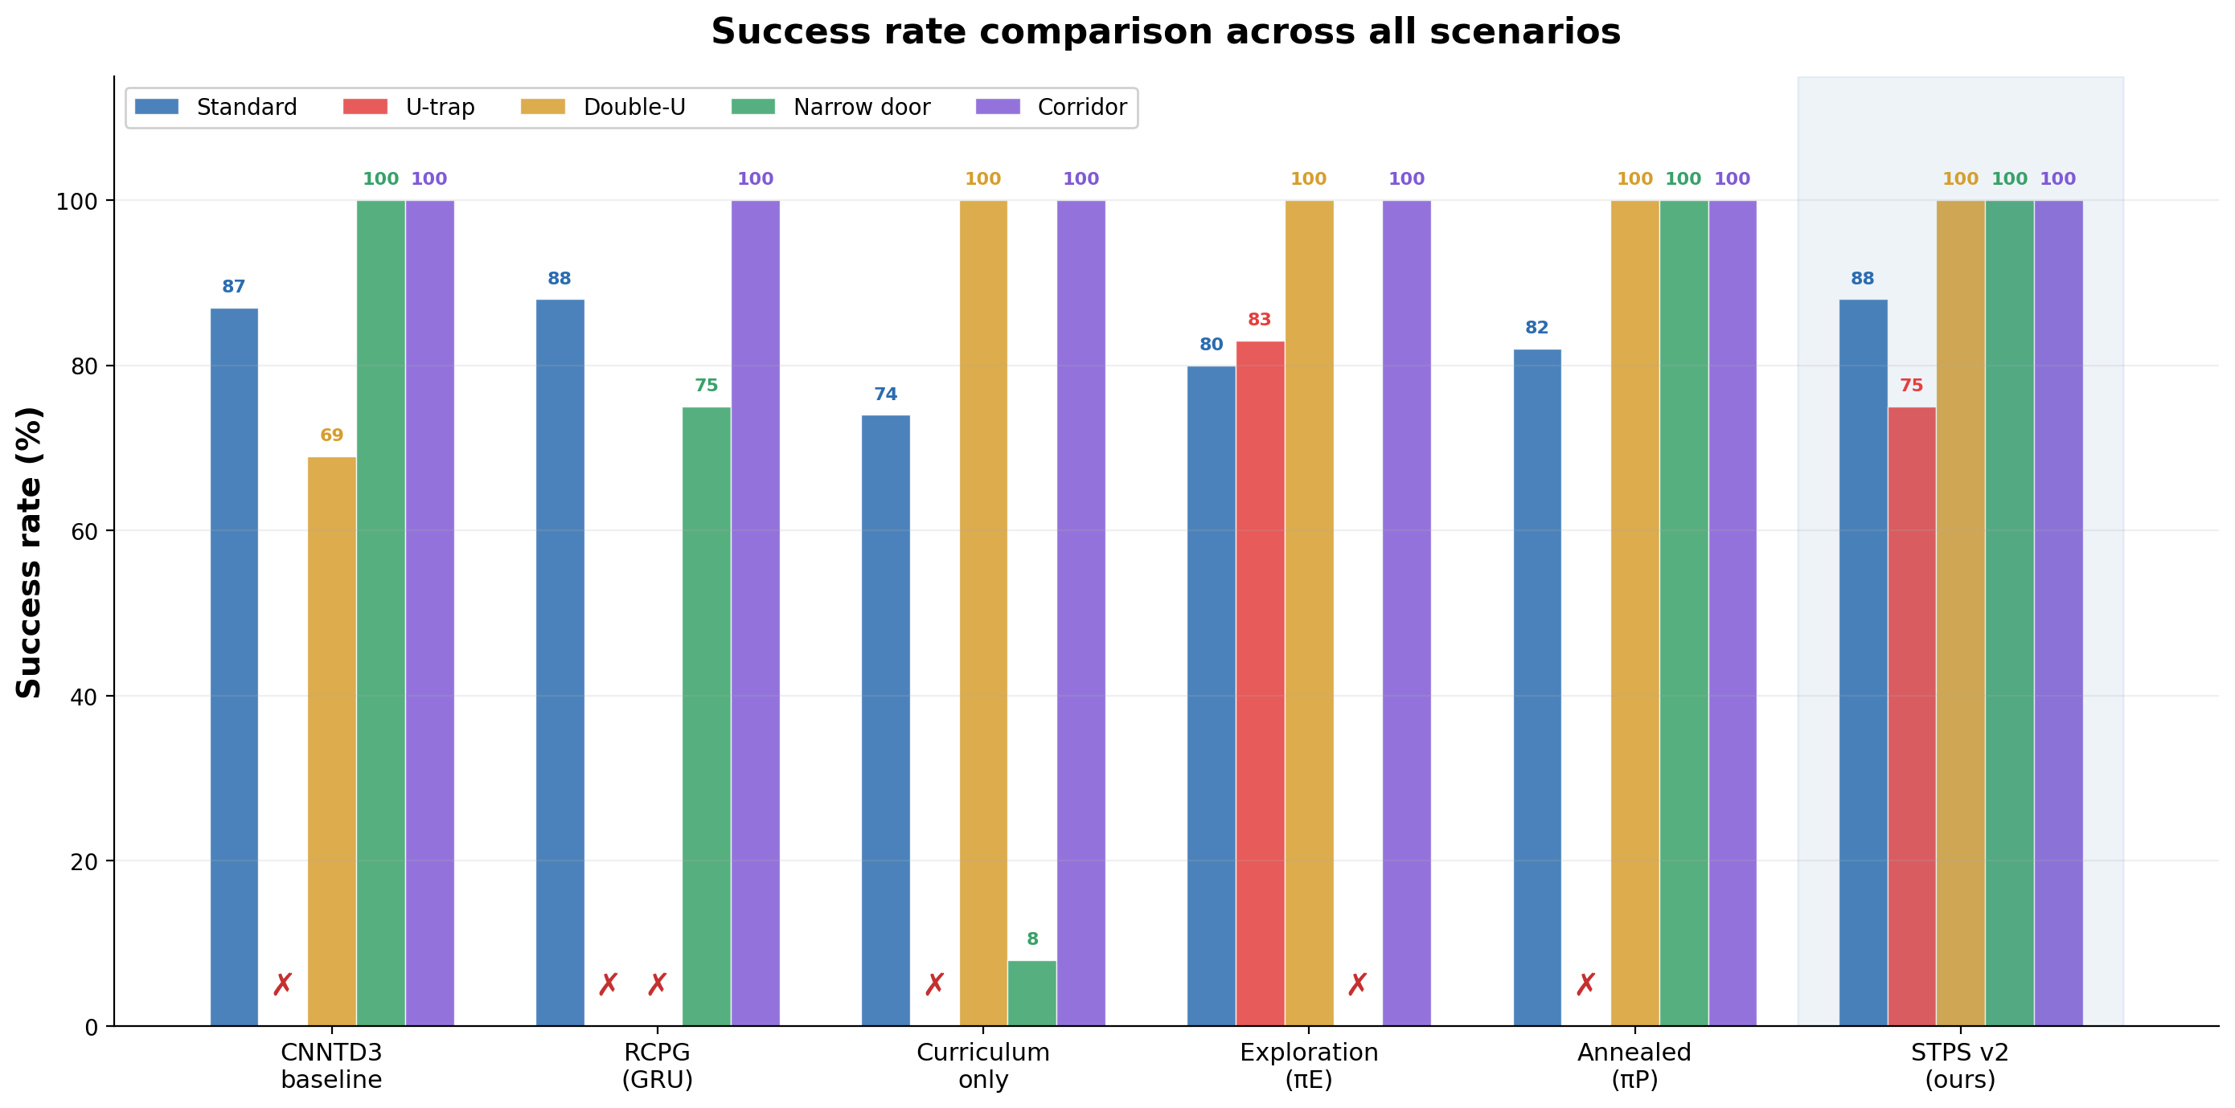
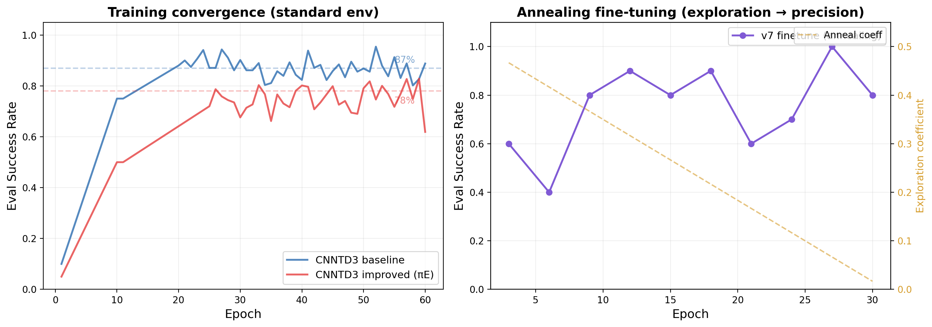
Department of Computer Science
Abstract
Problem: DRL navigation policies achieve >85% success in open environments but catastrophically fail (0% SR) in trap scenarios requiring temporary retreat from the goal. Gap: Exploration rewards fix traps (0→83%) but destroy precision (narrow door 100→0%). Reward annealing cannot resolve this conflict. Method: We propose Stall-Triggered Policy Switching (STPS), a training-free runtime architecture that detects motion stagnation and dynamically switches between precision and exploration policies. Result: STPS achieves 94% average scenario SR (+27 points vs baseline), is the only method without catastrophic failure on any scenario, and matches baseline on standard environments (88%).
Introduction
Key Finding: Exploration–Precision Conflict
Deep reinforcement learning (DRL) has become standard for mapless robot navigation, mapping raw LiDAR to velocity commands. CNN-TD3 achieves high success rates in cluttered environments.
However, in trap scenarios — U-shaped dead ends, narrow corridors requiring retreat — greedy goal-directed rewards cause the robot to oscillate until timeout.
Exploration bonus solves U-trap (0→83%) but kills narrow door (100→0%).
Annealing recovers narrow door but loses U-trap.
Method
Std
U-trap
Narrow
Avg
Baseline
87%
0%
100%
67%
Curriculum
74%
0%
8%
52%
Exploration
80%
83%
0%
71%
Annealed
82%
0%
100%
75%
Method: Stall-Triggered Policy Switching (STPS)
MAIN MODE
Precision policy πP
Stall: ‖xₜ−xₜ₋₂₀‖<0.15m OR oscillation≥5/12
ESCAPE MODE
Exploration policy πE
Standard goal-directed
navigation (DEFAULT)
Novelty-seeking
navigation (TEMPORARY)
Escaped: k≥120 AND ‖xₜ−xsw‖>0.5m
● Zero training cost: Frozen policies + runtime logic
● <0.1ms overhead: One distance check per step
● Real-robot ready: Simple if-else, deployable on LIMO
Main Results: STPS Outperforms All Single Policies
Method
Standard
U-trap
Double-U
Narrow
Corridor
Scenario Avg
CNNTD3 baseline
87%
0±0%
69±4%
100±0%
100±0%
67%
RCPG (GRU)
88%
0±0%
0±0%
75±0%
100±0%
44%
Curriculum only
74%
0±0%
100±0%
8±0%
100±0%
52%
Exploration (πE)
80%
83±0%
100±0%
0±0%
100±0%
71%
Annealed (πP)
82%
0±0%
100±0%
100±0%
100±0%
75%
STPS v2 (ours)
88%
75±7%
100±0%
100±0%
100±0%
94%
Training Curves
Parameter Sensitivity
Baseline
U-trap: TIMEOUT
πE Narrow:
COLLISION
STPS U-trap:
SUCCESS
STPS Narrow:
SUCCESS
W=15
δ=0.10
δ=0.15
δ=0.20
W=20
42/100
42/100
67/100
W=30
67/100
67/100
67/100
0/100
17/100
25/100
Narrow door = 100% across entire grid → switching never harms precision
W=20: stable 67% U-trap regardless of δ → no per-env tuning needed
What didn't work:
• STPS v3 (progressive escape): no gain
• U-trap specialist model: 83% = original improved
• Bottleneck = geometric difficulty
Conclusion
Application
1. Exploration rewards create a hard, irreconcilable conflict with precision navigation in DRL.
2. STPS resolves this by composing complementary frozen policies at runtime with stall/oscillation detection.
3. The method requires zero additional training and adds negligible (<0.1ms) computational overhead.
Sim-to-real advantages:
• STPS switching logic is pure Python if-else — no GPU, no retrain
• Both policies use standard LiDAR input, directly transferable
Deployable scenarios:
• Warehouse navigation with shelf dead-ends
• Any indoor space with concave obstacles
Left: Baseline converges to ~87% SR; Improved (πE) to ~78% (exploration bonus reduces standard SR).
Right: Annealing v7 — SR oscillates as exploration coefficient decays.
Jiabao Cao,Shengqin Jiang,Wenjing Chen,Zexian Xiong,Zhirui Shen
Supervisor: Fuhua Jia ,Tianxiang Cui

