Slide 1
2023_Undergraduate-Researcher
Topic：Git
主講者：楊宜祥

Slide 2
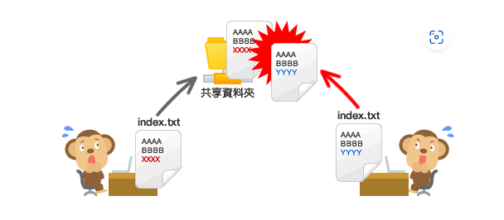
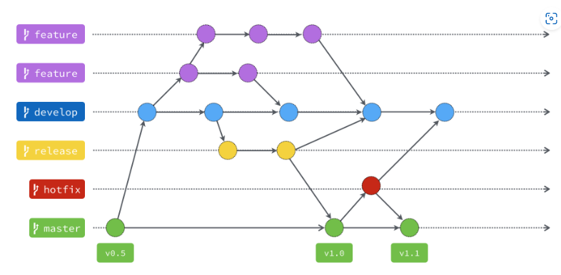
Why do you need Git ? Help Development
(x) 複製貼上 => Newest? Have others changed files? Difficult to maintain. Hard to cooperation.
(O) Version Control System (VCS)
Track Changes => Take snapshot of files
Benefits:
Create workflows
Work with versions
Code together
Keep a history
Notes:
https://learn.microsoft.com/en-us/devops/develop/git/what-is-version-control
https://gitbook.tw/chapters/gitflow/why-need-git-flow

Slide 3
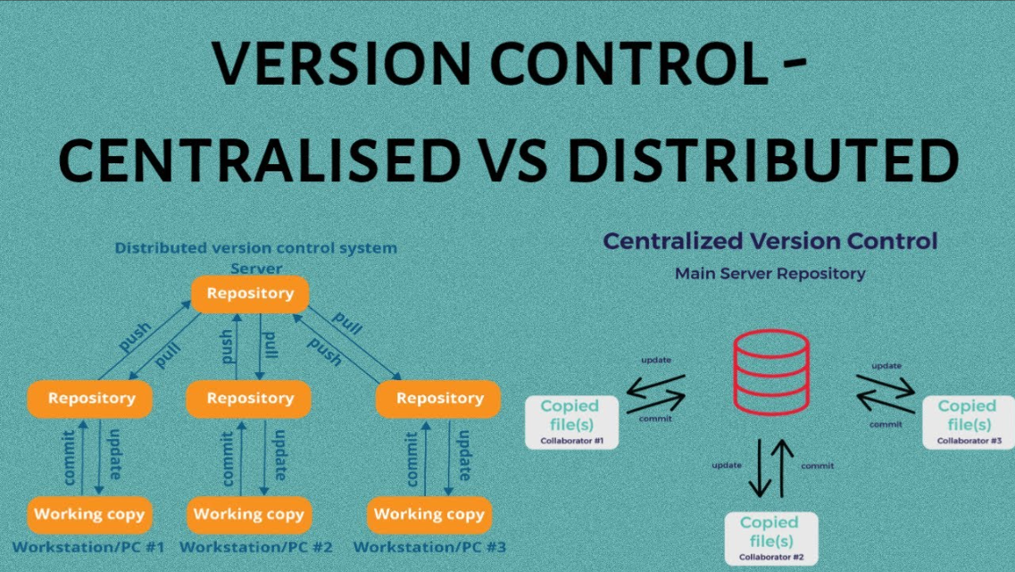
Introduction of Git
2005 Linus Torvalds developed, GPL （又是你）
Distributed Version Control System <=> Centralized Version Control System
 | DVCS | CVCS
Copy | Every developer “clones” a copy | Rely on central server
Operate | 操作較複雜 | 簡單快速
Teamwork | 適合多人合作 | 小團體有效快速溝通
Commit workflow | commit your changes to local repo After several commits, push them to the remote repo | Pull changes from server Make your changes Commit changes to central server
Notes:
https://www.youtube.com/watch?v=MAoAY1wYJuE

Slide 4
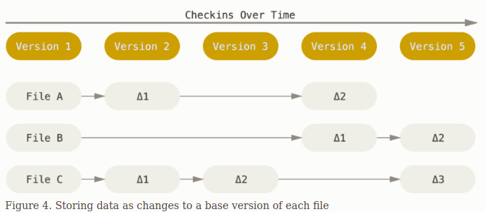
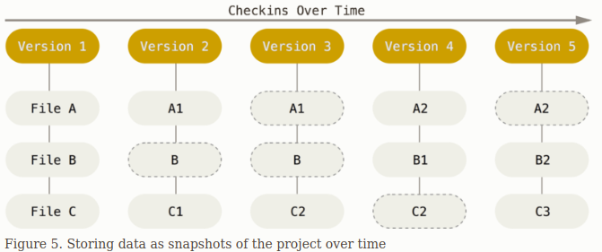
How does Git work?
Other version control system
Git
Store information as a list of file-based changes
Store stream of snapshots
Notes:
https://www.youtube.com/watch?v=MAoAY1wYJuE

Slide 5
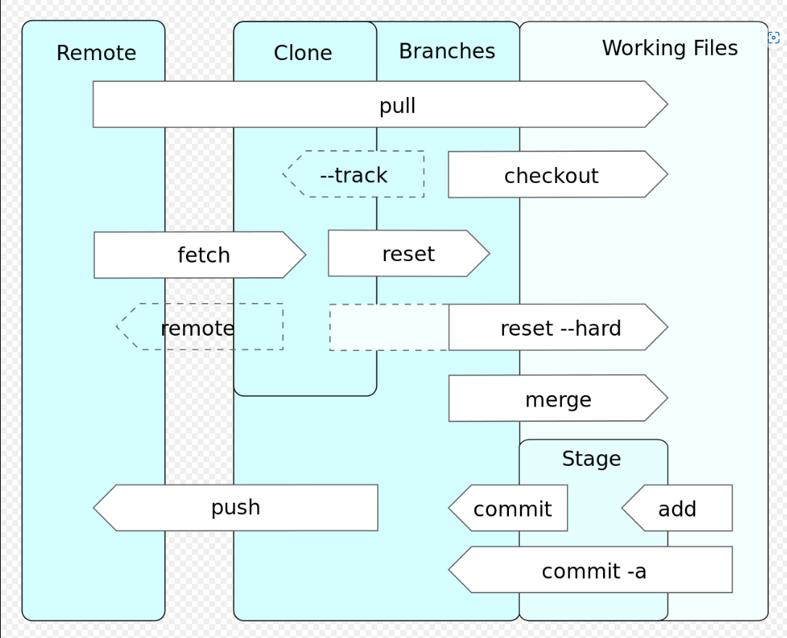
Data flow chart
Step：
clone Remote repo
checkout which branch you want to work
=== After Change ===
Add to stage
Commits
Push to remote repo
https://zh.wikipedia.org/zh-tw/Git

Slide 6
Global Settings
設定帳號密碼，在連接Github 的時候會讀取這些資訊
git config --global user.name “Your Name”
git config --global user.email “name@gmail.com”
git config --global core.editor vim
git config --global init.defaultBranch main

Slide 7
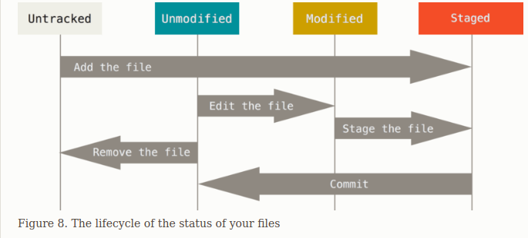
Local repository
git init
git add <file name>
git rm <file name> 記得加 --cached ，它只會從git 的歷史紀
錄中刪除，而不會刪掉檔案
git status
git reset HEAD <file>
git commit

Slide 8
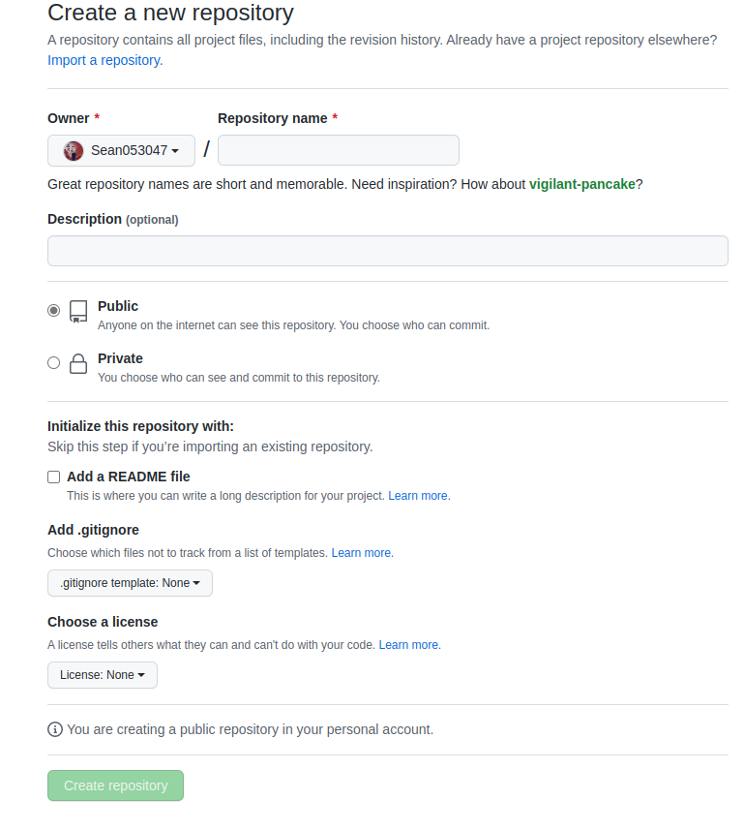
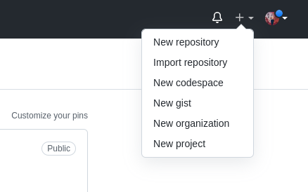
Connect to Github
Create a new Repository

Slide 9
Connect to Github
With SSH-keygen
https://medium.com/ntust-aivc/instruction-for-adding-an-ssh-key-to-your-github-account-ubuntu20-04-3-lts-f9f7802ed734
PS：There are 200MB limitation. You can use the package, git-lfs, to conquer it.

Slide 10
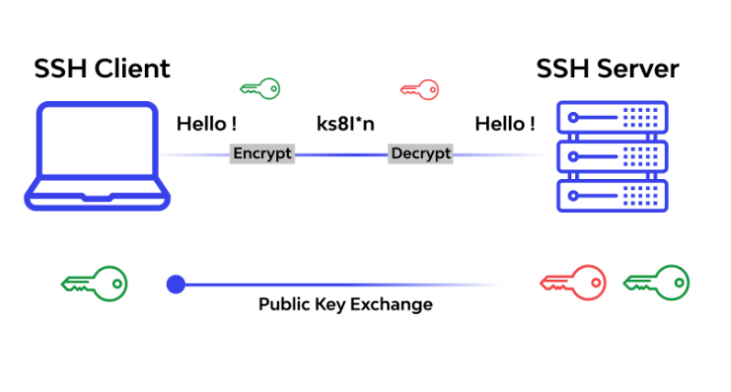
ssh keygen?
Secure Shell：Network Secure Protocol
https://www.wallarm.com/what/what-is-ssh-protocol

Slide 11
Remote repository
git clone
git remote add <name> <url>
git push -u <repository> <branch>
git pull <repository> <branch> fetch + merge
--allow-unrelated-histories : 可以合併兩個沒有共同起點的分支
例如：你有個working directory 還有一個剛創見的github repo，你想要Push 到github上，但github 上已經有一些License，而你的local repo並沒有，需要先從github 上pull 下License，才能夠把其他檔案push 上去，這時候的pull 就會需要--allow-unrelated-histories
-u : 設定 upstream 可以使分支開始追蹤指定的遠端分支
https://zh.wikipedia.org/zh-tw/Git

Slide 12

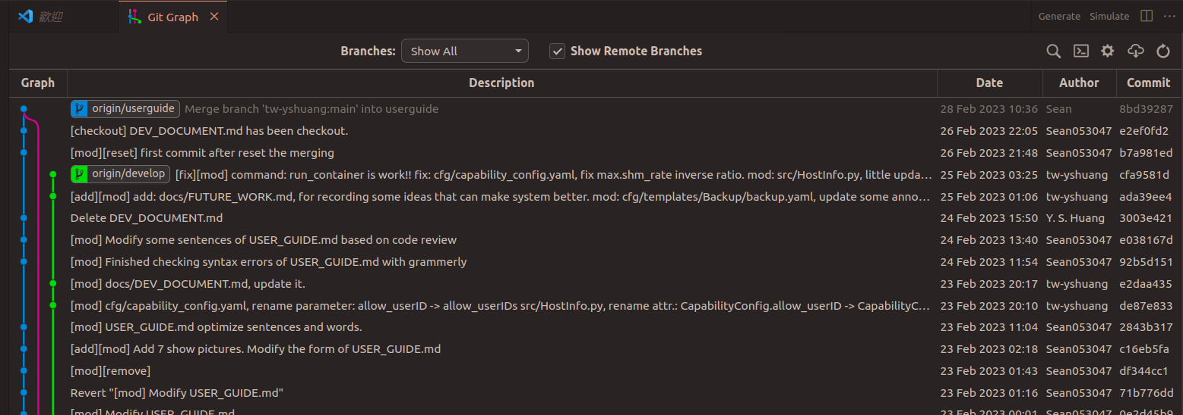
Vscode Extension

