Slide 1
Single Page Web App: Manchester Tech Meetups
by Sean O’Mahoney (@Sean12697)

Slide 2
Who?
Computer Science at Manchester Metropolitan University
Prolific Networker: ~200 Networking Events Attended
Hackathons: 1st Place once, 2nd place three times, lost none
Workshops/Talks: Run 4 (5 now), done 15 times (now 16)
Likes Web & Data stuffs, does Photography
@Sean12697

Slide 3
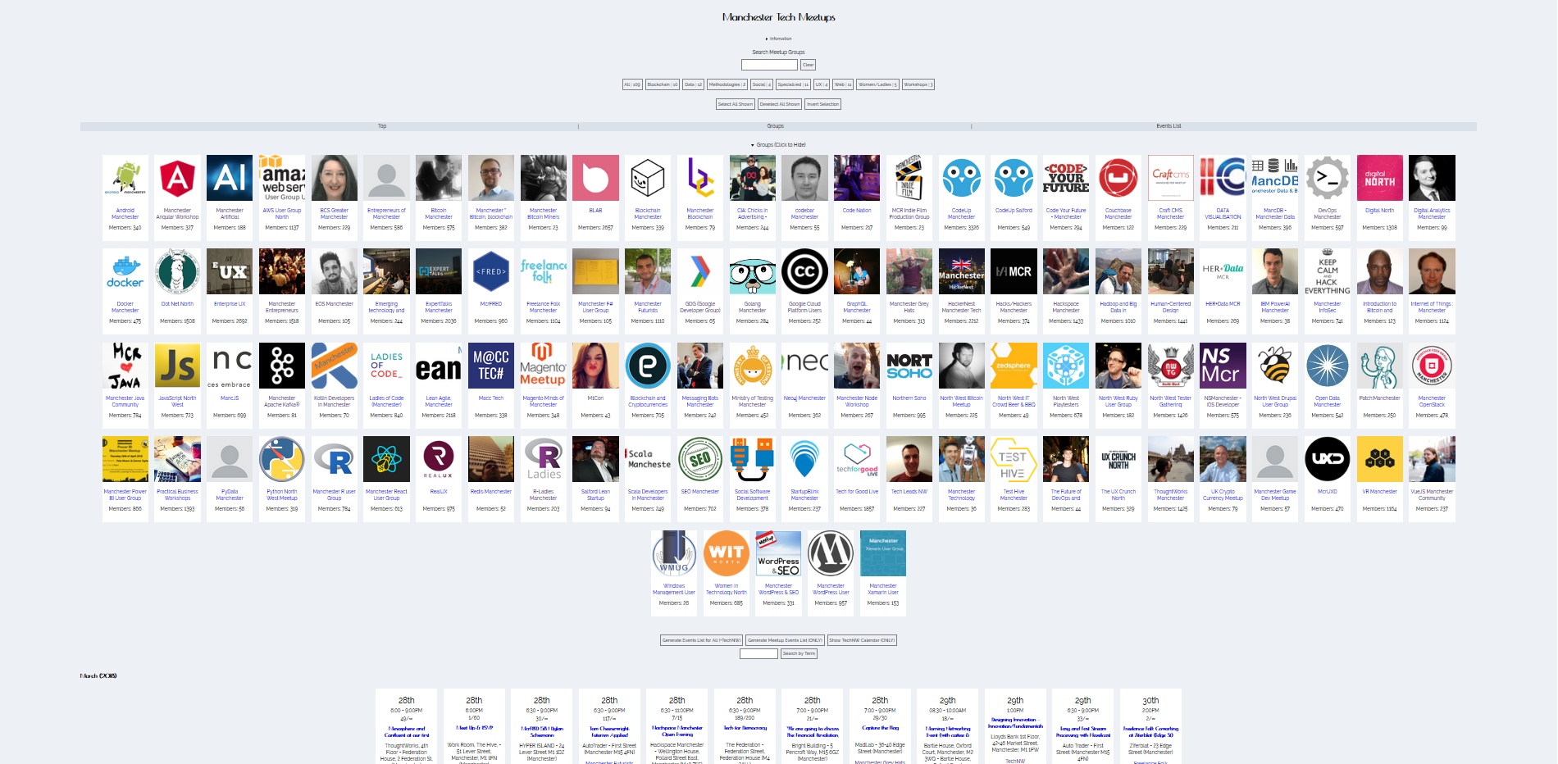
What? (http://mcrmeetup.tech/)
Essentially, a service which will allow you to find Meetup Groups, their events, and filter through both.
@Sean12697
Notes:
[Small Demo]

Slide 4
Inspiration / Research
Spotify Playlist Generator - https://www.youtube.com/watch?v=eV3WkDAM3Hw
GitHub Repository Video - https://github.com/lets-learn/spotify-playlist-generator
Meetup RESTFUL API - https://www.meetup.com/meetup_api/
@Sean12697

Slide 5
How to get there?
MVP! MVP! MVP!!! (Minimum Viable Product)
Ideas (Features):
Show All Meetups
Search
Filter into Categories
Show Events
Filter Events
TechNW Integration
Sorting
Activity
Essential Features:
Show All Meetups
Show Events
Search
MVP:
Show All Meetups
Release:
+ Show Events
+ Search
Iteration x:
+ Filters
@Sean12697

Slide 6
MVP
API Call compared from the tutorial, to research from the Meetup API
app.getAlbumTracks = (id) => $.ajax({
url: `https://api.spotify.com/v1/albums/${id}/tracks`,
method: 'GET',
dataType: 'json'
});
app.getMeetups = (meetup) => $.ajax({
url: 'https://api.meetup.com/' + meetup,
method: 'GET',
dataType: 'jsonp'
});
@Sean12697

Slide 7
MVP
Function calls to the API compared from the tutorial, to what’s needed for the Meetup API
app.getTracks = function(tracks) {
$.when(...tracks)
.then((...tracks) => {
tracks = tracks
.map(getDataObject)
.reduce((prev,curr) => [...prev,...curr],[]);
const randomPlayList = getRandomTracks(50,tracks);
app.createPlayList(randomPlayList);
})
};
function initGetMeetups() {
console.log(meetups);
MeetupsJSON = MeetupsJSON.map(app.getMeetups);
$.when(...MeetupsJSON)
.then((...MeetupsJSON) => {
MeetupsJSON = MeetupsJSON.map(a => a[0].data);
console.log(MeetupsJSON); // MVP
});
}
“meetups” & “MeetupJSON” = ["android_mcr", "BCS-Greater-Manchester-Branch“,.. ]
$.when & .then are async’ call, .then doing the anonymous function once complete
.map(a => a[0].data) to remove the JSONP padding ([0]), then async’ promise (.data)
@Sean12697

Slide 8
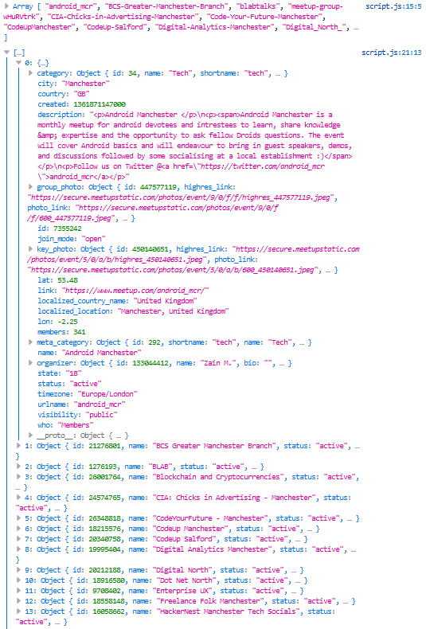
MVP (Console Logs)
Whoop!
@Sean12697

Slide 9
MVP (Display & Responsiveness)
What do we need? (Image, Name, Members).
How should elements be, how do they change (thinking about CSS in Media Queries).
Container (Div) = inline-block
Picture and Text Elements
Text Align: Centre or Left
NAME
MEMBERS
NAME
MEMBERS
NAME
MEMBERS
NAME
MEMBERS
@Sean12697

Slide 10
MVP (Resulting HTML)
<div class="group" id="0">
<div class="meetupImg">
<img src="https://secure.meetupstatic.com/photos/event/9/0/f/f/600_447577119.jpeg">
</div>
<div class="groupText">
<a href="https://www.meetup.com/android_mcr/" target="_blank">
<p class="groupName">Android Manchester</p>
</a>
<p>Members: 341</p>
</div>
</div>
@Sean12697

Slide 11
MVP (Resulting CSS)
.group {
display: inline-block;
width: 150px;
height: 280px;
margin: 10px;
overflow: hidden;
background-color: #fff;
transition-duration: 0.4s;
}
.group:hover {
transform: scale(1.1);
}
.groupText {
margin: 5px;
}
@media only screen and (min-width: 324px) and (max-width: 480px) {
.group {
width: 100%;
height: 100px;
margin: 8px 0px;
text-align: left;
overflow: hidden;
}
.group label {
width: 100px;
height: 100px;
padding: 0px;
margin: 0px;
display: inline-block;
overflow: hidden;
}
.group img {
object-fit: cover;
width: 150px;
height: 150px;
padding-bottom: 0px;
}
.groupName {
height: 40px;
overflow: hidden;
}
.meetupImg {
display: inline-block;
vertical-align: top;
}
.groupText {
padding: 0px 10px;
display: inline-block;
width: 50%;
}
.groupName {
margin: 0px;
margin-top: 10px;
}
.group img {
object-fit: cover;
width: 100px;
height: 100px;
padding-bottom: 0px;
}
.groupText p {
margin: 10px;
margin-left: 0px;
}
}
@Sean12697

Slide 12
MVP (Resulting JavaScript)
function drawMeetups(JSON) {
groupsContainer.innerHTML = "";
for (var i = 0; i < JSON.length; i++) {
var x = JSON[i];
var name = x.name;
var link = x.link;
var members = x.members;
var thumb = 'blank.jpg';
if (x.hasOwnProperty('group_photo')) {
thumb = x.group_photo.photo_link;
} else {
if(x.hasOwnProperty('organizer')) {
if (x.organizer.hasOwnProperty('photo')) {
thumb = x.organizer.photo.photo_link;
}
}
} groupsContainer.insertAdjacentHTML('beforeend', '<div class="group" id="' + i + '"><div class="meetupImg"><img src="' + thumb + '"></div><div class="groupText"><a href="' + link + '" target="_blank"><p class="groupName">' + name + '</p></a><p>Members: ' + members + '</p></div></div>');
}
}
Clear our container (which will have a loader)
Go through each object in our returned JSON
Put the content we need in variables
Do error correction on some (don’t make assumptions)
Generate HTML and insert it within a container element (which has been defined)
@Sean12697

Slide 13
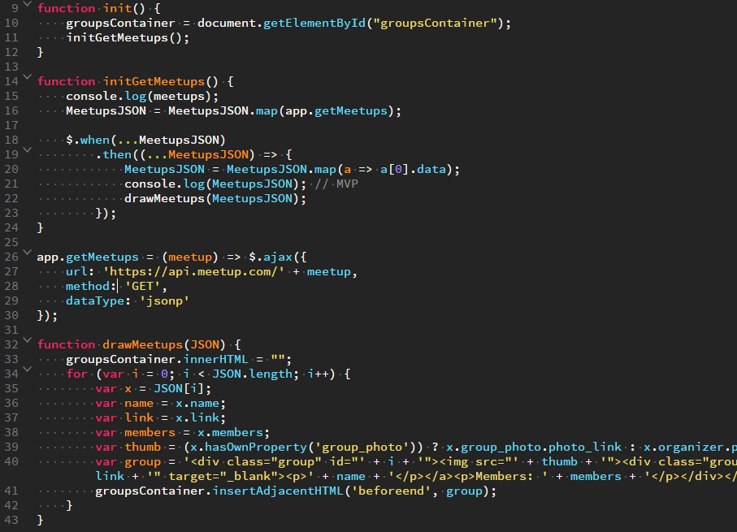
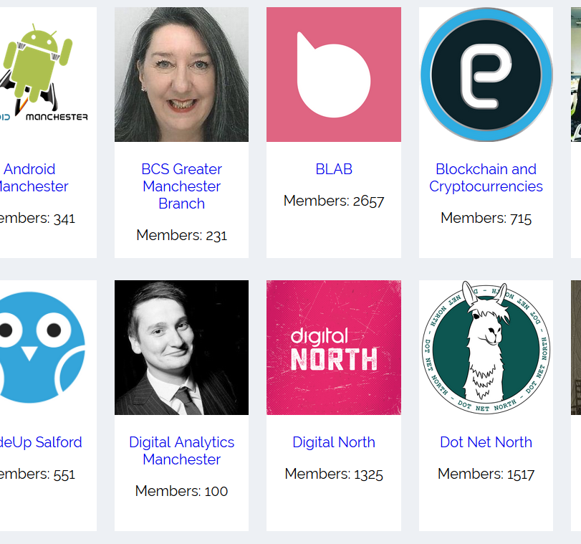
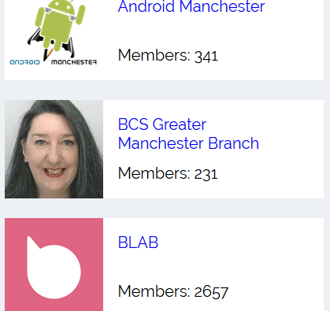
MVP Complete (“Show All Meetups”)
Within 43 lines of JavaScript
https://github.com/Sean12697/mcrmeetuptech_workshop
@Sean12697

Slide 14
Tips & Tricks
Spinner (for good UX) - https://medium.com/@kayliepoitras/css3-style-animation-preloaders-d07914bb84a8
@Sean12697

