Slide 1
Web Technology and Standards
Dr. Alawami

Slide 2
Goal
Applications need to save data to persistent storage.
Persistent storage can be database, directory service, or other.
For O-O programming, we'd like to save and retrieve objects to/from storage.
Java Application
object
Persistent Storage

Slide 3
ORM
Object Relational Mapping
is a technique that lets you query and manipulate data from a database using an object-oriented paradigm
Advantage?Disadvantage?
Without ORM
book_list = new List();
sql = "SELECT book FROM library WHERE author = 'Linus’”;
data = query(sql);
// I over simplify ...
while (row = data.next())
{ book = new Book();
book.setAuthor(row.get('author’);
book_list.add(book); }
With ORM
book_list = BookTable.query(author="Linus");

Slide 4
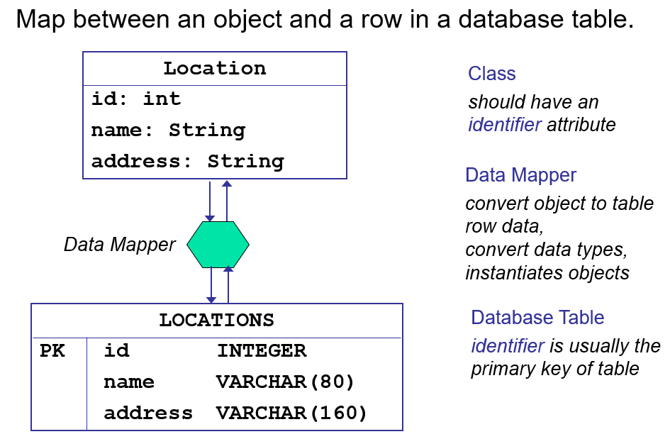
From DB to Objects

Slide 5
Pros and Cons
Pros | Cons
Save time | You have to learn it!
don't repeat yourself (DRY) | Better performance with SQL
Flexibility
Let you benefit from OOP
Some libraries:
Hibernate (Java)
PHP(Propel)
MeanStack (Mongoose-Object Document Mapper)
Node.js (Sequlize)
Many web programming frameworks come with ORM integrated with it.
Notes:
DRY, write your model in one place and you don’t need to repeat yourself.

Slide 6
Intro to MEAN STACK

Slide 7
Refresh your memory!
Last week, we used
Express, Nodejs,MongoDB => REST API
Today we will integrate Angularjs to complete our stack

Slide 8
Object Document Mapper
Mongoose

Slide 9
Connect Express app to MongoDB with Mongoose
Could use native MongoDB driver, but not easy to work with
MongoDB native driver does not offer built-in way of defining and maintaining data structures
Mongoose enables us to define data structures, and models, maintain them, and use them to interact with the DB

Slide 10
Add mongoose to your Express Application
$ npm install mongoose --save

Slide 11
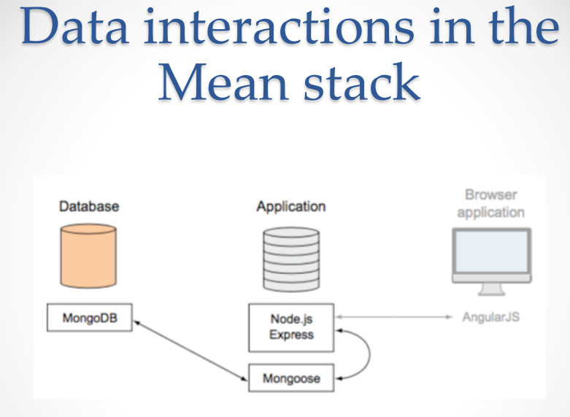

Slide 12
Add Mongoose Connection to your app
Mongoose opens a pool of five reusable connections when it connects to a MongoDB database
This pool of connections is shared between all requests
Best practice: open the connection when your application starts up; leave it open until your application restarts or shuts down.

Slide 13
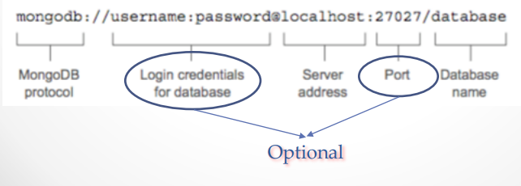
Setting up connection file
You can create
File models/db.js
Use the file in the application by requiring it in app.js
mongoose.connect('mongodb://localhost/rest_test');

Slide 14
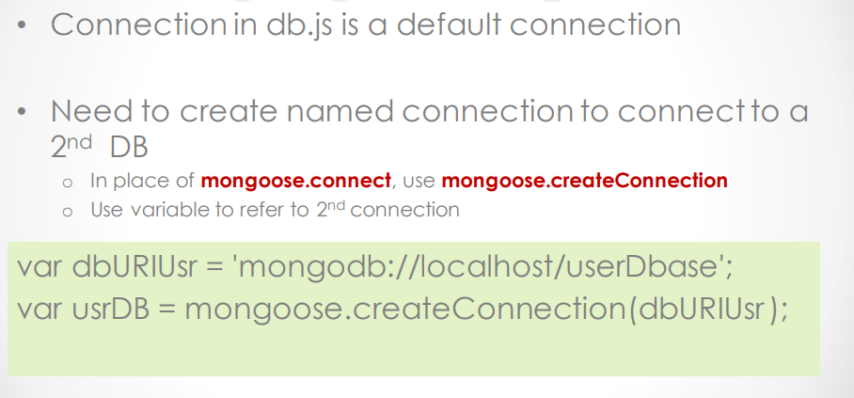
Multiple Connections

Slide 15
ODM
One of the key principles is that you can
Manage your data model from within your application
You don’t have to mess around directly with databases or external frameworks or relational mappers
You can just define your data model in the comfort of your application

Slide 16
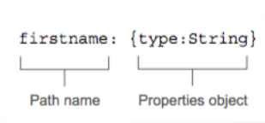
How mongoose models data?
A model is the compiled version of a schema
All data interactions using Mongoose go through the model
A schema bears a strong resemblance to the data
The schema defines the name for each data path
and the data type it will contain (e.g., model/contact.js)

Slide 17
Define a simple schema
Schema should be defined in a model folder alongside db.js
Plural form of the name is preferred
Need Mongoose in model/contacts.js to define a mongoose schema
Must require mongoose
Mongoose provides a constructor function for defining new schema o Mongoose.Schema({})

Slide 18
Our Product model from last week
// Dependencies
var restful = require('node-restful');
var mongoose = restful.mongoose;
// Schema
var productSchema = new mongoose.Schema({
name: String,
sku: String,
price: Number
});
// Return model
module.exports = restful.model('Products', productSchema);

Slide 19
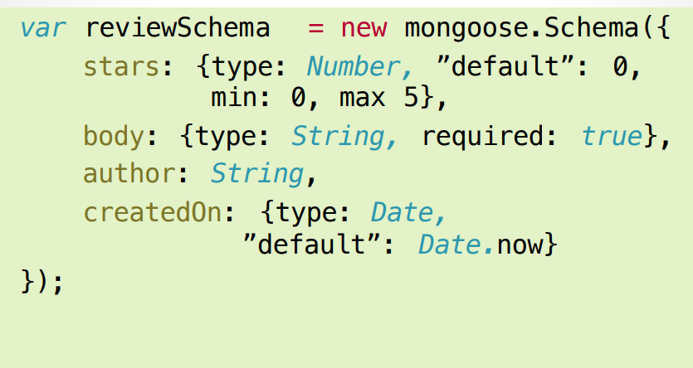
Another Example
Notes:
Notice default, min and max

Slide 20
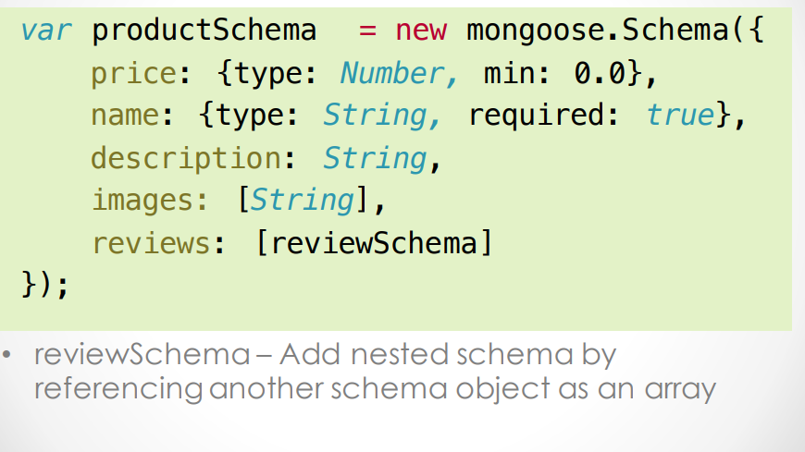
Complex Schema

Slide 21
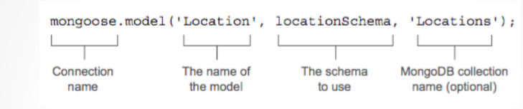
Compile your model
MongoDB Collection is optional
If not present, mongoose will use a lowercase pluralized version of the model name
For example, a model name of Location would look for a collection name of locations unless you specify something different

Slide 22

Templating
Jade intro and basic syntax

Slide 23

Jade is Templating Language
It is Clean and minimal html
It is Originally Packaged as node module
Indentation based language (we can use either spaces or tabs not both.)
Recently Jade renamed as pug

Slide 24
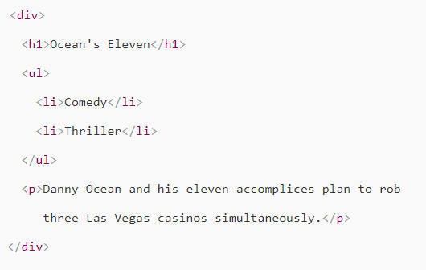
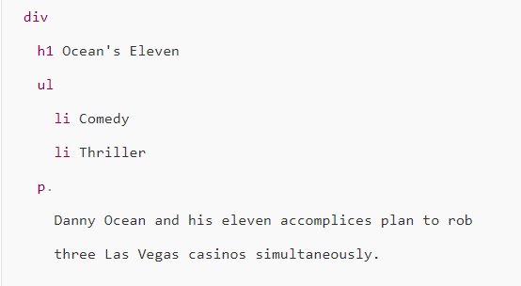

Slide 25
How to use it
npm install –g jade --save ( or pug)
app.set(‘view engine’, ‘pug’) (or jade)
All files has .pug extension (.jade)
It comes as the default engine in express

Slide 26
Basic syntax
Tags and Text
Nesting
Variables and comments
Classes, Ids and Attributes
Conditions (if, else, unless)
Loops and Iteration

Slide 27
Tags
Tags
First word is a Tag
p, div, h1 etc...
Jade knows self-closing tags
img, input etc...
Text
Everything after first word is text
p Hello, World
Multeline text uses pipes |
p Hello
| This is Jade

Slide 28
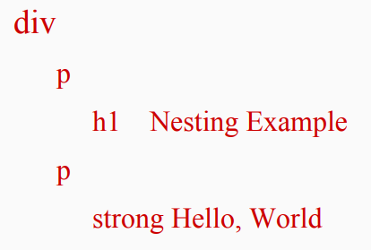
Nesting
Just add a new line and a tab per indent level

Slide 29
Variables
Variables are used to store values
title = “welcome to Jade”
h1 = title
Single comment
// p (visible in DOM)
//- p (invisible in DOM)

Slide 30
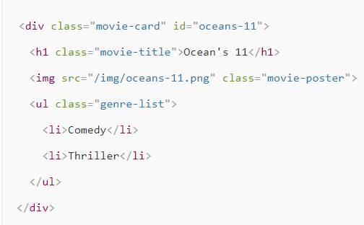
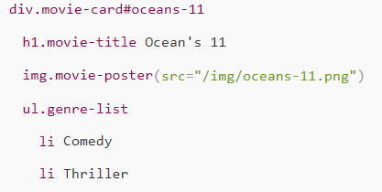
Classes and ids
The html class attribute is “.classname”
Can have multiple classes
p.col-md-2
div.row.col-md-6
The html id attribute is “#idname”
div#wrap
Can Combine Class and Id
.row.col-md-1 #container

Slide 31
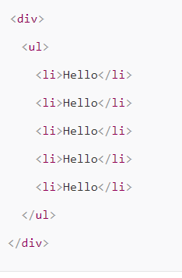
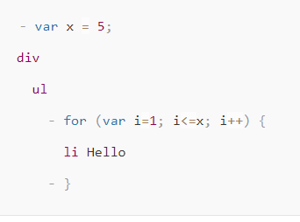
Jade is integrated with JavaScript

Slide 32
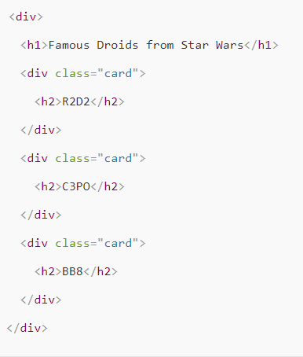
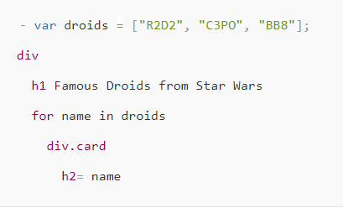
Loops

Slide 33
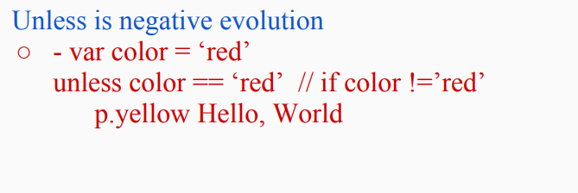
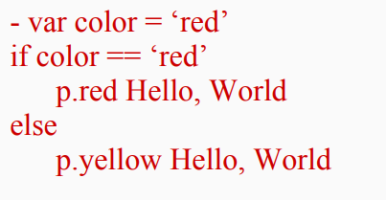
Conditions

Slide 34
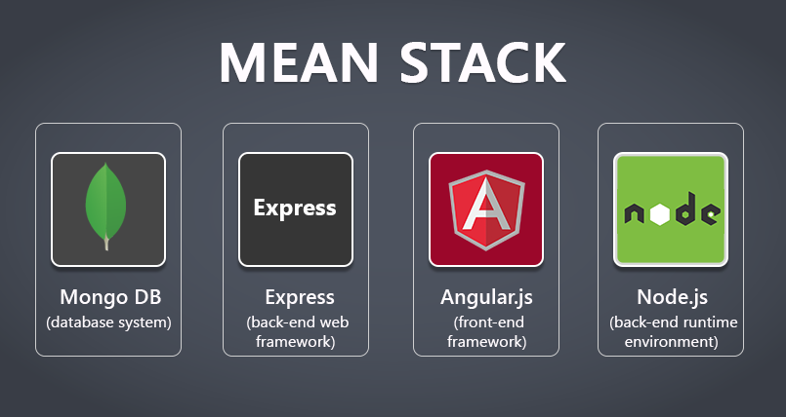
MEAN STACK
AngularJS as the front-end framework to fine-tune our DOM
NodeJS the backend engine
ExpressJS as the server-side communication platform
MongoDB as the data store. Easy stuff!

Slide 35
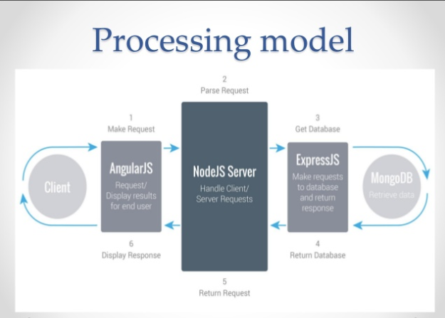

Slide 36
Mean Frameworks
Mean is the generic way!
Some framework with this concept
Meteor. (Angular support)
StrongLoop Loopback
Generator Angular (Fullstack)
Sails.js
Cleverstack

Slide 37
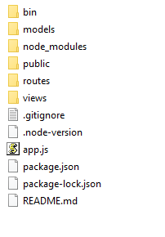
Anatomy of Mean APP

Slide 38
Make sure
Mongod is running!
Error: make sure you have data\db under c:\

Slide 39
A new project (To Do List)
We will implement a REST API with different routes(similar to last week)
We will add a front-end using Angularjs
We will use Angularjs + MongoDB+ Mongoose to deliver persistent content.

Slide 40
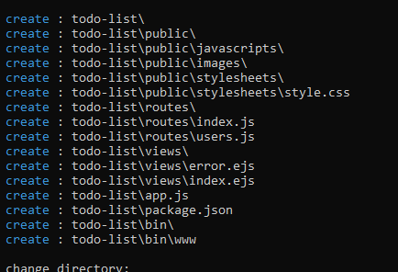
Express-generator
$npm install express-generator –g (this will install express-generator)
$express todo-list -e

Slide 41
For any EXPRESS project
$npm install // will install Nodejs Module required by the project
On windows:
$set port=4000 & npm start
On Mac
$PORT=4000 npm start

Slide 42
Touch
This tool can help you create files that you need
$npm install touch-cli -g
$touch models/todo.js

Slide 43
App.js vs Server.js
There is no specific convention on which one to use
Some uses
Server.js to deliver REST content (npm start looks for this file)
App.js to deliver views
Express generator will create app.js which is our main entry point.

Slide 44
REST API (back-end)
Assuming you have all the dependency installed from last week (mongoose, express, body-parser)
$mkdir todo-list
$cd todo-list
$npm init
$npm install exprcdess-generator – g //if you don’t have it installed
$ express todo-list (default is jade template, if you want ejs use –e)
$cd todo-list
$npm install
$ set port =4000 & npm start

Slide 45
Open app.js and add mongodb connection
var mongoose = require('mongoose');
// connect to MongoDB
mongoose.connect('mongodb://localhost/todo-api')
.then(() => console.log('connection succesful'))
.catch((err) => console.error(err));

Slide 46
In Nodejs bash
$mkdir models // create directory for ODM
$touch models/Todo.js // create empty file todo.js to hold the model

Slide 47
Todo.js
var mongoose = require('mongoose');
var TodoSchema = new mongoose.Schema({
name: String,
completed: Boolean,
note: String,
updated_at: { type: Date, default: Date.now },
});
module.exports = mongoose.model('Todo', TodoSchema);

Slide 48
We will define routes
Rename routes/users.js to routes/todos.js
In App.js
var usersRouter = require('./routes/users’);-> var todosRouter = require('./routes/todos');
app.use('/users', usersRouter); → app.use(‘/todos’, todosRouter);

Slide 49
In routes/todos.js
var express = require('express');
var router = express.Router();
var Todo = require('../models/Todo.js');
/* GET /todos listing. */
router.get('/', function(req, res, next) {
Todo.find(function (err, todos) {
if (err) return next(err);
res.json(todos);
});
});
/* POST /todos */
router.post('/', function(req, res, next) {
Todo.create(req.body, function (err, post) {
if (err) return next(err);
res.json(post);
});
});
/* GET /todos/id */
router.get('/:id', function(req, res, next) {
Todo.findById(req.params.id, function (err, post) {
if (err) return next(err);
res.json(post);
});
});
/* PUT /todos/:id */
router.put('/:id', function(req, res, next) {
Todo.findByIdAndUpdate(req.params.id, req.body, function (err, post) {
if (err) return next(err);
res.json(post);
});
});
/* DELETE /todos/:id */
router.delete('/:id', function(req, res, next) {
Todo.findByIdAndRemove(req.params.id, req.body, function (err, post) {
if (err) return next(err);
res.json(post);
});
});
module.exports = router;

Slide 50
try
Insert some todo items through postman, use the JSON below
http://localhost:4000/todos
{"name": “Meeting",
"completed": “false",
"note": "meeting at 1"}

Slide 51
Front-end
How?
Angularjs
You can use HTML by itself or any other front-end framework.
Mean is based on Angularjs

Slide 52
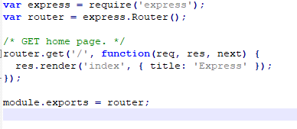
routes/index.js
If you review our code and looked for the index page
app.js loads the all the routes.
The root path (/) is mounted on the routes/index.js
routes/index.js sets the variable title and renders index.ejs

Slide 53
Let’s change the title
res.render('index', { title: 'ToDoList' });
Trace that!

Slide 54
To build our front-end
Jade vs ejs vs HTML
We will
Discuss the setup for jade ejs and HTML
Create two Angularjs controller for post and get
Create html page with
a button that call get elements(HTTP get request to our API)
Form to submit todo item

Slide 55
Template engine setup
app.set('views', path.join(__dirname, 'views’));
app.set('view engine', 'jade’);
We will work with html first lets change this to
app.engine('html', require('ejs').renderFile);
app.set('view engine', 'html’);
Under views-> create index.html

Slide 56
views\ndex.html
Copy the content and we will discuss it

Slide 57
Angularjs app
Our app consist of two controllers
app.controller('getController', ($scope, $http, $location) =>{
$scope.getAllUsers = function(){
var url = "/todos";
$http.get(url).then((response) => {
$scope.todos = response.data;
}, (response) => {
$scope.getErrMsg = "Error Status: " + response.statusText;
});
}
});

Slide 58
app.controller('postController', ($scope, $http, $location) => {
$scope.submitAddForm = function(){
var url = "/todos";
var config = {
headers : {
'Accept': 'application/json'
}
}
var data = {
name: $scope.itemname,
note: $scope.note
};
$http.post(url, JSON.stringify(data), config).then((response) => {
$scope.todos= response.data;
}, (response) => {
$scope.postErrMsg = "Error Status: " + response.statusText;
});
// reset data fields
$scope.itemname = "";
$scope.note = "";
}
});

Slide 59
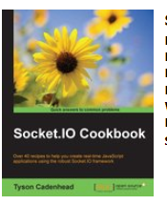
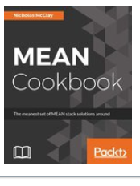
Reading/Resource
Work On your final Project (we covered most of what you will need)
Reading:
https://www.html5rocks.com/en/tutorials/frameworks/angular-websockets/
Chapter 1,2,3 from Socket.io Cookbook
Assignment4 details will be posted.
Source of today’s code without front-end is at
git clone https://github.com/amejiarosario/todoAPIjs.git

Slide 60
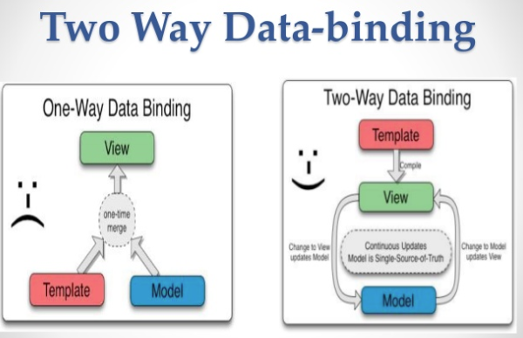

Slide 61
Angular
Not angularjs!

Slide 62
Intro
Official collaboration between Microsoft and Google
JavaScript-Like language
Angular is built on TypeScript
TypeScript is a strict syntactical superset of JavaScript
TypeScript is designed for development of large applications and transcompiles to JavaScript
provides optional static typing, classes and interfaces
Notes:
The main thing is the benefit to building large scale javascripts apps

Slide 63
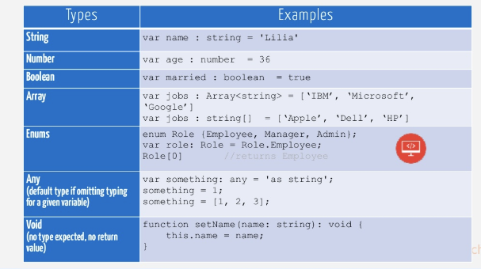
TypeScript Datatype
Similar to Java Script with minor syntax modification

Slide 64
For more on TypeScript
https://channel9.msdn.com/posts/Anders-Hejlsberg-Introducing-TypeScript

Slide 65
Angular
Angular is a JavaScript framework
provides a number of APIs and structure that helps you create complex client-side code
Angular Components
Modules
Directives
Data Binding
Dependency Injection
Services: HTTPService, AJAX

Slide 66
Modules
While not required, highly recommended
Divide your code into smaller parts-> Adv?
Between different modules
Impor external modules at the top of a file and export the functionality you need at the bottom
Import {Component} from 'angular2/core'; Export class App{}

Slide 67
Directives
Directives are JavaScript classes with metadata that defines the structure and behavior
Directives provide the majority of UI functionality for Angular applications.
There are three major types of directives:
Components:
HTML template +JavaScript functionality to create a self-contained UI element that can be added to an Angular application as a custom HTML element. Components are likely to be the directives you use the most in Angular.
Structural:
You use structural directives when you need to manipulate the DOM.
Allow you to create and destroy elements and components from a view.
Attribute:
An attribute directive changes the appearance and behavior of HTML elements by using HTML attributes

Slide 68
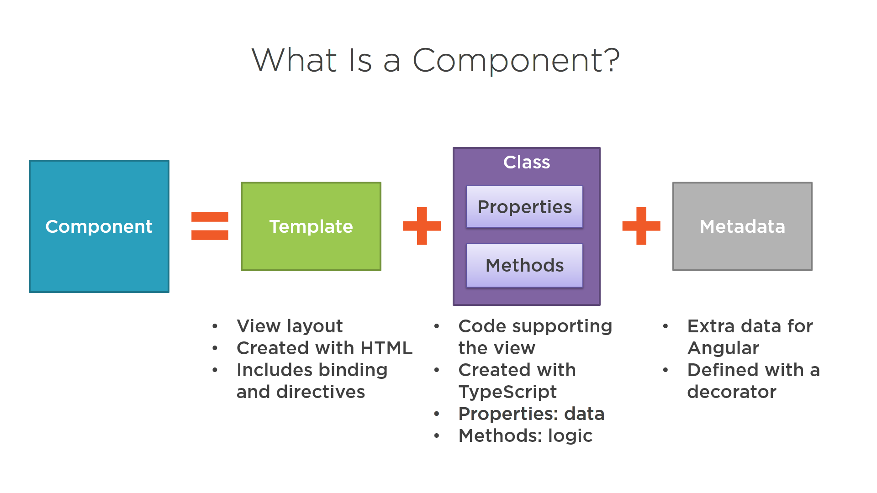

Slide 69
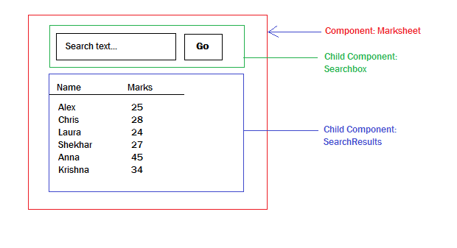

Slide 70
Angular Rules
Goal: The separation of responsibilities
Follow these rules:
The view acts as the official presentation structure for the application. Indicate any presentation logic as directives in the HTML template of the view.
Any DOM manipulation, should be done in a built-in fashion
Implement any reusable tasks as services and add them to your modules by using dependency injection.
Define controllers within the module namespace to ensure that your application can be packaged easily

Slide 72
Small Web App Demo
Our focus on Architicture

Slide 73
Angular
Using Nodejs, we will install angular cli
npm install –g @angular/cli
This tool will take care of generating your angular app, directories structure, module, directives, services, etc

Slide 74
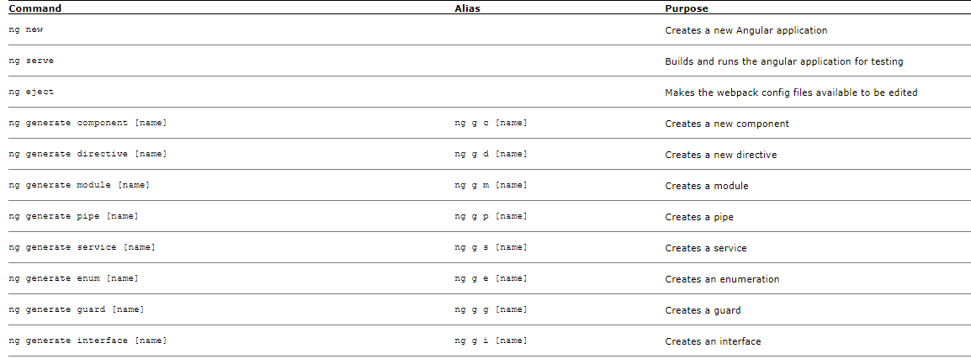
Some commands

Slide 75
Create new angular app
Go to the directory location where you want to save your project
ng new my-app
It will ask you if you want to use routes? Yes
and what type of stylesheet you want. CSS

Slide 76
Serve your app
Once the installation is done, go to the directory
cd my-app
The next command will run your app
ng serve –open
Serve will run you app and watch for any changes you make to your files and rebuild the app if needed!
--open will open the app in your browser.

Slide 77
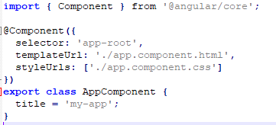
Understanding your app
Go to the directory my-app and check the content and structure
All your angular code is under my-app/app directory
Start with app.comoponent.ts (extension ts: typescript)
Name given to module
Your view, HTML template
StyleSheet, CSS or LESS or Jade

Slide 78
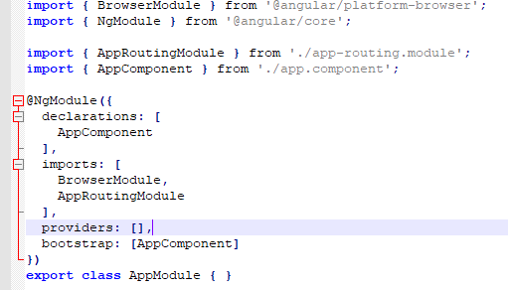
Understanding your app 2
Open app.module.ts
NgModule
NgModule: Angular decorator that allows you to place all your imports, declarations, and bootstrap files for a particular module in a single location

Slide 79
Other Component
Your app component is the root of your app.
For each element you have from your web app, you will have to create a new directory with a similar structure.
If we have a rate-item component
/app/rated-item: Folder containing the rated-item component.
/app/rated-item/rated-item.component.ts: Angular component that lets the user rate items
/app/rated-item/rated-item.component.html: Angular template for the rated-item component
/app/rated-item/rated-item.component.css: CSS file for the rated-item component

Slide 80
Learning Check
Can you change the title of your app?
{{title}} → What does it link to?

Slide 81
Let’s add another component to our app
ng generate component list
Check your NgModule under app.module.ts
Check your list.component.ts

Slide 82
ngOnInit
Life cycle hook.
Good place to add any initialization you need.

Slide 83
Add a value to class element
list = ‘MYList';
Add <app-list></app-list> to your app.component.html
This will import anything you created in your List Component to your main component.

Slide 84
Defining class in TypeScript

