Slide 1

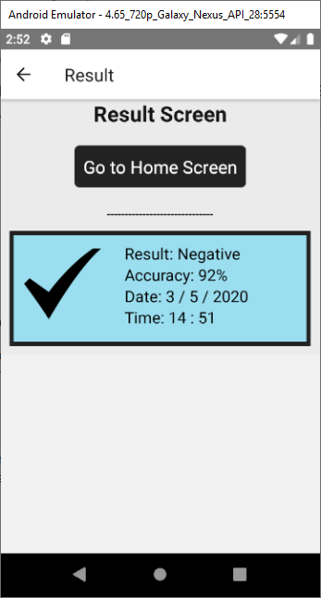
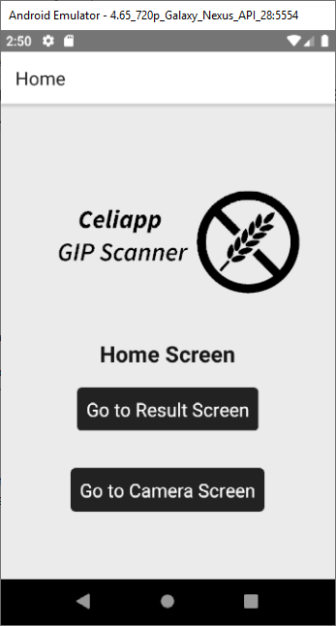
Celiapp GIP Stick Reader
Sean Nash de Andrade
Introduction
Methods
Results
Conclusions
My project is to create a phone app that will allow a patient to easily take a picture of their tests. This picture will then be sent to a photo recognition model backend on a server and then the results will be displayed to them while also allowing them to look over previous test results.
The user will be able to choose between capturing the results of their GIP stick tests on their phone to have the results confirmed by a server or review older test results. The Front end application will be made with React Native.
I created the frontend of an application that allows the user to easily view their result history or send a test result to a server for confirmation.
The app is easy to use and can fulfill it’s function within two presses of start up.
Alot of focus during this project was spent on how to get the UI as user friendly as possible to as many people as possible. Simplicity and ease of use were the focus with alot of value existing in contrasting colours and grouping of logical elements.
I feel that in the end the product is a an acceptable application and is prepared to accept any back end integration desired.
Bibliography
Michael Bridgette, Using Object Recognition To Read The Results Of Gluten Test Strips, Final Year Research Report at IT Carlow

