Slide 1
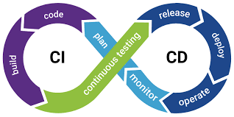
Continuous Integration and Continuous deployment

Slide 2
What does CI mean
Continuous integration is a practice that developers continuously check code into a shared project repository where it is integrated.
Upon each commit the code can be verified automatically by predetermined tests to ensure validity

Slide 3
What is CD
Continuous deployment is focused on the release of new code into production software.
It involves automated creation of infrastructure (servers, databases etc) and tests this to ensure confidence in the release code

Slide 4
How they work in harmony
Both CI and CD should be used together to remove automate processes and allow the developers to concentrate on producing code in confidence

Slide 5
Business benefits
Faster Release Times
  Developers can focus on adding value
  Smaller changes made more consistently
  Quicker promotion
Reduced Costs
  Easier to maintain and update
  Less failures in production
  Faster rollback and better error catching

