Slide 1


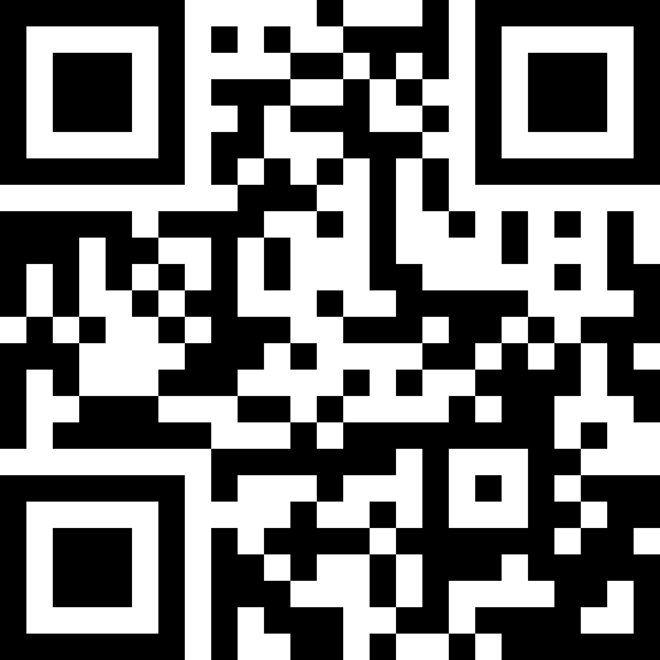



UMSL WOMEN’S HACKATHON 2025
Hacking Rooms ABH 003 & 004
KEY MOMENTS
JOIN THE DISCORD for updates and resources:
Breakfast – 8:00 AM
Lunch – 12:30 PM
Dinner – 5:30 PM
Presentations – 4:30 PM
Winners Announced – 6:30 PM
Brought to you by
Guest Wi-Fi Access:
Network: TritonNetGuest
ID: sbusmis@sbusmis.com
Password: 64448

