Slide 1

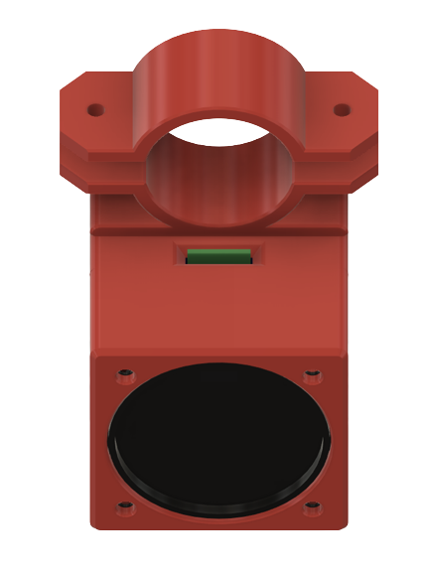
WALKING AID USAGE PROMPT SYSTEM Pedro Caetano, Matthew Culley, Sean Coaker, Panayiotis Melios Swansea University
ABSTRACT
BACKGROUND WORK
DESIGNS
Through the module Software Testing, we were given the chance to implement a system for Bangor Health Clinic. The system will be used for dementia patients, reminding them to take their walking aids. The system requires two devices that will communicate and an SD card where a familiar voice of the patient will be stored.
Dementia is a term used to describe a set of symptoms linked with progressive neurological (brain) disorders and may include memory loss, difficulties with thinking, problem-solving, or language.
Tile ecosystem is used as a locator system, for instance, allows users to track down valuables such as their wallets.
Hanging objects from door frames that clatter together when the patient comes through the door or placing pressure pads beneath doormats that sound an alert when the patient steps on the doormat are two other classic devices that caregivers may employ to warn themselves that their patient is moving.
Both devices for the system are being done by 3D printing. The one on the left is the walking aid device and the one on the right is the wearable device.
INTRODUCTION
The goal is to create a system that detects when a dementia patient moves without their walking aid and alerts them with a recorded message from a friend or relative.
Our solution is built as one device on the walking aid which includes a speaker, that will inform the user to take the walking aid, and another wearable device for the user that indicates whether the user is walking.
METHODOLOGY
We used an agile-based development methodology, after being small group members, in more detail, we held frequent intervals, every week, due to other university work.
Our hardware is based on the TinyPico implementation of the Espressif Systems ESP32 devices. For the movement detection, we used accelerometers specifically the ADXL345.
CONCLUSION
The Conclusion.
REFERENCES
Add References.

