Slide 1
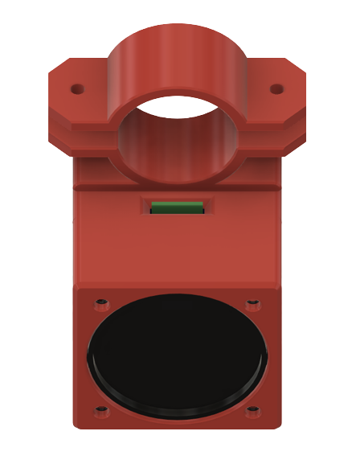
WALKING AID USAGE PROMPT SYSTEM Pedro Caetano, Matthew Culley, Sean Coaker, Panayiotis Melios Swansea University
ABSTRACT
BACKGROUND WORK
DESIGN
Through the module Software Testing, we were given the chance to implement a system for Bangor Health Clinic. The system will be used for dementia patients, reminding them to take their walking aids.
Tile ecosystem is used as a locator system, for instance, allows users to track down valuables such as their wallets.
Design for the walking aid system
INTRODUCTION
METHODOLOGY
The goal is to create a system that detects when a dementia patient moves without their walking aid and alerts them with a recorded message from a friend or relative.
Our solution is built as one device on the walking aid and another wearable device for the user that indicates whether the user is walking.
The methodology we used.
CONCLUSION
The Conclusion.
REFERENCES
Add References.

