Slide 1
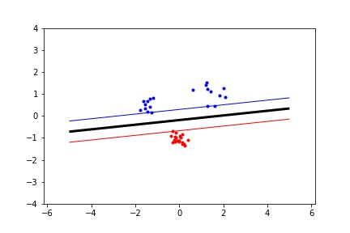
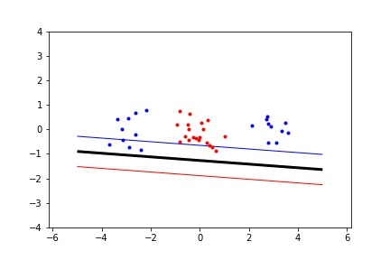
1. Move the clusters around and change their sizes to make it easier or harder for the classifier to find a decent boundary. Pay attention to when the optimizer (minimize function) is not able to find a solution at all.
Easy
Hard
C=10,d=0.5
Notes:
Easy when the clusters are linearily seperable, hard/impossible otherwise

Slide 2
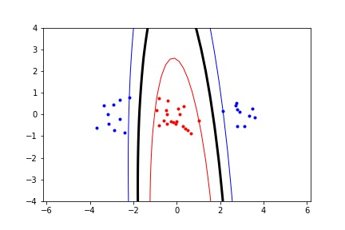
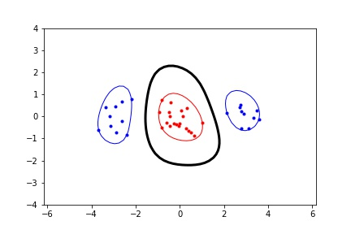
2. Implement the two non-linear kernels. You should be able to classify very hard data sets with these.
Polynomial, p = 2
Rbf, sigma = 1
Notes:
It seems we can indeed classify the dataset that the linear kernel wasn’t able to classify with the other kernels

Slide 3
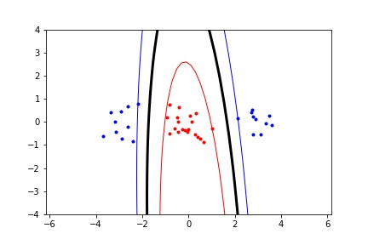
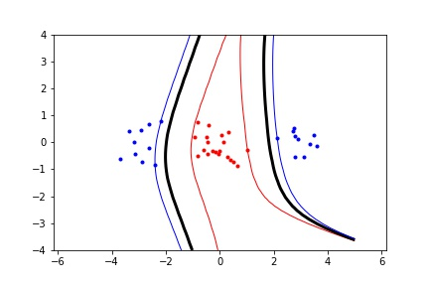
3. The non-linear kernels have parameters; explore how they influence the decision boundary. Reason about this in terms of the bias-variance trade-off.
Polynomial
Higher p means tighter fitting to dataset, so higher variance and lower bias (risk of overfitting)
Lower p means softer fitting to dataset, so lower variance and higher bias (less accurate)
P=5
P=2

Slide 4
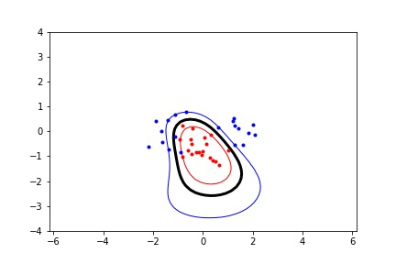
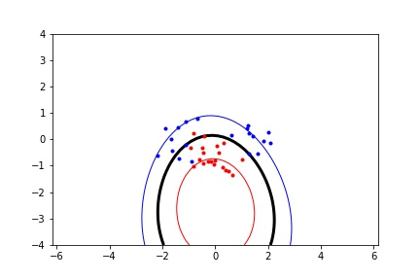
3. The non-linear kernels have parameters; explore how they influence the decision boundary. Reason about this in terms of the bias-variance trade-off.
RBF
lower sigma means tighter fitting to dataset, so higher variance and lower bias (risk of overfitting)
Higher sigma means softer fitting to dataset, so lower variance and higher bias (less accurate)
Sigma = 1
Sigma = 4
Notes:
Sigma helps determine the distance between point x and y in the kernelfunction, if sigma is small, the kernel function is 0 way quicker, so less points matter. If sigma is bigger, less points will be zero and more points will play a role in determining the seperation line, resulting in a lower variance and higher bias.

Slide 5
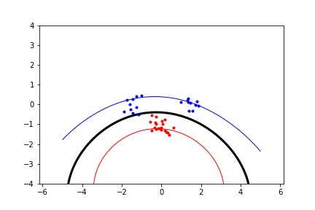
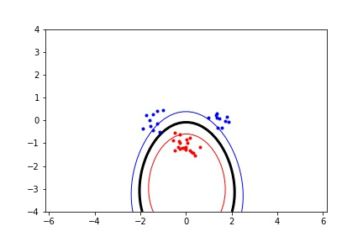
4. Explore the role of the slack parameter C. What happens for very large/small values?
The paramater C sets the relative importance of avoiding slack versus getting a wider margin. Noisy data typically deseres a low C value, allowing for more slack, since individual datapoints in strange locations should not be taken too seriously.
Higher C means bigger penalty for datapoints inside margin, resulting in tighter fitting to dataset, so higher variance and lower bias (risk of overfitting)
Lower C means being more forgiving to datapoints inside the margin, resulting in softer fitting to dataset, so lower variance and higher bias (less accurate)
C = 2
C = 100

Slide 6
5. Imagine that you are given data that is not easily separable. When should you opt for more slack rather than going for a more complex model (kernel) and vice versa?
If it is difficult to seperate because of noise or overlap between clusters then more slack will do fine, but if there are for example 2 or more clusters from 1 class with a seperate class in between them, then lowering C to allow more slack won’t help at all, we would need a different model. Also C is global (for all dimensions), with a different kernel we can do more flexible things such as put more emphasis on certain axises.

