Slide 1
Designing Large Programs

Slide 2
Objectives
To be able to
Design a program as a collection of interacting components.
Create a C program consisting of multiple source files.

Slide 3
Program Design
Program design means dividing the program into smaller pieces that can interact to fullfill the program’s requirements.
We have to understand the requirements before we can design the program.

Slide 4
Program Design
There are two kinds of parts that we must design (identify or invent.)
  Data Structures
  Algorithms
An experienced designer has a large repertoire of known data structures and algorithms to draw on.
  Normally can design a new program using known components.

Slide 5
Learning Program Design
A beginner has a very limited repertoire.
  Usually must find or invent components.
Learning program design consists largely of building a repertoire of known components and understanding how to put them together.
Like learning to ride a bicycle, it is best done by experience.

Slide 6
Implementing Large Programs
Large programs must be divided into multiple source files.
  Files more than a few pages long are difficult to edit, read, and understand.
  Very large files can take a long time to compile and link.
Let each file contain closely related code.
  Should make sense by itself.
  Limited number of inputs and outputs.
  Well defined functionality.

Slide 7
Compiling Multifile Programs
An Integrated Development Environment such as Visual Studio supports the development of multifile programs.
  “Project” contains files that make up a program.
  The IDE keeps track of what has changed and what needs to be recompiled.
  The IDE compiles and links the program transparently.

Slide 8
Compiling Multifile Programs
Without an IDE, as we work on Unix, you have to say what files to compile and link.
Unix make command helps.
  “makefile” provides rules for compiling and linking.
  You have to create the makefile with the right rules and commands for each program.
For programs of moderate size we can simply compile everything at the same time.
  gcc –Wall *.c

Slide 9
Designing a Large Program
It’s not practical to create an actual large program as a classroom example.
We will simulate development of a large program with a relatively small program that still needs to be divided into parts.
  Reverse Polish Notation Calculator
We will add functionality to this program over several classes.

Slide 10
Reverse Polish Notation Calculator
Reverse Polish Notation (RPN) is a way to write complex mathematical expressions without using parentheses.
Invented by the Polish mathematician Jan Lukasiewicz in the 1920’s.
  (wuka-SHEV-itch)

Slide 11
Reverse Polish Notation Calculator
References in our textbook:
  Section 15.1, page 349
  Project 10.6, page 239
For background info see
http://en.wikipedia.org/wiki/Reverse_Polish_notation
Or google “Reverse Polish Notation”

Slide 12
Reverse Polish Notation
Operands are written first, followed by operator.
Normal (infix) notation: 1 + 1
Reverse Polish notation: 1 1 +
Infix: 1 + (2 * 3)
RPN: 1 2 3 * +
Infix: (1 + 2 ) * 3
RPN: 1 2 + 3 *

Slide 13
Reverse Polish Notation
The expression is evaluated from left to right.
  Operands and operator are replaced by result.
  Further operations can be applied to results.

Slide 14
Postfix Evaluation Example
2 3 4 + 8 * 7 - +
2 7 8 * 7 - +
2 56 7 - +
2 49 +
51

Slide 15
Using a Stack to Evaluate Postfix Expressions
The stack data structure is ideal for postfix evaluation
We will assume that all arguments are positive integers and that we will not be using the unary minus ("negative of") operator in our expressions
The algorithm processes the expression from left to right as follows:
  if the leftmost term is an argument (int) remove it from the expression and push it on an integer stack;
  otherwise it is an operator symbol, so remove it and :
    pop the top of the stack and hold that value as the right argument to the expression; then
    pop the top of the stack and hold that value as the left argument to the expression
    apply the appropriate operation to the arguments and push the result onto the stack
  When the entire expression has been consumed, there will be exactly one value in the stack and it will be the value of the expression

Slide 16
Example: Using a Stack for Postfix Evaluation
left
right
operand stack
remaining expression
2 3 4 + 8 * 7 − +
2
3 4 + 8 * 7 − +
2 3
4 + 8 * 7 − +
2 3 4
+ 8 * 7 − +
3
4
2
+ 8 * 7 − +
2 7
8 * 7 − +
2 7 8
* 7 − +
7
8
2
* 7 − +
2 56
7 − +
2 56 7
− +
56
7
2
− +
2 49
+
2
49
+
51

Slide 17
Reverse Polish Notation
RPN can be applied to any arithmetic expression.
  Any expression you can write with operators, operands, and parentheses in normal (infix) notation can be written in RPN with no parentheses.
Why bother?
  Cleaner, more concise representation.
    Some errors are impossible to make.
  RPN is simpler to parse than infix notation.

Slide 18
RPN Calculator
Let’s write a program to evaluate simple RPN expressions.
To keep the program as simple as possible, it will take only integer constants as operands (no variables).
  Operators: + - * /
  Integer arithmetic.
  Ignore most errors.

Slide 19
Program Flow
Read a string from the keyboard.
  Should be a valid RPN expression.
View the input string as a sequence of "tokens" separated by whitespace characters. A token is a string of non-whitespace characters.
Example:
if the input string is
"25 32 15 - + 2 * = ",
then the tokens are
"25", "32", "15", "-", "+", "2", "*", "="
Utility function to extract tokens from the input string.

Slide 20
Program Flow
/* copies next non-whitespace string into token */
/* return 0 if no new token available, 1 otherwise */
int getNextToken(const char *buff, char *token, int len)
{
static int j = 0; /* start of next char to be checked */
/* value retained from call to call */
int i = 0;
token[0] = 0; /* string in token is now empty -- equals "" */
while(j < len && isspace(buff[j])) /* skip over whitespace */
j++;
while(j < len && !isspace(buff[j])) /* copy nonwhitespace chars into token */
token[i++] = buff[j++];
token[i] = 0;
if (token[0] == 0) /* no new token */
return 0; /* return value treated as boolean (true/false) */
else
return 1;
}

Slide 21
Program Flow
Read a string from the keyboard.
  Should be a valid RPN expression.
Evaluate the expression.
  Get the tokens one after another
  If first character of the token is a digit, use sscanf to input the integer in the token and push it onto the stack
  If the first character is an operator, pop top two values off the stack and apply the operator to them. Push the result back onto the stack.
  If char is =, return the result (top of the stack).
Output the result.

Slide 22
Error Processing
What if input is not a valid RPN expression?
  For this example, ignore the possibility.
  A real program would need to provide a useful error message to the user.
Ignore characters other than whitespace, digits and operator characters.
  Except “q” or “Q” for “quit”

Slide 23
Program Design
Think about how to divide the overall problem “Evaluate an RPN Expression” into smaller parts.
  Data Structure.
  Algorithm
Minimal coupling
  Parts should be independent
Well defined functionality
    Responsibilities

Slide 24
Divide the Program into Parts
Stack data structure.
  Supports push and pop operations for ints.
Inputter
  Reads a string from the keyboard.
  Does minimal validation.
RPN Evaluator
  Processes a string as an RPN expression.
  Uses the Stack data structure.
  Produces an integer result
Main
  Controls overall program execution.

Slide 25
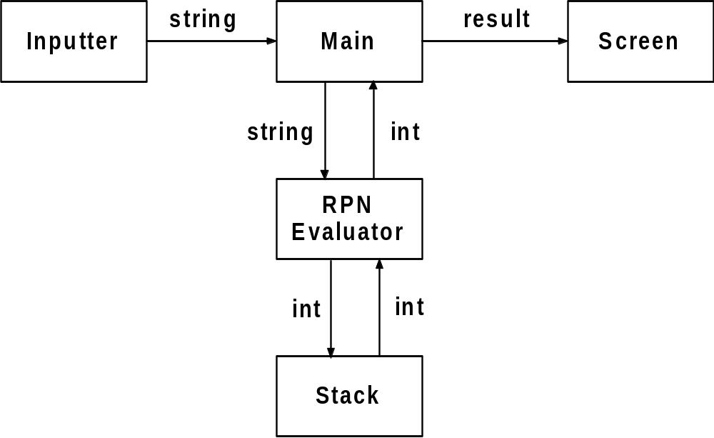
Design Diagram

Slide 26
Responsibilities
Stack just provides the ability to push and pop ints.
  Knows nothing about RPN
Inputter just knows how to get characters from the keyboard.
  Can validate them. Skip over invalid chars.
RPN Evaluator is the core of the program.
  Knows how to evaluate RPN.
Main just coordinates the other pieces.

Slide 27
Stack
Stack is a common data structure.
Specific to a type.
  We will have a stack of int.

Slide 28
Stack
The operations define the data structure’s user interface.
  All the outside world can see and do.
  Specified in the header file stack.h
Principle of encapsulation.
  Also known as information hiding.
  Show the outside world only what it has to know in order to use the services.
The implementation can be changed without affecting other code if the interface is preserved.

Slide 29
main.c
#include <stdio.h>
#include "stack.h"
int main (void)
{
printf ("Hello,world!\n");
getchar();
getchar();
return 0;
}
Build and test.
Always have a working program!

Slide 30
Using a Stack to Evaluate Postfix Expressions
The stack data structure is ideal for postfix evaluation
We will assume that all arguments are positive integers and that we will not be using the unary minus ("negative of") operator in our expressions
The algorithm processes the expression from left to right as follows:
  if the next token is an argument (int) push it on an integer stack;
  otherwise it is an operator symbol, so remove it and :
    pop the top of the stack and hold that value as the right argument to the expression; then
    pop the top of the stack and hold that value as the left argument to the expression
    apply the appropriate operation to the arguments and push the result onto the stack
  When the entire expression has been consumed, there will be exactly one value in the stack and it will be the value of the expression

