Slide 1
FURNITURE SHOP MANAGEMENT SYSTEM
BSIT 4-2N

Slide 2
OVERVIEW OF THE SYSTEM

Slide 3
The Furniture Shop offers high quality furniture that goes from simple and classic to one very luxurious design. They offer furniture generously made of narra and of high quality fabrics imported from other countries. The shop creates furniture for display and for walk-in customers to see and purchase. They accept orders with designs picked from their brochures or customized designs specified or brought by the customer.

Slide 4
The Furniture Shop Management System will help them manage order and the information that is going in and out of the shop, at the same time will help them promote their products and reach customers on a farther vicinity. The project will have the following subsystems:
Order Management, Billing and Collections and Production Tracking System.

Slide 5
The system does the following:
Monitor Inventory
Manage Orders
Monitor Production
Monitor Delivery
Process Payment
Manage Collections
Generate Reports

Slide 6
The system will be accessible to the owner/manager of the Furniture Shop and the customers through the website with the browsers, Google Chrome, Mozilla Firefox, Microsoft Edge and mobile browsers.

Slide 7
IMPLEMENTATION PLAN

Slide 8
INFORMATION SYSTEM ARCHITECTURE

Slide 9
INPUT
(Data)
Customer Information
Order Information
Customized Design
Payment Information
Delivery Details of Raw Materials
PROCESS
(Operation)
Monitor Inventory
Manage Orders
Monitor Production
Monitor Delivery
Process Payment
Manage Collections
Generate Reports
OUTPUT
(Reports/Output)
Official Receipt
Billing Receipt
Delivery Receipt
Job Order Form
Order Report
Sales Report
Inventory Report
Production Report
DATABASE
(Furniture Shop Management System)

Slide 10
CLIENT/SERVER ARCHITECTURE

Slide 11
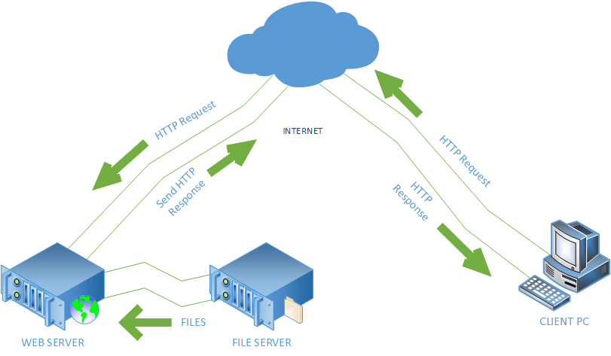

Slide 12
The File Server will store the files needed for the system. Web Server serves as the middle man wherein it processes requests via HTTP and distribute information on the internet. This information will be displayed as web pages to for the clients to interact.

Slide 13
QUALITY PLAN

Slide 14
To ensure the system’s great performance, accuracy, reliability and usability, here are the plan followed:
The system undergone series of test in order to ensure it is running smoothly and produces valid and reliable outputs
People other than the proponents tried using the system to ensure the user friendliness of the system.

Slide 15
The team conducted daily to weekly meetings in order for everyone to be updated on the project’s status.
The team communicates with each other and tells everyone the updates that they have done so far as well as the concerns and other ideas they have to ensure the project’s quality.

