Slide 1

Azure Functions

Slide 2
From IaaS to PaaS
IaaS
PaaS
VM
WebApps
WebJobs
Functions
Cloud Services
Service Fabric

Slide 3
Why Functions?
Fast development
Server headaches delegated
Focus on logic

Slide 4
App Service Plan
App Service Hosting Plan
Dedicated Hosting Plan
Consumption Hosting Plan
Functions
Basic, Standard, Premium
Pay based on # of reserved VMs
You’re responsible for scale
Pay on number of executions
Platform responsible for scale
WebJobs
WebApps
*Consumption Plan used to be Dynamic Plan

Slide 5
Dynamic Tier Pricing (Consumption Plan)
Pay per execution, 2 meters, 3 units
- Number of executions
- Execution duration (sec) X reserved memory (GB)
- Monthly 1 Million executions + 400,000GB-sec FREE
- After that $0.000016 GB-sec & $0.20 per Million Executions
https://azure.microsoft.com/en-us/pricing/details/functions/

Slide 6
Azure Functions architecture
Code
Config
Language Runtime C#, Node.js, F#, PHP, Python, PowerShell, Bash, etc.
WebJobs Script Runtime Azure Functions Host – Dynamic Compilation, Language abstractions, etc.
WebJobs Core
Programming model, common abstractions
WebJobs Extensions
Triggers, input and output bindings
App Service Dynamic Runtime Hosting, CI, Deployment Slots, Remote Debugging, etc.

Slide 7
What Functions Should Do
Functions should “do one thing”
Functions should be idempotent
Functions should finish as quickly as possible
1

Slide 8
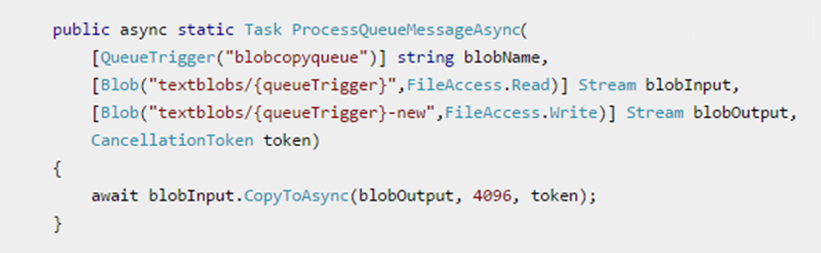
Functions Basics
Input trigger(s)
Body
Optional return value(s)

Slide 9
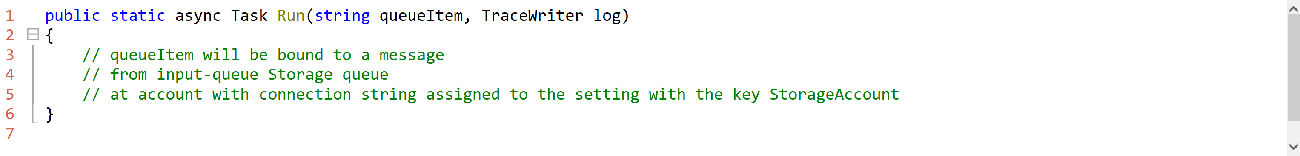
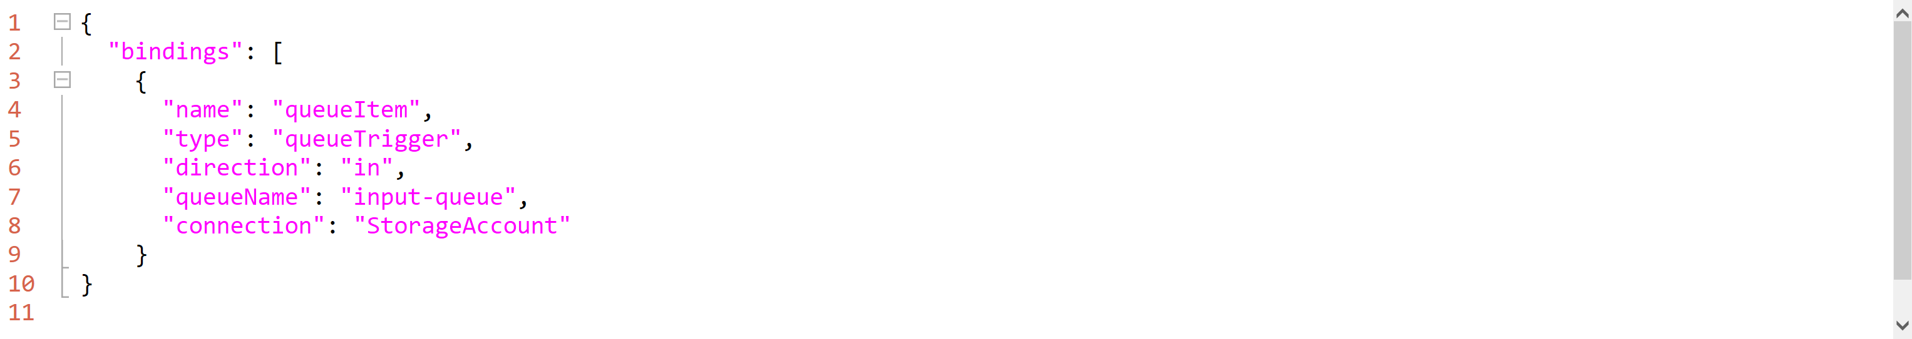
Bindings - Declarative
Using function.json

Slide 10
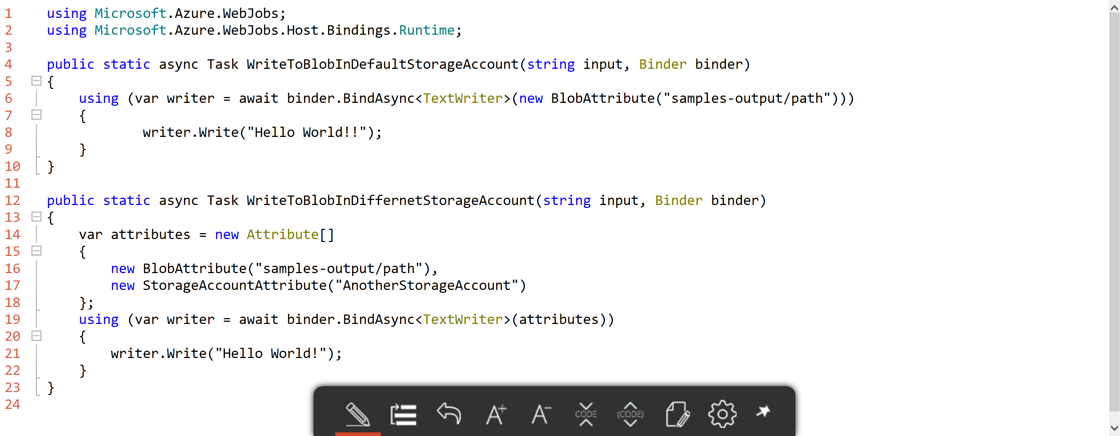
Bindings - Imperative
Using IBinder or Binder parameter

Slide 11
Triggers
Type | Service | Trigger | Input | Output
Schedule | Azure Functions | ✔
HTTP (REST or webhook) | Azure Functions | ✔ |  | ✔*
Blob Storage | Azure Storage | ✔ | ✔ | ✔
Events | Azure Event Hubs | ✔ |  | ✔
Queues | Azure Storage | ✔ |  | ✔
Tables | Azure Storage |  | ✔ | ✔
Tables | Azure Mobile Apps |  | ✔ | ✔
No-SQL DB | Azure DocumentDB |  | ✔ | ✔
Push Notifications | Azure Notification Hubs |  |  | ✔
Twilio SMS Text | Twilio |  |  | ✔
* requires an HTTP trigger
SaaS File (OneDrive, Google Drive, DropBox, etc)
SaaS Table (SalesForce, Dynamics, Google Sheets, etc)

Slide 12
Best Practices
Messaging for cross-function communication (ASQ/ASB)
Take advantage of dead letter queues
Use async code. Yes, with ConfigureAwait(false)
Don’t use Task.Result
Ideally stateless

Slide 13
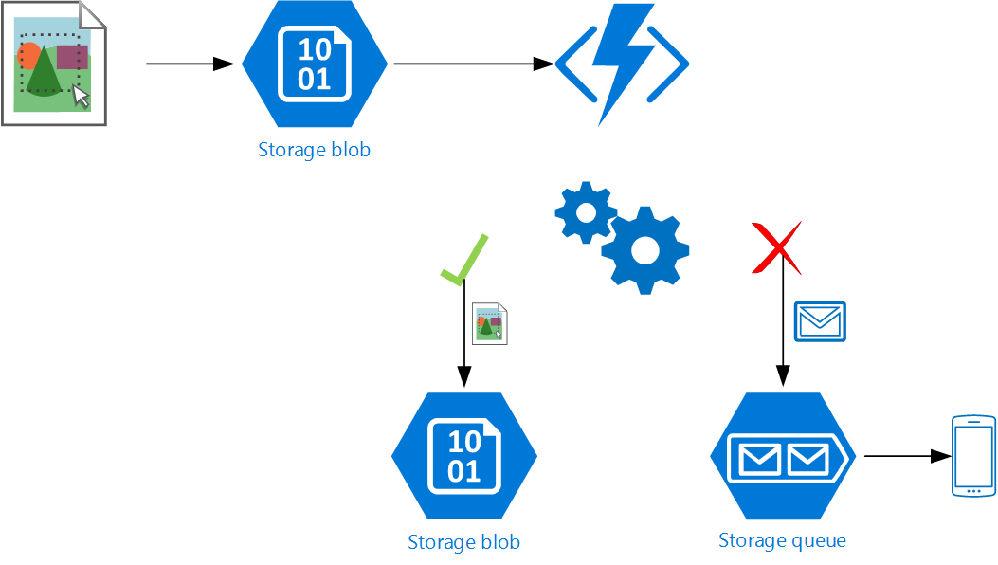
Demo: Monitored Thumbnail Generator
GH issue #971: Cannot perform runtime binding on a null reference

Slide 14
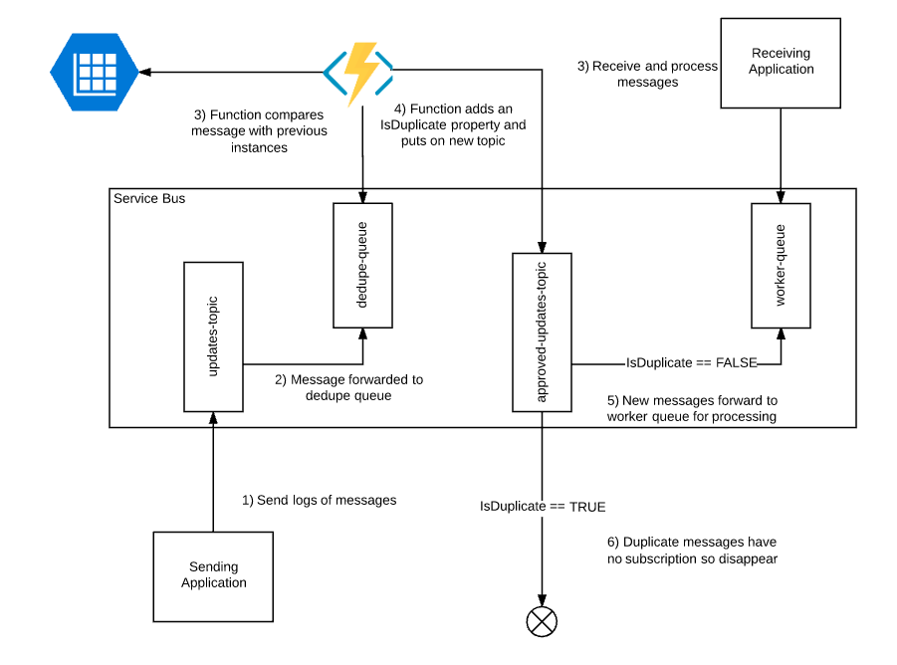
Use case: Message Deduplication
http://microsoftintegration.guru/2016/09/20/use-azure-function-to-deduplicate-messages-on-azure-service-bus/

Slide 15
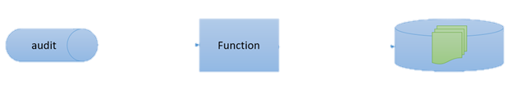
Use case: ETL (Failure Auditing)
https://weblogs.asp.net/sfeldman/azure-functions-to-make-audit-queue-and-auditors-happy

Slide 16

Use case: Updates Notifier
NuGet packages
https://portal.azure.com/#blade/WebsitesExtension/FunctionsIFrameBlade/id/%2Fsubscriptions%2F97d311d3-b788-4002-87c0-cd8688165f76%2FresourceGroups%2FAzureFunctions-WestUS%2Fproviders%2FMicrosoft.Web%2Fsites%2Fxkcd

Slide 17
Developing & Debugging Locally
NPM cli
npm install -g yo generator-azurefunctions azure-functions-cli
func init
func function create
func run <name> --debug
http://localhost:7071/api/<name>
OR… Exclusive For Calgary .NET usergroup - Visual Studio!
Notes:
npm cli + command line: https://shellmonger.com/2016/10/31/creating-and-debugging-azure-functions-locally/

Slide 18
Q&A
Ask away!

Slide 19

Thank you!
Connect @sfeldman
Send your feedback to feldman.sean@gmail.com
Feel up your RSS feed with https://weblogs.asp.net/sfeldman
Presentation https://github.com/SeanFeldman/AzureFunctions-DotNet-YYC
Tools
Azure Portal (Ibiza)
Azure Storage Explorer http://storageexplorer.com
npm azure-functions-cli https://www.npmjs.com/package/azure-functions-cli

