Slide 1

Azure Functions

Slide 2
From IaaS to PaaS
IaaS
PaaS
VM
WebApps
WebJobs
Functions
Cloud Services
Service Fabric

Slide 3
App Service Plan
App Service Hosting Plan
Dedicated Hosting Plan
Dynamic Hosting Plan
Functions
Basic, Standard, Premium
Pay based on # of reserved VMs
You’re responsible for scale
Pay on number of executions
Platform responsible for scale
WebJobs
WebApps

Slide 4
Dynamic Tier Pricing
Pay per execution, 2 meters, 3 units
- Number of executions
- Execution duration (sec) X reserved memory (GB)
- Monthly 1 Million executions + 400,000GB/sec FREE
- After that $0.000016 GB/sec & $0.20 per Million Executions

Slide 5
Azure Functions architecture
Code
Config
Language Runtime C#, Node.js, F#, PHP, Python, PowerShell, Bash, etc.
WebJobs Script Runtime Azure Functions Host – Dynamic Compilation, Language abstractions, etc.
WebJobs Core
Programming model, common abstractions
WebJobs Extensions
Triggers, input and output bindings
App Service Dynamic Runtime Hosting, CI, Deployment Slots, Remote Debugging, etc.

Slide 6
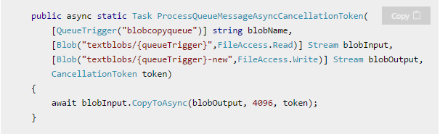
Function Basics
Input trigger(s)
Body
Optional return value(s)

Slide 7
Best Practices
Functions should “do one thing”
Functions should be idempotent
Functions should finish as quickly as possible
1

Slide 8
Best Practices
Messaging for cross-function communication (ASQ/ASB)
Take advantage of dead letter queues
Use async code. Yes, with ConfigureAwait(false)
Don’t use Task.Result
Ideally stateless

Slide 9
Triggers
Manual trigger (portal)
Timer
HTTP
Generic webhook / GitHub webhook / Slack webhook
Storage Queue
Storage Blob
Storage Table
EventHub
SaaS File (OneDrive, Google Drive, DropBox, etc)
SaaS Table (SalesForce, Dynamics, Google Sheets, etc)
DocumentDB

Slide 10
Code time
Canonical image resizing service – get an image and generate thumbnails
Handle failures
Create failure audits
Send notification(s)
Twillio: https://docs.microsoft.com/en-us/azure/azure-functions/functions-bindings-twilio

Slide 11
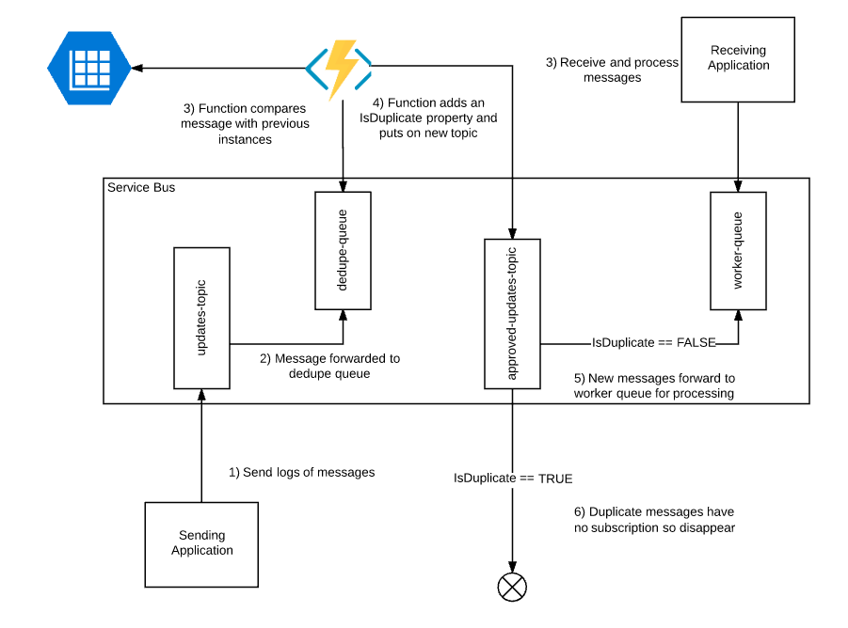
Use case: Message deduplication
http://microsoftintegration.guru/2016/09/20/use-azure-function-to-deduplicate-messages-on-azure-service-bus/

Slide 12
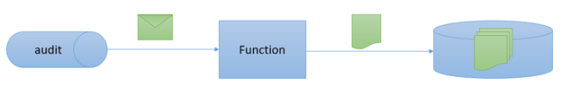
Use case: ETL (failure audits)
https://weblogs.asp.net/sfeldman/azure-functions-to-make-audit-queue-and-auditors-happy

Slide 13

Use case: Updates notifier
NuGet packages
https://portal.azure.com/#blade/WebsitesExtension/FunctionsIFrameBlade/id/%2Fsubscriptions%2F97d311d3-b788-4002-87c0-cd8688165f76%2FresourceGroups%2FAzureFunctions-WestUS%2Fproviders%2FMicrosoft.Web%2Fsites%2Fxkcd

Slide 14
Developing & Debugging Locally
npm cli + command line: https://shellmonger.com/2016/10/31/creating-and-debugging-azure-functions-locally/
func init
func function create
func run <name> --debug
http://localhost:7071/api/<name>
https://portal.azure.com/#blade/WebsitesExtension/FunctionsIFrameBlade/id/%2Fsubscriptions%2F97d311d3-b788-4002-87c0-cd8688165f76%2FresourceGroups%2FAzureFunctions-WestUS%2Fproviders%2FMicrosoft.Web%2Fsites%2Fxkcd

Slide 15

Thank you!
Connect @sfeldman
Send your feedback to feldman.sean@gmail.com
Feel up your RSS feed with https://weblogs.asp.net/sfeldman
Presentation https://github.com/SeanFeldman/AzureFunctions-DotNet-YYC
Tools
Azure Portal (Ibiza)
npm azure-functions-cli https://www.npmjs.com/package/azure-functions-cli

