Slide 1









Azure Service Bus - Taming the Beast

Slide 2

Azure Service Bus –
Taming the Beast
Sean Feldman / @sfeldman
Notes:
Azure Service Bus is an asynchronous messaging cloud platform that enables you to send data between decoupled systems.

Slide 3
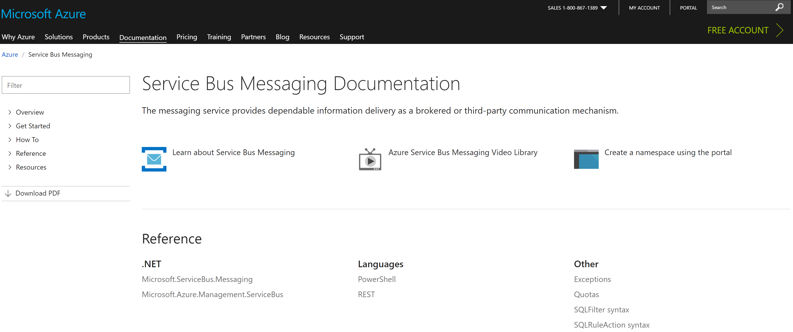

Is it a beast at all?!

Slide 4
ASB for Queueing
Sender
queue
Temporal coupling
Receiver
Notes:
Temporal coupling, synchronous.
Asynchronous messaging is fundamentally a pragmatic reaction to the problems of distributed systems. Sending a message does not require both systems to be up and ready at the same time. Furthermore, thinking about the communication in an asynchronous manner forces developers to recognize that working with a remote application is slower, which encourages design of components with high cohesion (lots of work locally) and low adhesion (selective work remotely).

Slide 5


ASB for Messaging
Notes:
Queues and topics/subscriptions. Also queues, but on steroids.

Slide 6
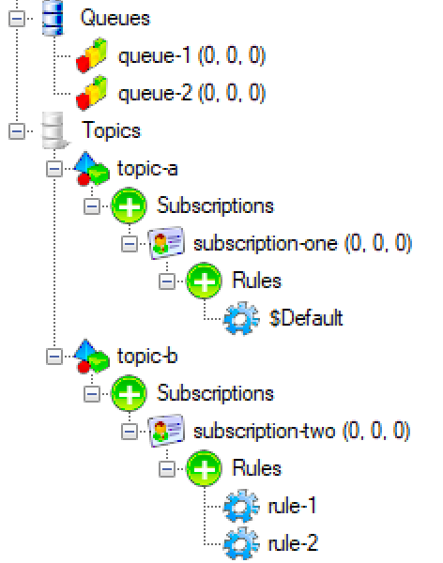
Building Blocks
Remote Service
Entities
Queues
Topics
Subscriptions
Rules
Client (WindowsAzure.ServiceBus)
Notes:
Azure Service Bus service (which I will call the broker) is represented by the store and the gateway.
The entities are used to store and operate on messages on the broker side.
- Queues
- Topics
- Subscriptions
And rules
To access the brokers and the entities, a client is required. For this talk, I’ll be using WindowsAzure.ServiceBus client

Slide 7
Brokered Messages
Headers
64 KB
256 KB (Standard)
1 MB (Premium)
Body
Notes:
Message size – not as generous as MSMQ. But if you need more than that, perhaps you’re not doing messaging.

Slide 8
Sending/Receiving Messages
Requires a client
A client to send
A client to receive

Slide 9


Sending and Receiving
QueueClient
QueueClient
MessageSender
MessageReceiver
MessageSender and MessageReceiver for code that doesn’t care about entity type
TopicClient
SubscriptionClient

Slide 10
Receive Modes
ReceiveAndDelete
PeekLock
Broker
Consumer A
Consumer B
PeekLock is at-least-once delivery
ReceiveAndDelete is at-most-once delivery
Use ReceiveAndDelete with caution
Consumers are competing

Slide 11
PeekLock-ed Options
Receive
Complete
Abandon
Defer
Deadletter
Lock timeout expired X MaxDeliveryCount
Abandon is not Defer
Deferred messages can only be retrieved by their SequenceNumber
Message can be dead-lettered explicitly
Message marked as completed and removed from the queue.
Message becomes visible on the queue and can be received again.
Message remains on the queue and can be received later using SequenceNumber
Message is moved to deadletter sub-queue and can be received from that queue.
Message is moved to deadletter sub-queue and can be received from that queue.

Slide 12

Receiving with Message Pump
OnMessage API to implement message pump
OnMessageOptions for parallelism, lock extension, and completion
OnMessageOptions.ExceptionReceived
Complete Abandon
Defer Deadletter
Notes:
OnMessageOptions (AutoComplete , AutoRenewTimeout, MaxConcurrentCalls)
OnMessageOptions.ExceptionReceived
MessageReceivier.OnMessageAsync

Slide 13
Duplicate Detection
{
"_id": "592dede7e37e197bc434cf0b",
"index": 0,
"isActive": false
}
Deduplication on message ID only
Deduplication time period specified per entity
Time based. Idempotency on consumers might be a better option
Broker
{
"_id": "592dede7e37e197bc434cf0b",
"index": 0,
"isActive": false
}
Notes:
Duplicates of already received messages (same message-id) are suppressed and not accepted into the entity within a defined time window

Slide 14
Auto-Forwarding
Namespace
queue1
queue2
Notes:
Native chaining of a queue or subscription to another queue or topic within the same namespace.

Slide 15
Multiple Forwardings
Forwarding is native on broker
Maximum 3 hops
Notes:
Native chaining of a queue or subscription to another queue or topic within the same namespace.
The rule of 3

Slide 16

Dead-Lettering
Dead-lettering happens for a reason, DeadLetterReason
Forwarded DLQed messages have a source, DeadLetterSource
117051215727656
Notes:
Expired or undelivered messages (exceeding maximum delivery count) can be placed into this special queue for retrieval and inspection
Centralized Dead-lettering and DeadLetterSource

Slide 17

Message Expiration
Good for time sensitive messages
Messages are cleared when a client connects
Notes:
Messages can be set to expire after a defined period. If the message has not been delivered at the deadline, the message is removed (or deadlettered)

Slide 18
Ephemeral (Idle) Entities
Minimum 5 minutes
Messages will be gone
Notes:
Queues, Topics, and Subscriptions created for temporary use can be automatically deleted after having been idle (unused) for defined time
Minimum 5 mins
If contains messages, those will be gone

Slide 19

Scheduling
Scheduling messages for future
Up to years (TimeSpan.Max)*
Notes:
Scheduling permits placing a message into the queue and make it available for retrieval later, starting at a specified time

Slide 20
Batching
Atomic operation
Single destination
100 or less messages
Total size is limited
Destination A
Notes:
Good: atomic
Bad: 100 or message size

Slide 21
Transactions - Atomic Sends
Messages can be sent one at a time
Transaction scope to complete or abort
Single destination
100 or less messages
Total size is limited
Transaction
Destination A
Notes:
Good: Multiple messages to the same destination
Good: can send and abort
The Bad: same as with batching

Slide 22
Transactions - Atomic Sends with Receive
Incoming and outgoing messages participate in transaction
Multiple outgoing destinations
Single namespace
Possible “ghost” messages
AMQP not supported*
Transaction
Destination A
Source
Destination B
Destination C
Notes:
Transaction with send-via to span multiple destinations
Multiple destination, atomic operation
Mandatory tx.commit
The Bad: Ghosts scenario
The Bad: no support for transactions and send-via when using AMQP
The Bad: no cross namespace support

Slide 23
There’s more to queues than meets the eye
queue/$DeadLetterQueue
queue/$Transfer
queue/$Transfer/$DeadLetterQueue
Non-delivered message was not lost
Transaction doesn’t fail
Another DLQ to monitor
Notes:
Ugly: Messages participating in a transaction that end up in TDLQ do not raise any exceptions (transaction completed, messages are gone, but not found in destination).
Possible reasons: queue is disabled / exceeds maximum size

Slide 24
Pub/Sub
Topic: mytopic
Subscription: mysub1
sys.Label LIKE ‘%rush%’ OR Amount >= 100
Rules
Broadcasting w/o knowing the recipients
Message headers can be mutated
Enables different levels of processing
Filter
HighPriority
SET Priority=‘high’
Action
Subscription: mysub1
Rules
(Amount < 100) AND (sys.Label NOT LIKE '%rush%')
Filter
NormalPriority
Action
SET Priority=‘normal’
Notes:
Broadcasting, various priorities of processing, message manipulations (headers)
Perhaps combine with forwarding?
Benefits are:
1. Native chaining
2. Single receiving client
3. No need to worry about subscriptions

Slide 25
Multiple rules
Topic: mytopic
Subscription: mysub
sys.Label LIKE '%rush%'
Rules
Rules evaluated using OR logic
When headers mutated, duplicates created
Filter
Rule1
Action
Filter
Amount >= 100
Rule2
Action
Notes:
Rules evaluated using OR logic, but when action is added, a copy of message is evaluated, not the original message

Slide 26
Multiplexing And Order Preservation
Session 1
Ordered processing is guaranteed
Max concurrency is 1
Single consumer only
Consumer A
FIFO
#2
#3
#2
#1
#1
Consumer B
Session 2
Notes:
Sessions allow separate flow of multiple, concurrent ordered sequences through a single entity

Slide 27
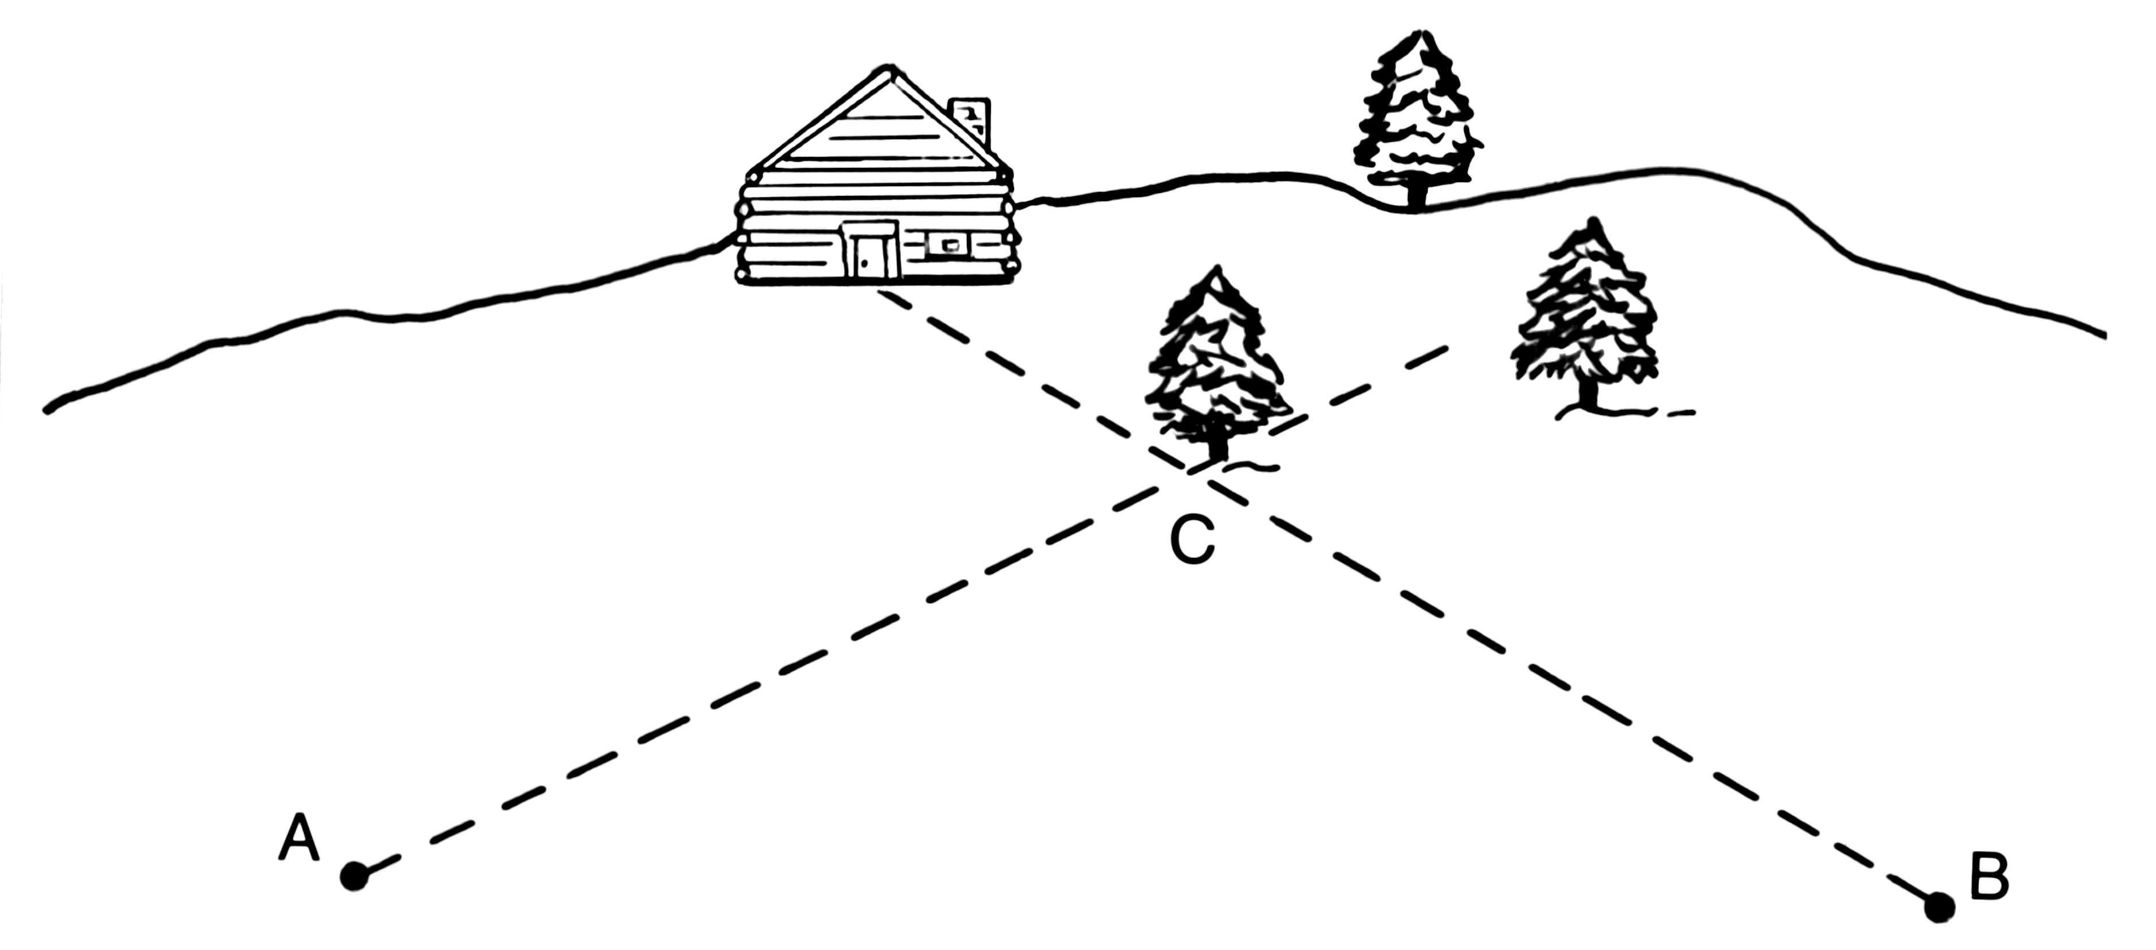
Challenge
If a single factory produces a connection, how many connections can it create?
A) Many
B) One
C) Defined Maximum
D) None above
Factory is a connection
Factory per client for high throughput
Factories are not cheap

Slide 28
Exception Handling
RetryPolicy
exception.IsTransient
Default RetryPolicy is great
Handle transient exceptions
Unless it’s a TimeoutException during lock renewal

Slide 29
What about .NET Core?
Microsoft.Azure.ServiceBus
Full Framework, .NET Standard 1.3, and UWP support
Rapidly catching up with the current client
Support plugins
OSS
Use if don’t need advanced features
No management operations, use separate package
AMQP only*

Slide 30
Thank you
Sean Feldman, Solutions Architect @ Particular Software
@sfeldman
http://weblogs.asp.net/sfeldman

