Slide 1









NServiceBus and Azure Service Bus

Slide 2



NServiceBus and Azure Service Bus
Sean Feldman / @sfeldman

Slide 3
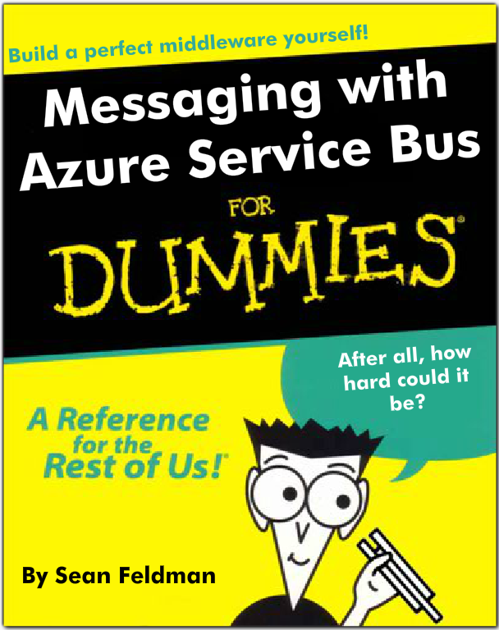
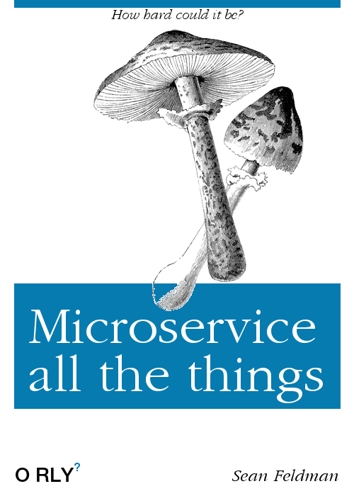

Slide 4
What’s NServiceBus?
Messaging and workflow code-based framework for distributed systems that are
Scalable
Reliable
Easy to work with and extend
Notes:
No need in a specialized server-based software installation.

Slide 5




Why do I need NServiceBus?
Decoupling (RPC/WCF)
Asynchronous communication
Pub/Sub
Ability to breakdown monoliths into smaller components (services)
RPC/WCF

Slide 6





Where do I Start?
From NServiceBus basic concepts
Message
Endpoint (logical)
Endpoint instances (physical)
Host
Transport
Handler
Saga
Notes:
Endpoint is a logical entity that communicates with other Endpoints
Endpoint instances physical deployment of endpoints and scale-out
Host environment where endpoints are running
Transport an abstraction of the underlying technology to provide messaging capabilities
Handler unit of code to operate on a messages. Stateless.
Saga handle long running processes. Stateful. Usually represent workflows and coordinate of for handlers.

Slide 7


How do I add NServiceBus?

Slide 8

But What is an Endpoint?
Shipping
Sales
A logical entity that communicates with other endpoints using messages
Usually equates to a process
Has a unique name
Contains message handlers
Deployed as a single or multiple instances
Customer
Relationship
Customer
Relationship
Customer
Relationship

Slide 9




What’s an Azure Service Bus?
Azure Service Bus is an asynchronous messaging cloud platform that enables you to send data between decoupled systems.
Notes:
Azure Service Bus is an asynchronous messaging cloud platform that enables you to send data between decoupled systems.

Slide 10
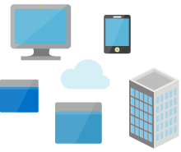
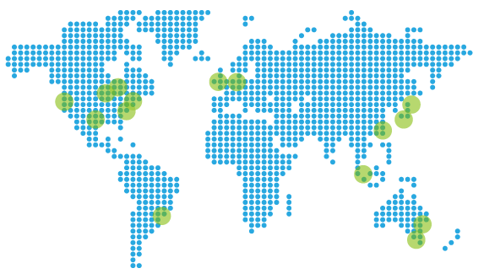
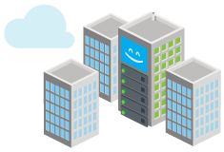


Why do I need Azure Service Bus?
The traditional RPC/WCF option doesn’t quite work
Enable secure and reliable communication in Azure or hybrid
Connect services in Azure and on premises
Advanced features services such as Storage Queues lack
Notes:
ASQ vs ASB

Slide 11



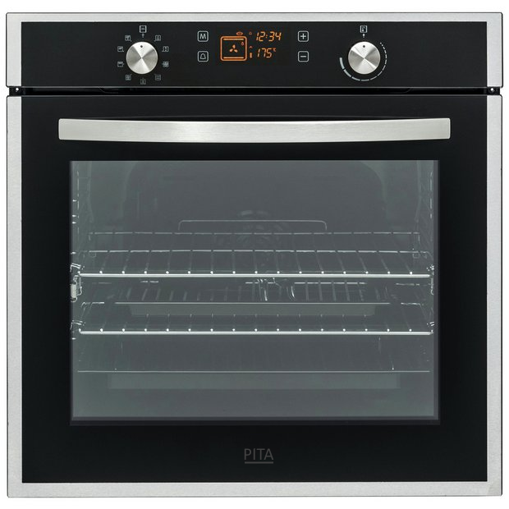




$1M question
Azure Service Bus vs NServiceBus

Slide 12
Sending/receiving a message over ASB
Entities management
Maintaining connectivity
Factories and clients
Error handling
Transient or not
Retries and backoffs
Serialization
Receiving loop
Error handling
…
Sender
Receiver
Azure Service Bus namespace

Slide 13
Demo: Sending/receiving with NSB over ASB
Endpoint A
Endpoint B

Slide 14
Demo: Request/Reply Pattern
Endpoint A
Endpoint B
Notes:
https://docs.particular.net/nservicebus/messaging/reply-to-a-message

Slide 15
Demo: Pub/Sub
Subscriber A
Publisher
Subscriber B
Notes:
https://docs.particular.net/samples/pubsub/

Slide 16


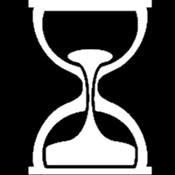


Error Handling
Error queue
Recoverability
Immediate and Delayed
Connected to DeliveryCount
Unrecoverable exceptions
Custom Recoverability Policy

Slide 17

Message Auditing
Endpoint A
Endpoint B
audit

Slide 18



Oversized Messages
ASB limit: 256KB or 1MB
Clean-up

Slide 19
Demo: DataBus
Sending a message larger than 256KB

Slide 20


Transaction Modes
Craving for more Azure Service Bus?
Azure Service Bus Messaging – Taming the Beast
tomorrow at 9:45AM @ room A3
Unreliable
ReceiveOnly
SendsAtomicWithReceive
ReceiveAndDelete
PeekLock
PeekLock… but not ☺
(PeekLock + Transaction + SendVia)

Slide 21
Batching of messages: behind the curtain
Overcome limitations
No ghost messages

Slide 22

Topologies
Represents the layout of Service Bus entities that allow endpoints to communicate
Evolving topology so that you don’t have to do it
From Endpoint Oriented to Forwarding

Slide 23
Endpoint Oriented Topology
Endpoint B
EndpointB.EventA
Endpoint A
EndpointB.EventB
EndpointA.Events
EndpointC.EventA
Endpoint C

Slide 24
Forwarding Topology
Endpoint B
EndpointB
Type A Type B
Endpoint A
Bundle-1
EndpointC
Type A
Endpoint C

Slide 25
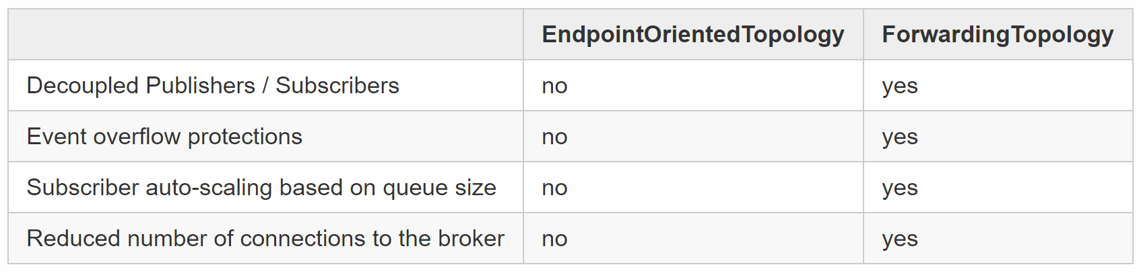
Why Forwarding Topology?

Slide 26

Native Integrations
Any 3rd party
Java Application
Microsoft CRM

Slide 27

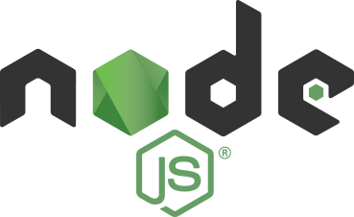
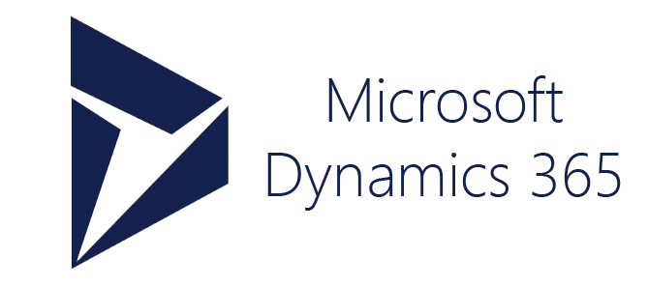
Demo: Native Integration
3rd Party
Endpoint B

Slide 28




HA and Throughput
Single Namespace Partitioning
Round Robin Namespace Partitioning
Failover Namespace Partitioning

Slide 29
NSB+ASB=Run Anywhere!
Host anywhere
On-premises or Azure (and other clouds! What other clouds?!)
Any type of compute service (minus Functions for a good reason)
Self-hosted
Windows Service
In-proc (webapp)
Azure VMs/VMSS
Azure App Service (webapps and webjobs)
Cloud Services
Service Fabric
The Next-Month Azure Service yet not announced :D

Slide 30


Azure VMs
Cloud Services
App Service
Service Fabric
Service ?

Slide 31

Building in Azure?
Get access to the Advanced Distributed Systems Design videos on the Fallacies of Distributed Computing to tackle the monster in the cloud
http://go.particular.net/PRD17S
Hurry up!
The magic works for 2 weeks only (till midnight)

Slide 32
Thank You
@sfeldman
http://weblogs.asp.net/sfeldman
sean.feldman@particular.net

